Slide 1
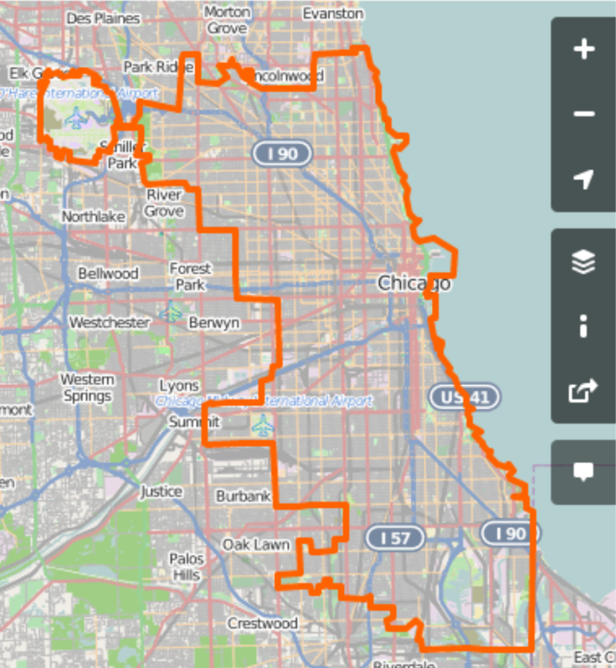


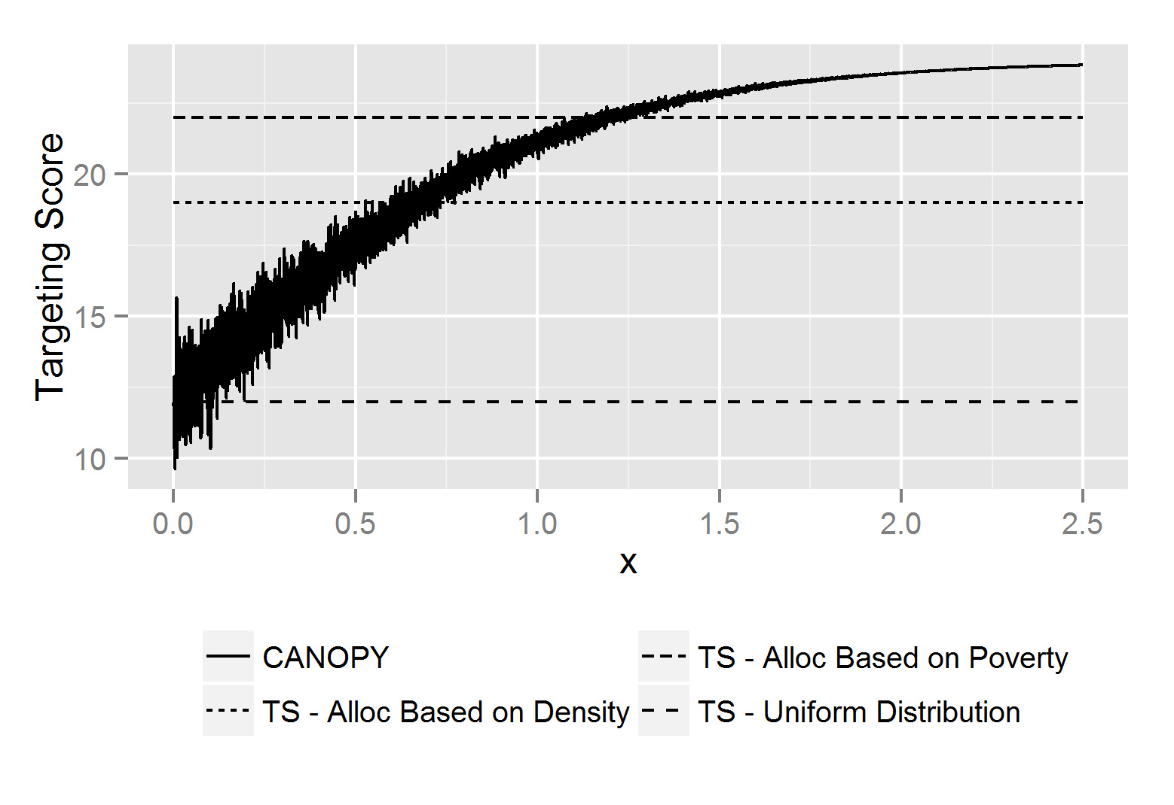
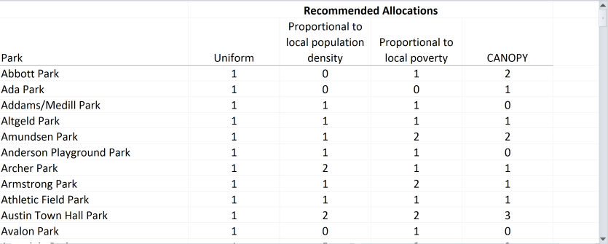

CANOPY Planning Tool for Allocating Staff to Ball Courts
Declarations for planning goals
Targeting score for enrolling youth between 0-50% FPL
Targeting score for enrolling youth between 50-100% FPL
Targeting score for enrolling youth between 100-200% FPL
Targeting score for enrolling youth greater than 200% FPL
Running CANOPY Iteration 82,000 of 100,000
Total staff available to allocate
Number of iterations to run (Larger numbers increase run time, but can help find better solutions)
Min resources per site:
Max resources per site:
0
7
The overall Targeting Score (TS) is calculated as the total number of expected youth expected to participate in programming, where each youth is weighted by the targeting score for their classification, determined above.
The “Uniform Distribution” is the TS obtained by evenly (as possible) distributing resources across all sites.
The “Alloc Based on Density” TS is based on allocating resources to sites in proportion to the population density within 1 mile of the site.
The “Alloc Based on Poverty” TS is based on allocating resources to sites in proportion to the poverty rate within 1 mile of the site.
The CANOPY TS is what was obtained in the most recent run of the CANOPY algorithm

