Slide 1
Vanguard – CX Journey Analytics
Niki Cutchall Case Study Presentation

Slide 2
Experiment Design
Objective: Analyze results of an A/B test on a customer process to determine if an updated UI, navigation, and in-line help was effective.
Measurement Period: 46 days from 3/15/2017 through 4/30/2017.
Clients are split into two groups, resulting in 39,708 unique clients:
Test – served updated UI
Control – served current state UI
Both groups proceed through the same 5 process steps: Start -> Step 1 -> Step 2 -> Step 3 -> Confirm
Hypothesis | Measurement
Clients in the test group (group exposed to new UI) will complete the process at a higher rate | Completion Rate
A modern UI and in-context prompts will help customers to feel more comfortable with the process | Average Time to Completion

Slide 3
Data & Assumptions
Four data files were provided to analyze this A/B test:
Client Demographics
Client Variation – type of test to which client was exposed
Web Data 1 – part 1 of page level web data for the process
Web Data 2 – part 2 of page level web data for the process
Assumptions
The process is linear, meaning clients must start on “start” and end on “confirm”
Clients must complete each page before moving onto the next.
Clients cannot save their progress in the process, nor does their progress save automatically.

Slide 4
Prepping the Data
Before analyzing the data, I performed some basic manipulation to get the data in a working format:
Merged all 4 data files into 1 data set.
Limited the time period of the data to 3/15/17 through 4/30/17.
Removed any clients that were missing 1 or all pieces of demographic information (~15 clients)
Removed all records with a variation = ‘NA’ or null (Note: I would like to see this test run across all traffic)
Note: There are some visitor_ids that have more than one client_id (~189 visitor unique visitor IDS; 376 client_ids). These records were not removed from the data set.

Slide 5
Results – Client Demographics
Overall the demographics of the Test and Control groups are not very different.
Both groups saw a slight decrease in the average and maximum client age between the “start” and “confirm” pages.
This could indicate some older clients were not able to make it through either process successfully.

Slide 6
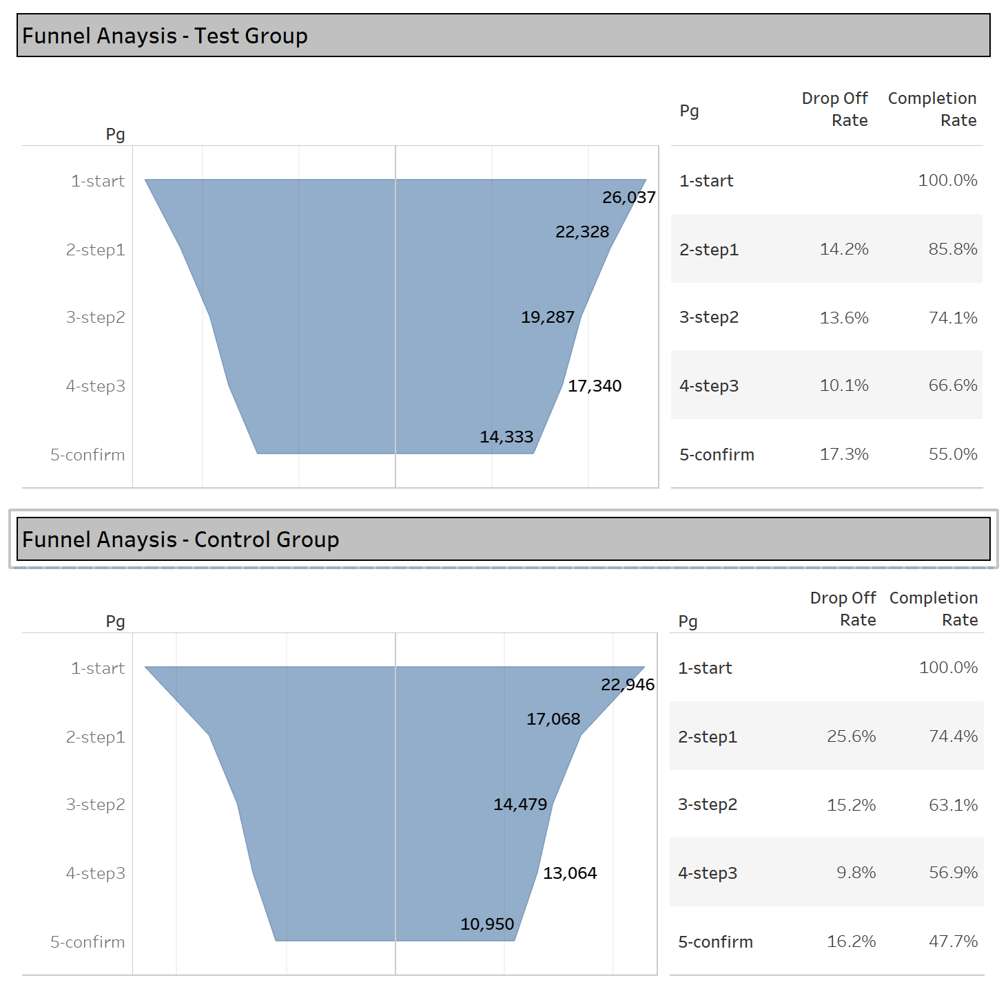
Results – Funnel Analysis
Based on a comparison of the process funnels for each group, the Test group (improved UI) performed better than the Control group.
The Test group completed the process at a higher rate; 55% compared to 47.7%.
Drop-off rate between the “start” page and “step 1” page was 11.4% lower for the Test group.
This indicates the updated UI did a better job at getting Clients past the first page of the process.
It also facilitated a smoother funnel, resulting in a higher completion rate.
*Sessions by page view
*To be counted on a page, the client must have completed the prior page in the same session

Slide 7
Results – Funnel Analysis (cont.)
The drop-off rates between steps 2-3 and 3 to confirm were slightly higher for the Test group.
Further investigation would be needed to determine if something on these pages in the new UI impeding Clients from proceeding.
*Sessions by page view
*To be counted on a page, the client must have completed the prior page in the same session

Slide 8
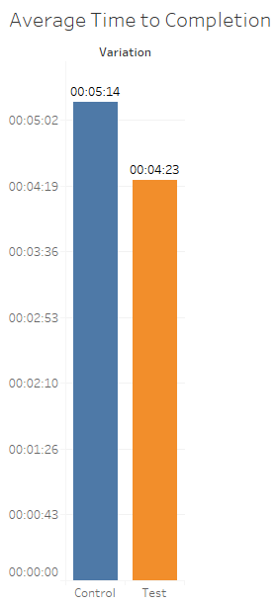
Results – Avg. Time to Completion
Time to Completion = timestamp of “confirm” page – timestamp of “start” page
Test: 4:23 minutes
Control: 5:14 minutes
Clients using the updated process (Test group) completed 51 seconds faster than those using the standard process (Control group).
Additional verification would be to check the median time to completion to see if there is still a gap between groups.
This would help to reduce impact from clients who temporarily stepped away from the application and returned prior to a time out.

Slide 9
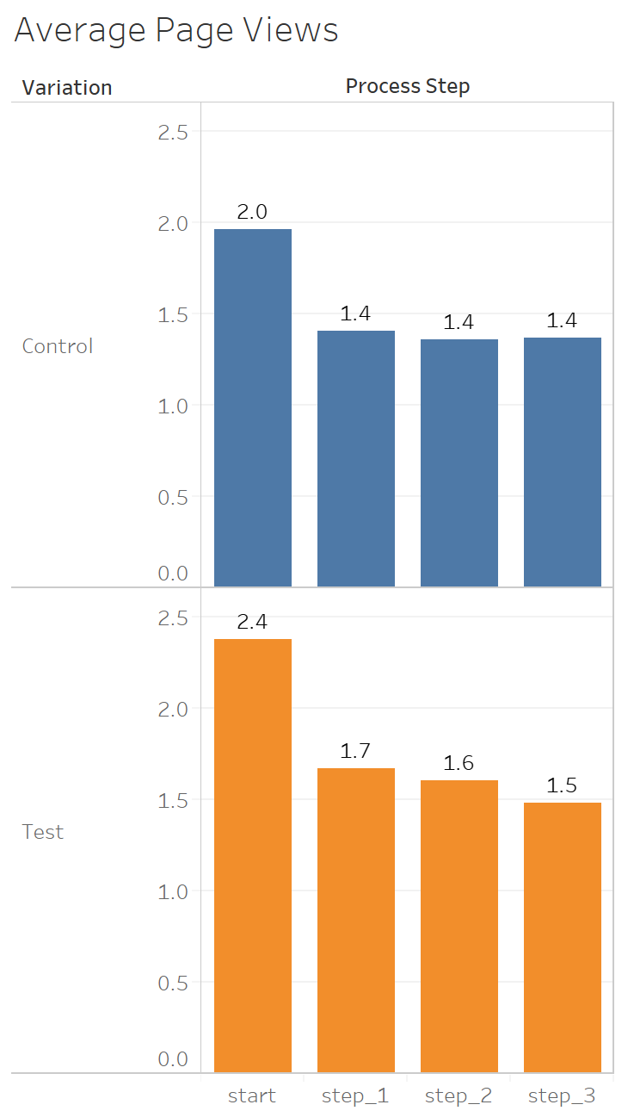
Results – Average Page Views
Charts illustrate the average page views for those visits that did not result in a process completion; they did not make it to the “confirm” page.
Client visits in the test group have higher page views for each step, on average.
Even though the Test group has a higher completion rate, it would be worth investigating why clients in the Test group view pages in the process more frequently.

Slide 10
Measuring Success – Completion Rate
Confidence Interval for Two Independent Proportions
95% Confidence Interval: (0.067, 0.079)
95% confident that the difference in the population proportions of test group completions & control group completions is between 0.067 and 0.079.
Hypothesis
Clients in the test group (group exposed to new UI) will complete the process at a higher rate
H₁ = p₁ – p₂ = 0
H₁ = no difference in completion rate between control & test groups
H_{A} = p₁ – p₂ > 0
H_{A} = completion rate for test group > completion rate for control
p₁ is test group
p₂ is control group
Reject the null hypothesis. At 95% confidence level there is enough evidence to conclude that the completion rate for the test group is greater than the completion rate for the control group.
Calculations in Appendix
*Sessions by page view

Slide 11
Additional Data Points
While the results from the Test group are significant, and indicate that the new UI results in a better process for clients, there are some additional data points I would want to check prior to making a final conclusion on the experiment.
Device type (web, mobile, native app) – necessary to confirm that the process is consistent across platforms.
Page Errors – assess if the new process is more efficient, intuitive, and easy to use for clients
Click Data – help to identify where on the page clients may encounter bottle necks or pain points

Slide 12
Appendix

Slide 13
Measuring Success – Completion Rate

