Slide 1
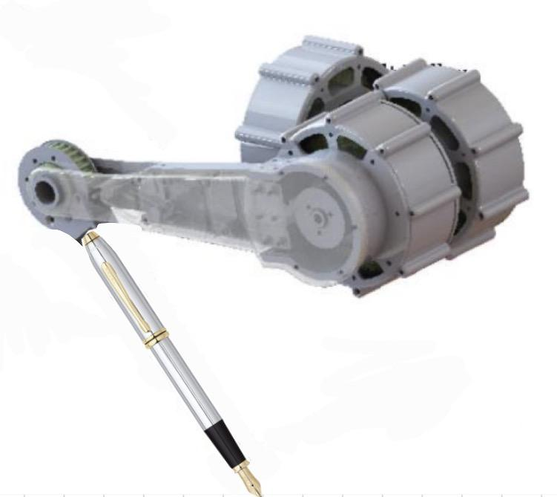
Lyra, Art Dog using Cascaded PID
05/04/2026
Joseph Dai, Nishanth Shubhakar Mandala, Diego Quintanilla

Slide 2
Agenda
ROB-UY 2004
1.
Introduction
2.
Problem Definition
3.
Method
4.
Experiment & Results
5.
Conclusion
6.
References

Slide 3
ROB-UY 2004
Introduction
Lyra uses a quadruped robot with a marker to draw different patterns on the ground.
The goal is to follow a given path and reproduce it as accurately as possible in the real world.
The system uses joint measurements and kinematics to track the marker position, and a cascaded PID controller to reduce tracking error during motion.

Slide 4
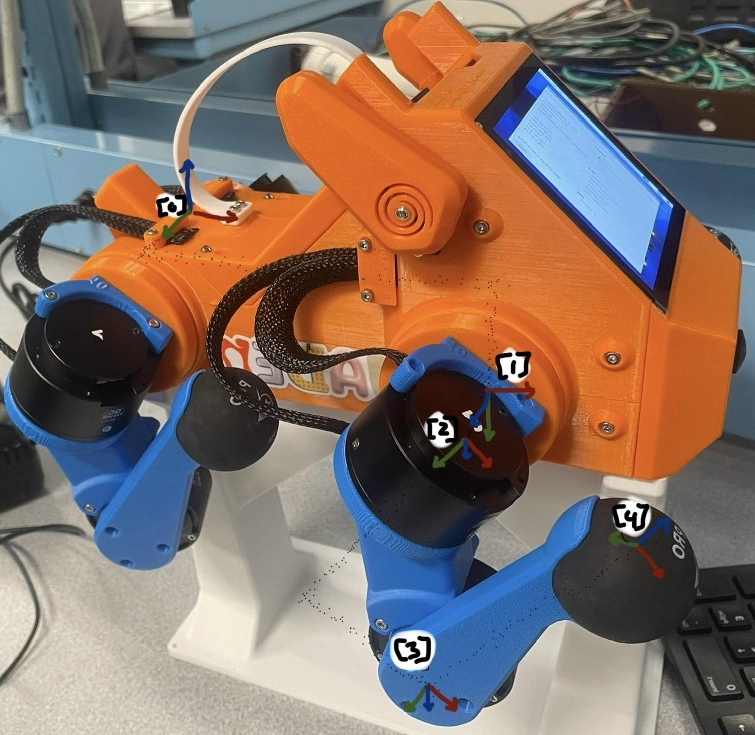
ROB-UY 2004
Problem Definition
Goal: Make Lyra accurately draw target shapes using the robot foot-mounted marker.
Given Measurements:
Joint angles from the robot
Joint speeds from the robot
Desired drawing path
Motor commands
State Variable:
The marker tip position on the ground
Intermediate Variables:
Marker position calculated from joint angles
Difference between target path and actual marker path
PID control command used to reduce the difference
Coordinate Frames:

Slide 5
ROB-UY 2004
Method
Hardware:
3-DOF leg
SteadyWin GIM4305-10 Planetary Reducer Motor, different from the previously aforementioned BLDC motors configured as Quasi-Direct Drive (QDD) actuators, low gear reduction.
General Control Class:
Cascaded PID
IK controller
Trajectory controller
Notes:
The Core Difference: Torque Transparency
QDD Actuators (The Paper): True QDD actuators (like those popularized by the MIT Cheetah) pair a very high-torque-density motor with a highly specialized, ultra-low friction gear reduction (usually 6:1 to 9:1). They are designed for maximum torque transparency—meaning mechanical losses are so low that the controller can accurately estimate the actual physical torque output just by reading the motor's electrical phase current.
SteadyWin GIM4305-10 (Your Hardware): While it does have a low 10:1 reduction, it uses a standard, commercial off-the-shelf planetary gearbox. These gearboxes inherently introduce higher friction, mechanical inertia, and roughly 15 arcminutes of backlash (play between the gear teeth). Because of these mechanical losses, electrical current does not map perfectly to output torque.
2. How This Impacts Your Project
This hardware difference is the exact reason why your control architecture differs from the reference paper:
Why you can't command raw torque: Because the SteadyWin's planetary gearbox isn't perfectly torque-transparent, a closed-loop "Torque PID" based purely on current (like the paper uses) would be inaccurate. This completely justifies why your Python script (pupper_art.py) takes the output of the 3rd PID stage and converts it into a position delta instead of a raw motor torque command.
Explaining the Sim-to-Real Gap: In your presentation (Slide 24), you noted a "noticeable sim-to-real gap." The friction and backlash inherent to the SteadyWin's planetary gears are major contributing factors to this gap. The simulation likely assumes perfectly rigid, frictionless joints, while the real robot has to overcome the gearbox mechanics, leading to the RMSE errors you measured.

Slide 6
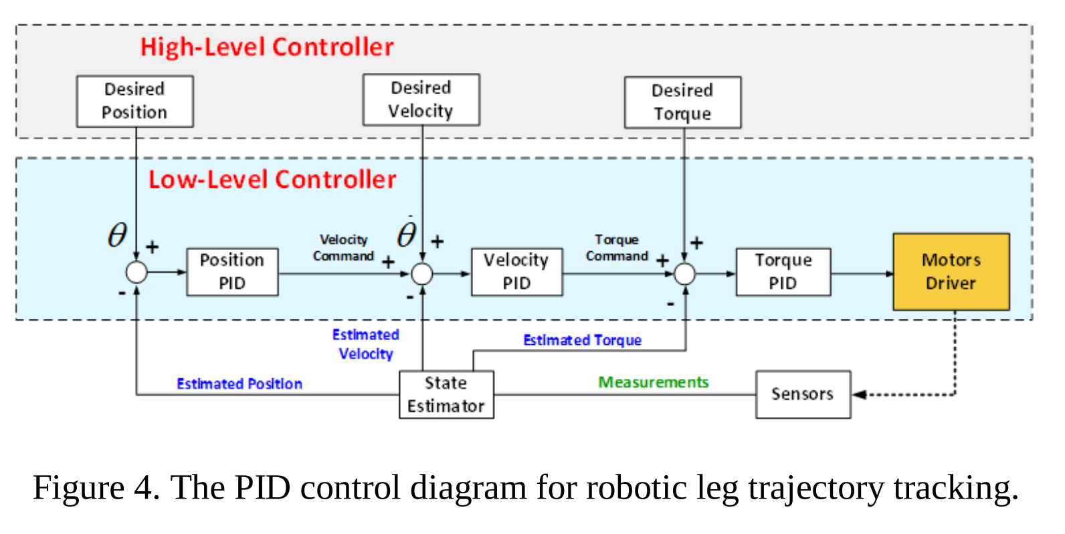
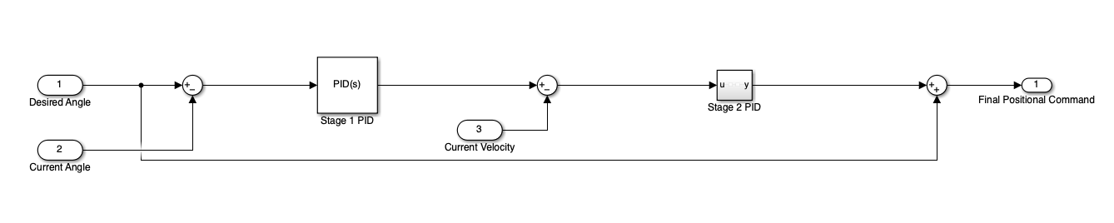
Method - Control Architecture

Slide 7
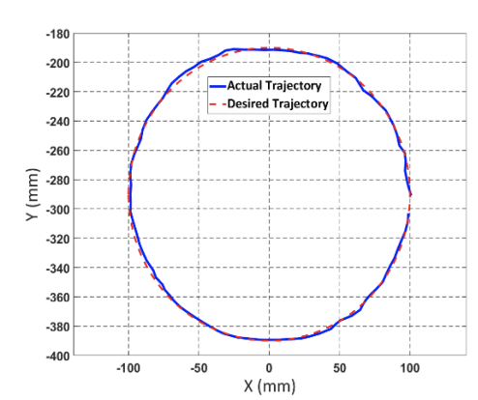
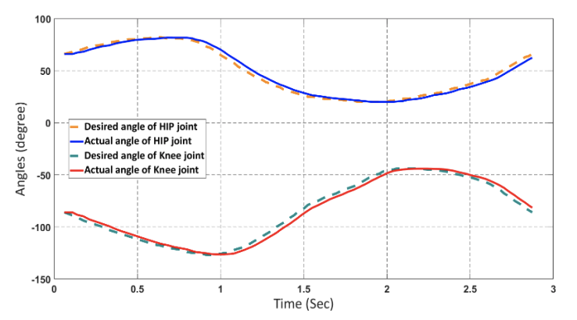
Method - Relation
ROB-UY 2004
In lab we have implemented trotting gaits, PID control, and both forward and inverse kinematics, cascaded PID controllers combines these concepts to create a highly accurate and consistent system. This cascaded PID controller was specifically chosen as some tests demonstrated in the article match tests and actions our project include such as:
Trajectory tracking
Drawing a circle

Slide 8
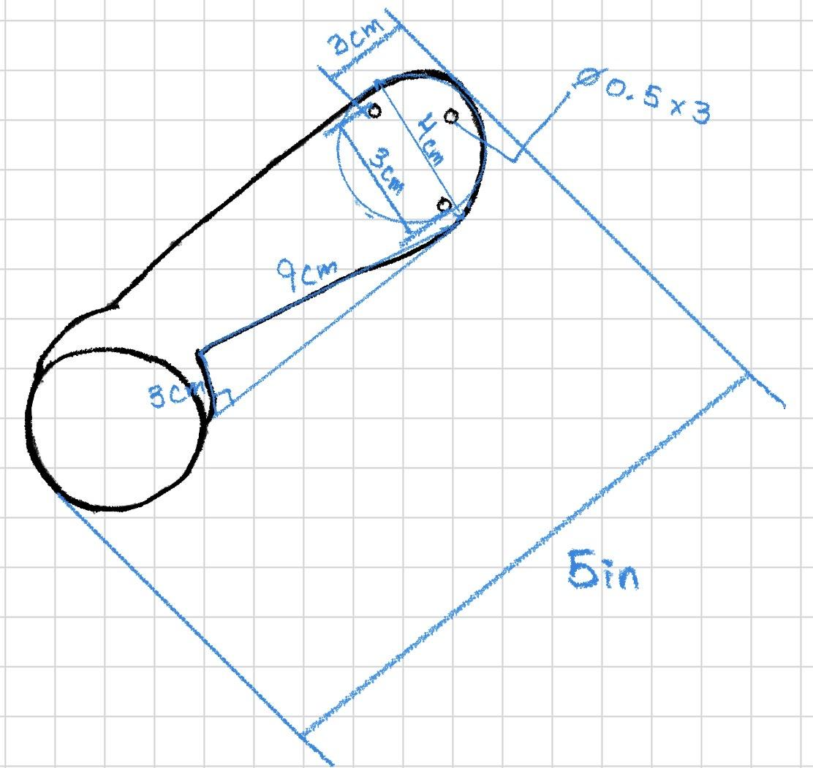
Method - Hardware
ROB-UY 2004
One of the biggest problems in the article found using the cascaded PID is that although it is highly accurate, it is susceptible to oscillation still. To mitigate this in a real world environment we designed a foot specically designed to handle a pen going over uneven terrain.

Slide 9
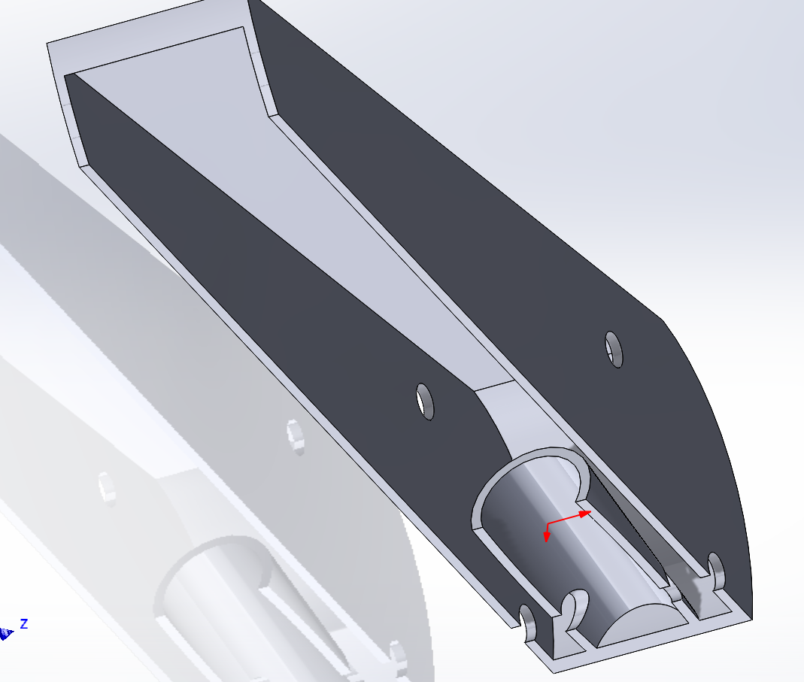
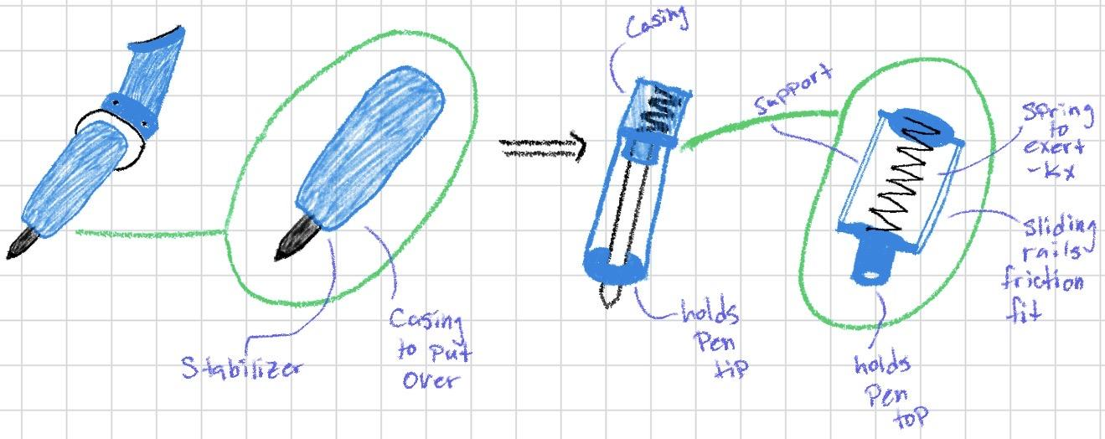
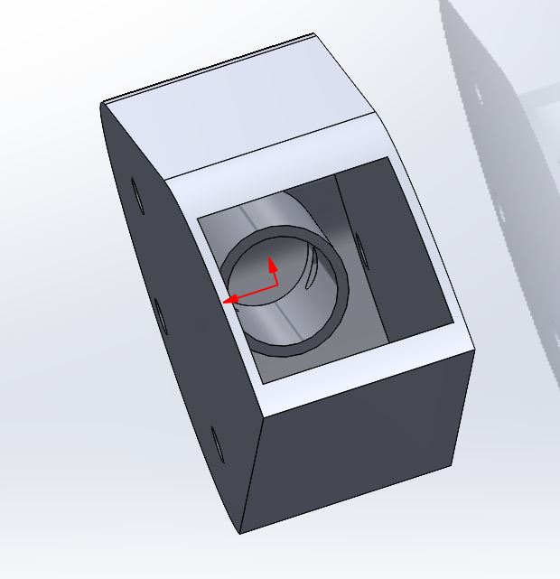
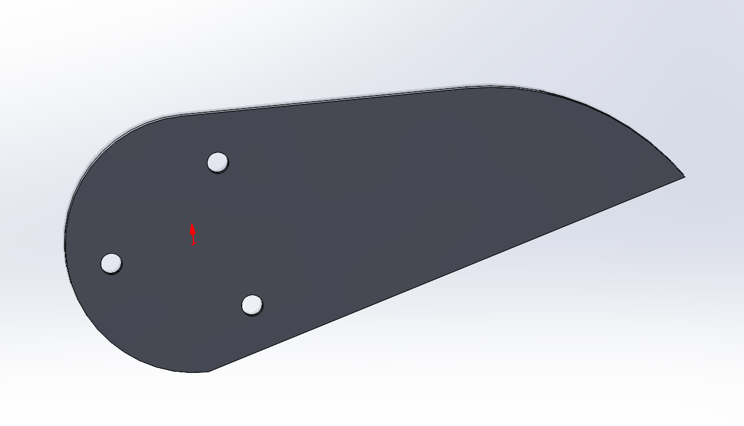
Method - Hardware
ROB-UY 2004

Slide 10
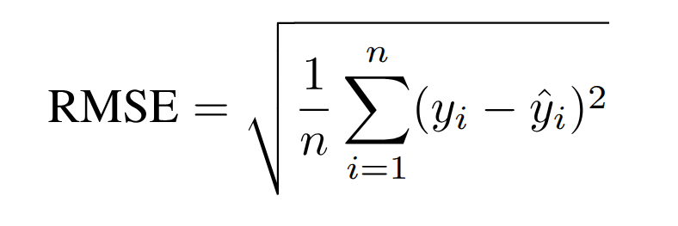
ROB-UY 2004
Experiment & Results
Experiments Conducted:
Validated in both RViz/Python simulation and on Pupper
Two trajectories tested:
Circle
Star
How Data Was Obtained:
Joint states logged from /joint_states topic
Control signals were interpreted as Torque
Foot tip position computed via forward kinematics
Interpreted using RMSE

Slide 11
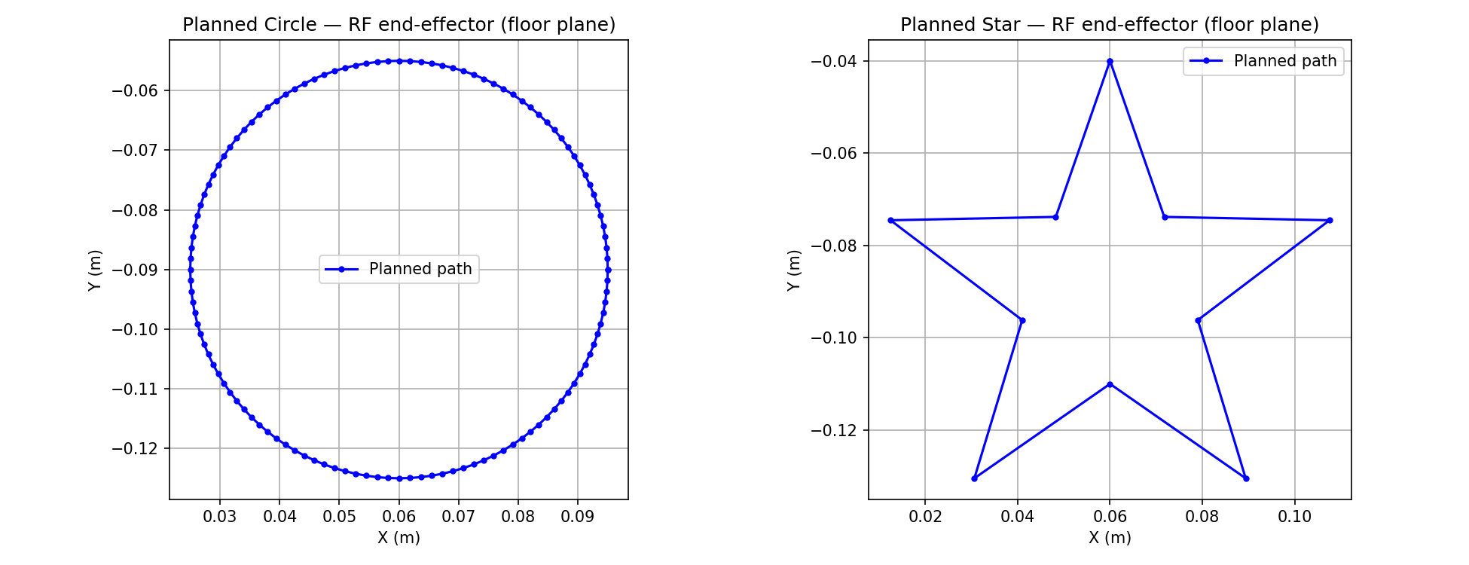
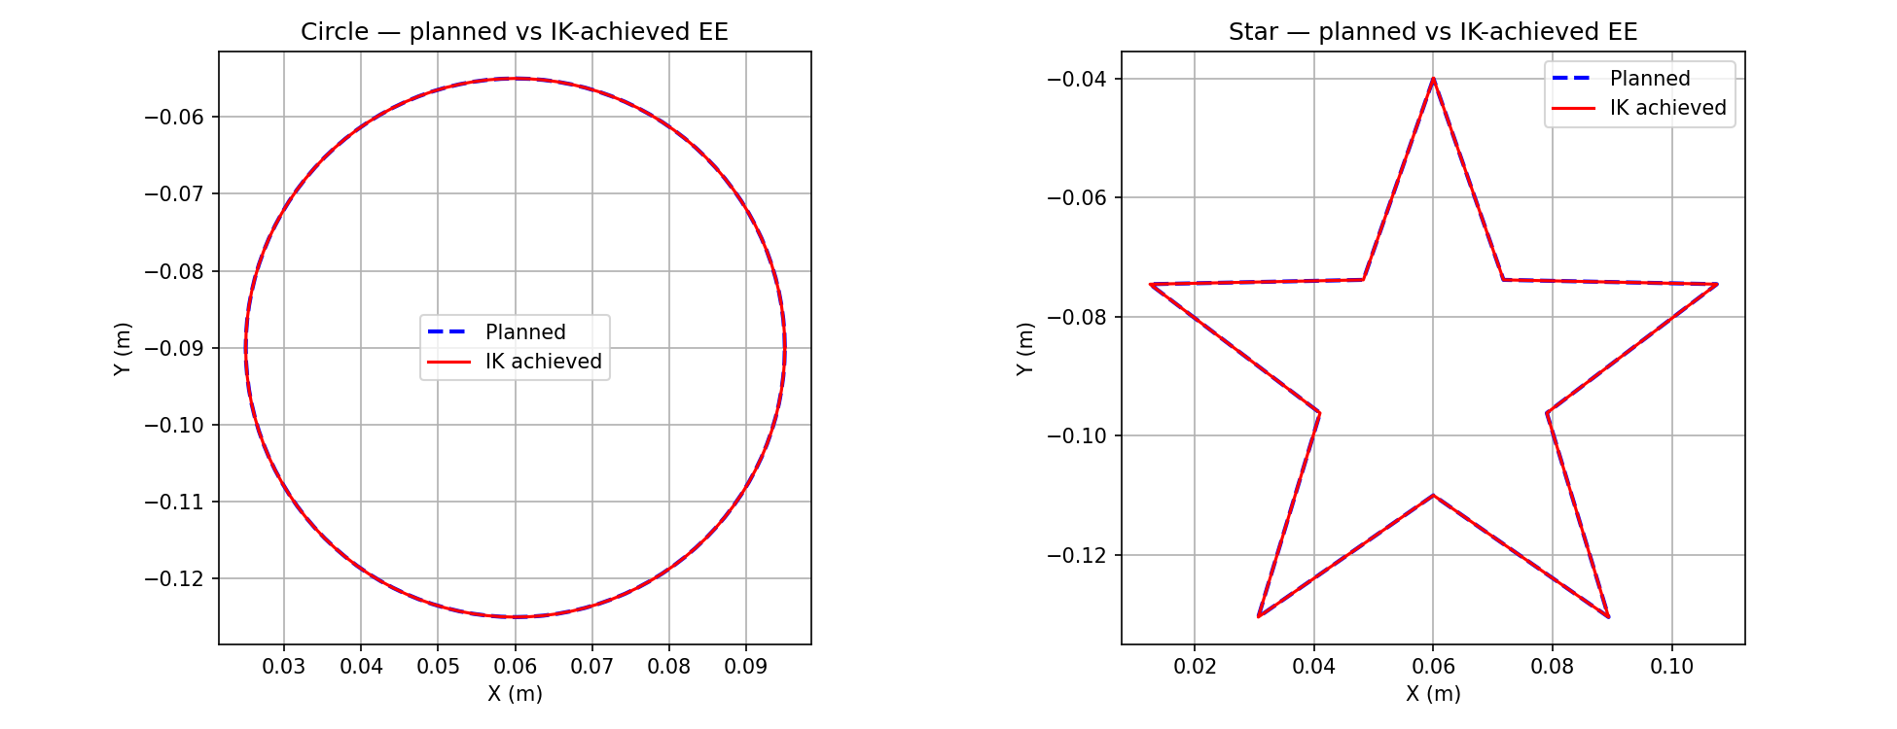

Slide 12
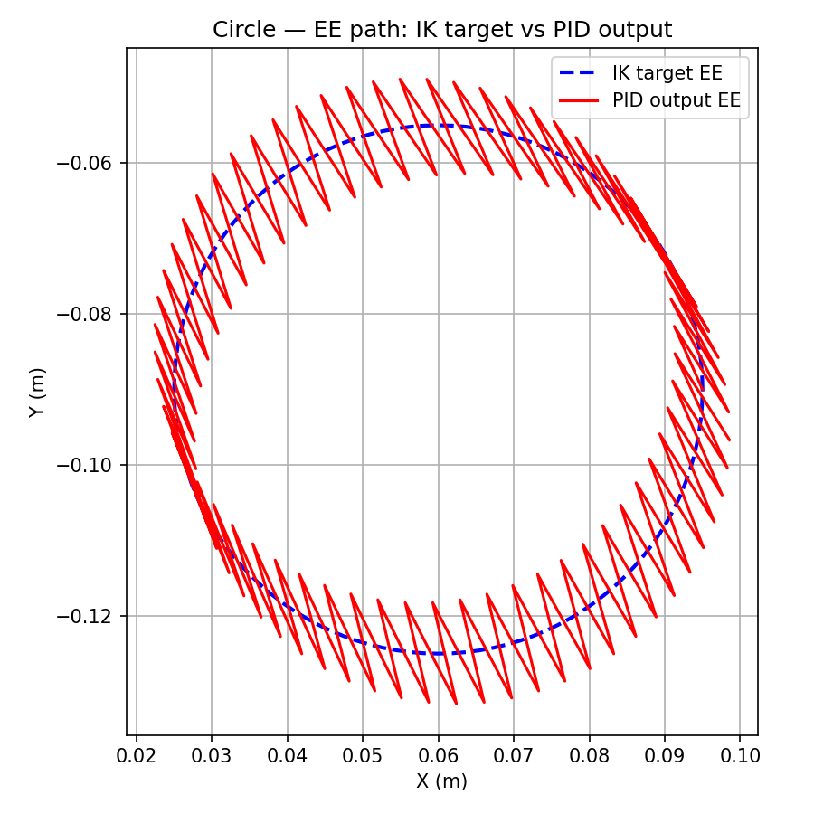
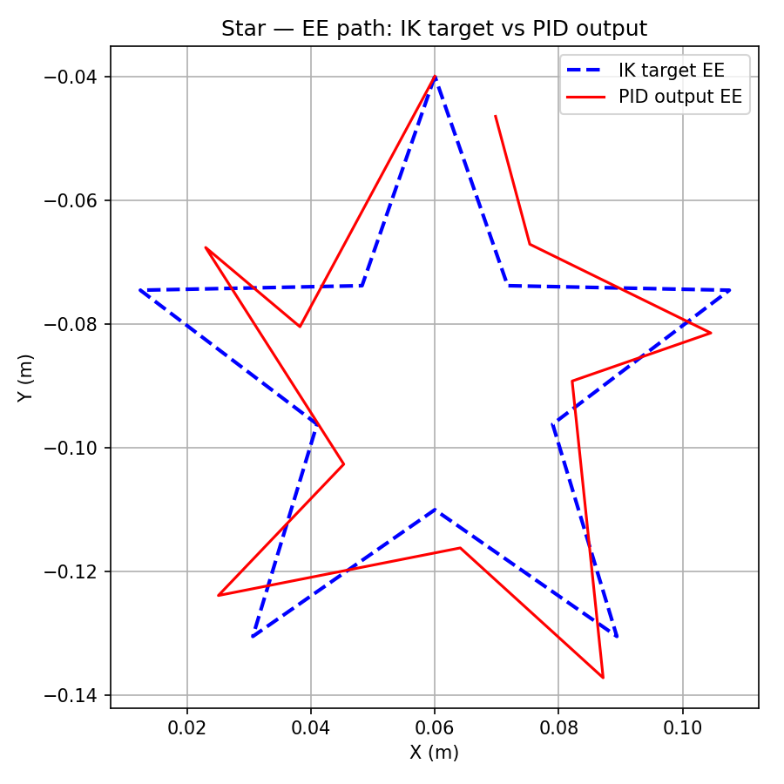

Slide 13
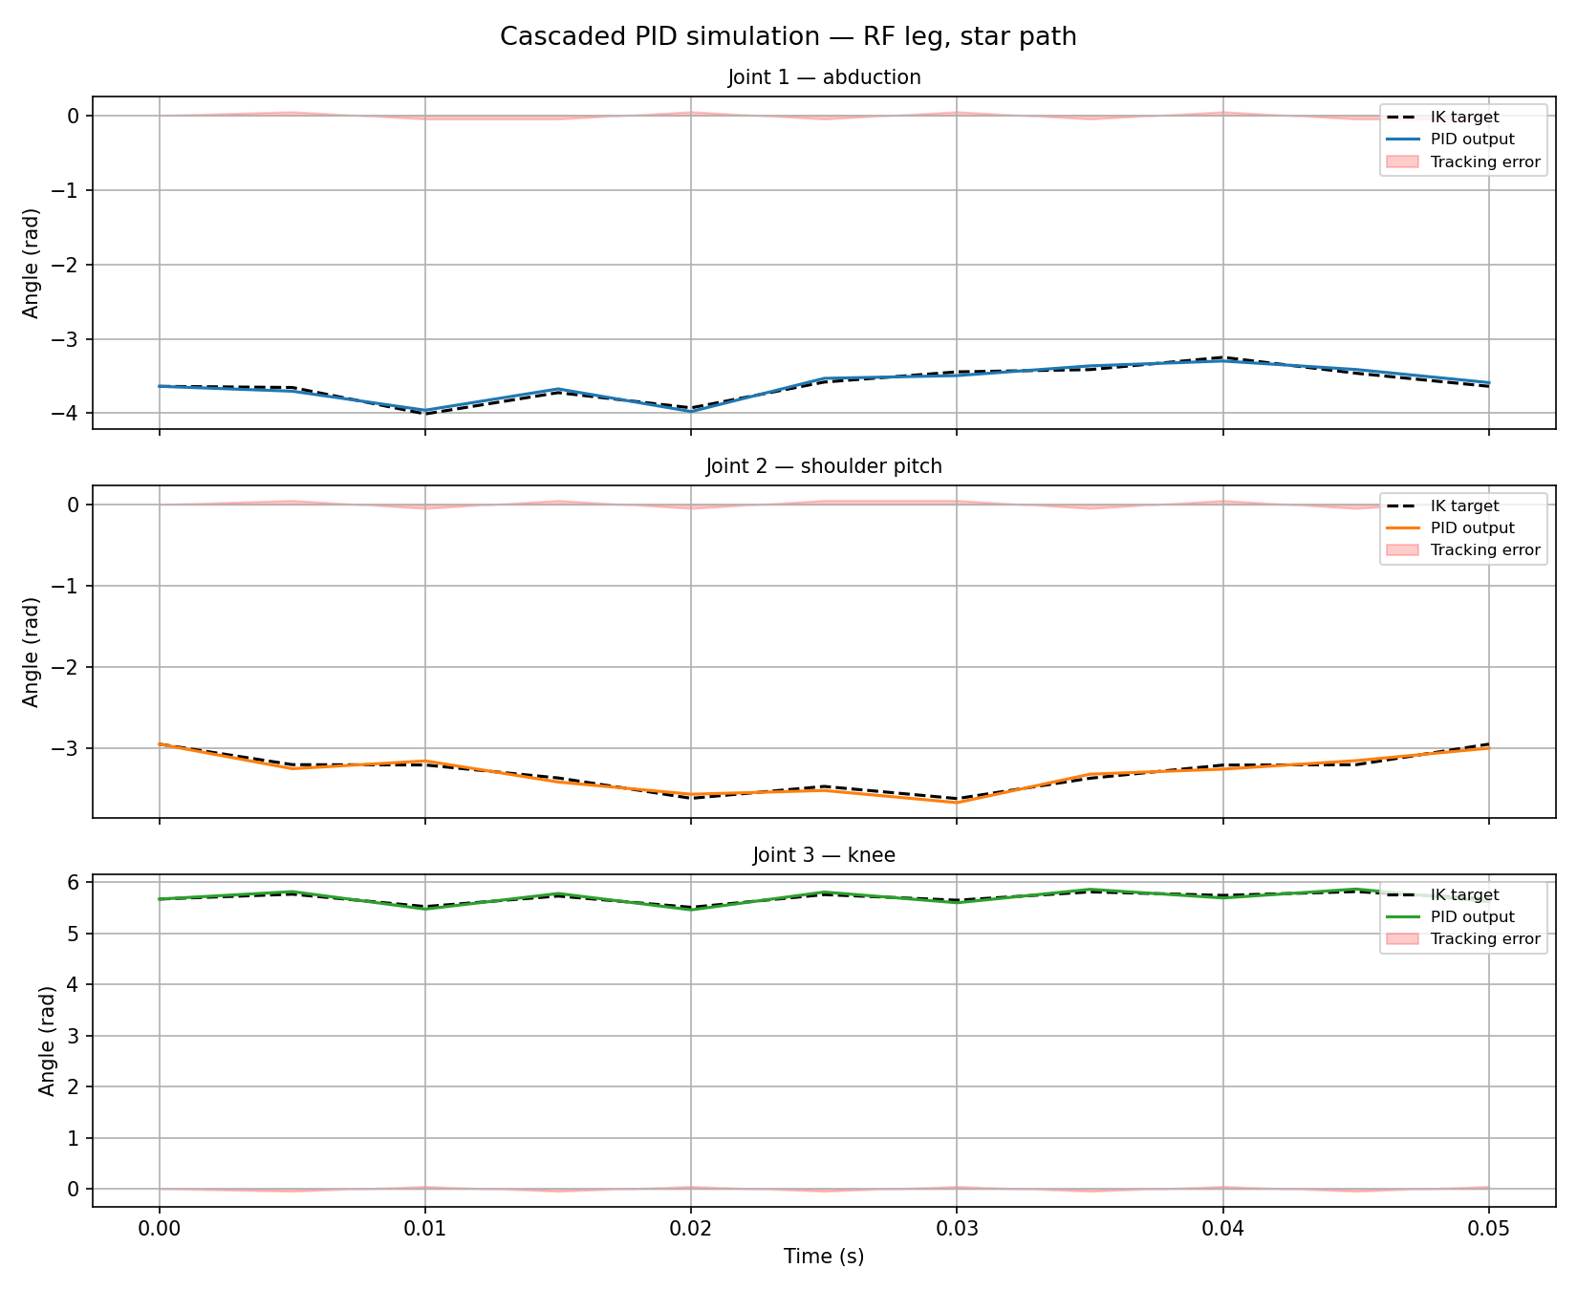
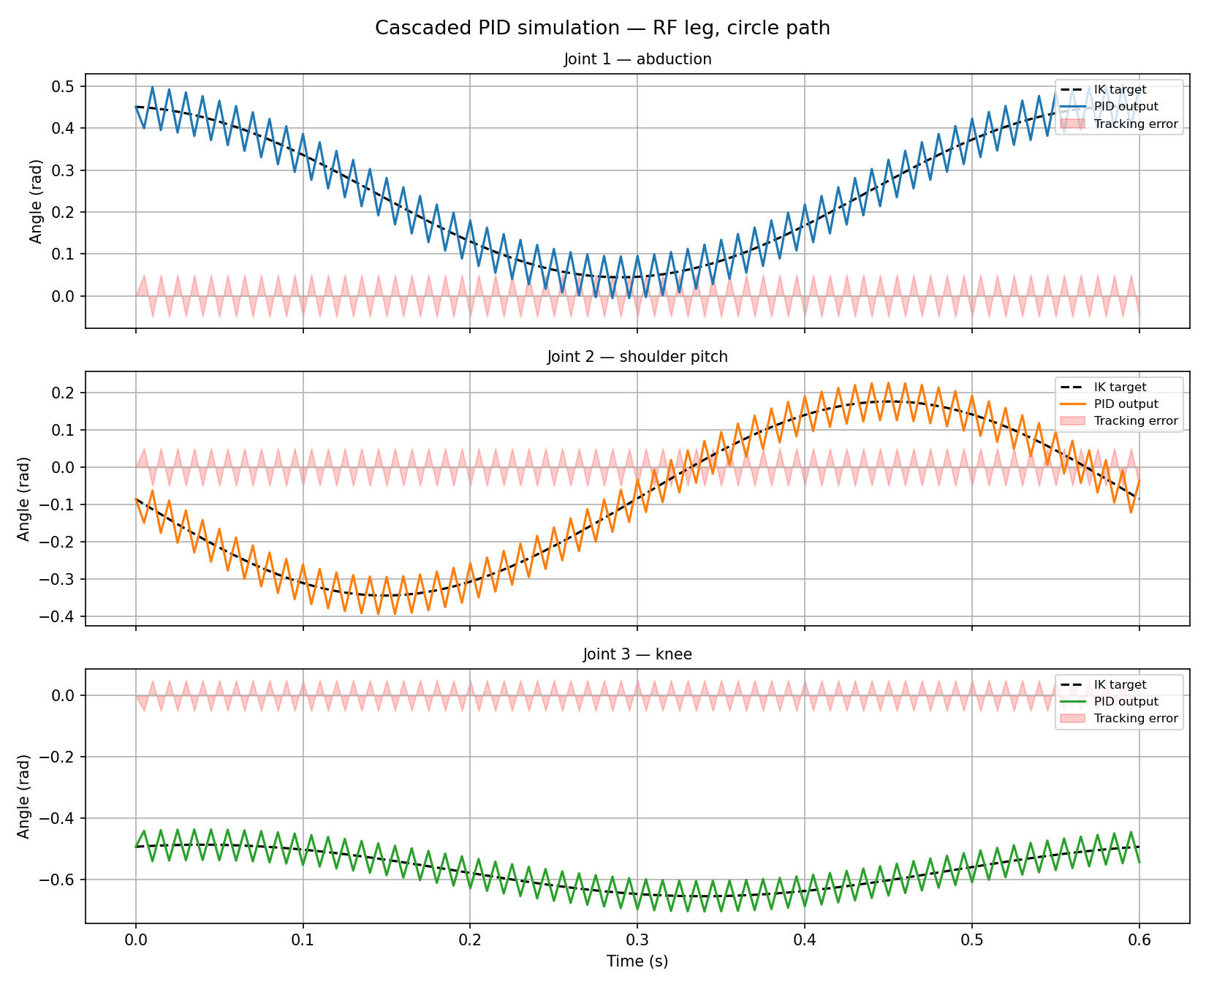

Slide 14
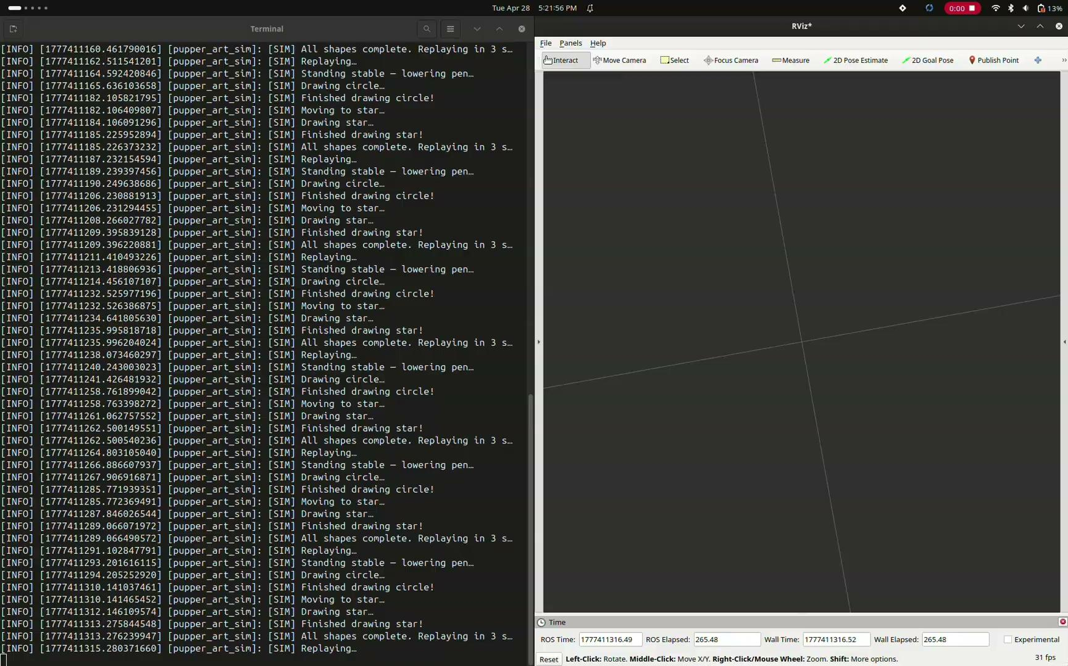

Slide 15
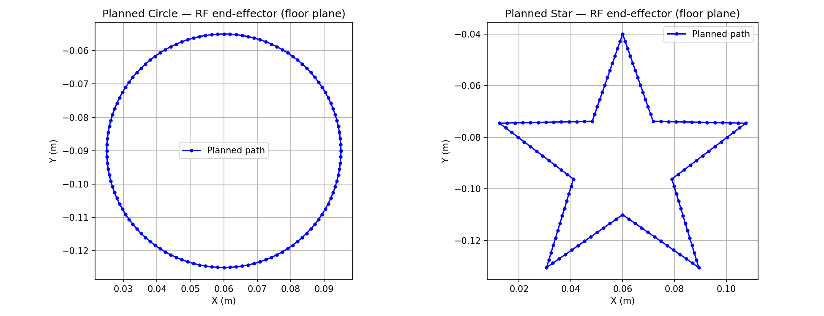

Slide 16
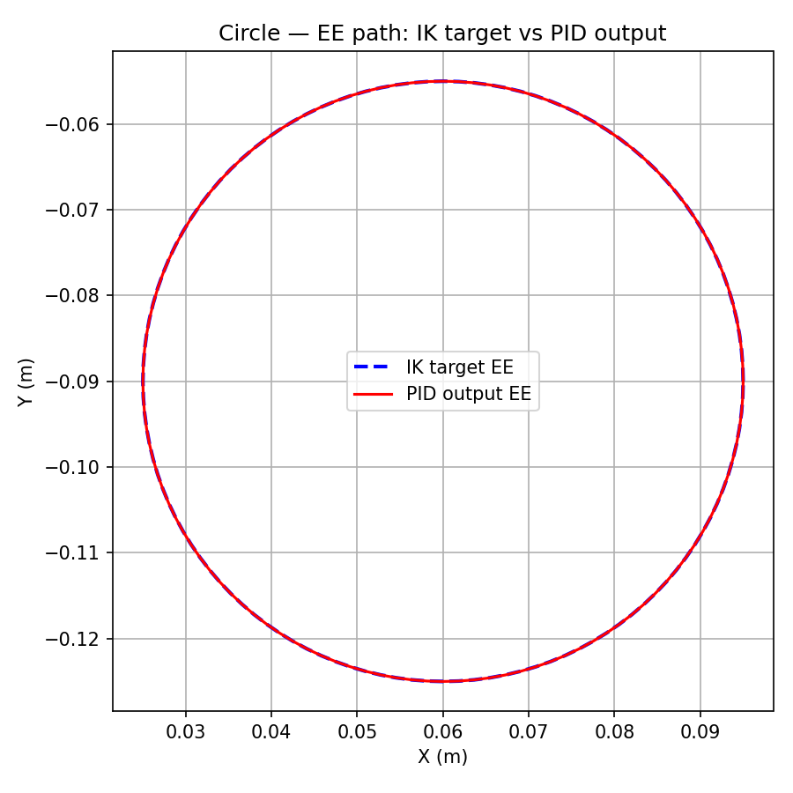
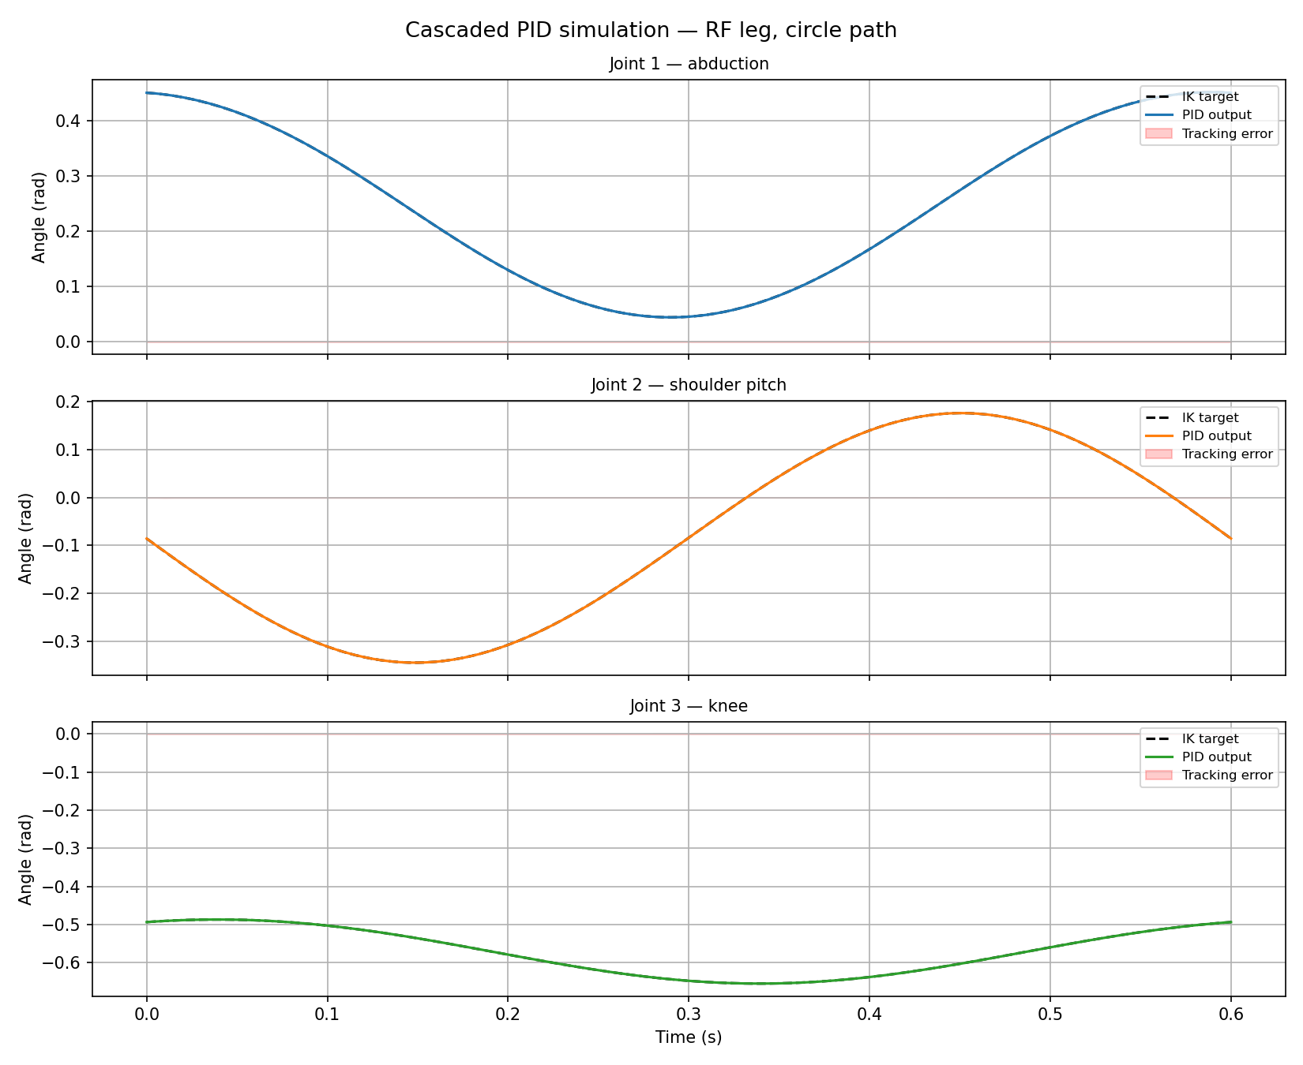
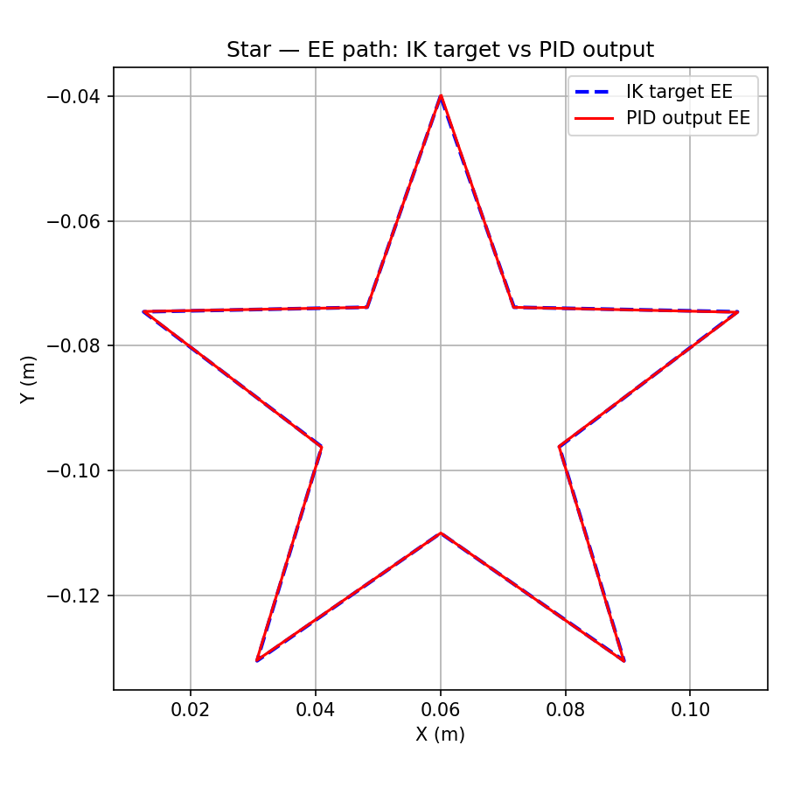
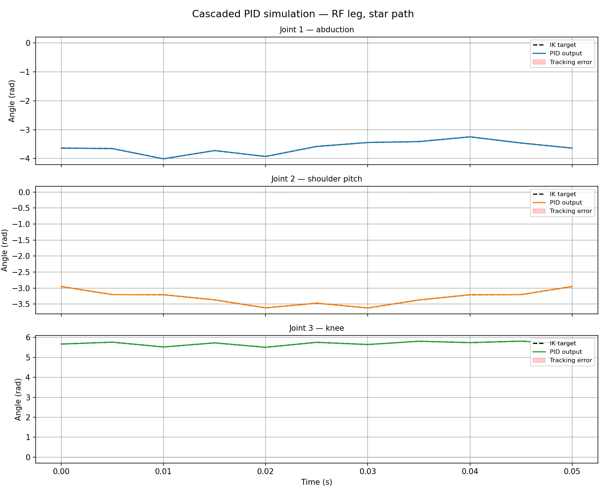

Slide 17
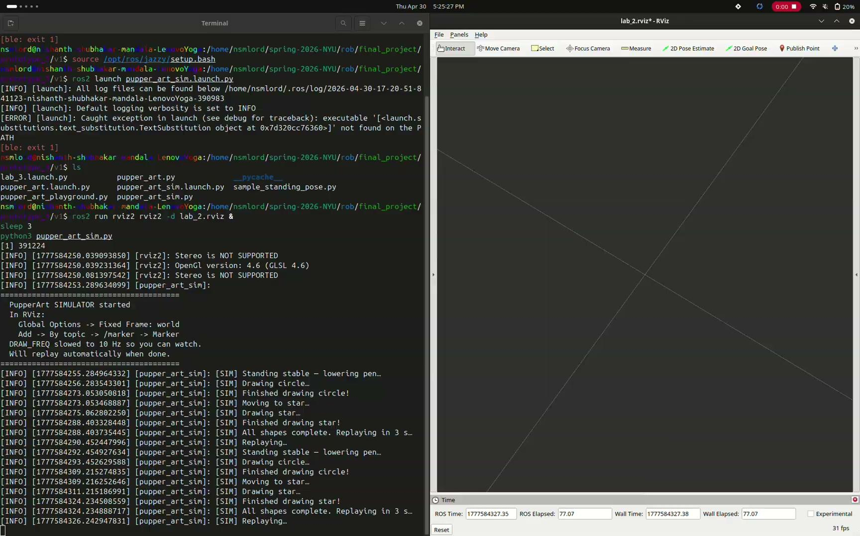

Slide 18


Slide 19
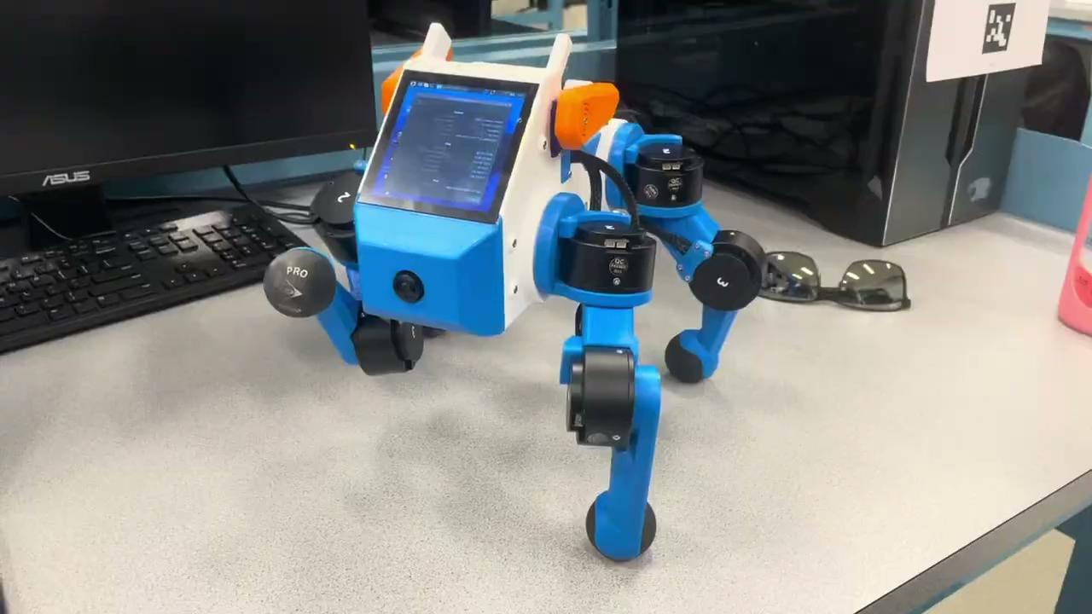

Slide 20
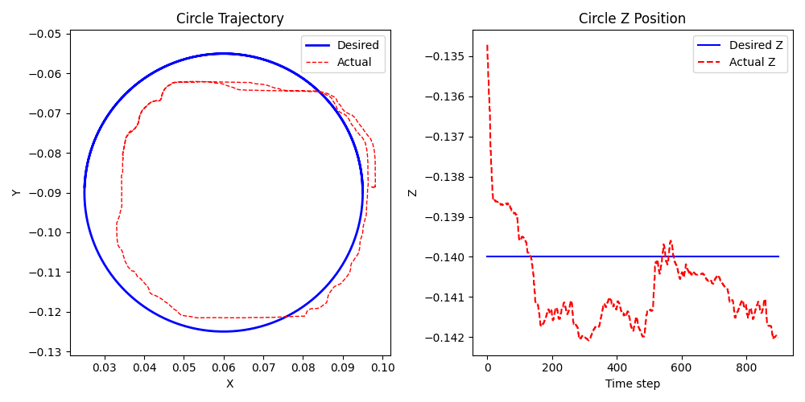
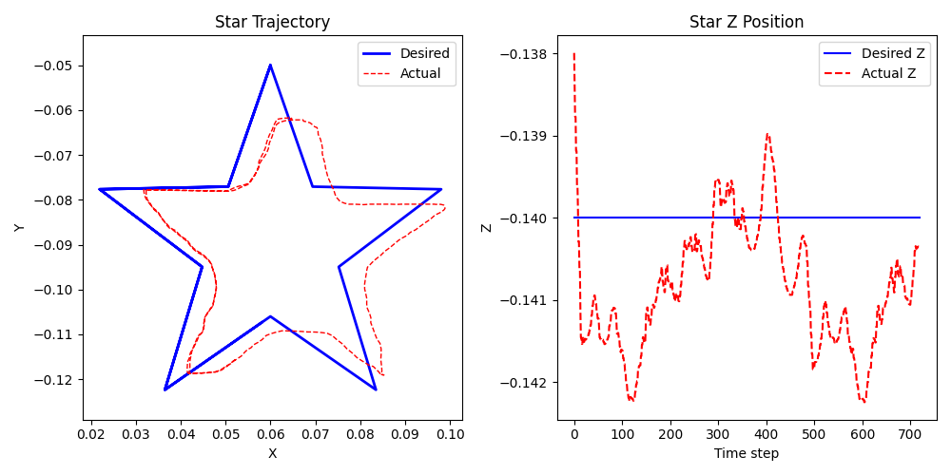

Slide 21
Initial Run - Star and Circle RMSE
 | Circle | Star
XYZ | 10.0719 mm | 15.0748 mm
XY | 10.0000 mm | 15.0000 mm
Z | 1.2000 mm | 1.5000 mm

Slide 22


Slide 23
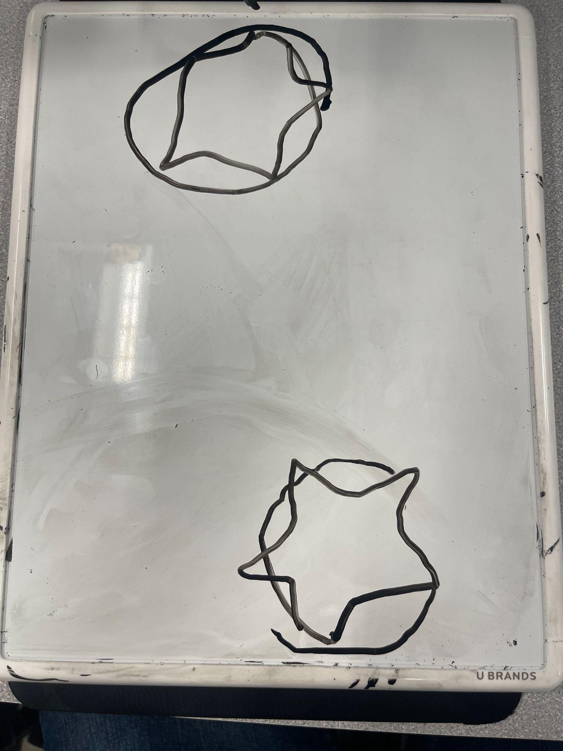

Slide 24
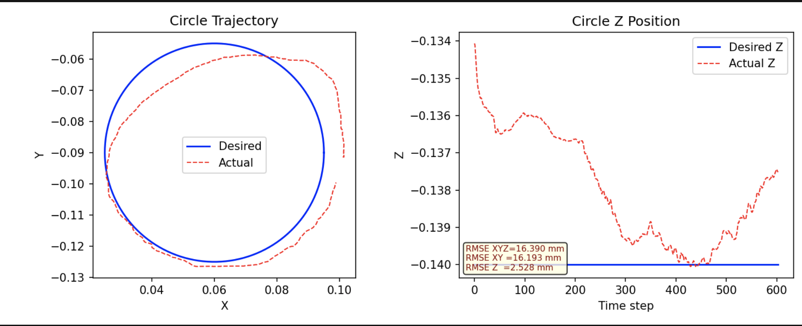
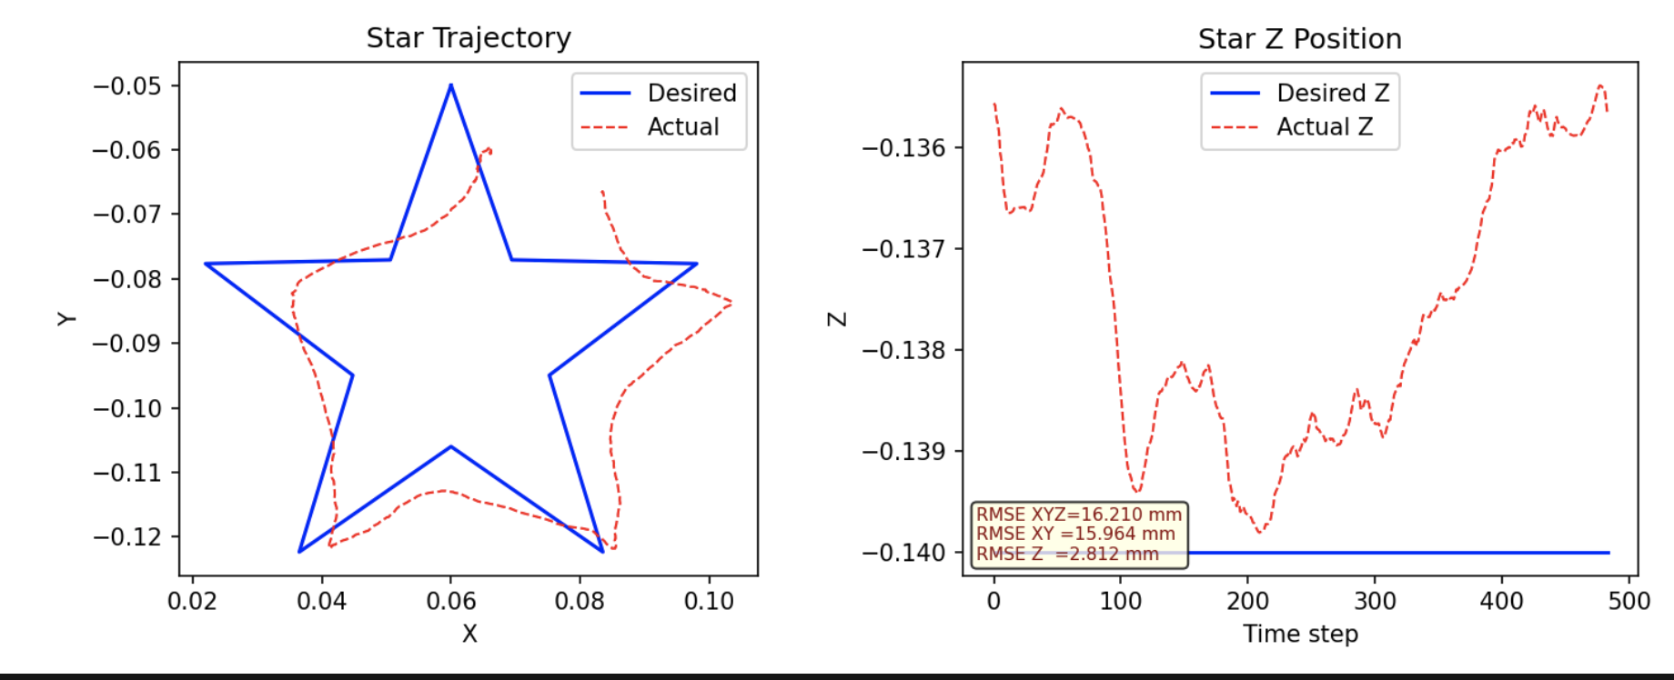

Slide 25
Complete Run - Star and Circle RMSE
 | Circle | Star
XYZ | 16.3896 mm | 16.2100 mm
XY | 16.1934 mm | 15.9642 mm
Z | 2.5283 mm | 2.8121 mm

Slide 26
Results
Actual trajectories closely follow desired paths in simulation (RMSE ~ 0)
There is a noticeable sim-to-real gap when considering hardware deployment
Dry run (no drawing):
Circle XYZ RMSE = 10.0719mm
Star XYZ RMSE = 15.0748mm
Complete run (drawing):
Circle XYZ RMSE = 16.3896mm
Star XYZ RMSE = 16.2100mm
We believe the spike in error is due to the controller being unable to account for the feedback from the marker/whiteboard interaction
Controller somewhat handles two structurally different trajectory types
shows some generality

Slide 27
Conclusion
ROB-UY 2004
The robot is somewhat able to follow and draw target shapes using cascaded PID control.
Simulation results are highly accurate, but real-world experiments show error due to friction and hardware limitations.
The system works on different shapes (circle and star), showing it has the capability to generalize to different trajectories.
Using joint measurements and kinematics is sufficient for this task, but performance could be improved with better modeling or sensing.
Computationally solving the cascaded PID for the precise values
Accounting for feedback from marker/whiteboard interaction
Better motor control / state estimation

Slide 28
References
A. M. El-Dalatony, T. Attia, H. Ragheb, and A. M. Sharaf, "Cascaded PID Trajectory Tracking Control for Quadruped Robotic Leg," International Journal of Mechanical Engineering and Robotics Research, vol. 12, no. 1, pp. 40-47, Jan. 2023.
M. A. Sen, V. Bakircioglu, and M. Kalyoncu, "Inverse Kinematic Analysis Of A Quadruped Robot," International Journal of Scientific & Technology Research, vol. 6, no. 9, pp. 285-289, Sep. 2017.

