Slide 2
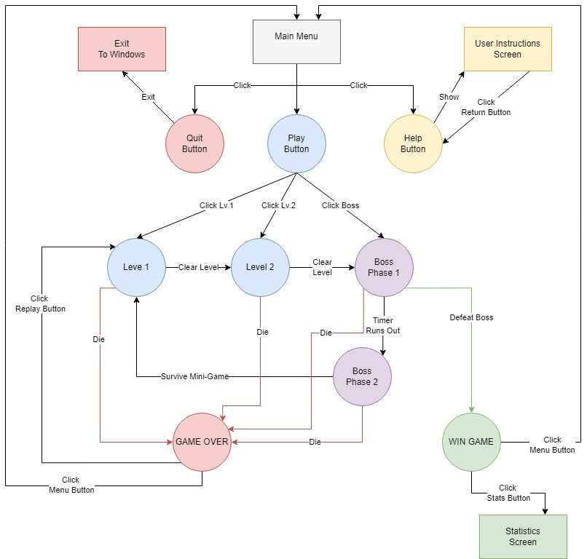

Slide 3
Pick-ups
Item | Image | Description
Heart |  | Restores the Health bar to its full capacity.
Demonic Seal Script |  | Cleanses the Corruption Bar, leaving it empty.
Side-Grades
Item | Image | Content | Description
Holy Water |  | - | Adam’s corruption bar fills 50% slower, but Adam takes increased damage.
Deal With The Devil (Fire Ball) |  | - | Adam gains the ranged ability of throwing Demonic Fire Balls.
Treasure Chest |  | - | Randomized chance of getting one of four different contents that give the player an advantage or disadvantage for the next level.
- |  | Prayer Scroll | The player starts the next level with a temporary shield that can absorb up to two hits.
- |  | Jump Scare | The player starts the level with the corruption bar filled at 25% capacity.
- |  | Trap Chest | The player starts the next level with 25% less health.
- |  | Holy Shield | When crouching, the player becomes immune to any kind of damage to his health. However, it does not affect the corruption bar.

Slide 4
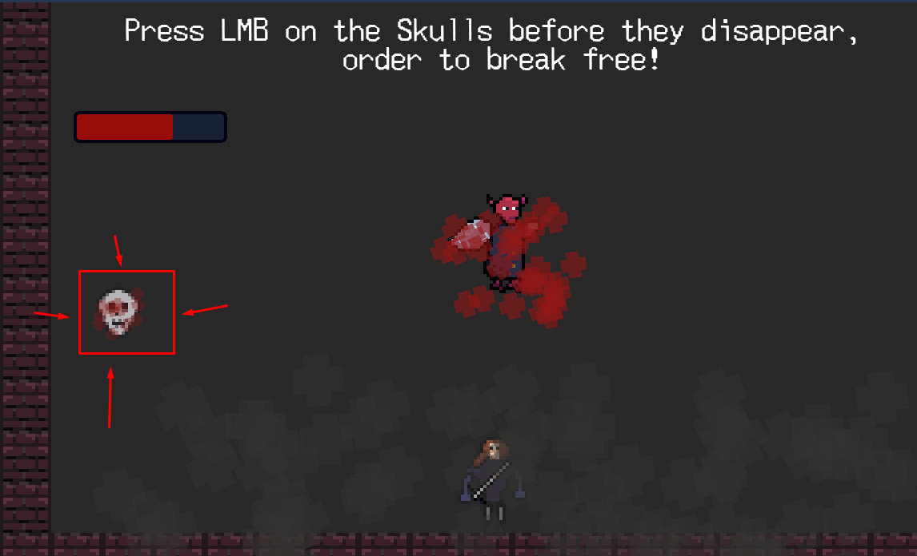

Slide 5
