Slide 1
Calculator Using Register File and ALU
Connor Prior, Nahom Solomon, Seth Iris Canonigo, Tedla Boke

Slide 2
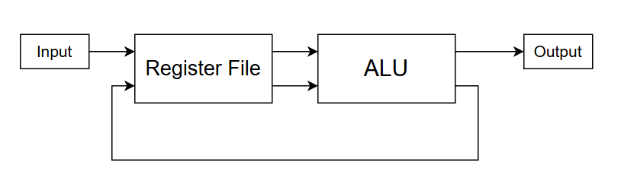
Overview
Takes an 8-bit input and stores it in one of seven registers in the Register File
Performs various operations on two values read from the register and outputs the result.
Can write back the result of the operation back to a register in the Register File

Slide 3
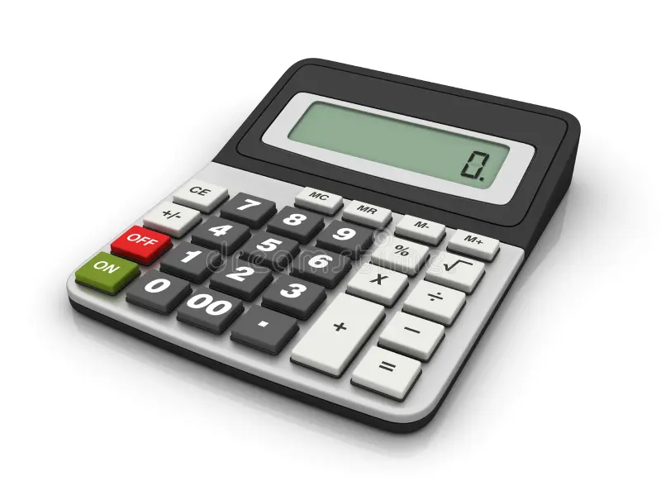
ALU Functions
Takes two 8-bit inputs A/B
Addition (A + B)
Subtraction (A - B)
Bitwise AND (A and B)
Bitwise OR (A or B)
Bitwise NOR (A nor B)
Bitwise XOR (A xor B)
Shift (A shifted by B bits)
Comparison (A > B, A < B, A = B)

Slide 4
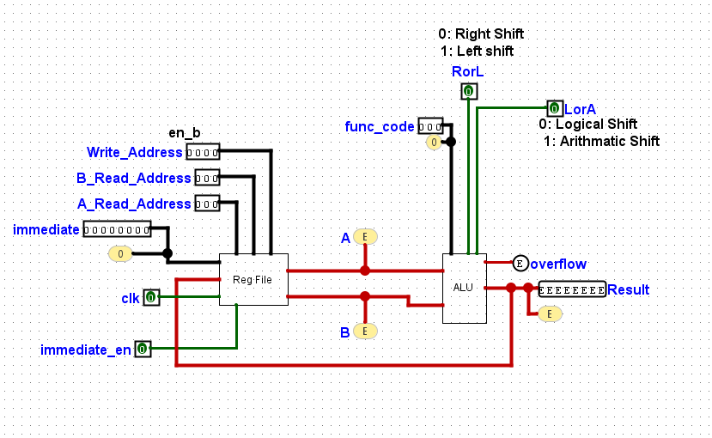
Top Level Diagram
Inputs:
immediate
imm_en
Write_Address
Read_Address
clk
func_code
RorL
LorA
Outputs:
Result
Overflow
Equal

Slide 5
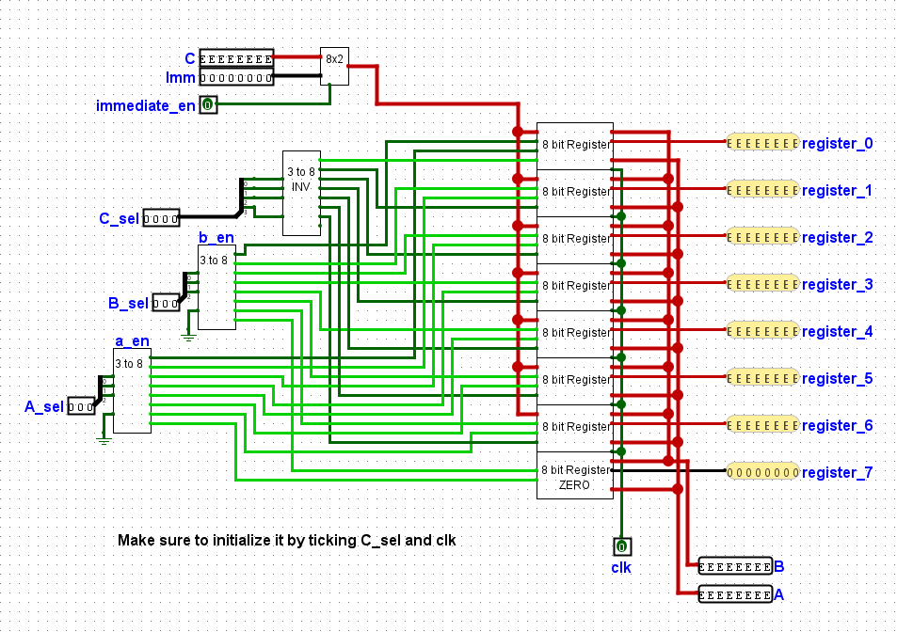
Register File
Seven 8-bit Registers and a Zero Register
Writes either Imm or our result from the ALU into a register based on immediate_en
Writes to the register designated by C_sel
Reads values from two registers to outputs A and B based on A_sel and B_sel

Slide 6
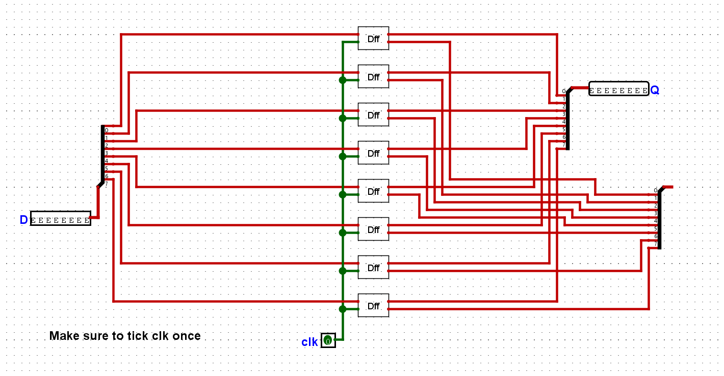
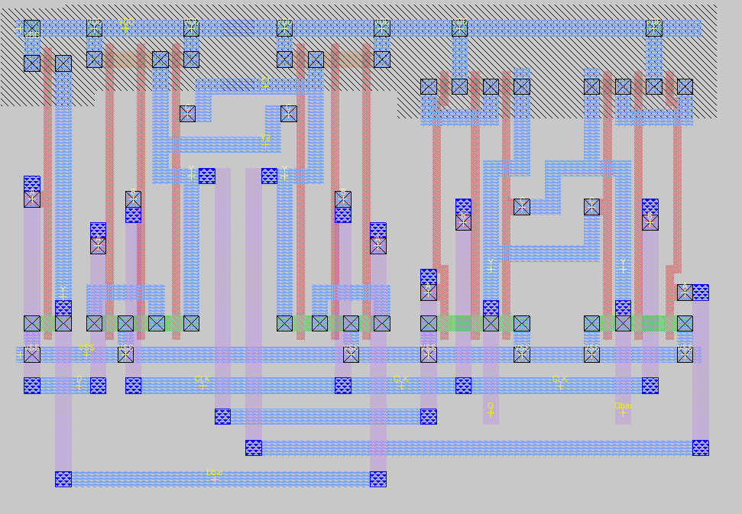
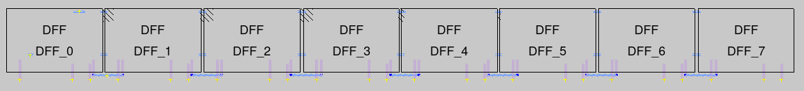
8 bit Register
To store bits in our registers, we use D Flip Flops, which either:
Take in a new value from D
Hold the same value
based on the clk signal.
8 DFFs allows us to store 8 bits based on the rising edge of clk.
Inside of a DFF
Array of 8 DFFs

Slide 7
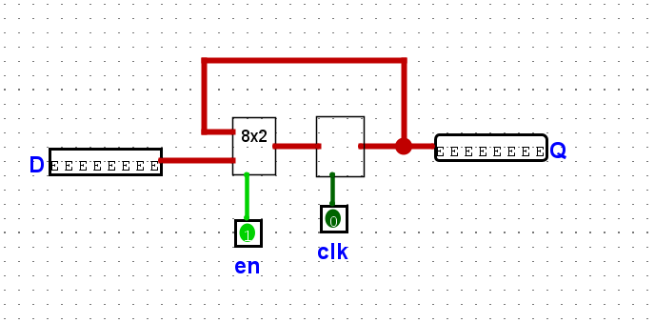
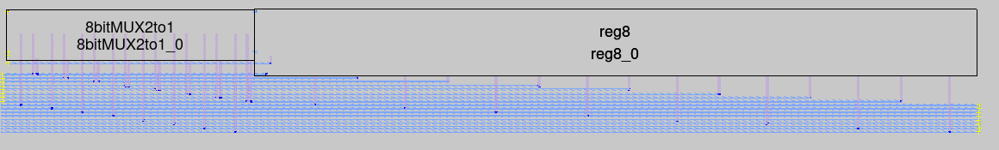
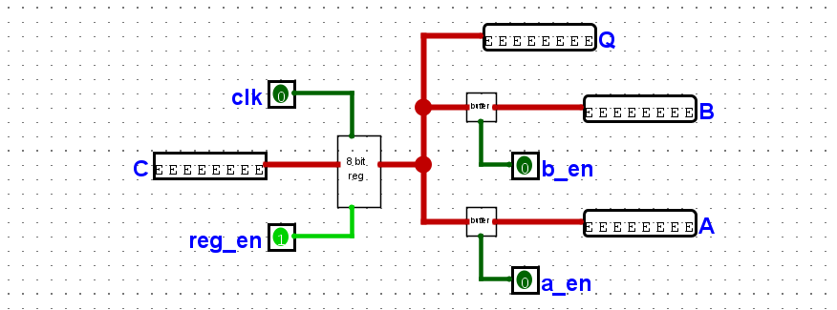
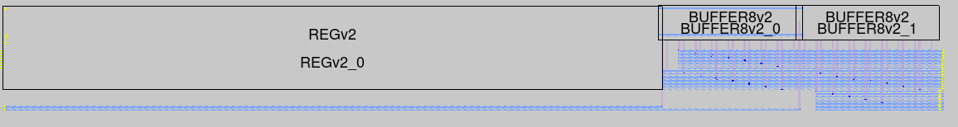
8 bit Register
We add an 8x2 multiplexer to choose to store a new value based on the write enable signal.
reg
We then use two 8-bit tri-state buffers with enable signals to choose if the register is read to outputs A and B based on the A/B read enable signals.

Slide 8
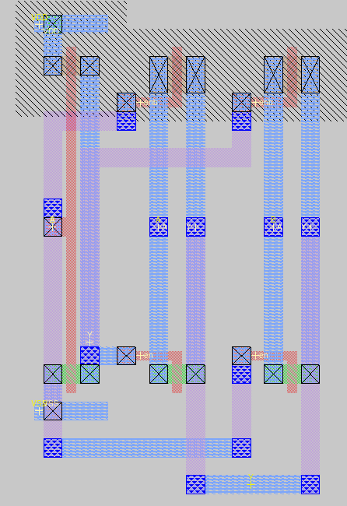
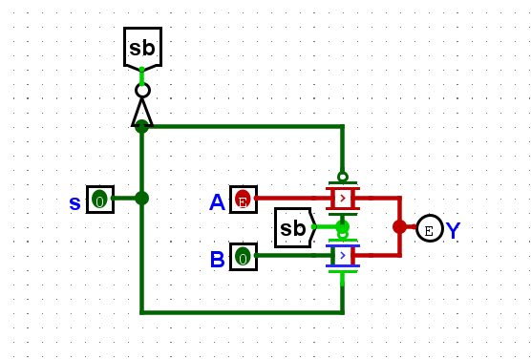
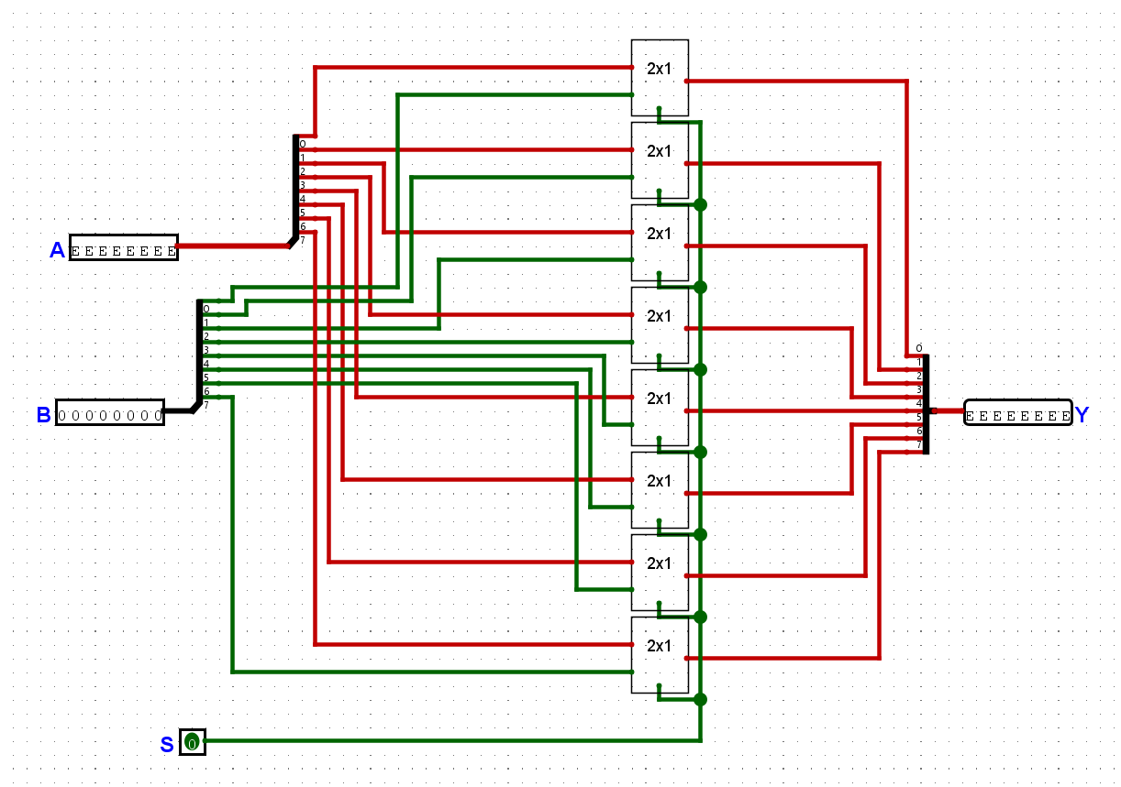
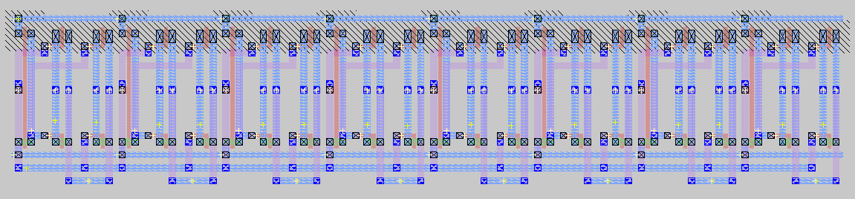
Multiplexers
2 input multiplexer
Chooses to output either A or B to Y depending on the selection bit (S).
Uses transmission gates
Can use an array of them to make an 8x2 Multiplexer
8x2 input multiplexers

Slide 9
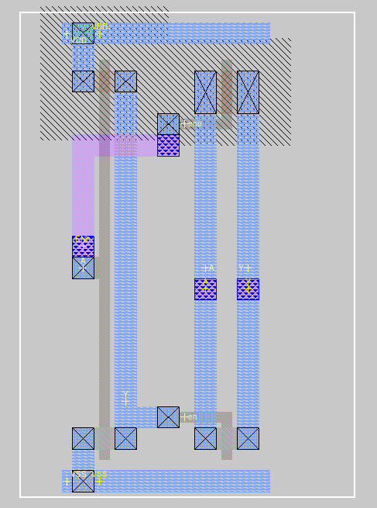
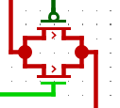
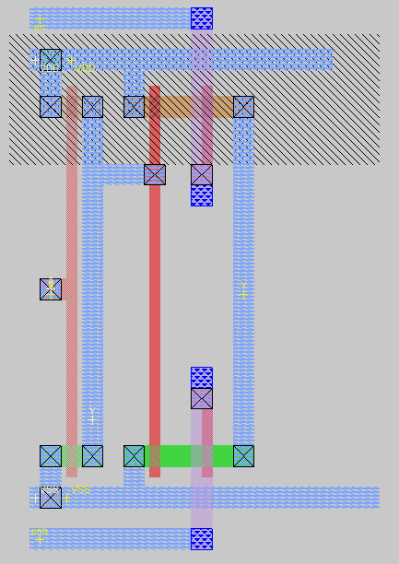
Tri-state Buffers
Transmission gate Buffers
We used 2 different types of tri-state buffers
1 based on logic gates
1 based on transmission gates
We found that when using transmission gates in IRSIM, our tri-state buffers allowed signals through both ways, which would corrupt our registers
Logic gate Buffers

Slide 10
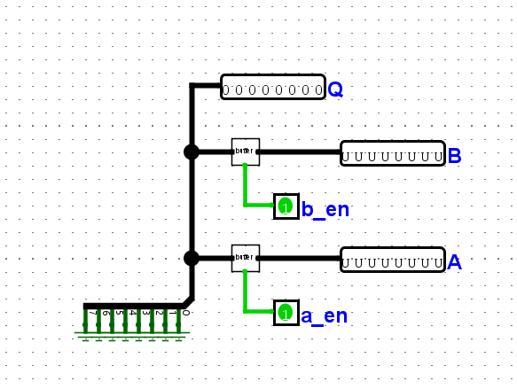
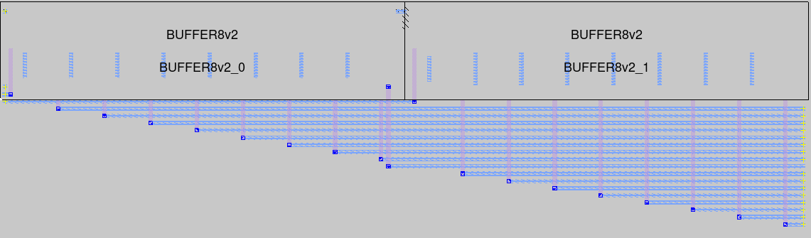
Zero Register
Outputs 0 for all 8 bits
Since we don’t need to write to this register, we can short all the bits to VSS.
Don’t need a write enable signal, but still need 2 buffers for read enable signals.

Slide 11
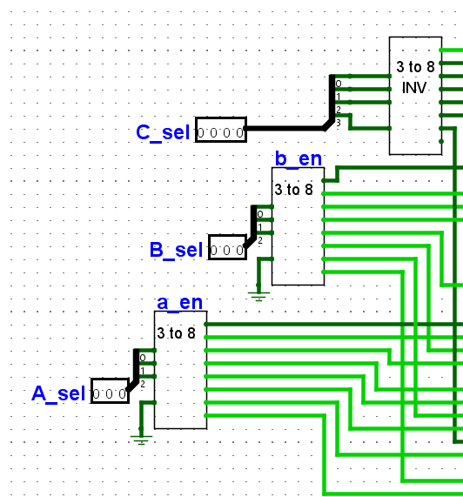
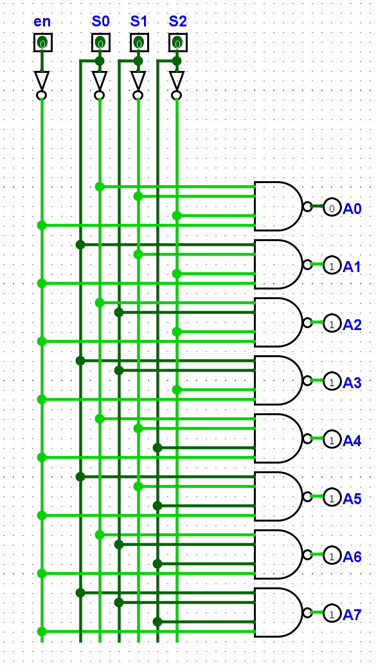
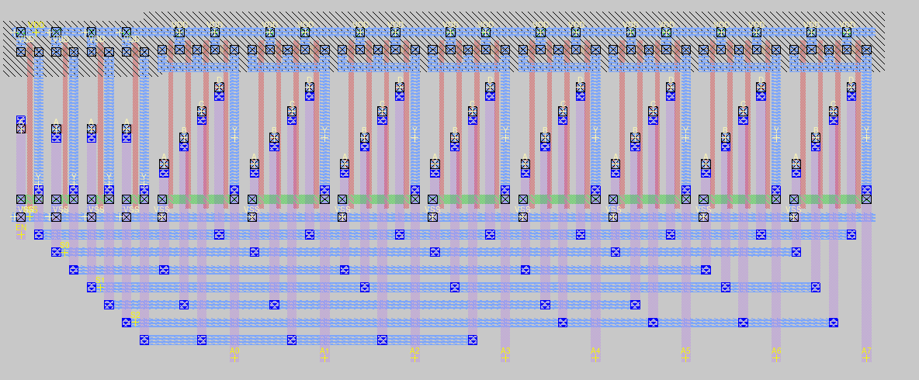
Reading and Writing
We choose which register to read/write using decoders
The first bit of C_sel is used as the write enable bit (enabled at 0)
C_sel sends enable signals to each 8x2 multiplexer to tell it when to write
A_sel and B_sel send enable signals to our buffers to tell them when to read

Slide 12
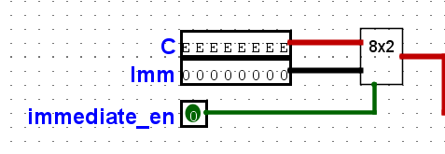
Choosing a Value to Write
We can either write a value directly into a register (Imm), or take our output from our ALU ( C )
Uses an 8x2 Multiplexer

Slide 13
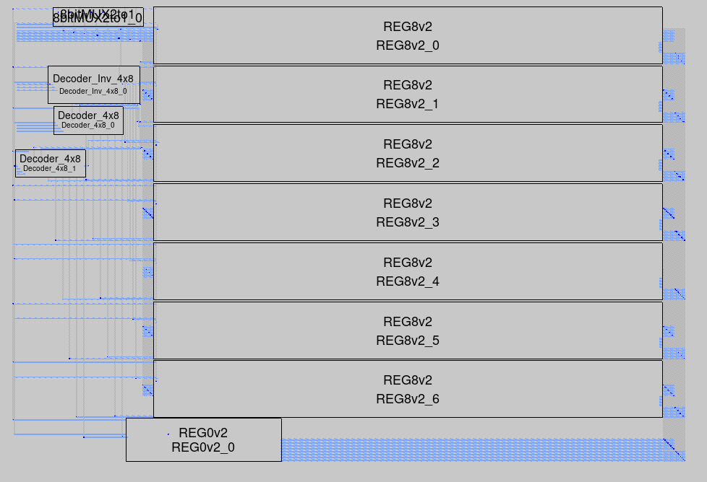
Register File Review

Slide 14
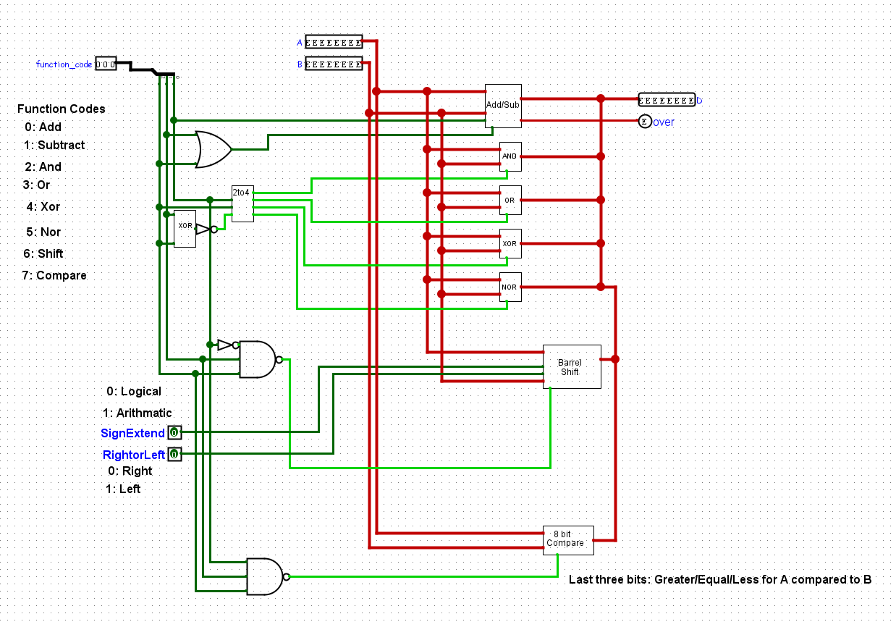
Arithmetic Logic Unit (ALU)
Executes various functions based on function codes
Takes in two 8-bit numbers (A and B)
Outputs an 8-bit number and an overflow signal for Addition/Subtraction

Slide 15
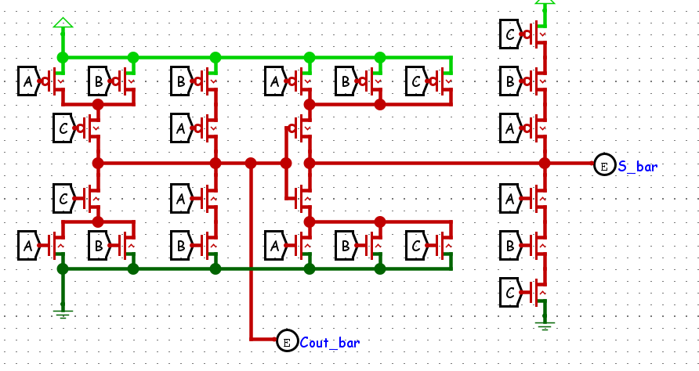
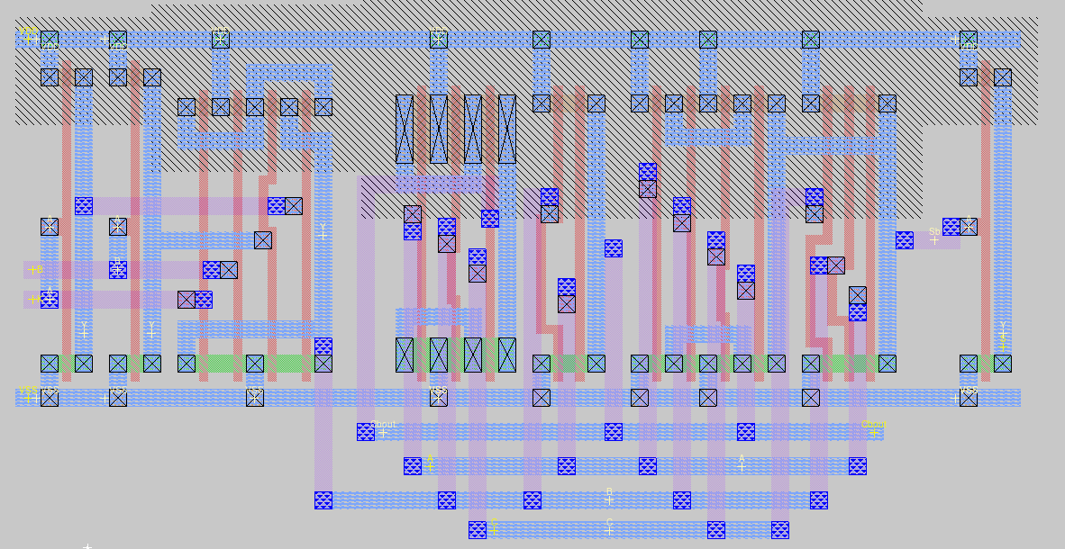
Addition/Subtraction
Primarily uses mirror adders to produce the sum and carry out bits.
S_bar will be inverted and sent to be part of the result.
Carry outs will be added to the next most significant bit.

Slide 16
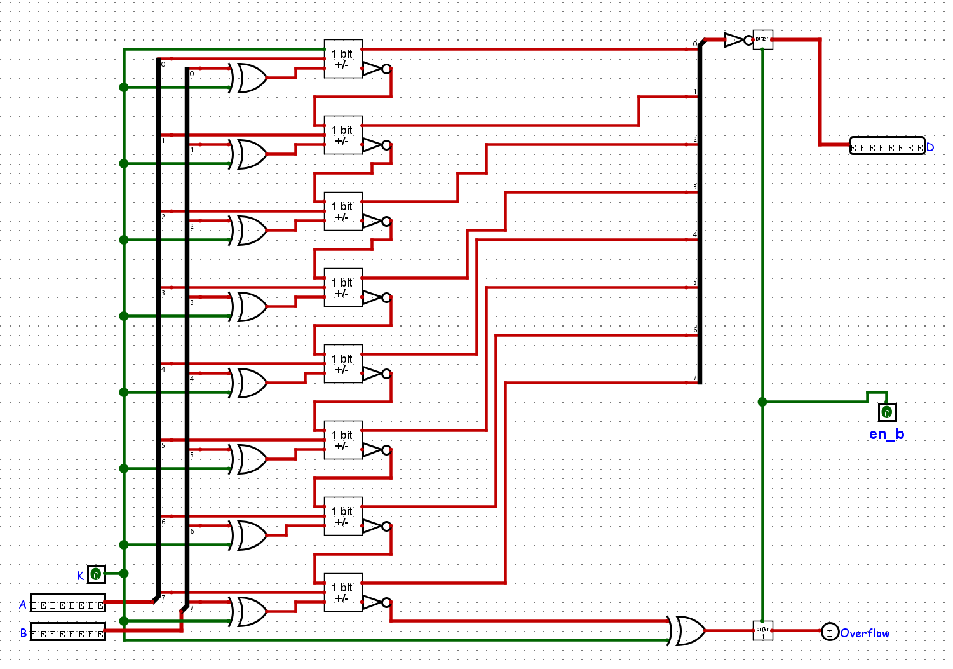
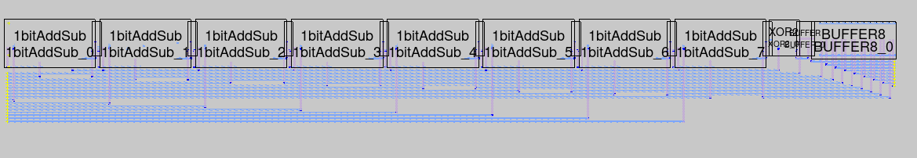
Addition/Subtraction
Subtraction is produced by adding an XOR gate with inputs B and K (subtract enable)
Overflow will be triggered by the carry out of the MSB
Will also be triggered by underflow
Outputs will be enabled/disabled with the 8 bit buffer.

Slide 17

Bitwise AND/OR/XOR/NOR
Simple bitwise logic using an array of logic gates
Buffers added to the result for enabling
Takes two 8-bit inputs and outputs the respective logic applied to individual bits of the inputs.

Slide 18
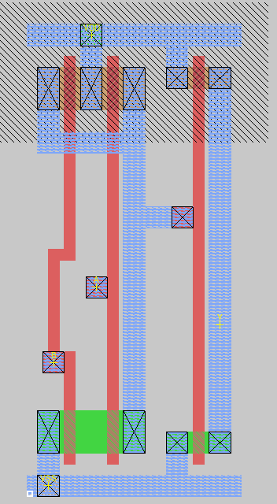
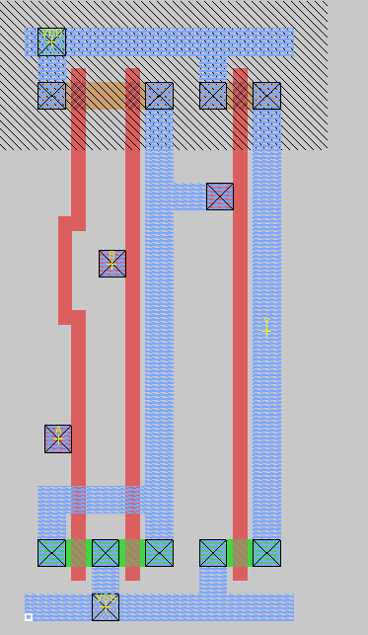
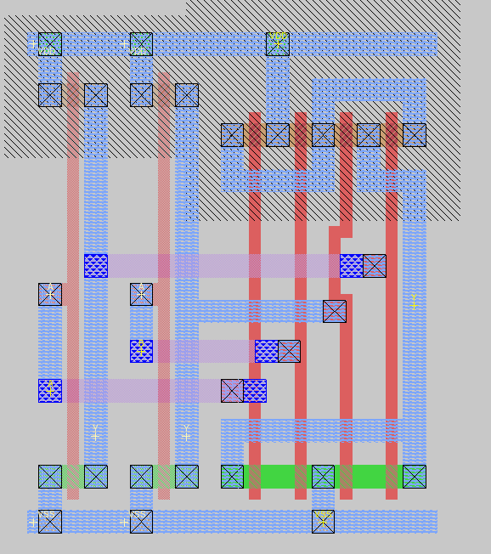
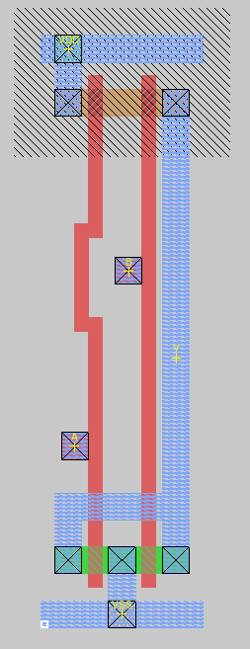
Bitwise AND/OR/XOR/NOR
Basic Logic Gates:
2-input AND
2-input OR
2-input XOR
2-input NOR

Slide 19
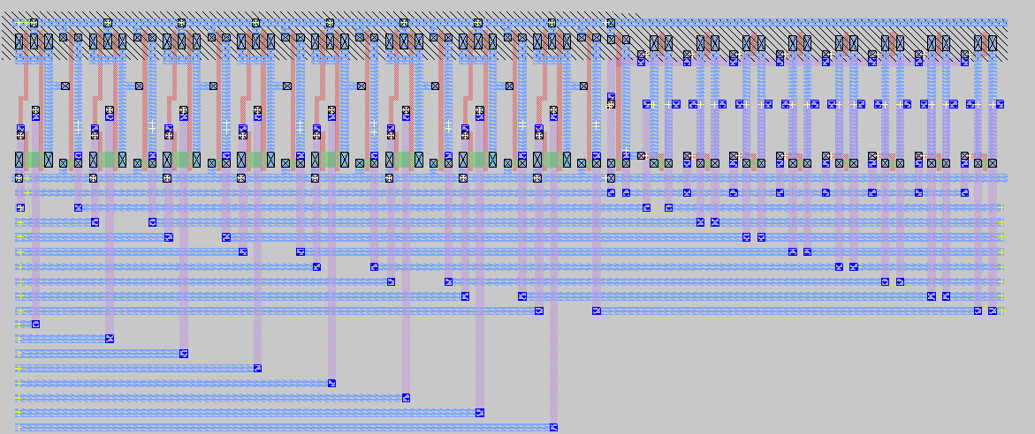
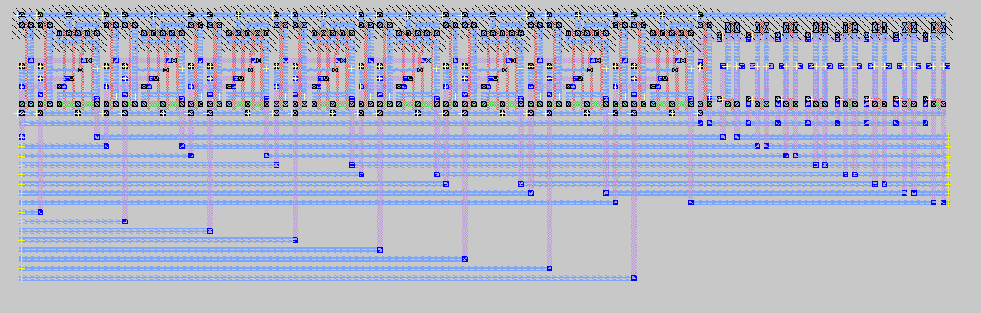
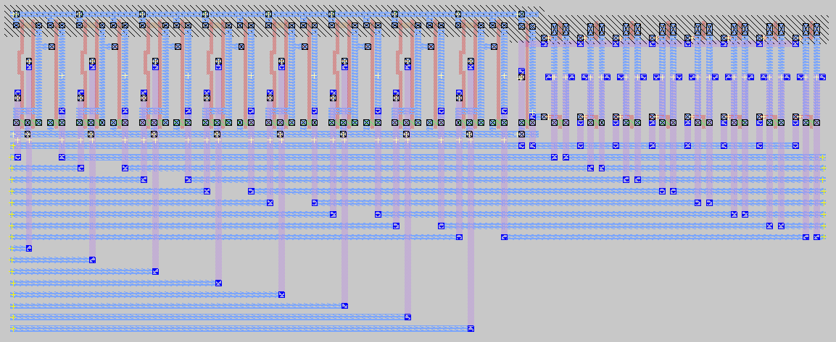
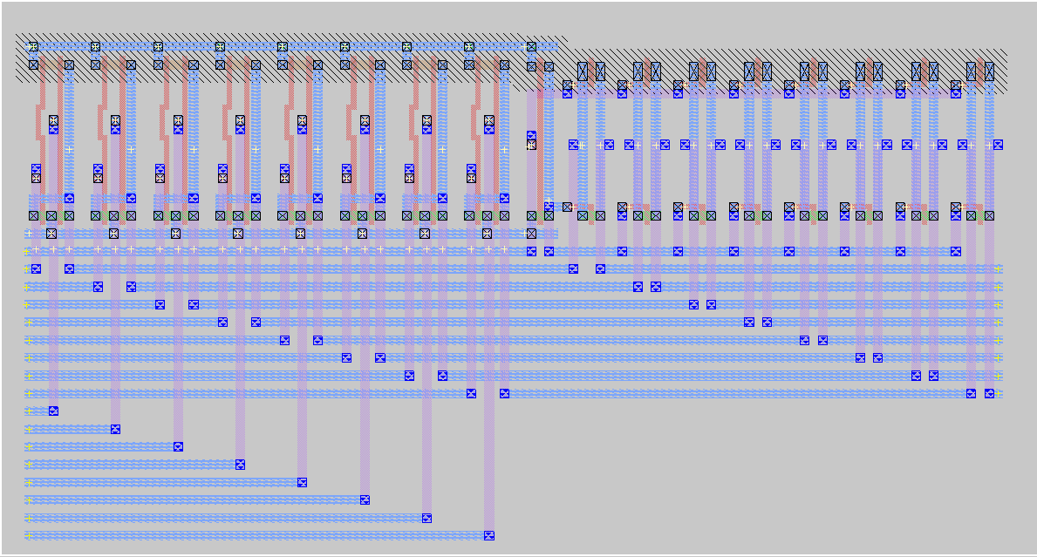
Bitwise AND/OR/XOR/NOR
AND2x8 + Buffer
XOR2x8 + Buffer
OR2x8 + Buffer
NOR2x8 + Buffer

Slide 20
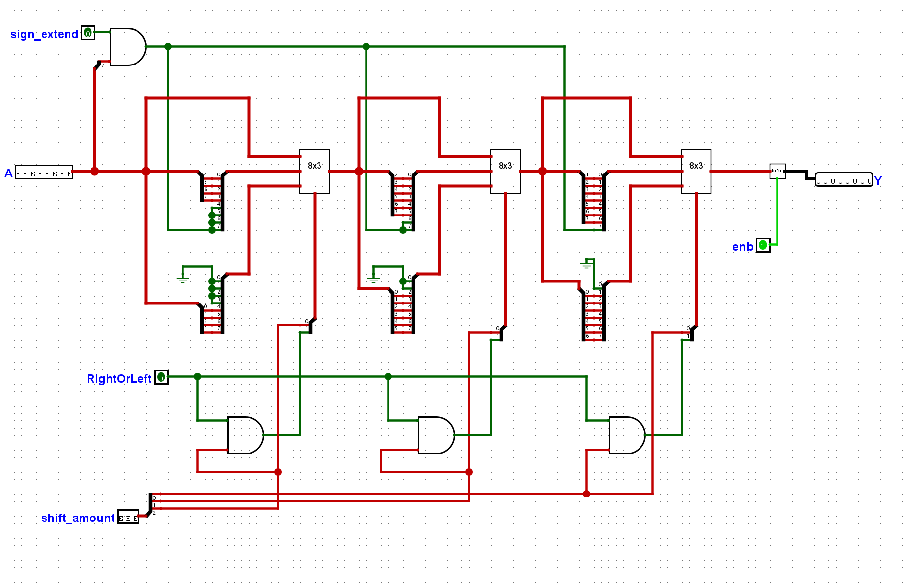
Shifting
Uses multiplexers to shift bits from input A by a number of bits based on input B (shift_amount)
Input from RightOrLeft will determine the direction of the shift
Input from sign_extend will determine if the shift will result in the newly added bits will turn to 0 or 1

Slide 21
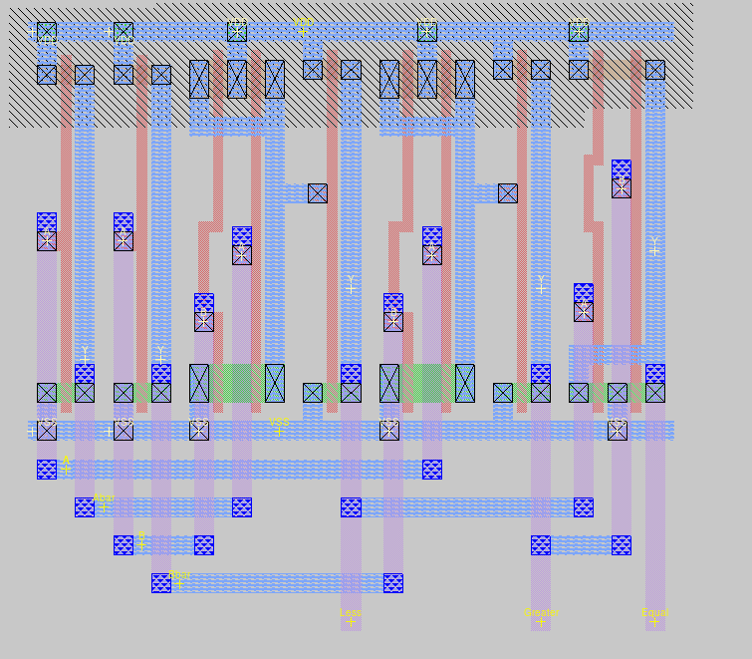
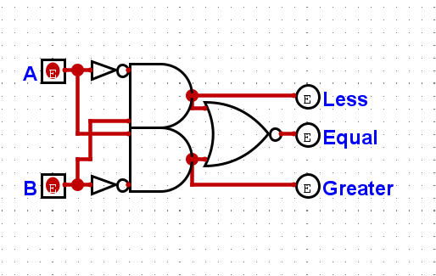
Comparator
1 bit comparator
Uses logic gates to check if A is greater than, less than, or equal to B.
Will output:
00000100 if A > B
00000010 if A = B
00000001 if A < B

Slide 22
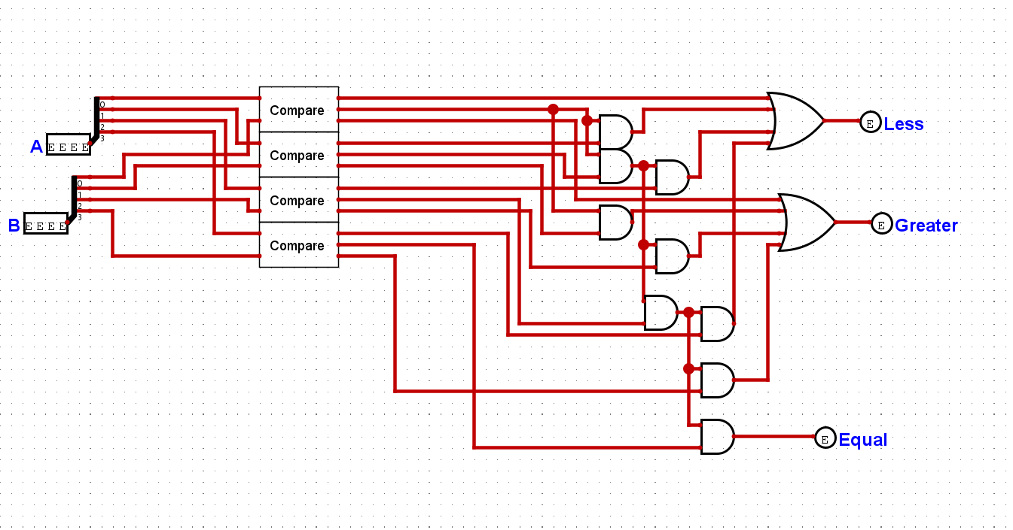
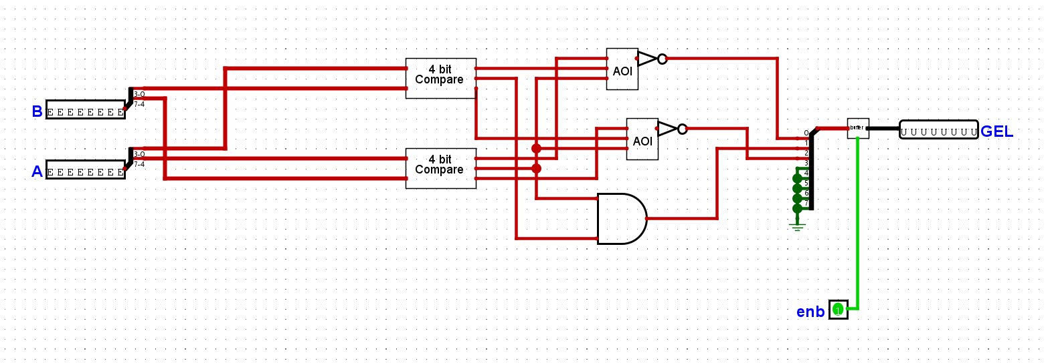
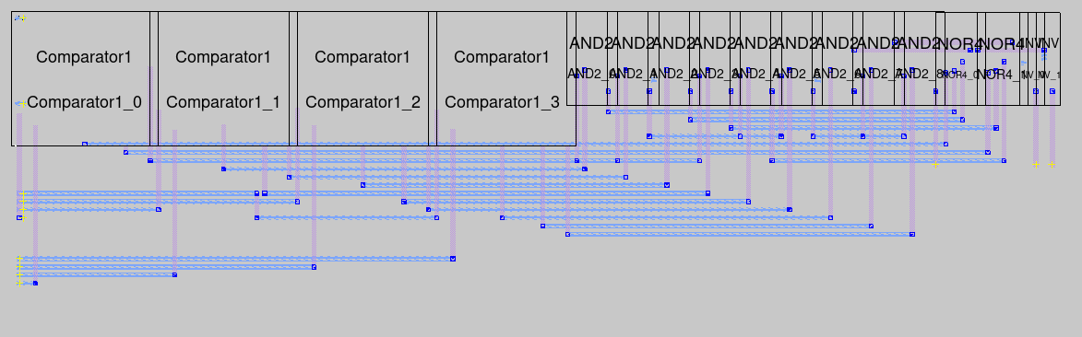
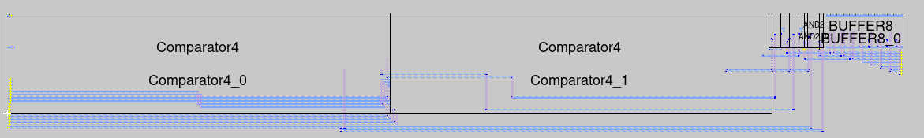
Comparator
4 bit comparator
8 bit comparator

Slide 23
Function Codes
000: Add (A+B)
001: Subtract (A-B)
010: Bitwise And (A and B)
011: Bitwise Or (A or B)
100: Bitwise Xor (A xor B)
101: Bitwise Nor (A nor B)
110: Shift (Shifts A by B number of bits up to 3), RorL (0: Right 1: Left), LorA (0: Logical 1: Arithmatic)
111: Compare (Compares A with B) Outputs GEL: Last three binary digits. Greater Equal Less.

Slide 24
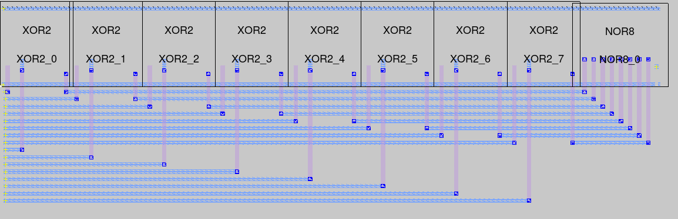
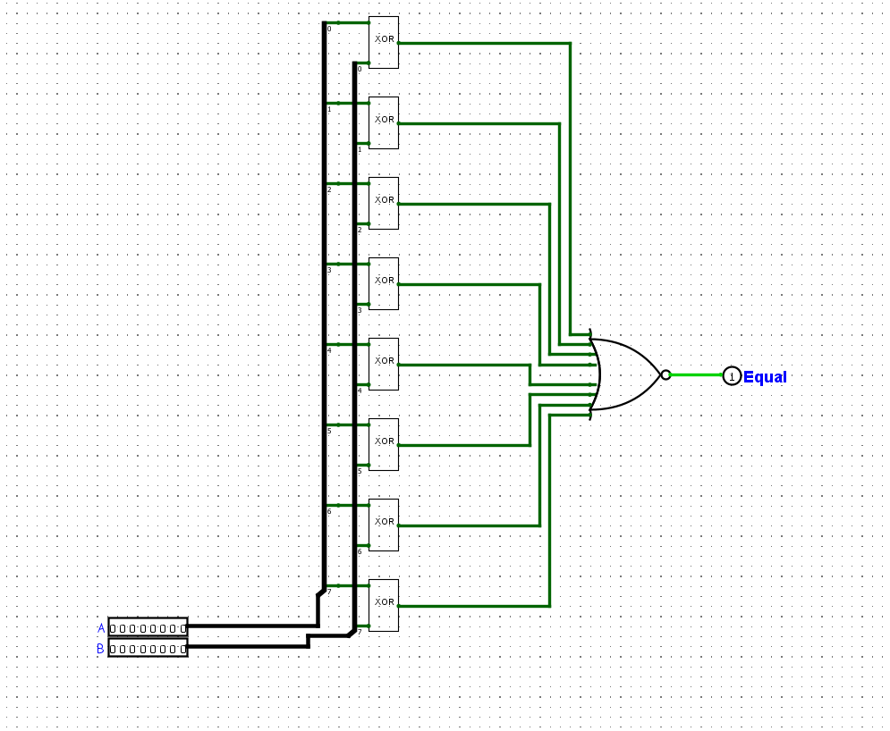
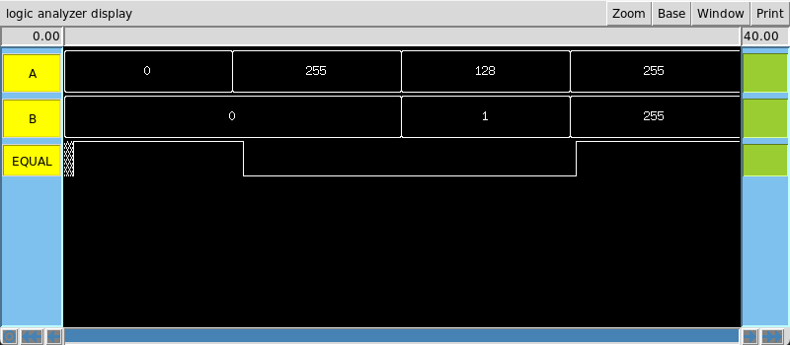
Equal Block
Uses an array of 2-input XOR gates and and an 8-input NOR gate to determine if input A is equal to input B.

Slide 25
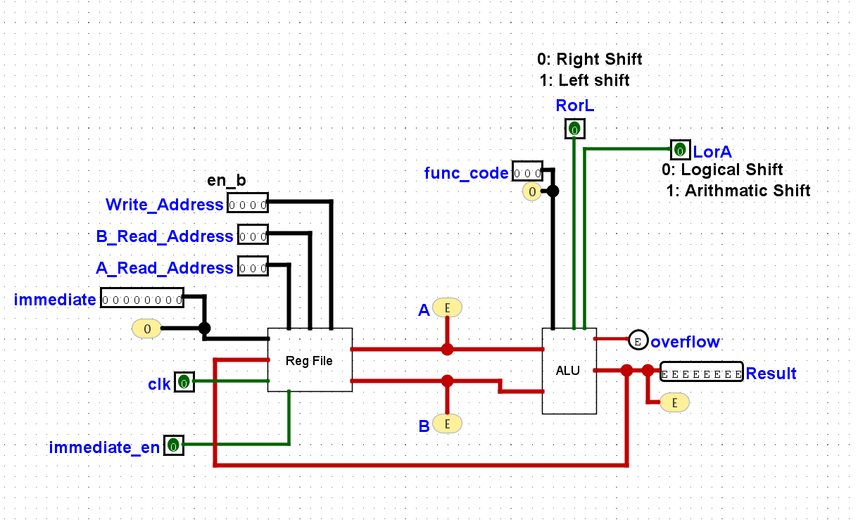
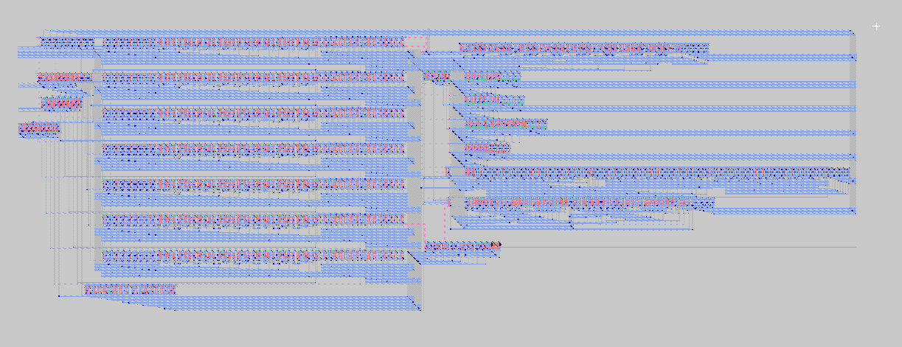
Final Layout

Slide 26


Slide 27


