Slide 1
Model trong ASP.Net MVC

Slide 2
Nội dung
Define and describe models
Explain how to create a model
Describe how to pass model data from controllers to views
Explain how to create strongly typed models
Explain the role of the model binder
Explain how to use scaffolding in Visual Studio.NET

Slide 3
Giới thiệu về Model
In an ASP.NET MVC application, a model:
  Is a class containing properties that represents data of an application.
  Represents data associated with the application.
ASP.NET MVC Framework is based on the MVC pattern.
The MVC pattern defines the following three types of models, where each model has specific purpose:
  Data model: Represent classes that interact with a database. Data models are set of classes that can either follow the database-first approach or code-first approach.
  Business model: Represent classes that implement a functionality that represents business logic of an application.
  View model: Represent classes that provide information passed between controllers and views.

Slide 4
Tạo Model
Tạo Model trong dự án ASP.Net MVC:
  Tạo một public class với tên tùy chọn.
  Định nghĩa các thuộc tính public cho lass đó.
Sau đây là đoạn mã cho Model tên là User:
public class User
{
public long Id { get; set; }
public string name { get; set; }
public string address { get; set; }
public string email { get; set; }
}

Slide 5
Thao tác với Model trong Controller
In an ASP.NET MVC application when a user request for some information, the request is received by an action method.
The action method is used to access the model storing the data.
To access the model, you need to create an object of the model class and either retrieve or set the property values of the object.
Following code shows the creating an object of the model class in the Index()action method:
public ActionResult Index()
{
var user = new MVCModelDemo.Models.User();
user.name = "John Smith";
user.address = "Park Street";
user.email = "john@mvcexample.com";
return View();
}

Slide 6
Truyền Model cho View
Once you have accessed the model within a controller, you need to make the model data accessible to a view so that the view can display the data to the user.
To do this, you need to pass the model object to the view while invoking the view.
You can model the object as follows:
A single object
A collection of model objects

Slide 7
Truyền Model cho View
In an action method, you can create a model object and then pass the object to a view by using the ViewBag object.
Following code shows passing the User model data from an action method to a view by using a ViewBag object:
In this code, an object of the User model class is created and initialized with values. The object is then, passed to the view by using a ViewBag object.
public ActionResult Index()
{
var user = new MVCModelDemo.Models.User();
user.name = "John Smith";
user.address = "Park Street";
user.email = "john@mvcexample.com";
ViewBag.user = user;
return View();
}

Slide 8
Truyền Model cho View
You can access the data of the model object stored in the ViewBagobject from within the view.
Following code snippet shows accessing the data of the model object stored in the ViewBagobject:
In this code, the view accesses and displays the name, address, and emailproperties of the Usermodel object stored in the ViewBagobject.
<!DOCTYPE html>
<html>
<body>
<p> User Name: @ViewBag.user.name</p>
<p> Address: @ViewBag.user.address</p>
<p> Email: @ViewBag.user.email</p>
</body>
</html>

Slide 9
Truyền Model cho View
Following code shows passing a collection of model objects to a view:
public ActionResult Index(){
var user = new List<User>();
var user1 = new User();
user1.name = "Mark Smith";
user1.address = "Park Street";
user1.email = "Mark@mvcexample.com";
var user2 = new User();
user2.name = "John Parker";
user2.address = "New Park";
user2.email = "John@mvcexample.com";
var user3 = new User();
user3.name = "Steave Edward ";
user3.address = "Melbourne Street";
user3.email = "steave@mvcexample.com";
user.Add(user1); user.Add(user2); user.Add(user3);
ViewBag.user = user; return View(); }

Slide 10
Truyền Model cho View
The preceding code:
Creates and initializes three objects of the model class, named User.
Then, a List<User>collection is created and the model objects are added to it.
Finally, the collection is passed to the view by using a ViewBagobject.
Once you pass a collection of model objects to a view using a ViewBagobject:
You can retrieve the collection stored in the ViewBagobject from within the view.
You can iterate through the collection to retrieve each model object.
You can access their properties.

Slide 11
Truyền Model cho View
Following code snippet shows retrieving model objects from a collection and displaying their properties:
This code uses a foreach loop to iterate through the collection of model object stored in the ViewBag object and the name, address, and emailproperties are rendered as response
<!DOCTYPE html>
<html> <body>
<h3>User Details</h3>
@{ var user = ViewBag.user;}
@foreach (var p in user)
{
@p.name<br />
@p.address<br />
@p.email<br />
<br /> }
</body>
</html>

Slide 12
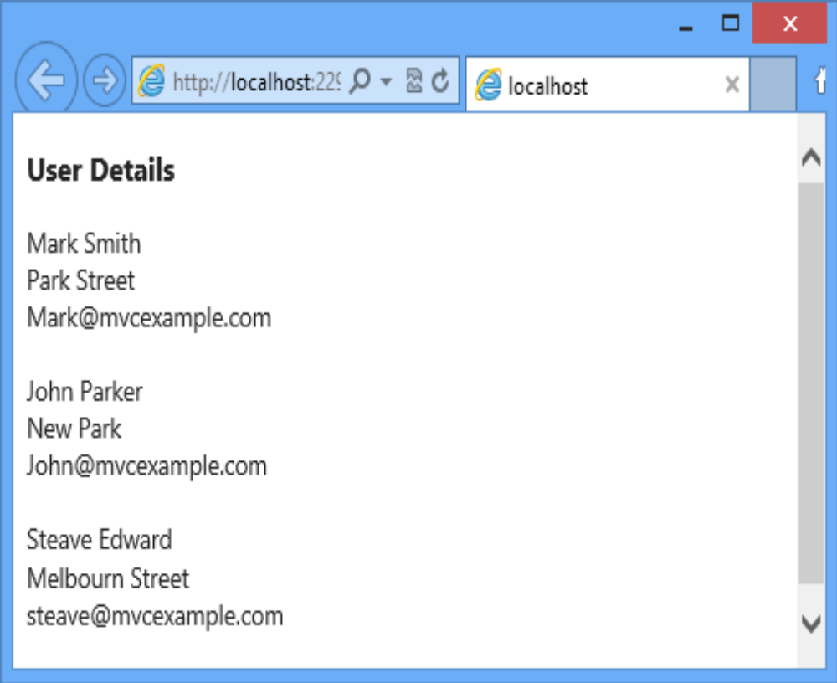
Tạo View cho một Action
Following figure shows the output of retrieving model objects:
You can use another approach to pass a collection of model objects from an action method to a view is to pass the collection directly as a parameter to the View()method.
This code uses a foreach loop to iterate through the collection of model object stored in the ViewBag object and the name, address, and email properties are rendered as response.

Slide 13
Truyền Model cho View
Following code snippet shows passing a collection of model objects to a view as a parameter to the View() method:
The preceding code will create and initializes three objects of the model class, named User.
  Then, a List<User>collection is created and the model objects are added to it.
  Finally, the collection is passed to the view as a parameter to the View() method.
ActionResult Index() {
var user = new List<User>();
var user1 = new User();
user1.name = "Mark Smith";
user1.address = "Park Street";
user1.email = "Mark@mvcexample.com";
var user2 = new User();
user2.name = "John Parker";
user2.address = "New Park";
user2.email = "John@mvcexample.com";
var user3 = new User();
user3.name = "Steave Edward ";
user3.address = "Melbourn Street";
user3.email = "steave@mvcexample.com";
user.Add(user1);
user.Add(user2);
user.Add(user3);
return View(user);
}

Slide 14
Truyền Model cho View
Following code snippet shows retrieving the user information in the view:
This code shows how to retrieve the user information that has been passed to a view by passing a collection of objects as a parameter.
<!DOCTYPE html>
<html> <body>
<h3>User Details</h3>
@{ var user = Model }
@foreach(var p in user)
{
@p.name <br />
@p.address<br />
@p.email<br />
<br/>
}
</body>
</html>

Slide 15
Định kiểu cho Model trên View
Khi truyền model từ Controller sang View, có thể View không biết chính xác kiểu dữ liệu trong Model.
Giải pháp đặt ra là chuyển kiểu
Trong ví dụ trên, Model được chuyển sang kiểu MVCModelDemo.Models.User.
<html> <body>
<h3>User Details</h3>
@{
var user = Model as MVCModelDemo.Models.User;
}
@user.name <br/>
@user.address<br/>
@user.email<br/>
</body> </html>

Slide 16
Định kiểu cho Model trên View
Ta có thể không cần chuyển kiểu cho Model một cách tường minh như ví dụ trước mà khai báo “Định kiểu cho Model trên View” bằng việc sử dụng từ khóa @model theo cú pháp sau:
Trong đó
  model_name: là tên đầy đủ của Model đã được định nghĩa
  Khi sử dụng từ khóa @model keyword, ta có thể truy nhập các thuộc tính của đối tượng Model trên View.
@model <model_name>

Slide 17
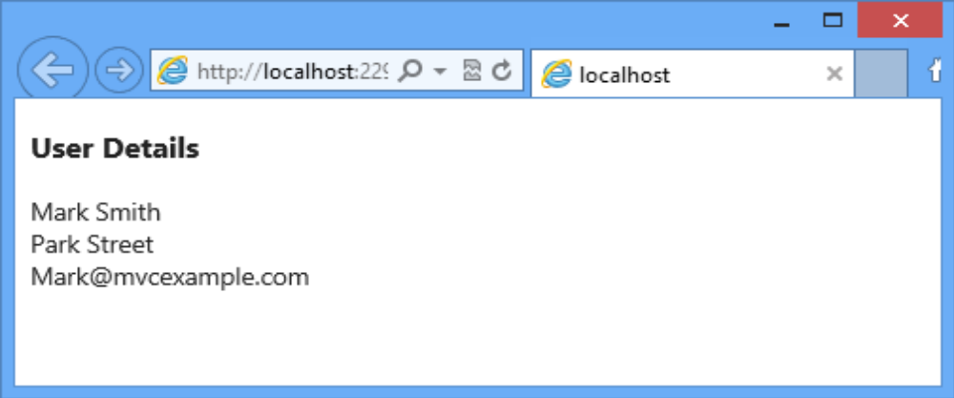
Định kiểu cho Model trên View
Đoạn mã sau mô tả truy nhập các thuộc tính của Model bằng từ khóa @model
Kết quả các thuộc tính của Model được hiển thị như sau:
@model MVCModelDemo.Models.User
<html><body>
<h3>User Details</h3>
@Model.name <br/>
@Model.address<br/>
@Model.email<br/>
</body> </html>

Slide 18
Định kiểu cho Model trên View
Sometime, you may need to pass a collection of objects to a view.
In such situation, you can use the @modelkeyword.
Following code snippet shows using the @model keyword to pass a collection of Model object:
This code uses the @model keyword to indicate that it expects a collection of the Usermodel objects.
Once you pass a collection of the model objects, you can access it in a view.
@model IEnumerable<MVCModelDemo.Models.User>

Slide 19
Định kiểu cho Model trên View
Following code snippet shows accessing the collection of the Usermodel in a view:
@model IEnumerable<MVCModelDemo.Models.User>
<html>
<body>
<h3>User Details</h3>
@{
var user = Model;
}
@foreach(var u in user)
{
@u.name <br/>
@u.address<br/>
@u.email<br/>
<br/>
}
</body>
</html>

Slide 20
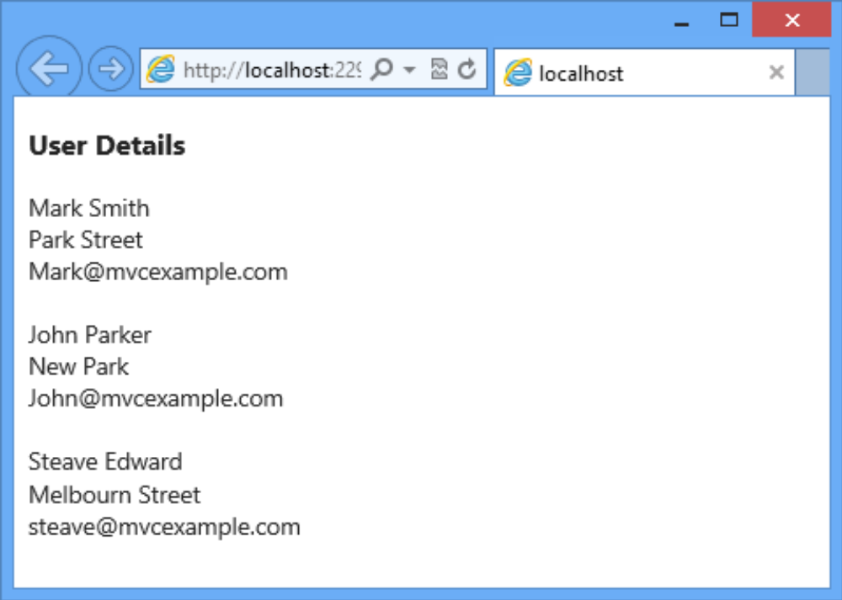
Định kiểu cho Model trên View
Following figure shows the output of accessing collection of the Usermodel:

Slide 21
Sử dụng HTML Helper
The MVC Framework:
  Enables these helper methods to directly associate with model properties in a strongly types views.
  Provides helper methods that you can use only in strongly typed views.
Following table lists the helper methods that you can use only in strongly typed views:
Helper Method | Description
Html.LabelFor() | Is the strongly typed version of the Html.Label()helper method that uses a lambda expression as its parameter, which provides compile time checking.
Html.DisplayNameFor() | Is used to display the names of model properties.
Html.DisplayFor() | Is used to display the values of the model properties.

Slide 22
Sử dụng HTML Helper
Helper Method | Description
Html.TextBoxFor() | Is the strongly typed version of the Html.TextBox()helper method.
Html.TextAreaFor() | IIs the strongly typed version of the Html.TextArea()helper method that generates the same markup as that of the Html.TextArea()helper method.
Html.EditorFor() | Is used to display an editor for the specified model property.
Html.PasswordFor() | Is the strongly typed version of the Html.Password()helper method.
Html.DropDownListFor() | Is the strongly typed version of the Html.DropDownList()helper method that allows selection of a single item.

Slide 23
Sử dụng HTML Helper
Following code snippet shows the HTML helper methods in a strongly typed view:
@model MVCModelDemo.Models.User
@{
ViewBag.Title = "User Form";
}
<h2>User Form</h2>
@using (Html.BeginForm()) {
@Html.ValidationSummary(true)
<div>@Html.LabelFor(model => model.name)</div>
<div>@Html.EditorFor(model => model.name)</div>
<div>@Html.LabelFor(model => model.address)</div>
<div>@Html.EditorFor(model => model.address)</div>
<div>@Html.LabelFor(model => model.email)</div>
<div>@Html.EditorFor(model => model.email)</div>
}

Slide 24
Sử dụng HTML Helper
Following code snippet shows the HTML helper methods in a strongly typed view:
In this code:
  The Html.LabelFor() method is used to display labels based on the property names of the model.
  The Html.EditorFor() method is used to display editable fields for the properties of the model.
@model MVCModelDemo.Models.User
@{ViewBag.Title = "User Form";}
<h2>User Form</h2>
@using (Html.BeginForm()) {
@Html.ValidationSummary(true)
<div>@Html.LabelFor(model => model.name)</div>
<div>@Html.EditorFor(model => model.name)</div>
<div>@Html.LabelFor(model =>model.address)</div>
<div>@Html.EditorFor(model =>model.address)</div>
<div>@Html.LabelFor(model =>model.email) </div>
<div>@Html.EditorFor(model =>model.email)</div>
<p><input type="submit" value="Create" /></p>
}

Slide 25
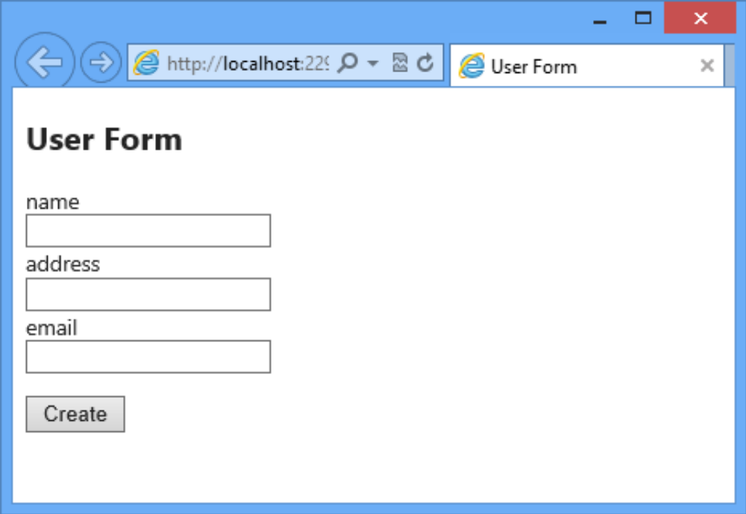
Sử dụng HTML Helper
Following figure shows the output of using HTML helper methods:

Slide 26
Binding Model
When a user submits information in a form within a strongly typed view, ASP.NET MVC automatically examines the HttpRequest object and maps the information sent to fields in the model object.
The process of mapping the information in the HttpRequest object to the model object is known as model binding.
Some of the advantages of model binding are as follows:
Automatically extract the data from the HttpRequest object.
Automatically converts data type.
Makes data validation easy.

Slide 27
Binding Model
The MVC Framework provides a model binder that performs model binding in application.
The Default Model Binder class implements the model binder on the MVC Framework.
The two most important roles of the model binder are as follows:
  Bind request to primitive values
  Bind request to objects

Slide 28
Binding Primitive values
To understand how the model binder binds request to primitive values, consider a scenario where you are creating a log in form that accepts log in details from user.
For this, first you need to create a Login model in your application.
Following code snippet shows the Login model class:
This code creates two properties named userName and password in the Login model.
After creating the model class, you need to create an Index.cshtml view to display the login form.
public class Login
{
public string userName { get; set; }
[DataType(DataType.Password)]
public string password { get; set; }
}

Slide 29
Binding Primitive values
Following code shows the content of the Index.cshtml file:
@model ModelDemo.Models.Login
@{ ViewBag.Title = "Index";}
<h2>User Details</h2>
@using (Html.BeginForm()) {
@Html.ValidationSummary(true)
<div>@Html.LabelFor(model =>model.userName)</div>
<div>@Html.EditorFor(model =>model.userName)</div>
<div>@Html.LabelFor(model =>model.password)</div>
<div>@Html.EditorFor(model =>model.password) </div>
<div><input type="submit" value="Submit" /></div>
}

Slide 30
Binding Primitive values
Once, you have created the view, you need to create a controller class that contains the Index() action method to display the view.
Following code shows the HomeController
public class HomeController : Controller {
  public ActionResult Index() {
  return View();
  }
  [HttpPost]
  public ActionResult Index(string userName, string password) {
  if (userName == "Peter" && password == "pass@123") {
  string msg = "Welcome " + userName;
  return Content(msg);
  }
  else {
  return View();
  }
  }
}

Slide 31
Binding Primitive values
In the preceding code:
  The first Index() method returns the Index.cshtml view that displays a login form.
  The second Index() method is marked with the HttpPost attribute. This method accepts two primitive as parameters. The Index()method compares the parameters with predefined values and returns a message if the comparison returns true. Else, the Index()method returns back the Index.cshtml view.
When a user submits the login data, the default model binder maps the values of the username and password fields to the primitive type parameters of the Index()action method.
In the Index()action method, you can perform the required authentication and return a result.

Slide 32
Binding object
To understand how the model binder binds requests to objects, consider the same scenario where you are creating a login form.
For this, you have already created the Login model and the Index.cshtml view.
To bind request to object, you need to update the controller class so that it accepts a Login object as a parameter, instead of an HttpRequest object.

Slide 33
Binding object
Following code shows the updated controller class:
In this code:
  The first Index()method returns the Index.cshtml view that displays a login form.
  The second Index()method automatically removes the data from the HttpRequest object and put into the Login object.
public class HomeController : Controller {
public ActionResult Index() {
return View();
}
[HttpPost]
public ActionResult Index(Login login) {
if (login.userName == "Peter" &&login.password == "pass@123") {
string msg = "Welcome " + login.userName;
return Content(msg); }
else {
return View(); } }
}

Slide 34
Binding object
When a user submits the login data, the Index()method validates the username and password passed in the Login object.
When the validation is successful, the view displays a welcome message.
When you access the application from the browser the Index.cshtml view displays the login form.
1. Type Peter in the UserName text field and pass@123 in the Password field of the login form.

Slide 35
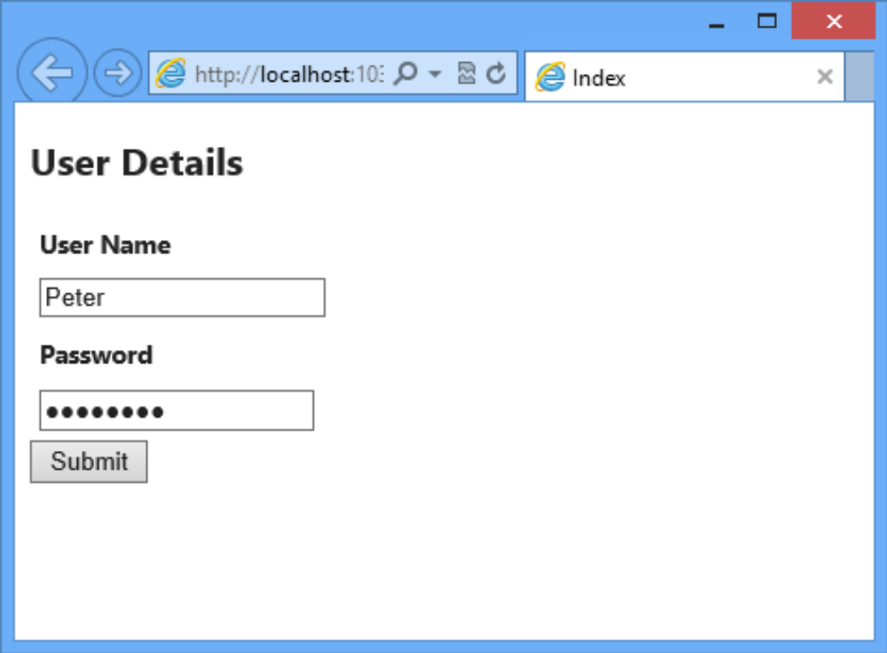
Binding object
Following figure shows the login form with data specified in the User Name and Password fields:
2. Click Submit. The login form displays a ‘WelcomePeter’ message.

Slide 36
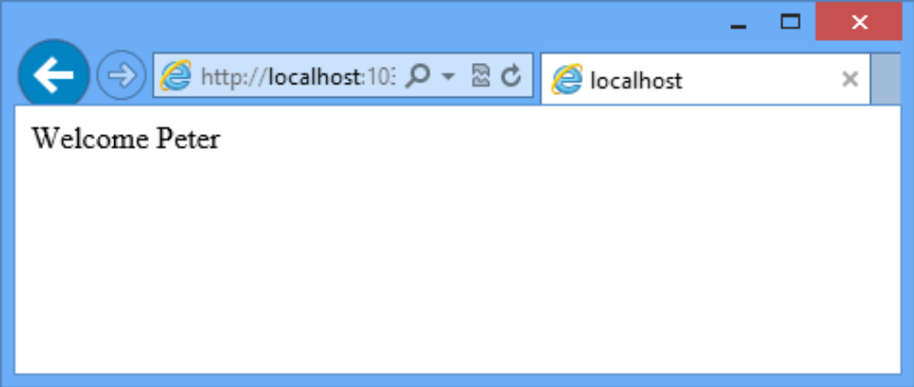
Binding object
Following figure shows the output of the Index.cshtml view after submitting the user name and password:

Slide 37
Visual Studio.NET Scaffolding
The ASP.NET MVC Framework provides a feature called scaffolding that allows you to generate views automatically.
By convention, scaffolding uses specific name for views. After creating a view it stores the auto-generated code in respective places for the application to work.
Following are the five types of template that provides to create views:
  List: Generates markup to display the list of model objects.
  Create: Generates markup to add a new object to the list.
  Edit: Generates markup to edit an existing model object.
  Details: Generates markup to show the information of an existing model object.
  Delete: Generates markup to delete an existing model object.
In this code, ViewData is used to display the values of the Message and CurrentTime keys.

Slide 38
List template
List template allows you to create a view that displays a list of model objects.
Following code shows an Index() action method that returns an ActionResult object through a call to the View() method of the controller class:
This code shows the Index()action method of a controller that returns the result of a call to the View()method.
The result of the View()method is an ActionResultobject that renders a view.
In this code, ViewData is used to display the values of the Message and CurrentTime keys.
public ActionResult Index()
{
var user = new List<User>();
//Code to populate the user collection
return View(user);
}

Slide 39
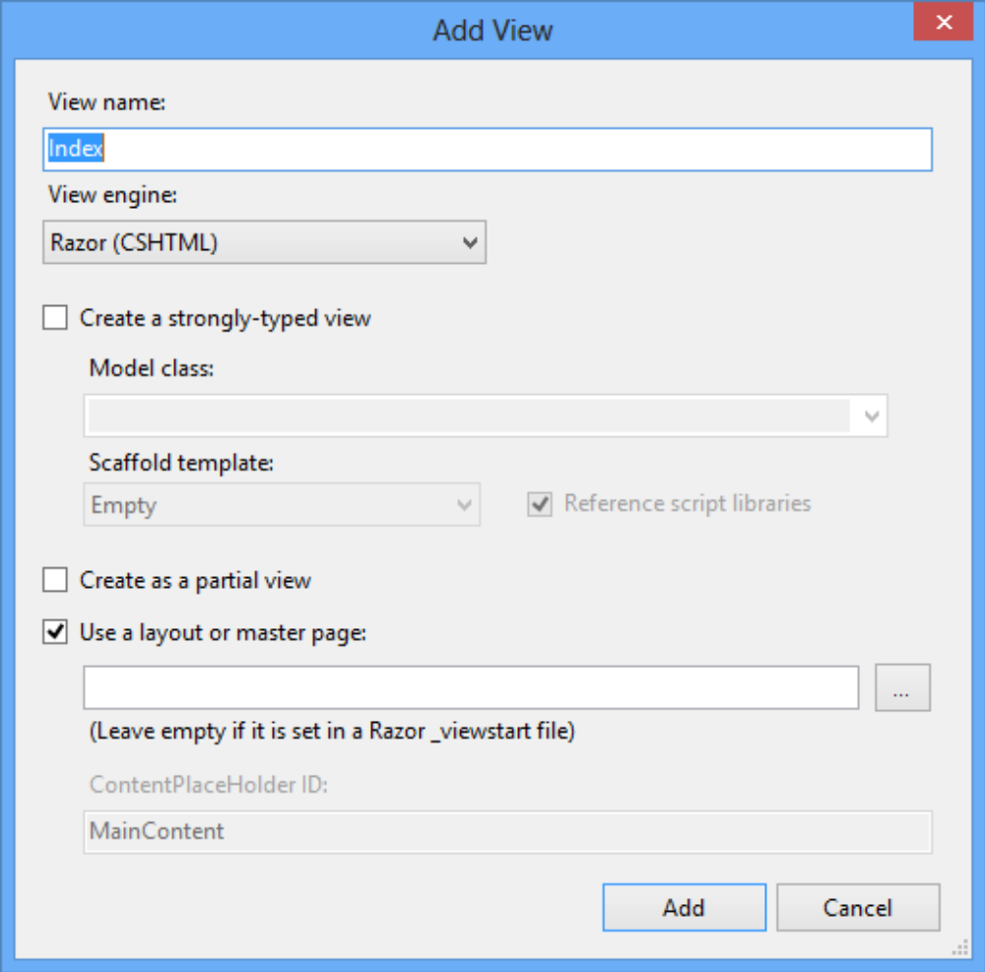
List template
To create a view using the List template, you need to perform the following steps:
1.Right-click inside the action method for which you need to create a view.
2.Select Add View from the context menu that appears. The Add View dialog box is displayed, as shown in the following figure:

Slide 40
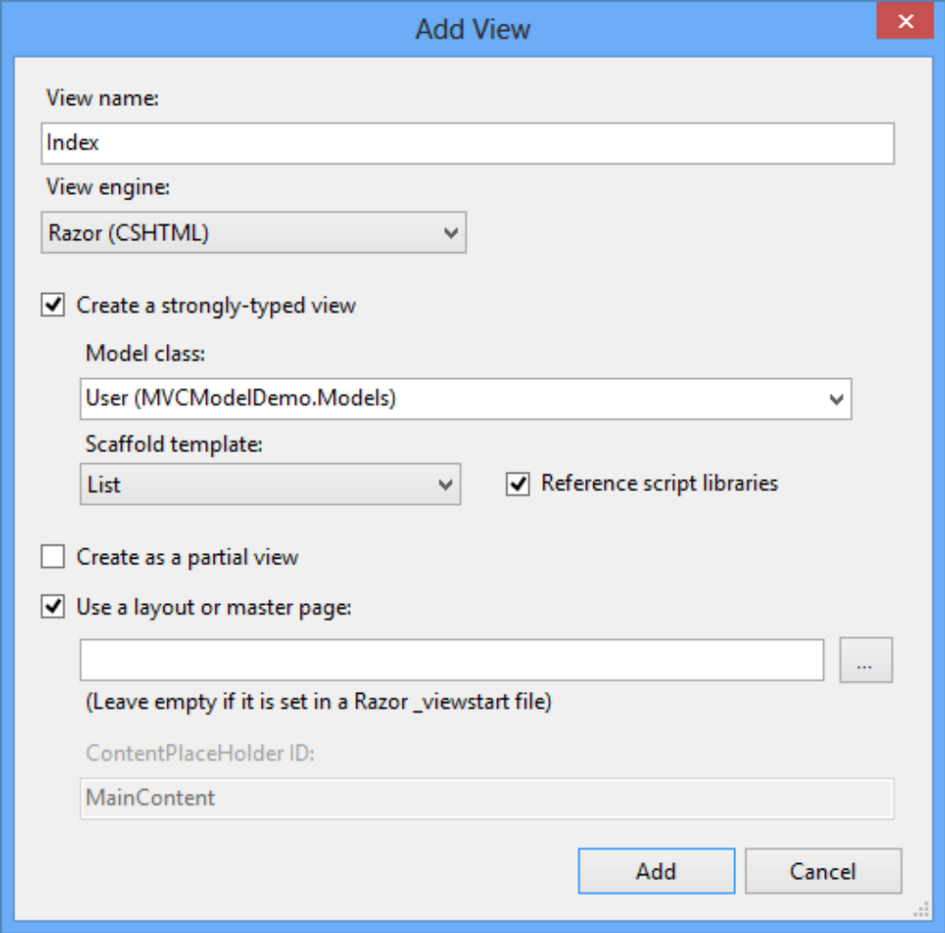
List template
3.Select the Create a strongly-typed view check box. This will enable the fields that allow you to specify the model class and scaffolding template.
4.Select the model class from the Model class drop-down list.
5.Select List from the Scaffold templates drop-down list. Following figure specifies the model class and the scaffolding template:

Slide 41
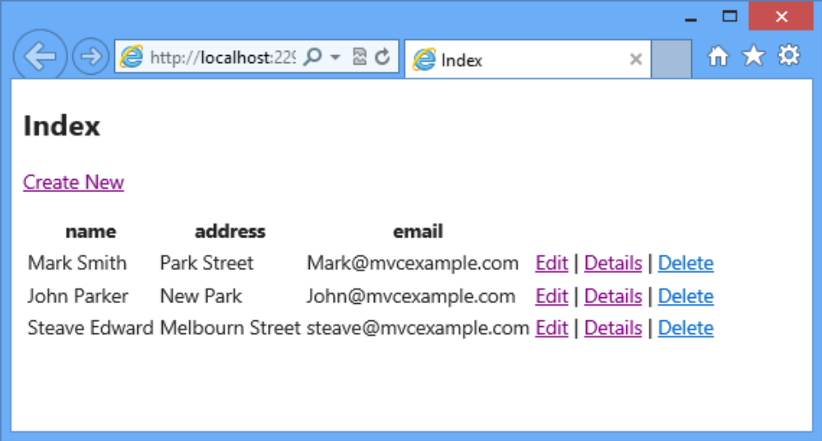
List template
6. Click Add. Visual Studio.NET automatically creates the appropriate directory structure and adds the view file to it.
Following figure shows the output of the auto-generated markup:

Slide 42
Create template
The Create template allows you to generate a view that accepts the details of a new object to be stored in a data store.
You need to create an action method, to display a view based on the Create template.
Following code shows creating an action method named, Create()in the HomeControllercontroller:
This code creates the Create() action method that will invoke when a user clicks the Createlink on the view generated using the List template.
public ActionResult Create()
{
return View();
}

Slide 43
Create template
To create a view using the Create template, you need to perform the following steps:
  1.Right-click inside the Create() action method.
  2.Select Add View from the context menu that appears. The Add View dialog box appears.
  3.Select the Create a strongly-typed view checkbox.
  4.Select the model class from the Model classdrop-down list.
  5.Select Create from the Scaffold templatesdrop-down list.
  6.Click Add. Visual Studio.NET automatically creates a view named, Create in the appropriate directory structure.

Slide 44
Create template
Following code snippet shows the auto-generated markup using the Create template:
@model MVCModelDemo.Models.User
@{ ViewBag.Title = “Create”;}
<h2>Create</h2>
@using (Html.BeginForm()) {
@Html.ValidationSummary(true)
<fieldset>
<legend>User</legend>
<div class=”editor-label”>@Html.LabelFor(model => model.name)</div>
<div class=”editor-field”>
@Html.EditorFor(model => model.name)
@Html.ValidationMessageFor(model => model.name)
</div>
<div class=”editor-label”>
@Html.LabelFor(model =>model.address)
</div>
<div class=”editor-field”>

Slide 45
Create template
@Html.EditorFor(model =>model.address)
@Html.ValidationMessageFor(model =>model.address)
</div>
<div class=”editor-label”>@Html.LabelFor(model =>model.email)</div>
<div class=”editor-field”>
@Html.EditorFor(model =>model.email)
@Html.ValidationMessageFor(model =>model.email)
</div>
<p><input type=”submit” value=”Create” /></p>
</fieldset>
}
<div>@Html.ActionLink(“Back to List”, “Index”)</div>
@section Scripts {
@Scripts.Render(“~/bundles/jqueryval”)
}

Slide 46
Create template
In this code,
  The BeginFormhelper method starts a form.
  The Html.ValidationSummary() validation helper displays the summary of all the error messages at one place.
  The Html.LabelFor() helper method displays an HTML label element with the name of the property.
  The Html.EditorFor() helper method displays a textbox that accepts the value of a model property.
  The Html.ValidationMessageFor() validation helper method displays a validation error message for the associated model property.

Slide 47
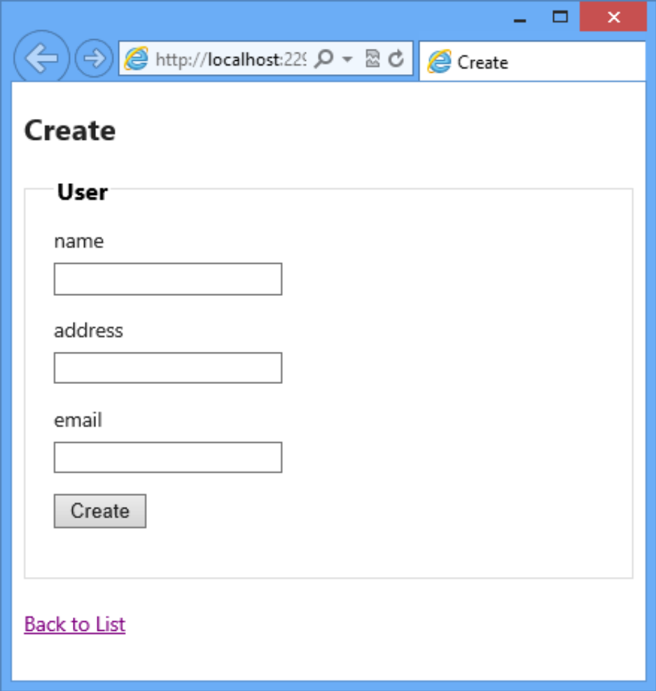
Create template
Following figure shows the output of auto-generated markup using the Create template:

Slide 48
Edit Template
The Edit template can be used whenever you want to generate a view that required to be used for modifying the details of an existing object stored in a data store.
To display a view based on the Edit template, you need to create an action method to pass the model object to be edited to the view.
Following code shows the action method named Edit()
Once you have created the Edit()action method in the controller, you can use Visual Studio.NET to create the view using the Edit template. To create the view using the Edit template in Visual Studio.NET, you need to select Edit from the Scaffold templates drop-down list.
public ActionResult Edit()
{
return View();
}

Slide 49
Edit Template
After creating a view named, Editfor the User model using the Edit template, Visual Studio.NET generates the markup for the view.
In this code, ViewData is used to display the values of the Message and CurrentTime keys.
@model MVCModelDemo.Models.User
@{ViewBag.Title = “Edit”;}
<h2>Edit</h2>
@using (Html.BeginForm()) {
@Html.ValidationSummary(true)
<fieldset>
<legend>User</legend>
@Html.HiddenFor(model => model.Id)
<div class=”editor-label”> @Html.LabelFor(model => model.name)</div>
<div class=”editor-field”>
@Html.EditorFor(model => model.name)
@Html.ValidationMessageFor(model => model.name)
</div>
<div class=”editor-label”>@Html.LabelFor(model =>model.address)</div>

Slide 50
Edit Template
  <div class=”editor-field”>
  @Html.EditorFor(model =>model.address)
  @Html.ValidationMessageFor(model =>model.address)
  </div>
  <div class=”editor-label”>@Html.LabelFor(model =>model.email)</div>
  <div class=”editor-field”>
  @Html.EditorFor(model =>model.email)
  @Html.ValidationMessageFor(model =>model.email)
  </div>
  <p> <input type=”submit” value=”Save” /></p>
  </fieldset>
}
<div>@Html.ActionLink(“Back to List”, “Index”)</div>
@section Scripts {
@Scripts.Render(“~/bundles/jqueryval”)
}

Slide 51
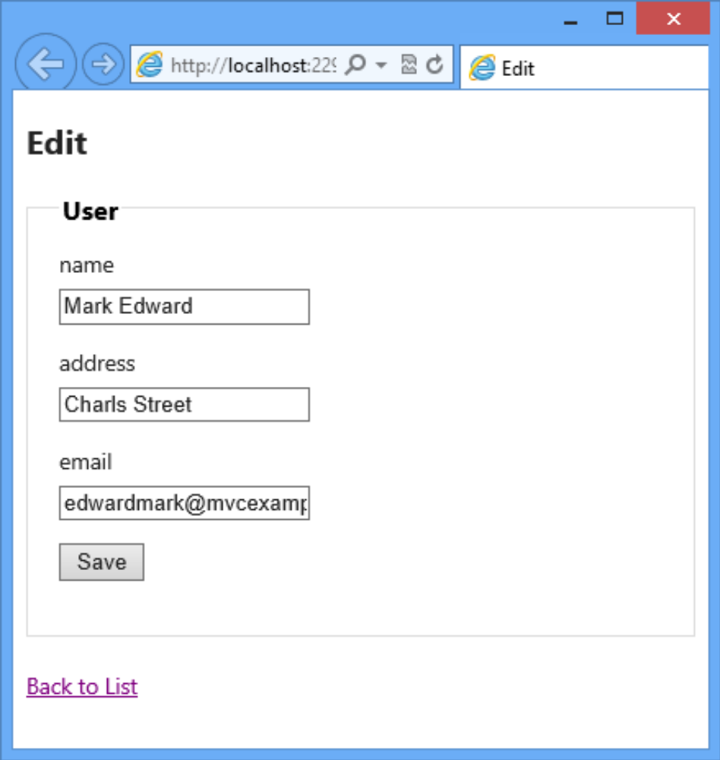
Edit template
The Html.LabelFor()helper method displays an HTML label element with the name of the property.
The Html.EditorFor()helper method displays a textbox to accept the value of a model property.
The Html.ValidationMessageFor() helper method displays a validation error message.
Following figure shows the output of creating the view using the Edit template:

Slide 52
Detail Template
The Details template allows you to create a view that displays details of the Usermodel.
Once you have created the Details()action method in the controller, and a view using the Details template in Visual Studio.NET, it generates the markup for the view.
Following code snippet shows the auto-generated markup when you create the view using the Details template:
@model MVCModelDemo.Models.User
@{ViewBag.Title = “Details”;}
<h2>Details</h2>
<fieldset>
<legend>User</legend>
<div class=”display-label”>@Html.DisplayNameFor(model => model.name)</div>
<div class=”display-field”> @Html.DisplayFor(model => model.name)</div>

Slide 53
Detail Template
In this code, the Html.DisplayNameFor()helper method displays the name of model properties and the Html.DisplayFor()helper method displays the values of the model properties.
<div class=”display-label”>@Html.DisplayNameFor(model =>model.address)</div>
<div class=”display-field”>@Html.DisplayFor(model =>model.address)</div>
<div class=”display-label”>@Html.DisplayNameFor(model =>model.email)</div>
<div class=”display-field”>@Html.DisplayFor(model =>model.email)</div>
</fieldset>
<p>
@Html.ActionLink(“Edit”, “Edit”, new { id=Model.Id }) |
@Html.ActionLink(“Back to List”, “Index”)
</p>

Slide 54
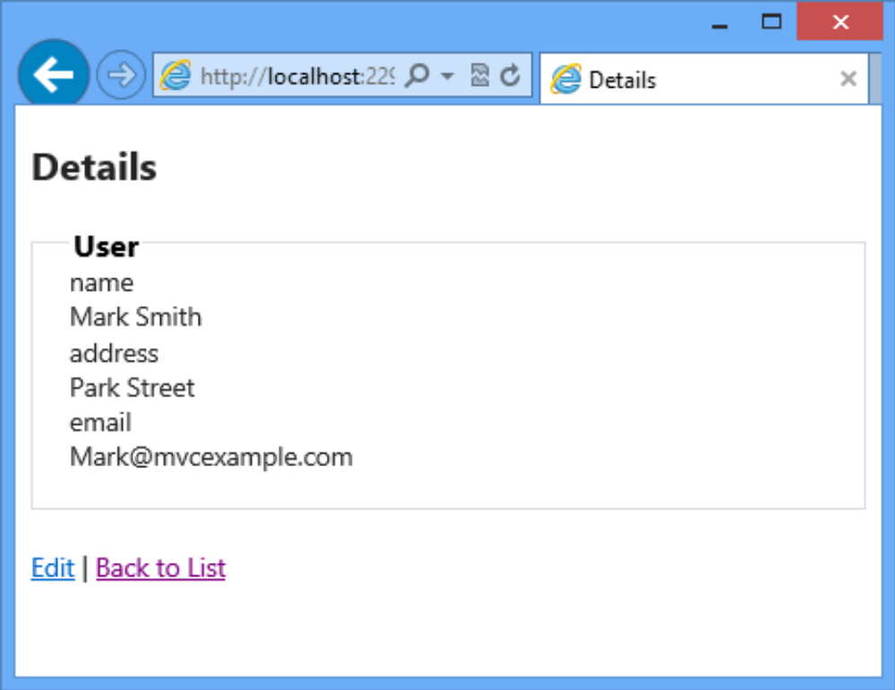
Detail Template
Following figure shows the output of auto-generated markup for Details template:

Slide 55
Delete Template
Allows generating a view that allows a user to delete an existing object from a data store.
To create a view based on the Delete template, first you need to create an action method that passes the model object to be deleted to the view.
After you create the Delete()action method, and a view for the User model using the Delete template in Visual Studio.NET, it generates the markup for the view.
Following code snippet shows the auto-generated markup when you create a view using the Delete template:

Slide 56
Delete Template
@model MVCModelDemo.Models.User
@{ViewBag.Title = “Delete”;}
<h2>Delete</h2>
<h3>Are you sure you want to delete this?</h3>
<fieldset>
<legend>User</legend>
<div class=”display-label”>@Html.DisplayNameFor(model => model.name)</div>
<div class=”display-field”>@Html.DisplayFor(model => model.name)</div>
<div class=”display-label”>@Html.DisplayNameFor(model =>model.address)</div>
<div class=”display-field”>@Html.DisplayFor(model =>model.address)</div>
<div class=”display-label”>@Html.DisplayNameFor(model =>model.email)</div>
<div class=”display-field”>@Html.DisplayFor(model =>model.email)</div>
</fieldset>
@using (Html.BeginForm()) {
<p>
<input type=”submit” value=”Delete” /> |@Html.ActionLink(“Back to List”, “Index”)
</p>
}

Slide 57
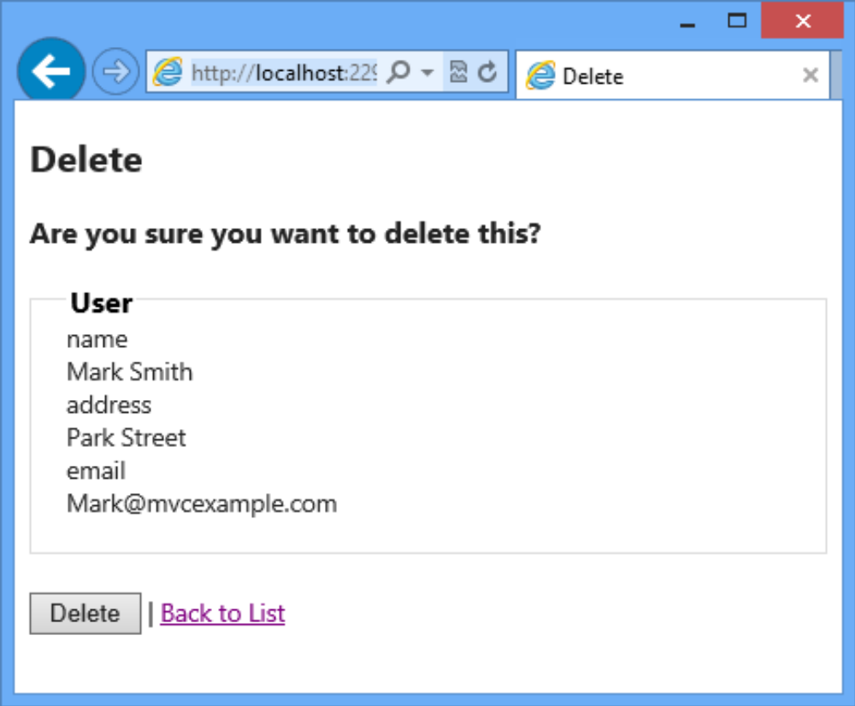
Delete Template
Following figure shows the output of creating view using the Delete template:

Slide 58
Summary
In an ASP.NET MVC application, a model represents data associated with the application. In the MVC pattern, there are three types of models, where each model has specific purpose.
The MVC Framework provides helper methods that you can use only in strongly typed views.
The process of mapping the data in an HttpRequest object to a model object is known as model binding.
The MVC Framework provides a model binder that performs model binding in application.
The ASP.NET MVC Framework provides a feature called scaffolding that allows you to generate views automatically.
Visual Studio.NET simplifies the process of creating views for an action method using the different scaffolding template.

