Slide 1
Assessing drift uncertainty
Graig Sutherland
Nancy Soontiens

Slide 2
outline
Focus on uncertainty (variance)
Windage tuning paper
Dispersion using Smagorinsky
FSLE-TReX
Nancy’s error maps

Slide 3
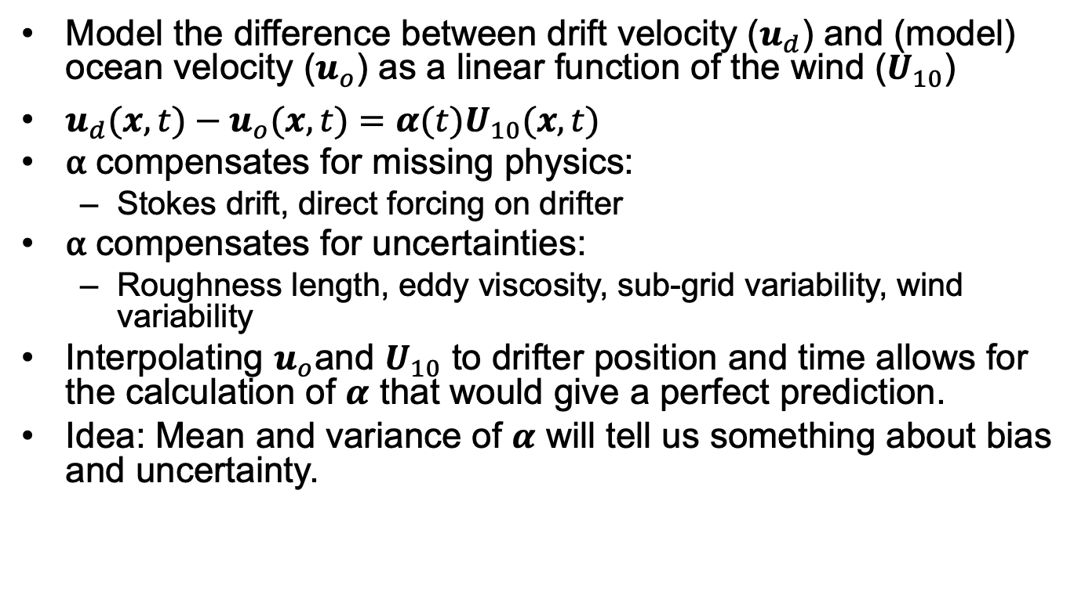
Drift modeling
Model the difference between drift velocity ($u_{d}$) and (model) ocean velocity ($u_{o}$) as a linear function of the wind ($U_{10}$)
$u_{d}(x,t)−u_{o}(x,t)=α(t)U_{10}(x,t)$
⍺ compensates for missing physics:
Stokes drift, direct forcing on drifter
⍺ compensates for uncertainties:
Roughness length, eddy viscosity, sub-grid variability, wind variability
Interpolating $u_{o}$and $U_{10}$ to drifter position and time allows for the calculation of $α$ that would give a perfect prediction.
Idea: Mean and variance of $α$ will tell us something about bias and uncertainty.

Slide 4
Drifter Release June 2018
Surface: Osker and iSphere
Intermediate: Roby and SCT
Drogued: CODE, SVP
Calculate ⍺ using two operational models
ECCC: RIOPS + GEM
METNO: NORSHELF + AROME

Slide 5
Histogram for surface drifters
Both models give similar mean and standard deviation
Mean bias is similar to other studies looking at surface drift

Slide 6
Histogram for drogued drifters
CODE has small bias (due to Stokes drift) and SVP has no bias (as expected)
Standard deviation is comparable to that of surface drifters

Slide 7
Rotary spectra osker
Calculate rotary spectra of ⍺
Energy mostly at mean due to bias and at inertial frequency
This energy at inertial frequency is most likely due to correcting errors in magnitude and/or phase of the inertial response of ocean model

Slide 8
Rotary spectra of SVP
Most energy is now near inertial frequency
Mean bias in ECCC at 15 m is in direction suggesting error in eddy viscosity

