Slide 1
Assessing drift uncertainty
Graig Sutherland
Nancy Soontiens

Slide 2
outline
Focus on uncertainty (variance)
Windage tuning paper
FSLE-TReX
Nancy’s error maps

Slide 3
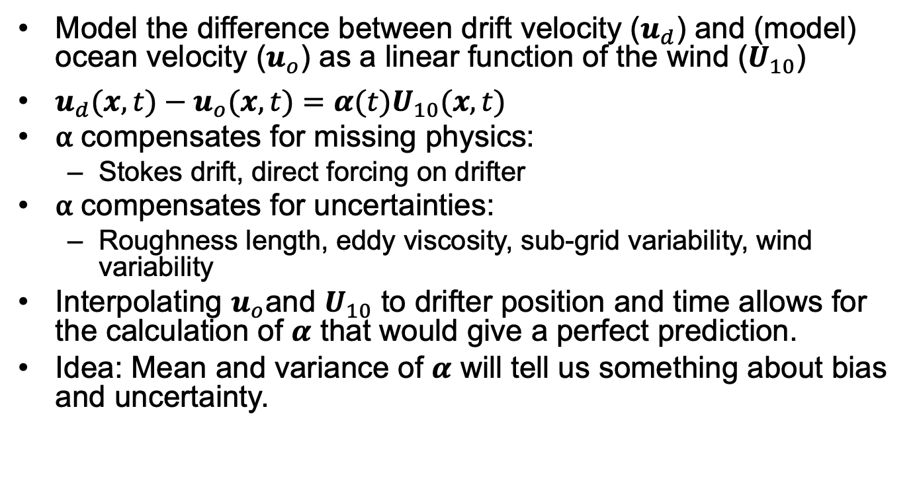
Assessing uncertainty using drifters
Model the difference between drift velocity ($u_{d}$) and (model) ocean velocity ($u_{o}$) as a linear function of the wind ($U_{10}$)
$u_{d}(x,t)−u_{o}(x,t)=α(t)U_{10}(x,t)$
⍺ compensates for missing physics:
Stokes drift, direct forcing on drifter
⍺ compensates for uncertainties:
Roughness length, eddy viscosity, sub-grid variability, wind variability
Interpolating $u_{o}$and $U_{10}$ to drifter position and time allows for the calculation of $α$ that would give a perfect prediction.
Idea: Mean and variance of $α$ will tell us something about bias and uncertainty.

Slide 4
Drifter Release June 2018
Surface: Osker and iSphere
Intermediate: Roby and SCT
Drogued: CODE, SVP
Calculate ⍺ using two operational models
ECCC: RIOPS + GEM
METNO: NORSHELF + AROME

Slide 5
Histogram for surface drifters
Both models give similar mean and standard deviation
Mean bias is similar to other studies looking at surface drift

Slide 6
Histogram for drogued drifters
CODE has small bias (due to Stokes drift) and SVP has no bias (as expected)
Standard deviation is comparable to that of surface drifters

Slide 7
Rotary spectra osker
Calculate rotary spectra of ⍺
Energy mostly at mean due to bias and at inertial frequency
This energy at inertial frequency is most likely due to correcting errors in magnitude and/or phase of the inertial response of ocean model

Slide 8
Rotary spectra of SVP
Most energy is now near inertial frequency
Mean bias in ECCC at 15 m is in direction suggesting error in eddy viscosity

Slide 9
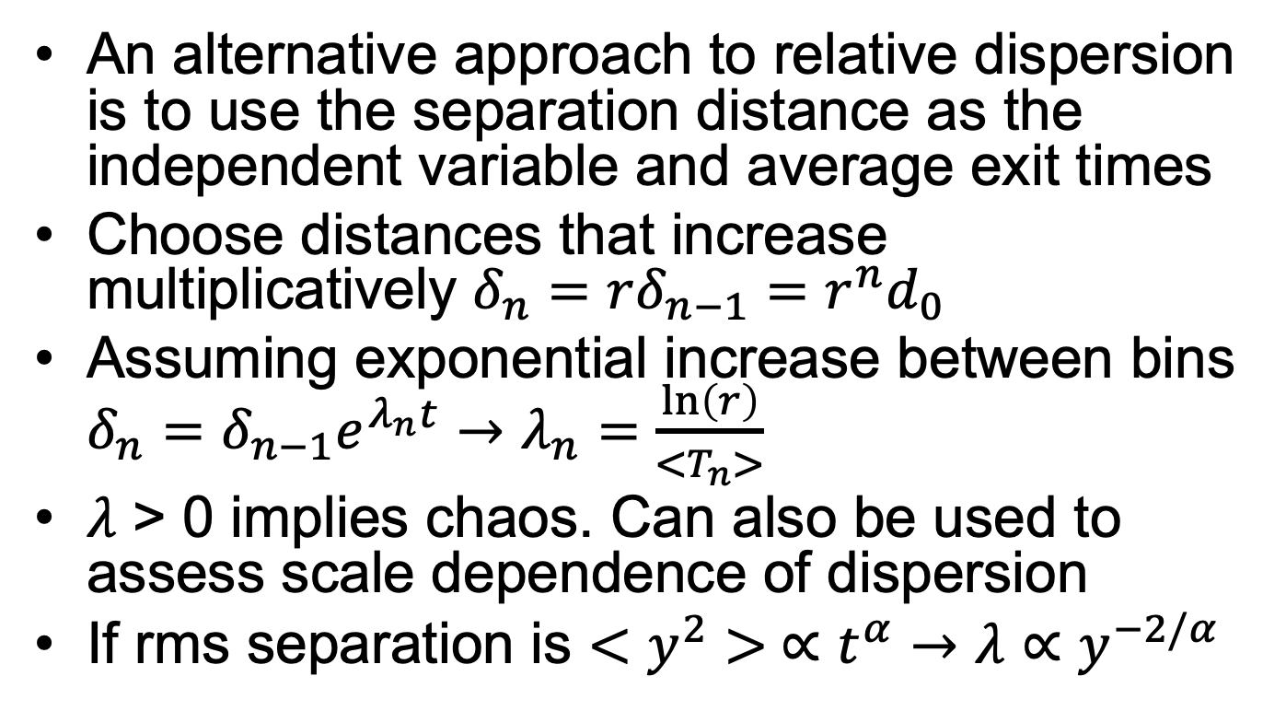
Finite Scale Lyapunov Exponent (FSLE)
An alternative approach to relative dispersion is to use the separation distance as the independent variable and average exit times
Choose distances that increase multiplicatively $δ_{n}=rδ_{n−1}=r^{n}d_{0}$
Assuming exponential increase between bins $δ_{n}=δ_{n−1}e^{λ_{n}t}→λ_{n}=\frac{\ln\left(r\right)}{<T_{n}>}$
$λ$ > 0 implies chaos. Can also be used to assess scale dependence of dispersion
If rms separation is $<y^{2}> ∝t^{α}→λ∝y^{−2/α}$

Slide 10
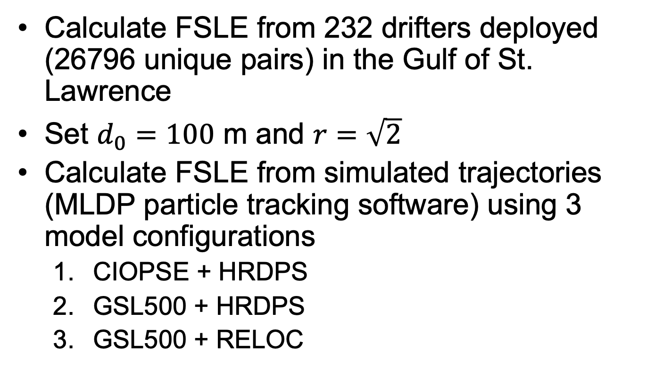
FSLE – Gulf of St. Lawrence
Calculate FSLE from 232 drifters deployed (26796 unique pairs) in the Gulf of St. Lawrence
Set $d_{0}=100$ m and $r=\sqrt{2}$
Calculate FSLE from simulated trajectories (MLDP particle tracking software) using 3 model configurations
CIOPSE + HRDPS
GSL500 + HRDPS
GSL500 + RELOC

Slide 11
FSLE: CIOPSE + HRDPS

Slide 12
FSLE: GSL500 + HRDPS

Slide 13
FSLE: GSL500 + RELOC

Slide 14
FSLE: CIOPSE + HRDPS + 2% wind

Slide 15
FSLE: GSL500 + HRDPS + 2% wind

