Slide 1
Assessing drift uncertainty
Graig Sutherland
Nancy Soontiens
Graigory.Sutherland@ec.gc.ca
Nancy.Soontiens@dfo-mpo.gc.ca

Slide 2
Introduction
The uncertainty of surface currents is important to know for many marine operations
Most abundant source of surface current data is in the form of Lagrangian drifters
Present a couple methods of assessing ocean model uncertainty with drifter data
Look at both bias and variance

Slide 3
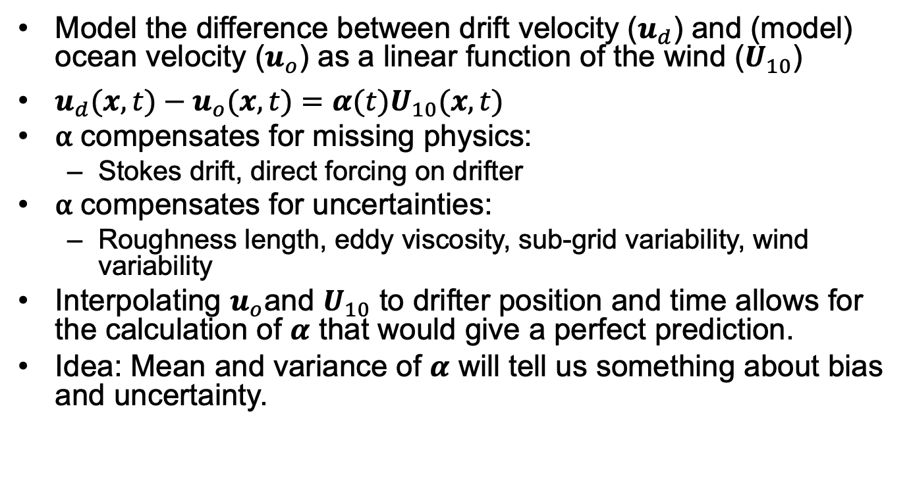
Assessing uncertainty using drifters
Model the difference between drift velocity ($u_{d}$) and (model) ocean velocity ($u_{o}$) as a linear function of the wind ($U_{10}$)
$u_{d}(x,t)−u_{o}(x,t)=α(t)U_{10}(x,t)$
⍺ compensates for missing physics:
Stokes drift, direct forcing on drifter
⍺ compensates for uncertainties:
Roughness length, eddy viscosity, sub-grid variability, wind variability
Interpolating $u_{o}$and $U_{10}$ to drifter position and time allows for the calculation of $α$ that would give a perfect prediction.
Idea: Mean and variance of $α$ will tell us something about bias and uncertainty.

Slide 4
Drifter Release June 2018
Surface: Osker and iSphere
Intermediate: Roby and SCT
Drogued: CODE, SVP
Calculate ⍺ using two operational models
ECCC: RIOPS + GEM
METNO: NORSHELF + AROME

Slide 5
Histogram for surface drifters
Both models give similar mean and standard deviation
Mean bias is similar to other studies looking at surface drift

Slide 6
Histogram for drogued drifters
CODE has small bias (due to Stokes drift) and SVP has no bias (as expected)
Standard deviation is comparable to that of surface drifters

Slide 7
Rotary spectra osker
Calculate rotary spectra of ⍺
Energy mostly at mean due to bias and at inertial frequency
This energy at inertial frequency is most likely due to correcting errors in magnitude and/or phase of the inertial response of ocean model

Slide 8
Rotary spectra of SVP
Most energy is now near inertial frequency
Mean bias in ECCC at 15 m is in direction suggesting error in eddy viscosity

Slide 9
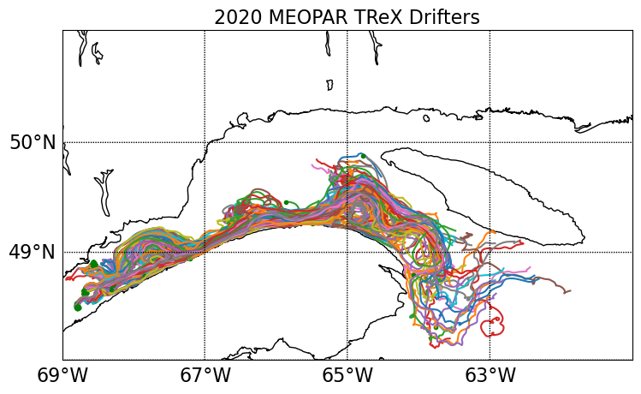
MEOPAR Trex Sept 2020
~200 drifters released in St. Lawrence Estuary
Surface: Osker, iSphere, ISMER
Intermediate: SCT, UBC
Drogued: CARTHE, CODE, iSVP
Calculate ⍺ using two ocean/atmosphere modelling systems
1/36 deg CIOPSE + 1km RELOC
500m GSL + 1km RELOC
https://meopar.ca/research/tracer-release-experiment/

Slide 10
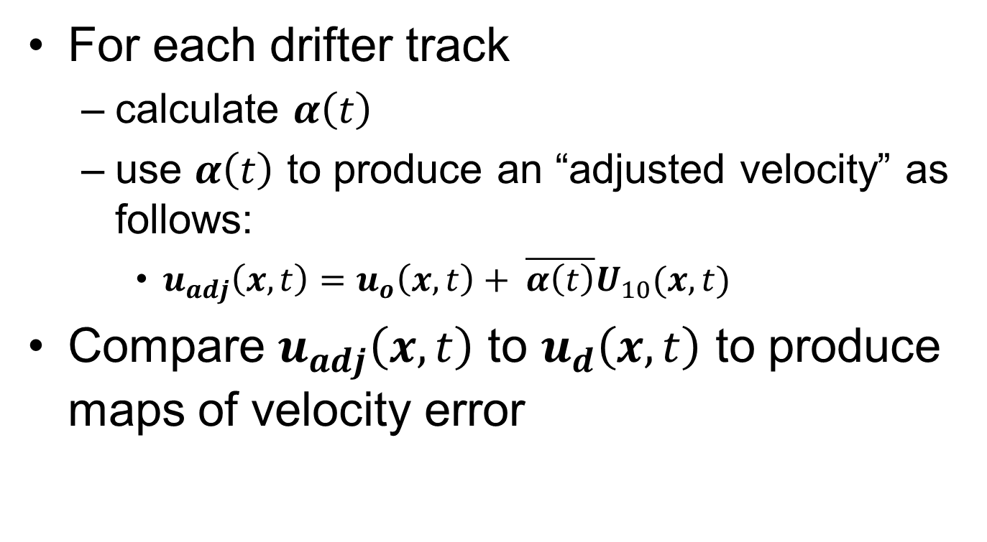
BIAS Correction
For each drifter track
calculate $α\left(t\right)$
use $α\left(t\right)$ to produce an “adjusted velocity” as follows:
$u_{adj}\left(x,t\right)=u_{o}\left(x,t\right)+ \overline{α\left(t\right)}U_{10}(x,t)$
Compare $u_{adj}\left(x,t\right)$ to $u_{d}\left(x,t\right)$ to produce maps of velocity error

Slide 11
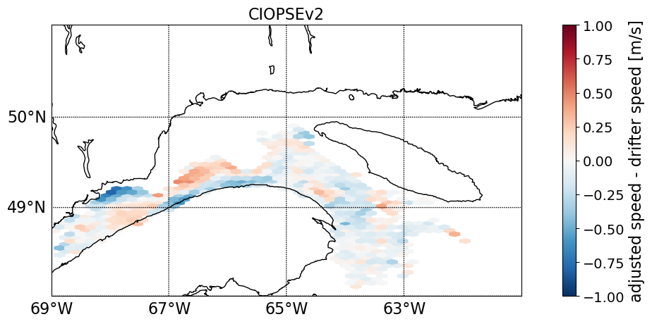
CIOPSE
Some eddies unaccounted for in model
Speeds in Gaspé current too low

Slide 12
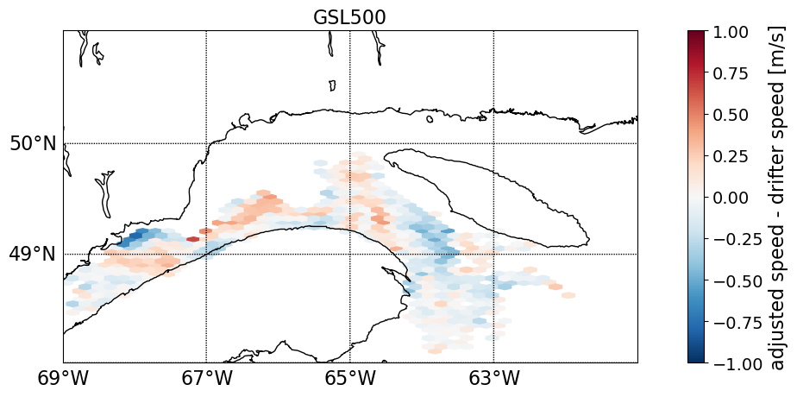
GSL500
Improvement to speeds in Gaspé current

Slide 13
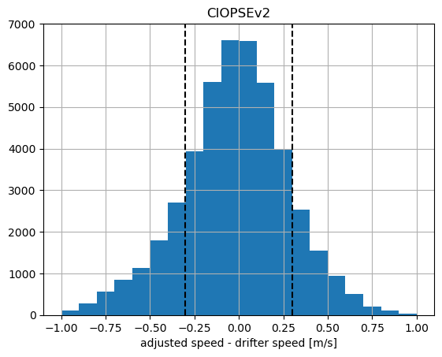
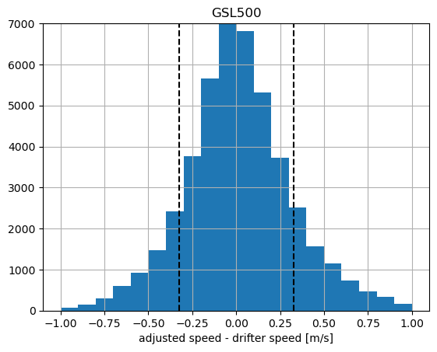



SPEED Error Histograms
CIOPSE
GSL500
$$γ^{2}=1.18$$
$$γ^{2}=1.36$$
$$γ^{2}= \frac{var(u_{adj}−u_{d})}{var(u_{d})}$$
Bias corrected speed contains high degree of variance

Slide 14
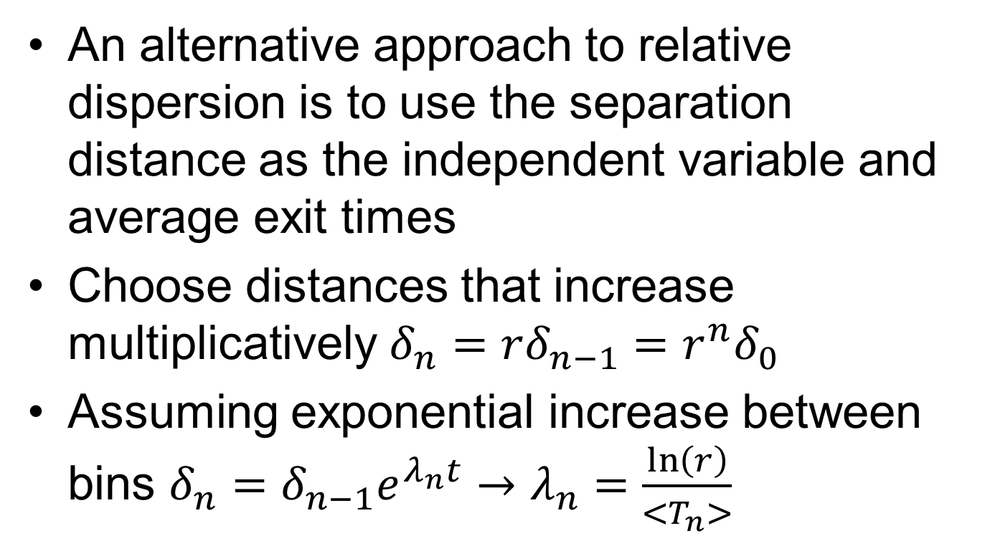
Finite Scale Lyapunov Exponent (FSLE)
An alternative approach to relative dispersion is to use the separation distance as the independent variable and average exit times
Choose distances that increase multiplicatively $δ_{n}=rδ_{n−1}=r^{n}δ_{0}$
Assuming exponential increase between bins $δ_{n}=δ_{n−1}e^{λ_{n}t}→λ_{n}=\frac{\ln\left(r\right)}{<T_{n}>}$

Slide 15
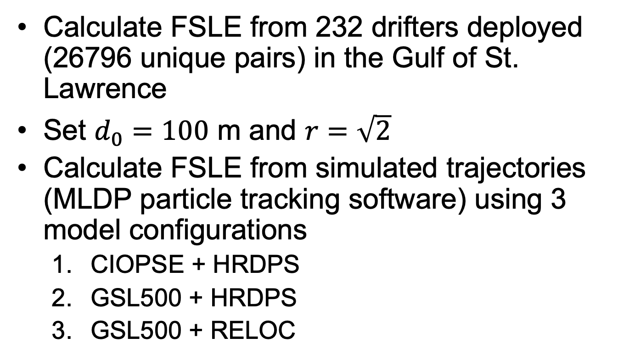
FSLE – Gulf of St. Lawrence
Calculate FSLE from 232 drifters deployed (26796 unique pairs) in the Gulf of St. Lawrence
Set $d_{0}=100$ m and $r=\sqrt{2}$
Calculate FSLE from simulated trajectories (MLDP particle tracking software) using 3 model configurations
CIOPSE + HRDPS
GSL500 + HRDPS
GSL500 + RELOC

Slide 16
FSLE: CIOPS + HRDPS
0% windage
2% windage

Slide 17
FSLe: GSL500 + HRDPS

Slide 18
FSLE: GSL500 + RELOC

Slide 19
Summary
Estimate model uncertainty using different types of drifters
Calculate a bias correction as a linear function of the wind
FSLE represent scale dependent dispersion
Higher resolution models improve dispersion at larger scales

