Slide 1
Door Peep Hole Camera with Facial Recognition
By: Daniel Wild

Slide 2
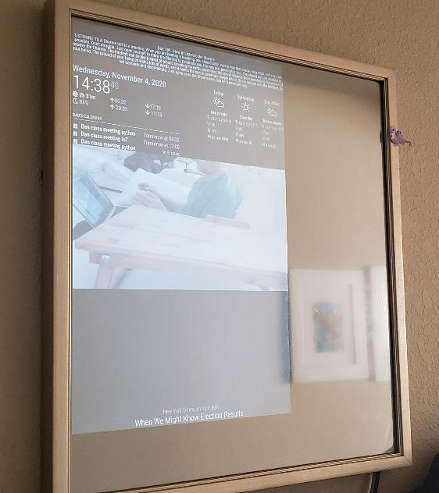
Project Requirements
- Functioning Raspberry Pi based Magic Mirror
- Second Raspberry Pi
- PIR Motion Sensor
- Red LED
- Green LED
- 6 jumper wires
- Raspberry Pi Camera module
- 2 330 Ohm resistors
- Internet and functioning wireless LAN setup
- Cardboard for camera module and egg carton for LED module.
PLEASE VIEW NOTES FOR DETAILS!!!
Notes:
This project requires that a user has an already functioning Magic Mirror based on the platform and modules located at: https://magicmirror.builders/
Soldering of LEDs is optional, but does add some aesthetic value to the project.
Password protection of SMB server and the Raspberry Pi(s) are recommended but beyond the configuration scope of this build tutorial.

Slide 3
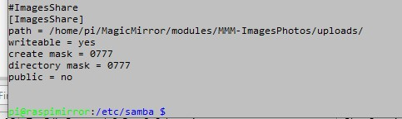
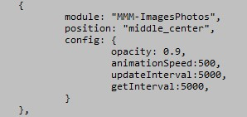
Setup Samba Server on Magic Mirror
Install the module MMM-ImagesPhotos using directions from the readme at (https://github.com/roramirez/MMM-ImagesPhotos)
Place some pictures in the uploads folder of the MMM-ImagesPhotos upload directory to verify functionality
Install Samba on the Magic Mirror from terminal (sudo apt install samba)
Use Vim or nanao to edit Samba config file located at /etc/samba/smb.conf
Magic mirror config.js
SAMBA config
Notes:
Installing the modules can be frustrating, because the configuration file is very finicky. The config file for the magic mirror is located at ~/MagicMirror/config/config.js
Edit it with vim or nano to add the module config information. Especially important is to set the Update interval and the Get interval. Update interval adjusts the time that pictures are shown and Get interval determines how long it waits until it checks the directory for file changes. Setting at 5000 is equivalent to 5 seconds
Samba file share setup should create a file share from the uploads folder in the Magic Mirror module, if you do not want to set up a password, then set public = yes
After configuring the Samba server, you must enable it at terminal (sudo systemctl enable smbd)

Slide 4
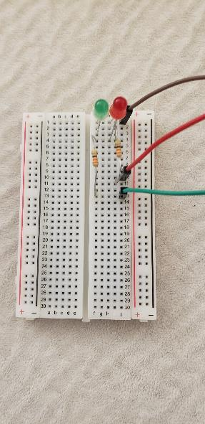
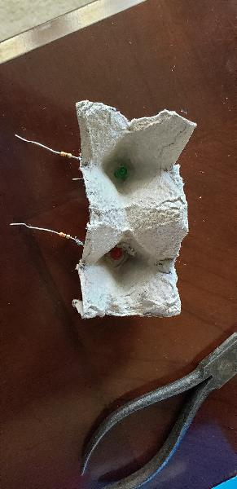
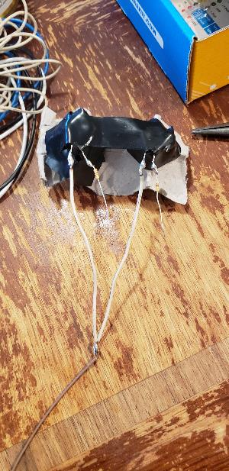
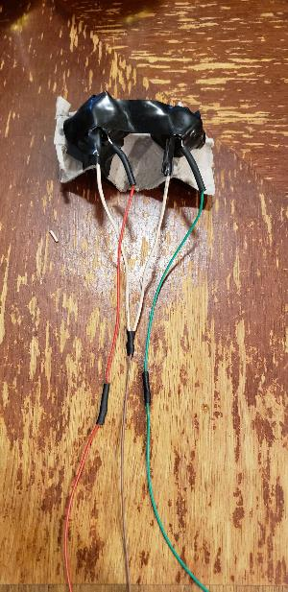
Setting up the LEDs for Light module
Notes:
Prototype the LED setup using a breadboard placing the LEDs with a common ground and individual 330 Ohm resistors leading to an input. Test this using some basic Python Code using the gpiozero module to import LEDs and set them up to light up or flash.
After prototyping and ensuring functionality, optionally cut 2 holes in an egg carton to create light reflectors and solder 330 Ohm resistors to the positive side of each LED. Then solder the grounds to a common wire by splicing them together. Use heat shrink tubing and electrical tape to insulate the soldered connections.

Slide 5
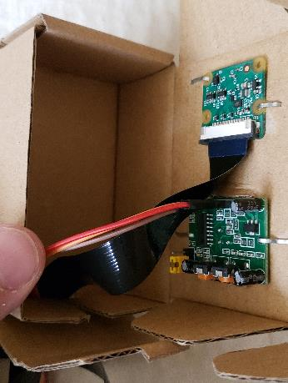
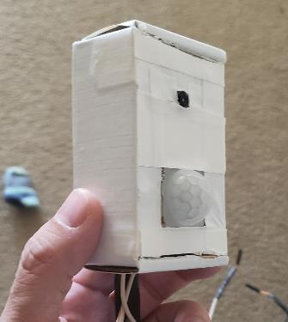
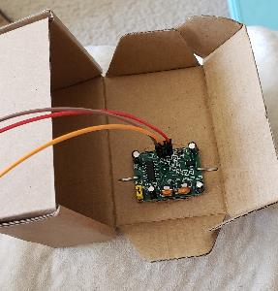
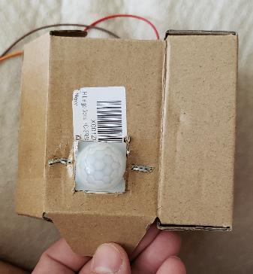
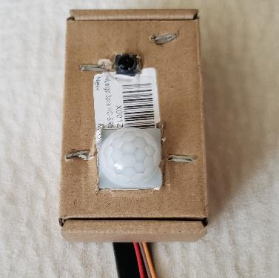
Build Camera and Motion Module
PIR stapled in place of cutout
Front View
Front View
Decorated Camera Module
Camera module stapled in place of next cutout
Notes:
Using a small cardboard box, make 2 cutouts to accommodate the motion sensor and the camera. These can be fixed in placed with staples or small nuts and bolts. Feed the ribbon cable and wires out of the box through a slit in the box. Duct tape makes cleaning up and decorating easy!

Slide 6
Sign up for Microsoft Azure
Sign up for a Microsoft Azure account
(https://azure.microsoft.com/en-us/)
Sign in to the portal and create a cognitive services resource for Face API
Select either free service or standard (standard bills $1 per 1000 API calls) but free is limited to 20 calls per min and 35k per month
Locate and save the Endpoint and one of the API secret keys
Notes:
After creating an Azure account, sign in to the portal and click on the create resource at the top left of the screen.
On the next screen type Face in the search box to find the Face API.
On the Face API page, click create and follow the prompts, you can create a resource group here for the service if you don’t already have one, but make sure that names are unique.
Select the appropriate region that is closest to your location.
Then select a pricing tier. Initial sign ups get a credit so I recommend the standard tier so you don’t have to worry about API calls being rejected because of time constraints.
After creating the resource look for the API key and End point url, you will need this for the code portion.

Slide 7
Create Folders
Create directories on Door Raspberry Pi named: ~/PiDoorCamera
and ~/PiDoorCameraApp and ~/PiDoorCameraApp/data
Put a copy of family pictures in ~/PiDoorCameraApp/data with naming convention of family*.jpg (family0.jpg, family1.jpg, family2.jpg, etc...)

Slide 8
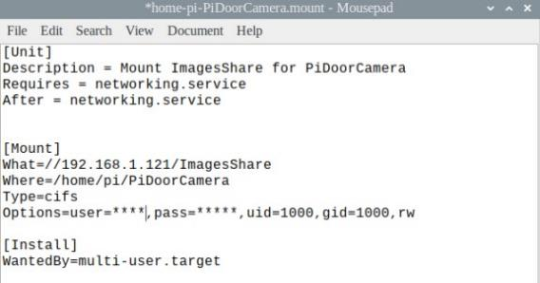
Setup Auto-mount in Door Raspberry Pi
There are several ways to accomplish this based on your comfort level with Linux.
Ensure that the SMB share from the Magic Mirror are auto-mounted after every restart.
Make sure that you have the proper permissions to copy and delete files to the file share from the Door Raspberry Pi
Notes:
One of the easiest ways to auto-mount in linux is to make use of the mount file type in SystemD. This avoids messing with the FSTAB file.
Create a file in the //etc/systemd/system/ directory with .mount following the name you choose. Remember the name because you have to enable it though systemctl later.
Ensure that you replace the *** with the user name and password you set up with you created the share on the magic mirror. Delete those parts if you are making a share that is public. Make sure the IP address matches the IP for your Magic Mirror.
Following file creation, open a terminal and type:
sudo systemctl enable mountfilename.mount
Make sure after reboot, that the upload directory from the Magic Mirror is mounted to the ~/PiDoorCamera directory

Slide 9
Install Azure module in Python
- Install the Azure Module for python
pip install azure-cognitiveservices-vision-face
- Optionally install AI fundamentals from github:
git clone https://github.com/MicrosoftDocs/ai-fundamentals
- There are a few Jupyter notebooks that are interesting to play around with to understand the functionality of the different cognitive services available from Azure
- The notebook that teaches the fundamentals that are helpful for this tutorial is:
01d- Face Analysis.ipynb
Notes:
The essential part of this step is to do the pip install of azure-cognitiveservices-vision-face
Depending on your setup, you may have to install some other non-essential modules for the code provided here to work.

Slide 10
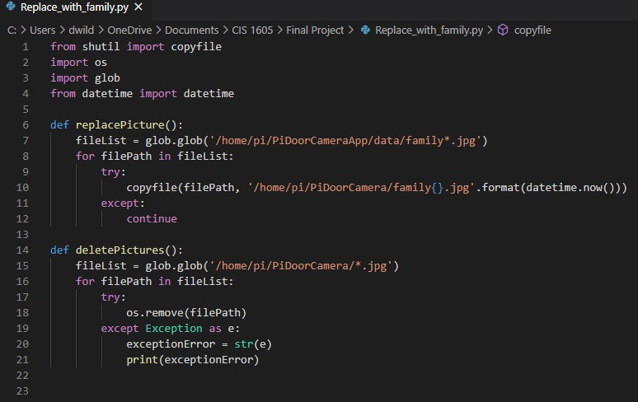
Test code for Replacing family pictures
Notes:
This program only has functions, test each one by adding the name of the function followed my ().
For example:
replacePicture()
Or
deletePictures()

Slide 11
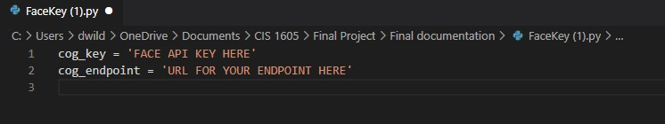
Create Program to Hold Keys
Notes:
Create this program to obscure your API Key and Endpoint. Insert your personal information here.
NOTE: Face API supplies 2 Keys, but you only need one, you can choose whichever one you want, the second is just for redundancy to provide high availability in case you need to re-provision your keys

Slide 12
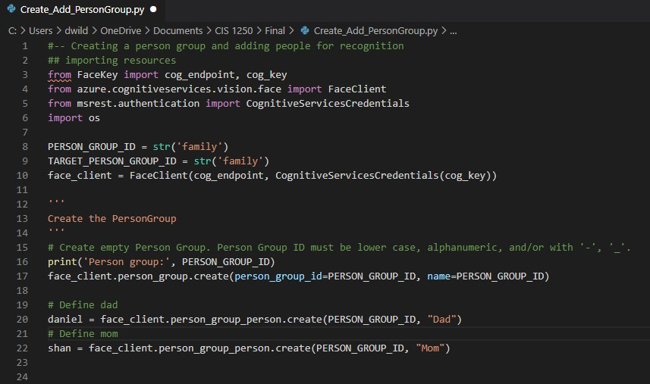
Create Person Group
Notes:
Next is to create a person group named family and members named dad and mom.
Add other members as you need for your project.

Slide 13
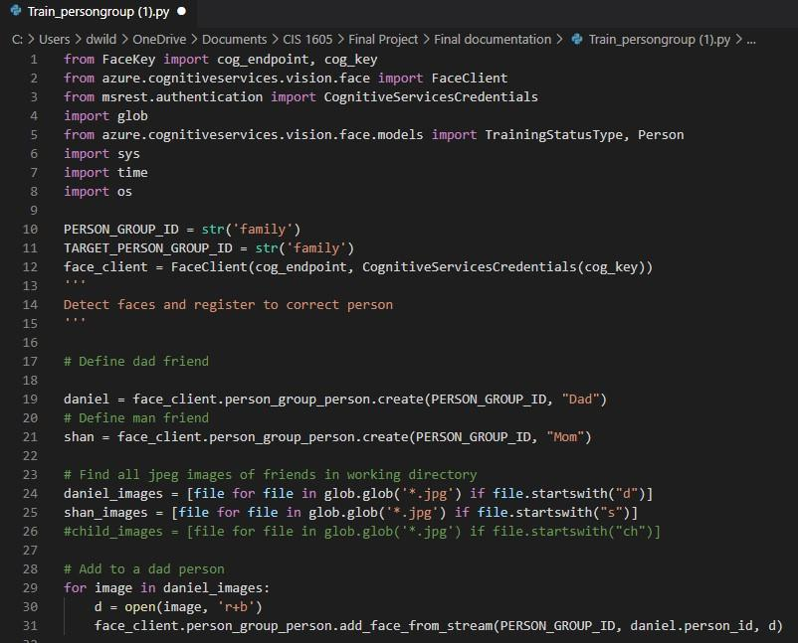
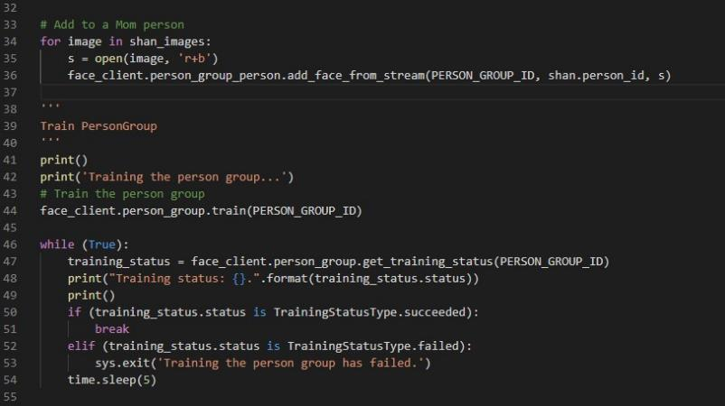
Train person group
Notes:
Create this program and retain to train your person group. Ensure that files start with appropriate naming convention to make sure that files are picked appropriately.
Files must be placed in the directory where the program is located and named according to the convention in the program. In this case, all pictures in the dad group start with “d” and all in the mom group start with “s”. Also the training will fail if there is not a recognized face in the picture.
Best practice are well lit pictures with varying angles and only a single person in the picture.
Run the program and it will print out if if succeeded or had an error. You can repeat as many times as you want. Best results will require at least 10-15 pictures per person.

Slide 14
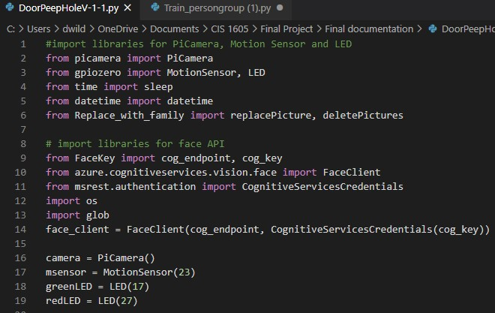
Main Program Code part 1
Notes:
This is the initial import portion of the program and setting of GPIO pins to the correct ones.
PIR needs to have 3 wires set, 1 to a ground pin, 1 to a 5V pin and 1 to a GPIO pin (in this case I have it set to 23).
LEDs need to have the common ground attached to another ground pin. The red LED needs a GPIO(27in this setup) and the green LED needs to be attached to a GPIO(17 in this setup).

Slide 15
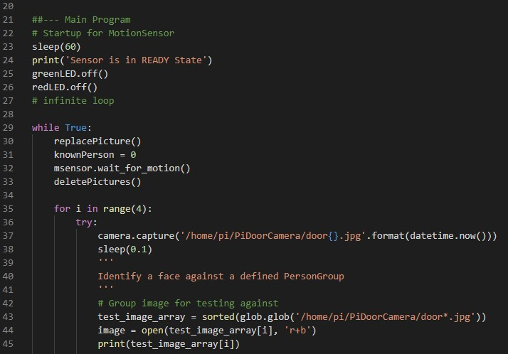
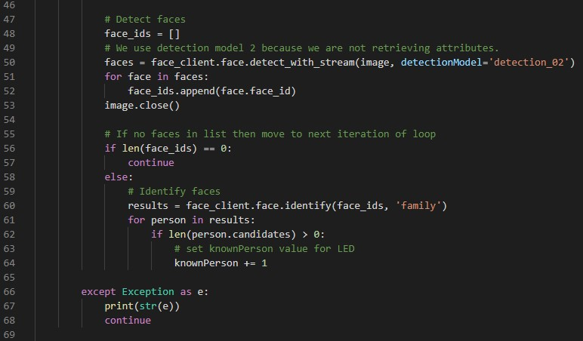
Main Program part 2
Notes:
Next portion of code is the Main loop

Slide 16
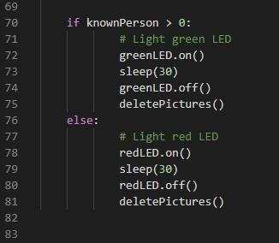
Main Program part 3
Notes:
Last part of the code sets an LED to light for 30 seconds and then resets the loop.

Slide 17
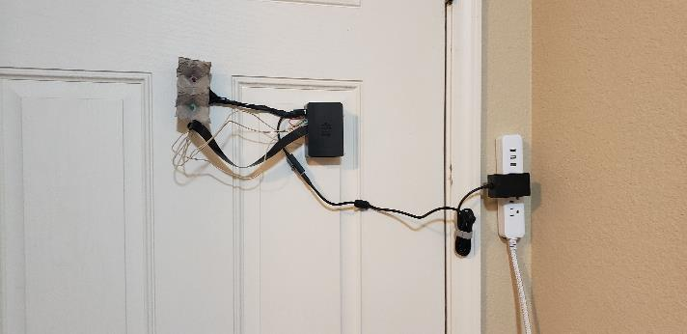
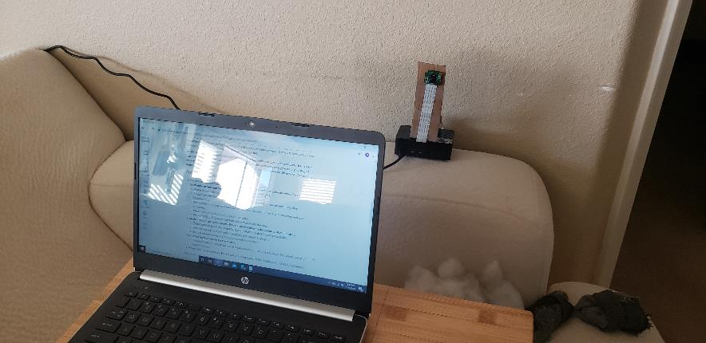
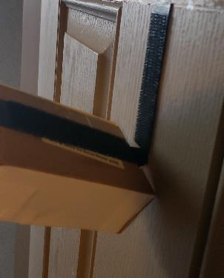
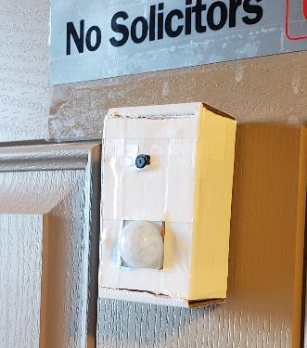
Verify Face API functionality
Notes:
Now for the exciting part! The bench test! Set up the Camera module and Light module anywhere you want and run the program. Test functionality by using your computer connected to VNC to the Door Raspberry Pi and also to the file share on the Magic Mirror. As the PIR engages and detects motion, Pictures that are taken should be replacing the pictures on the Magic Mirror.
It is important to create unique filenames each time the family pictures are replaced as the mirror module caches the pictures and if the names match, you will have duplicate pictures. Using Datetime allows for a unique naming convention everytime.
Once you have determined full functionality of the system, you can start dry mounting the modules on the door.

Slide 18
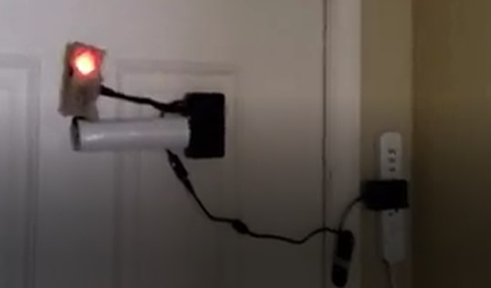
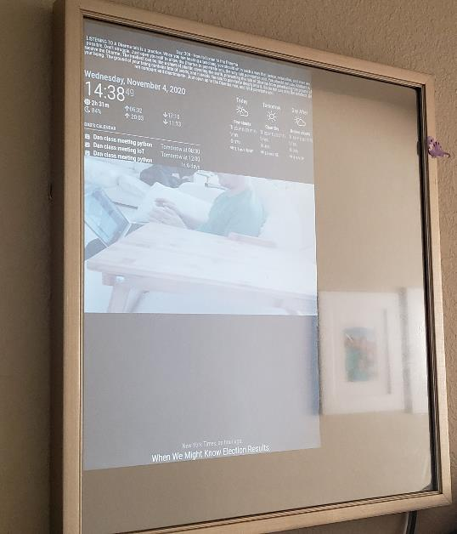
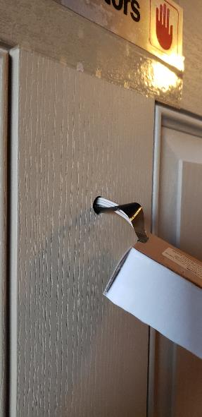
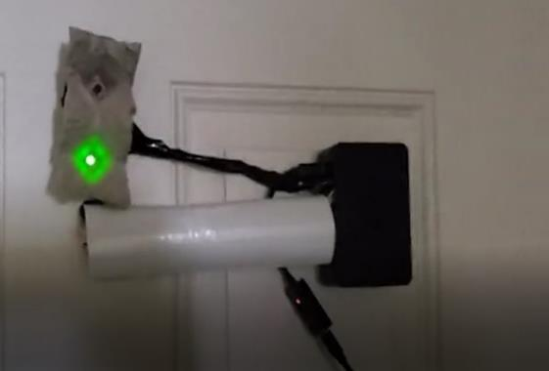
Install and test
Notes:
An old paper towel roll or cardboard and duct tape can be used to clean up the cables for a smoother look. The ribbon cable can be bent slightly to assist in feeding through the peephole.
I used command strip velco to attach all the modules.
Finally test the functionality by starting the program and walking up to the door. The PIR has a 60 sec warm up time which is built into the program at start before the main loop. Sensitivity can be adjusted on the motion sensor itself to a degree.
On successful install, you should see pictures taken on motion detected and then those pictures displayed on the magic mirror and the appropriate light will turn on for 30 seconds. After the light turns off, the pictures displayed on the mirror will return to default pictures.

Slide 19
Issues
- Adjusting existing Face API python code to work with local images instead of the default web-based lookups.
- Compensating for the low light in my entryway.
- False motion readings from cold windy day.
Notes:
The tutorials available for the python-based Face API were limited in scope, for instance looking up images from stream(local files) was not very well explained, so adjustments had to be made from the url-based lookup code.
The low light in my entryway is an issue I have had for some time, but was a consistent issue in testing the final project. This was overcome by standing farther away, which still allowed the camera to properly identify me.
The cold windy day caused many false motion readings on my PIR, even with the sensitivity turned all the way down, even passing cars on the street were detected. Not that much of an issue, as it did give me an outside view from the pictures. The biggest downside is that it locks out the recognition during those periods of false positives.

