Slide 1
Approximation Solution
By: Abdallah Derbala & Nick Spokes

Slide 2
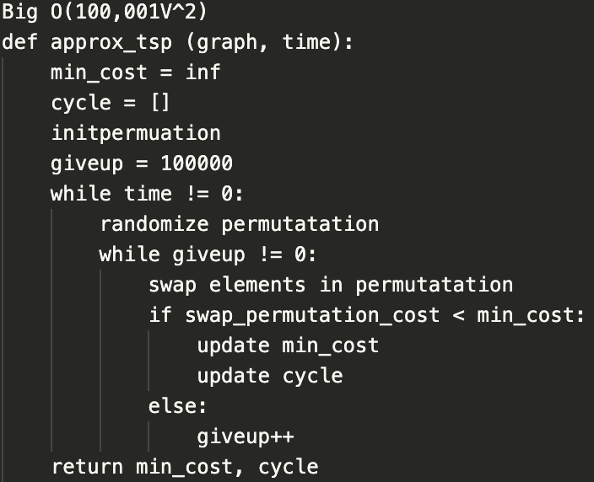
Pseudocode:

Slide 3
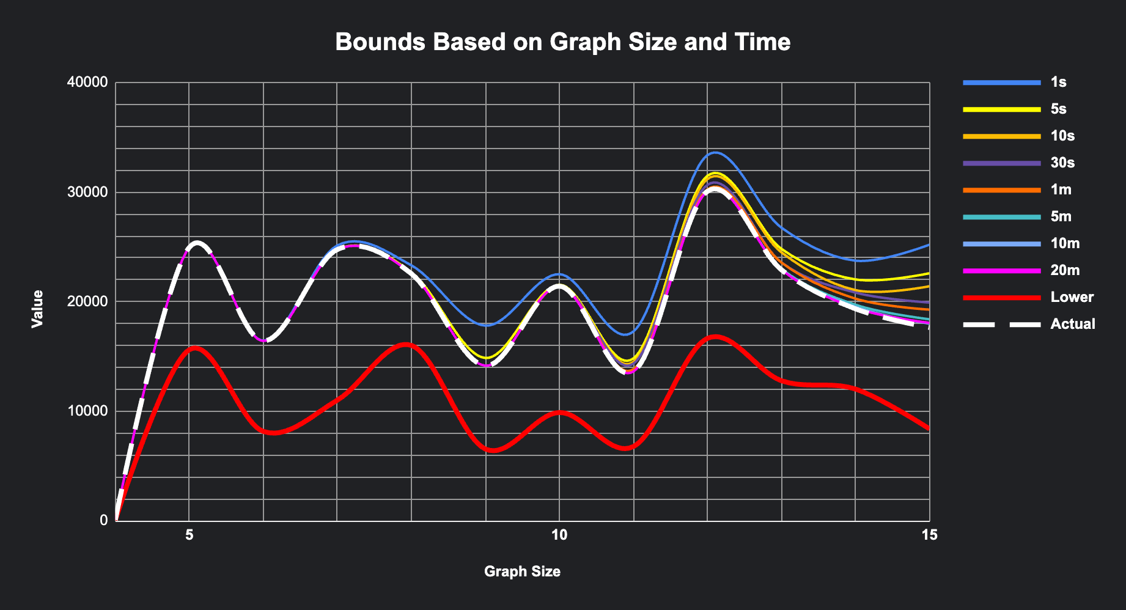

Slide 4


Do you remember…
AND

Slide 5
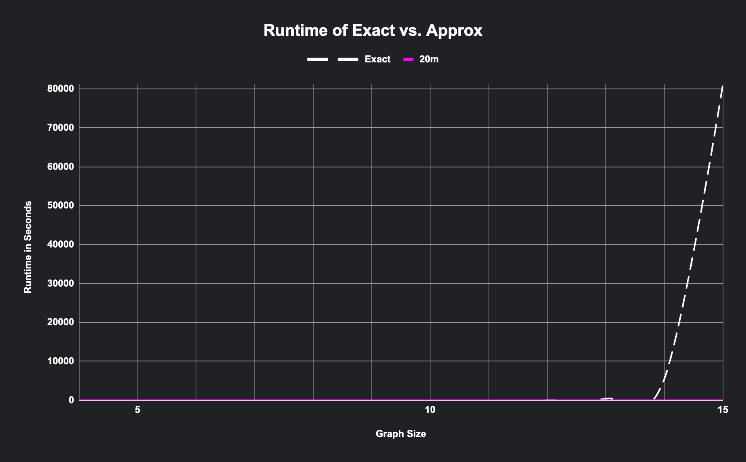

Slide 6
Source:
https://towardsdatascience.com/how-to-solve-travelling-salesman-problem-with-simulated-annealing-c248447a8bcd

