Slide 1
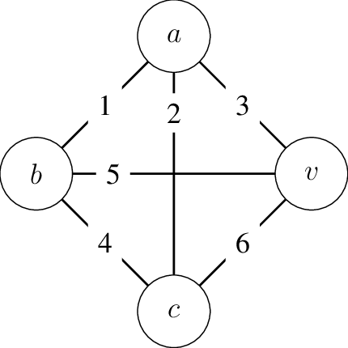
Traveling Salesman Problem (TSP)

Slide 2
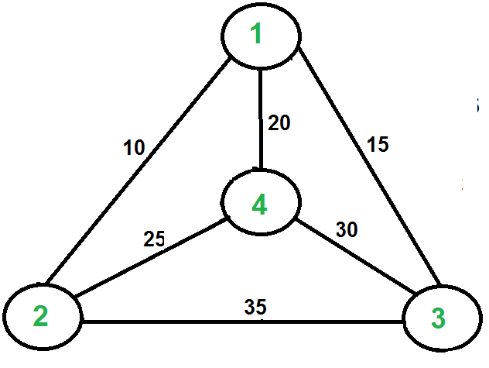
Description
Hamiltonian (Simple) Cycle - Cycle that visits each vertex once
TSP - Find the Hamiltonian Cycle with the least cost
Graph is:
Weighted
Weights > 0
Undirected
Complete

Slide 3
In other words…
Decision being made
Given a graph and a cost k, is there a Hamiltonian cycle whose cost is ≤ k?
Can be proved in polynomial time
Optimization performed
What is the Hamiltonian cycle with the least cost?
Can NOT be proved in polynomial time

Slide 4
Wait why?
Logistics
Delivery routes
Planning
Order picking
Circuit board manufacturing
It takes time to drill different size holes
When to drill which size?
DNA sequencing
Order of nucleotides in DNA

Slide 5

Reduction
Hamiltonian Cycle ≤_{P} TSP
From graph G = (V, E), construct G′ = (V′, E′)
Copy vertices from G to G′ → V′ = V
Copy edges from G to G′ with weight 0
Edges not in G are created in G′ with weight 1
Traverse G′ with DFS along edges
Is there a cycle whose cost k == 0? If so…
There’s a Hamiltonian Cycle in G
There’s a solution to TSP in G′ with length ≤ 0
**Can be done in polynomial time
TSP ∈ NP Complete

Slide 6
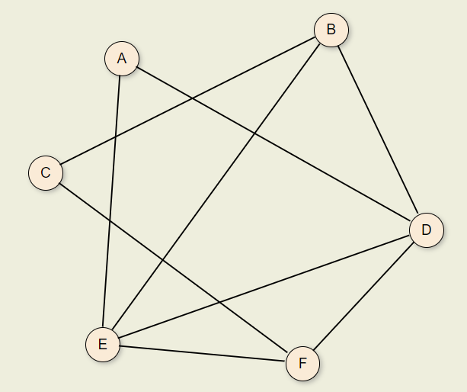
Reduction Example: Part 1
Image credit: Virginia Tech OpenDSA

Slide 7
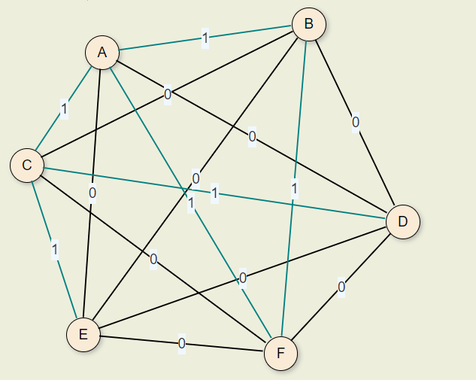
Reduction Example: Part 2
Image credit: Virginia Tech OpenDSA

Slide 8
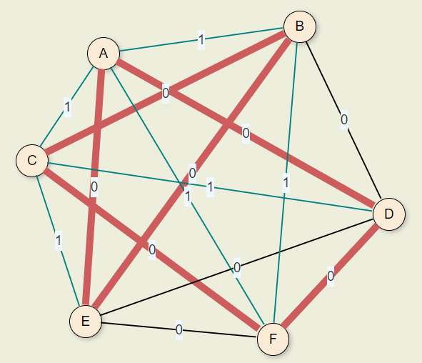
Reduction Example: Part 3
Image credit: Virginia Tech OpenDSA

Slide 9
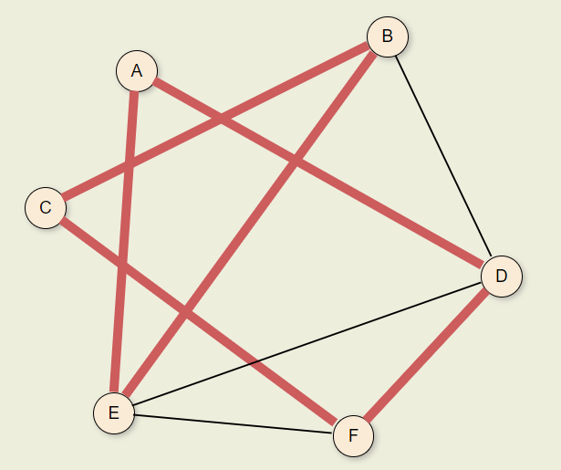
Reduction Example: Part 4
Image credit: Virginia Tech OpenDSA

Slide 10


Input & Output
In
Out
==

Slide 11
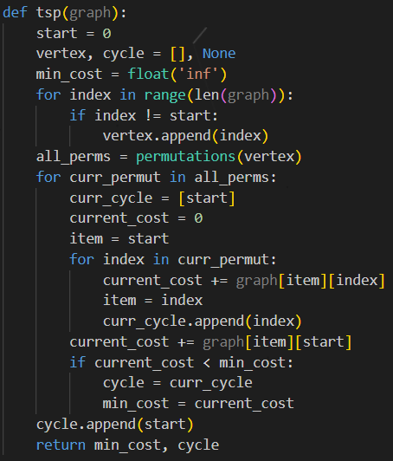
Exact Solution
Find all permutations of vertices that are not the starting point
Iterate through permutations to find the optimal path
Find cost & path of the current permutation
Keep track of the best cost & path
Append start to path again and return results
1
2
a
b
3

Slide 12
Runtime
1
O(V)
O(V!)
O(V)
O(1)
O(1)
O(V + V! * V) O(V!)
2
a
b
3

Slide 13
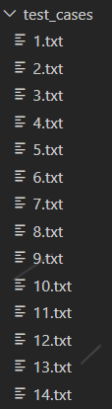

Testing
Python script was used to generate individual test cases with random numbers
Based on number of vertices
Shell script used to execute each test case over long periods of time
Output directed to text file
Another Python script used to compile the data to a CSV
Data manually inspected and copied to master CSV

Slide 14


Slide 15
Approximation Solution

Slide 16
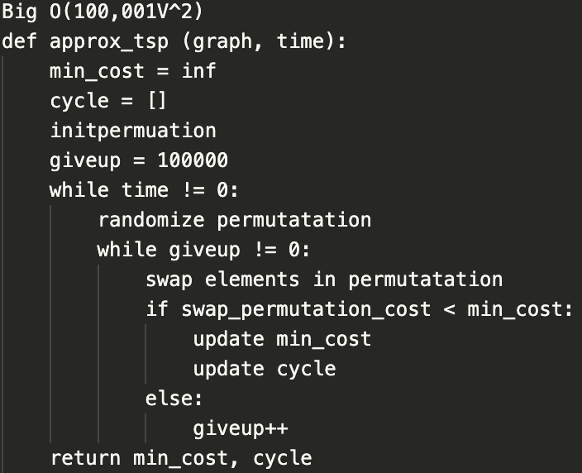
Pseudocode:

Slide 17
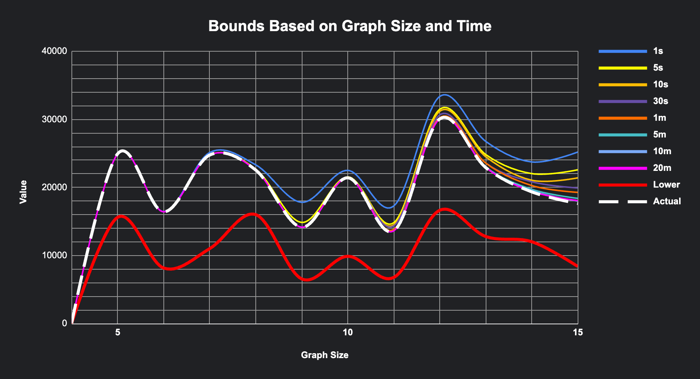

Slide 18


Do you remember…
AND

Slide 19
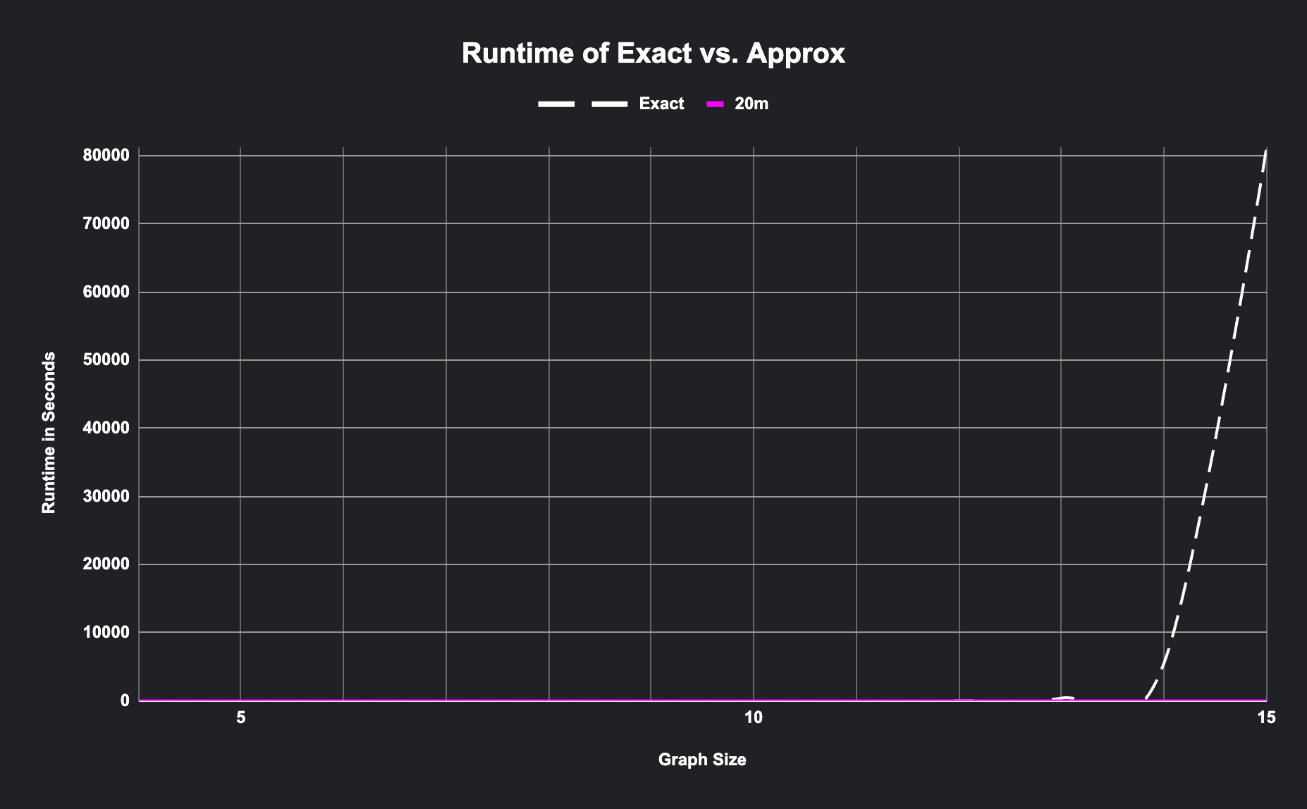

Slide 20
Sources
https://www.guru99.com/travelling-salesman-problem.html
https://www.rodhilton.com/2012/09/14/traveling-salesman-the-most-misunderstood-problem/
https://opendsa-server.cs.vt.edu/ODSA/Books/Everything/html/hamiltonianCycle_to_TSP.html
https://towardsdatascience.com/how-to-solve-travelling-salesman-problem-with-simulated-annealing-c248447a8bcd

