Slide 1
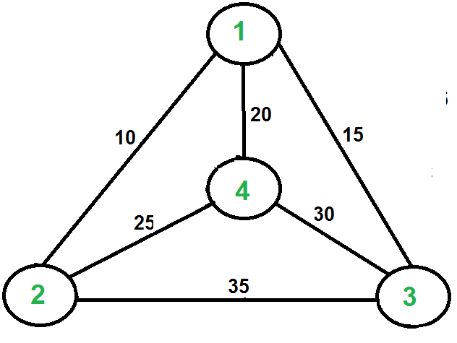
Traveling Salesman Problem (TSP)

