Slide 1
Network Security Tutor & Quiz Agent
Alekhya Reminisetti R11965201
Rishitha Sana Vanapalli R11967143
Madhan kommi R11969820
Yeswanth Naidu Anchuri R11982094
Hari Krishna Cherukuri R11978051
Manideep Thogiti R11934465
Sundar Sodadasi R11971977
Anusha Triveni Maddina R11979105

Slide 2
Project Overview
Our project is an offline, privacy-focused AI learning system.
It lets users upload their study documents and then provides:
Interactive Q&A tutoring using locally-run agent
Document-based answers with citations
Auto-generated quizzes (MCQ, True/False, Open-ended)
Quiz Grading
Fully local processing
The system is built using:
React (frontend)
FastAPI (backend)
Ollama (local LLM)
ChromaDB (local vector database for document search)

Slide 3
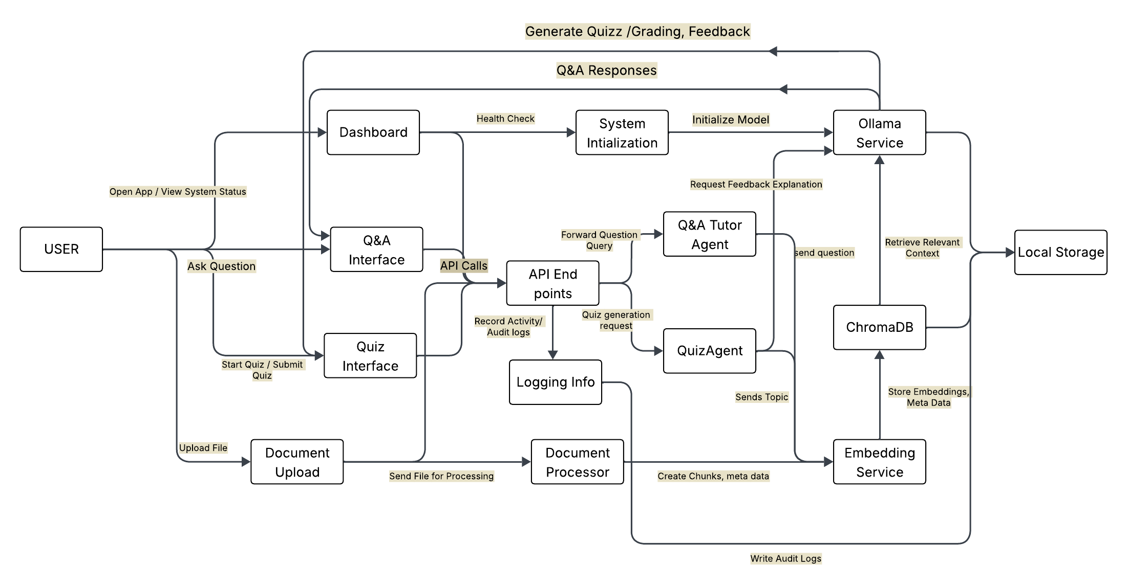
System Architecture

Slide 4
Tech Stack
React.js : Frontend UI for Q&A, quizzes, document uploads
FastAPI (Python) : Backend for processing, retrieval, and orchestration
Ollama (Local LLM): Runs llama3.2:3b fully offline for Q&A, quizzes, and explanations
SentenceTransformers (all-MiniLM-L6-v2) : 384-dim embeddings for documents, queries, and grading
ChromaDB : Local vector database storing embeddings and metadata

Slide 5
Features
AI-Powered Tutoring
  Answers network-security questions with accurate, context-based explanations
  Provides citations from uploaded documents
Document-Based Learning
  Upload PDFs, PPTX, DOCX, TXT
  System extracts, chunks, embeds, and uses them for Q&A and quizzes
Automated Quiz Generation
  Generates MCQs, True/False, and Open-Ended questions
  Covers key topics and random quiz
Smart Quiz Grading
  Grades MCQ/T-F directly
  Grades open-ended answers using semantic similarity
  Gives constructive feedback using the LLM

Slide 6
Security Features
Privacy-First Design
  Runs fully offline : no cloud, no external API calls
  All embeddings, logs, and documents stay on the local machine
Logging & Monitoring
  Tracks system activity and user interactions
  Stores audit logs securely for debugging and analysis

Slide 7
Conclusion
The system includes an interactive dashboard that lets users easily navigate Q&A, quizzes, and document uploads.
We designed a user-friendly quiz module that auto-generates MCQs, True/False, and open-ended questions.
The Q&A module provides accurate, document-based answers along with Q&A logs for tracking and review.
All data processing including LLM inference and embeddings, runs fully locally, ensuring strong privacy.
Using Wireshark, we verified that the system makes no external network calls, confirming true offline behavior.
Overall, the project delivers a secure, efficient, and interactive learning platform for network security students.

