Slide 1
(Gist of) Nested SHAP layers

Slide 2
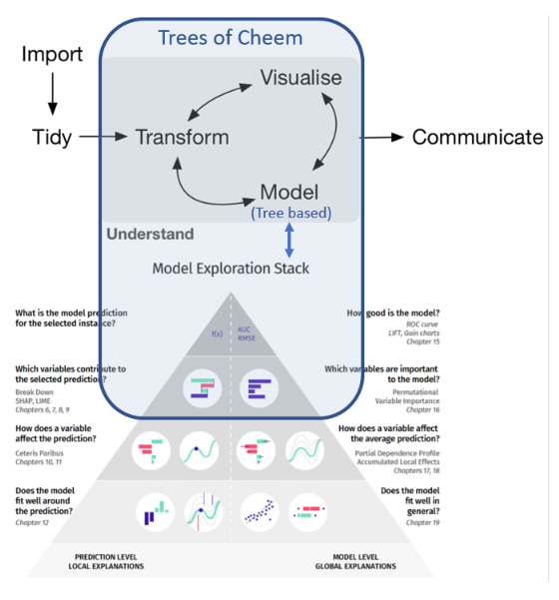
Context
Previously have been working on multivariate data vis in general.
Now getting a into a more specific area; multivariate features and interpretation to agnostic black box models
(top) Wickham, H. & Grolemund, G. (2016). R for data science
(bottom) Biecek P. & Burzykowski T. (2020). Explanatory Model Analysis
(Blue overlay) our work in terms of workflow and specificity

Slide 3
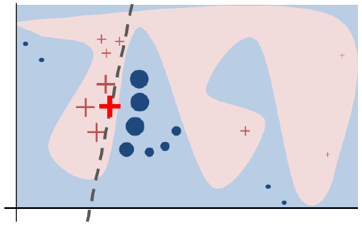
Local Attributions & SHAP
Local Attributions – given arbitrary model, the variable weights at one location, traditionally 1 observation.
There are a number of flavors of Local Attribution: LIME, Deep_lift, SHAP, We’ll be applying SHAP.
Ribeiro, M. et. al. (2017). Why Should I Trust You? (“LIME paper”)

Slide 4
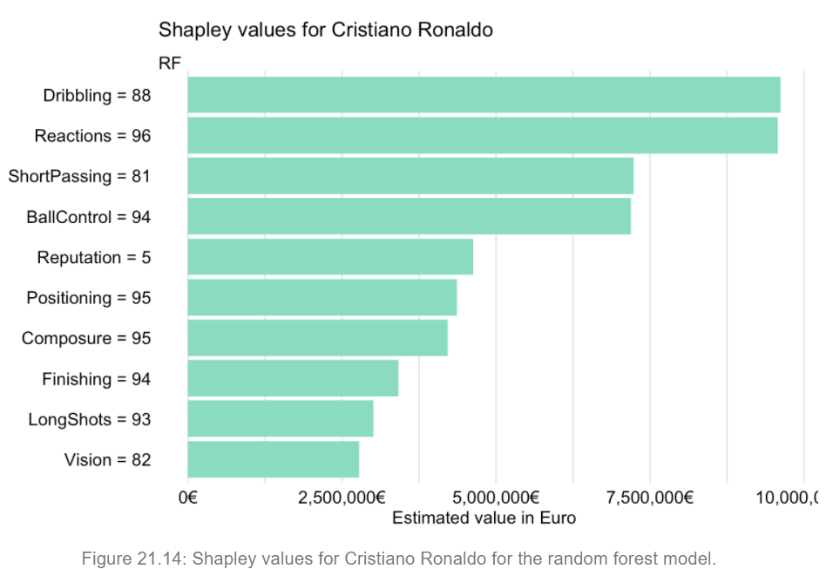
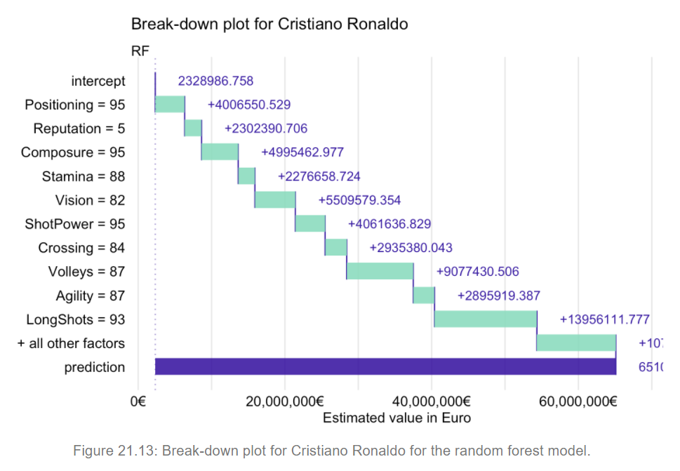
SHAP workflow
X, preprocess(raw_data) ## multivariate data [n*p]
M, model Y~X, predict Y given data
SHAP_i = SHAP(M, new_observation = Xi)
[1, p] row weighting of variables as they contribute
Bicek, P. & Burzykowski, T. (2020). Explanatory Model Analysis (Book)

Slide 5
Iterate over rows: “SHAP data frame”
shap_df_of(X, Model){ ## back to [n, p] for (i in 1:n)
SHAP_df[i, ] <- SHAP(Model, X_i) }

Slide 6
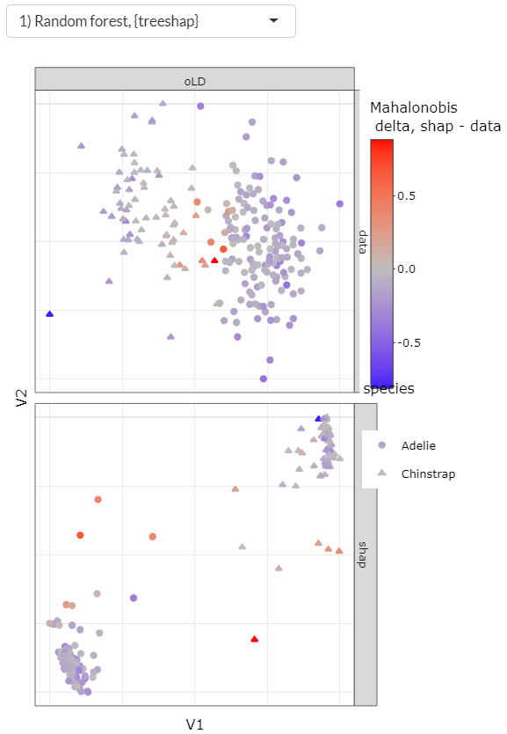
Example – Palmer Penguins
Data and shap spaces are [n*p]
View a 2D approximation of p-dim space, the Orthonormal Linear Discriminant of the species.
Color by the difference in Mahalonobis distances; maha(shap) – maha(data)
blue – more an outlier in data space
grey – a dense member
red – more an outlier in SHAP weight space

Slide 7
An aside, quantifying sensitivity of SHAP obs
Extract the Mahalonobis distances of data and SHAP spaces
Create ordered quantile-quantile plots/data frames
Fit a polynomial/exponential model fit, finding the best fit magnitudes of the spaces.
Compare the power/exponent of shap- relative to data-space.
Keep in mind the Y is distribution of Mahalonobis distances, a measure of outlierness, this feels like it would probe the sensitivity of data and shap spaces.

Slide 8
Wait a minute….
Same dimensions
More separable
…
Profit?
Improved model performance?

Slide 9
Appendix: SHAP performance and tree based SHAP

