Slide 1


Trees of Cheem
https://tardis.fandom.com/wiki/Tree_of_Cheem
Dr. Who, Series 1,
Episode 2, The End of the World
Font Awesome
<i class="fas fa-medal"></i>
<i class="fas fa-tree"></i>

Slide 2
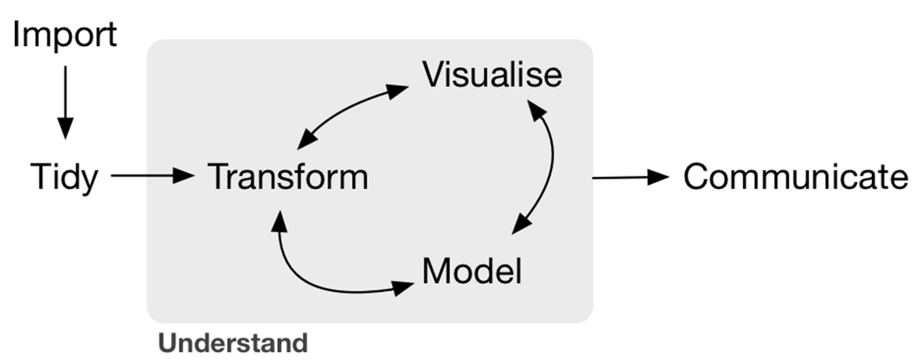
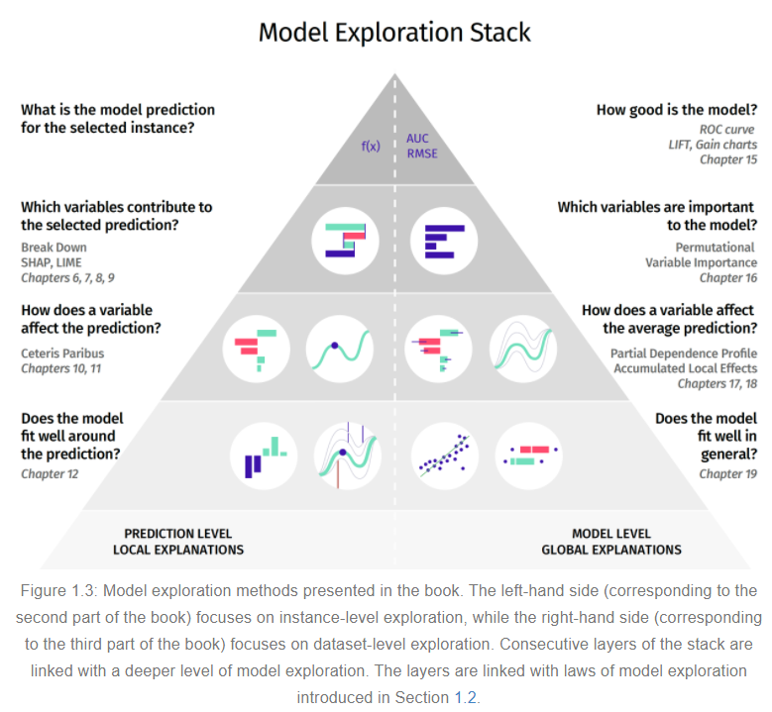
Trees of Cheem
(Tree based)
(top) Wickham, H., & Grolemund, G. (2016). R for data science. https://r4ds.had.co.nz/
(bottom) Biecek P. & Burzykowski T. (2020). Explanatory Model Analysis. http://ema.drwhy.ai/
(blue) proposed, Spyrison, N. & Doogan, C.

Slide 3
Tour work flow suppose data, X[n,p], ~ p > 20, n > p
Normal
Transform
Apply PCA, embed first q PC
Tour q-space
MEDAL
Transform
PCA & embed, suggesting q dim
Explore tours and tSNE while varying q
Trees of Cheem
Transform
Apply, PCA/OLDA; p-dim space
Fit tree based model
Use Perm Imp & SHAP to suggest q dim
Explore tours and tSNE while varying q

Slide 4
Trees of Cheem
Transform
Apply, PCA/OLDA; p-dim space
Fit tree based model
Use Perm Imp & SHAP to suggest q dim
Explore tours and tSNE while varying q

Slide 5
Appendix slides after

Slide 6
Wickham, H., & Grolemund, G. (2016). R for data science. https://r4ds.had.co.nz/
counter clockwise arrows added.

Slide 7
pyramid exists only after working ML model; what about before that.
Running models takes a long time.
Many models use some sort of PCA initialization, but just default to some static number of PCs. Rtsne defaults to the first 50
What is idd<50? You miss out on reduced run times
What if idd>50?
{Rdimtools} has a suite of 17 `est_*` that predict the Intrinsic data dimensionality (idd), let’s use these to initialize the dim to start a stepwise tour.
Take this value, create a stepwise tour based on variance explained, in the previously suggested dim.
Start your EDA here.
Biecek P. & Burzykowski T. (2020). Explanatory Model Analysis. http://ema.drwhy.ai/

Slide 8
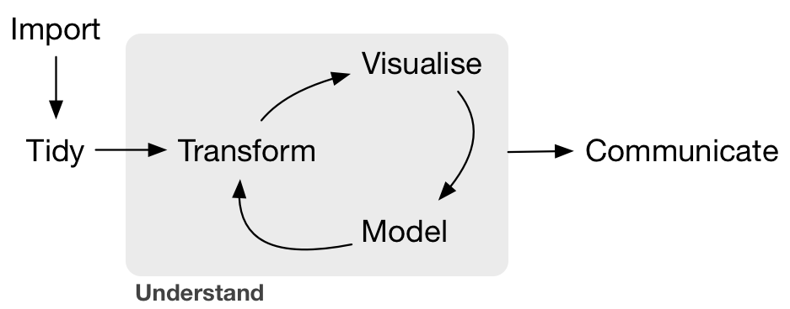
ML EDA, MEDAL
(top) Wickham, H., & Grolemund, G. (2016). R for data science. https://r4ds.had.co.nz/
(bottom) Biecek P. & Burzykowski T. (2020). Explanatory Model Analysis. http://ema.drwhy.ai/
(blue) proposed, Spyrison, N. & Doogan, C.

Slide 9
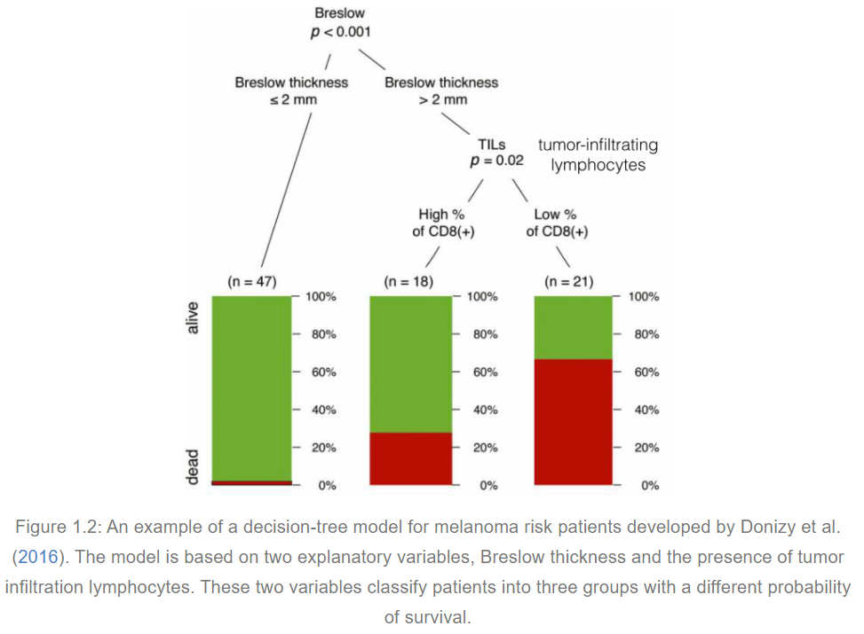
Biecek P. & Burzykowski T. (2020). Explanatory Model Analysis. http://ema.drwhy.ai/

Slide 10
Layout – ML EDA
Input data, pre-processing step, summarize, select target variables
Use {Rdimtools} to estimate the internal data dimensionally, idd^
Create a stepwise tour; initialize pca/olda-space and basis, display at p = idd^, as part of ensemble graphics[Unwin, 2018] for EDA before ML.
Step wise tour -> local tour/grand tour, tsne or umap, PC density, etc.
Tooltip pointing back to observations in the original data space
Options for occlusion, k2Density, alpha~1/density, etc.
Export
Embedded PC-space
Preprocessed data
ensemble graphics

Slide 11
Tab 1) Input (.csv, .rds, .rda)
-DT table, see gallery example:
--include buttons,
--target factor button
--summary or head of data
-Force remove NA rows, with message, # and percent% obs removed.
-scale_sd(default), scale_10
-sphere data
Tab 2) PCA & stepwise tour
- Benchmark prcomp and alternative?
- Scree plot and scree table
- Permuted PC importance? → suggested number of PC (how long of a wait, how many permutations?)
- Initial dimensionality for vis with interpretation of %var, and % of dimensionality
- Histograms w/ rug?
- Stepwise tour
Tab 3) Vis [in PC space] (all as plotly? Vega?)
~This feels like Liminal, make sure to explore that.
Global or local tour?
TSNE (force load last? Include hyperparameters)
Tab 4) Output
- PC space, (list storing what elements? Output format RDS?)
- Some tour offering output to .gif or self-contained HTML. What graphics and res? May be prohibitively hard to host a remote {gifsky} generation
- Current Basis?
- tSNE with hyperparameters
Tab 5) About
- Context and scope
- Try to rationalize and explain some of the ideas
- Use video?

Slide 12
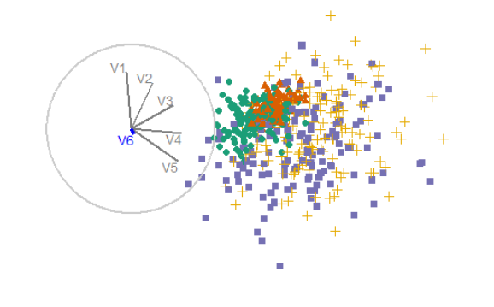
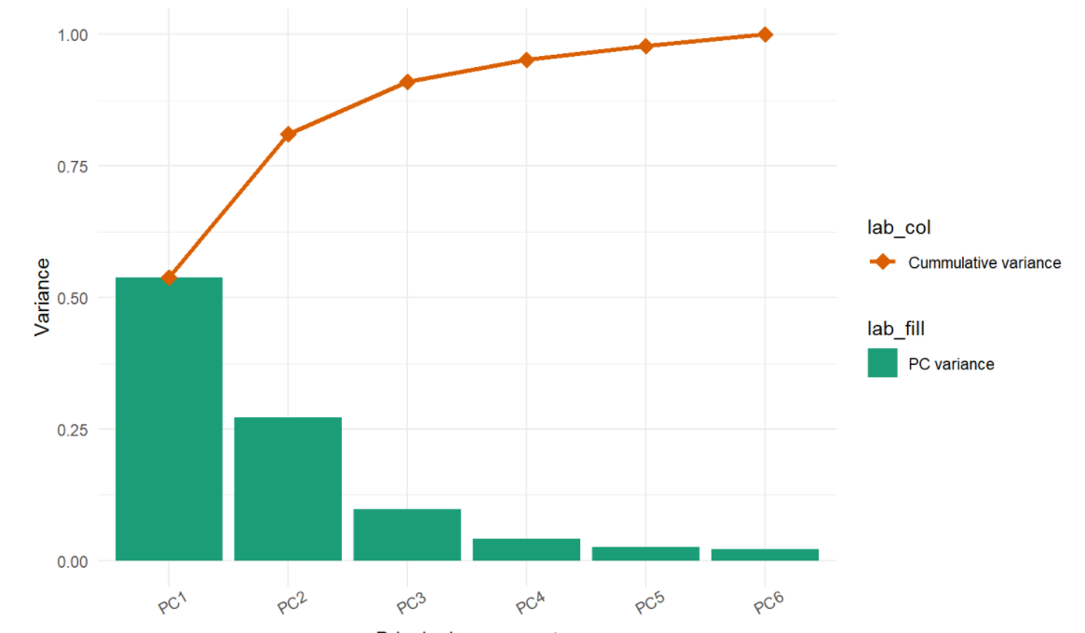
Sketch for stepwise tour
< Remove next variable
Add next variable >
Interaction: radially add or remove the next lowest component based on the defined univariate function
Purpose: explore the marginal change of adding/removing next variable
Setup: produce scree table, find all basis removing latest variable. This ensures you go back to exactly where you were
Limitation: the marginal cost/benefit of the variable is contingent on the starting basis.
In the context of XAI (explainable AI)?

Slide 13
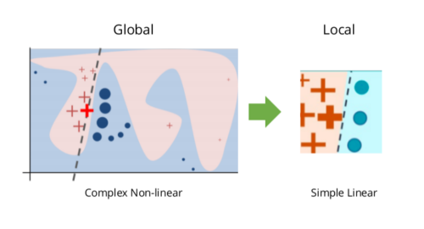
Concern – abstraction from LIME?
local interpretable model-agnostic explanations (LIME) [Peltola, 2018], is a popular, new technique for examining observations in non-linear models.
Do we lose this interpretability if we embed in PC/OLDA-space upfront?
Models already use PCA init; presumably can map back or otherwise interpret based

Slide 14
Notes
Remember half baked spinifex apps including gallery, DT table.
Good use of: Shinythemes, shinyJS, notifications.
Plots as plotly objs? Look into Carson S’s UseR2018 workshop.
Make sure to review Liminal (errors from main 2 tour options, last push Oct 2020?)

Slide 15
tSNE and multivariate viz implementaions
Blog, parameterization: https://jef.works/blog/2018/04/10/interactive-tsne/
Blog, vignette: https://www.kaggle.com/maniyar2jaimin/interactive-plotly-guide-to-pca-lda-t-sne
https://cs.stanford.edu/people/karpathy/tsnejs/csvdemo.html
tweets
https://distill.pub/2016/misread-tsne/]
https://sirselim.github.io/tSNE_plotting/
paper: https://github.com/sirselim/immunecell_methylation_paper_data
https://cs.stanford.edu/people/karpathy/tsnejs/
https://nicola17.github.io/tfjs-tsne-demo/
Blog: https://ai.googleblog.com/2018/06/realtime-tsne-visualizations-with.html
Paper: https://arxiv.org/abs/1805.10817
VIS 2019 pptx
Paper: https://arxiv.org/pdf/2002.06910.pdf
Hosting, shiny-like: https://bokeh.org/
Stand alone: https://www.cytosplore.org/
Stand alone: https://glueviz.org/
Stand alone: http://ggobi.org/index.html
ORCA (T. Lumley)
Stand alone: http://www.theusrus.de/Mondrian/
Liminal: https://github.com/sa-lee/liminal/

