Slide 1

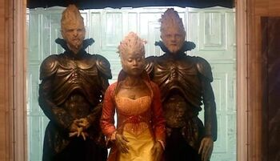
Trees of Cheem
https://tardis.fandom.com/wiki/Tree_of_Cheem
Dr. Who, Series 1,
Episode 2, The End of the World
Font Awesome
<i class="fas fa-medal"></i>
<i class="fas fa-tree"></i>

Slide 2
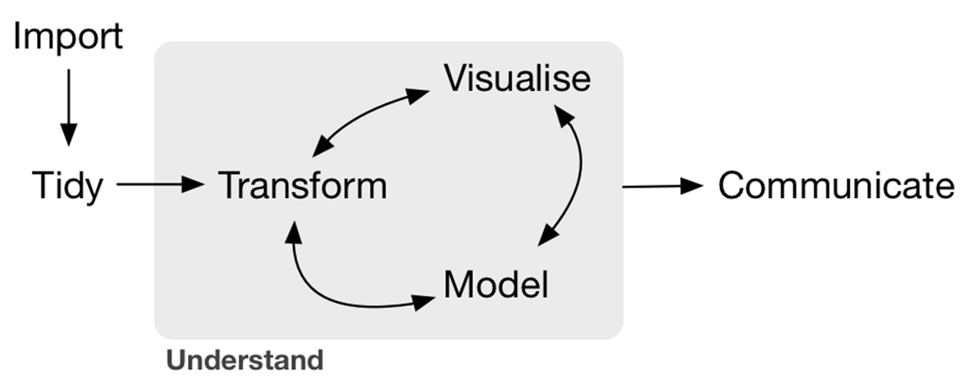
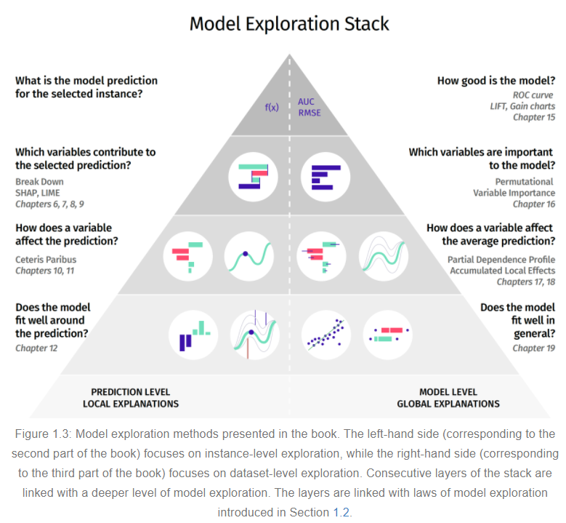
Trees of Cheem
(Tree based)
(top) Wickham, H., & Grolemund, G. (2016). R for data science. https://r4ds.had.co.nz/
(bottom) Biecek P. & Burzykowski T. (2020). Explanatory Model Analysis. http://ema.drwhy.ai/
(blue) proposed

Slide 3
Workflow suppose data, X[n,p], ~ p > 20, n > p
Typical multivariate EDA, via tours
Transform
Apply PCA, embed first q PC
Tour q-space
MEDAL
Transform
PCA & embed, suggesting q dim
Explore tours and tSNE while varying q
Trees of Cheem
Transform
Apply, PCA/OLDA; p-dim space
Fit tree based model
Use Perm Imp & SHAP to suggest q dim
Explore tours and tSNE while varying q

Slide 4
basis_cheem(*){
rf <- randomForest::randomForest()
ex <- DALEX::explain()
parts <- DALEX::predict_parts()
local_attr <- f(parts) | [px1]
bas <- basis_func() | [pxd]
basis <- orthonormalize(cbind(local_attr , bas))
}
view_cheem(cheem_basis){
gg <- spinifex::view_frame()
gg + plot.parts(parts)
}

Slide 5
Cheem tours
Variant 1
Input: processed data, class, new observation
SHAP -- Explain(RF mod, new obs)
Basis=orthonormalize([normalize(shap) | OLDA[first d-1 column])
Freeze the first column, SHAP
Output: Grand tour on frozen matrix (shap values cannot change, while we wander from OLDA component 1)
Feels arbitrary to tack on OLDA component, but may be interesting or boring to only tour on 1 disp dim.
Variant 2
Input: processed data, class, new observation
Convert to OLDA space
SHAP -- Explain(RF mod(OLDA), new obs)
Basis = OLDA components as selected by SHAP
Tour normally (local)
May be a better way to produce basis/single linear projection to explain SHAP, but will quickly wander away.

Slide 6
Appendix slides after

Slide 7
Wickham, H., & Grolemund, G. (2016). R for data science. https://r4ds.had.co.nz/
counter clockwise arrows added.

Slide 8
pyramid exists only after working ML model; what about before that.
Running models takes a long time.
Many models use some sort of PCA initialization, but just default to some static number of PCs. Rtsne defaults to the first 50
What is idd<50? You miss out on reduced run times
What if idd>50?
{Rdimtools} has a suite of 17 `est_*` that predict the Intrinsic data dimensionality (idd), let’s use these to initialize the dim to start a stepwise tour.
Take this value, create a stepwise tour based on variance explained, in the previously suggested dim.
Start your EDA here.
Biecek P. & Burzykowski T. (2020). Explanatory Model Analysis. http://ema.drwhy.ai/

Slide 9
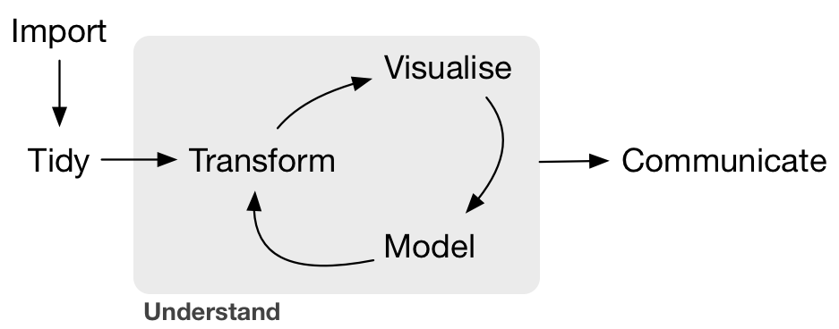
ML EDA, MEDAL
(top) Wickham, H., & Grolemund, G. (2016). R for data science. https://r4ds.had.co.nz/
(bottom) Biecek P. & Burzykowski T. (2020). Explanatory Model Analysis. http://ema.drwhy.ai/
(blue) proposed, Spyrison, N. & Doogan, C.

Slide 10
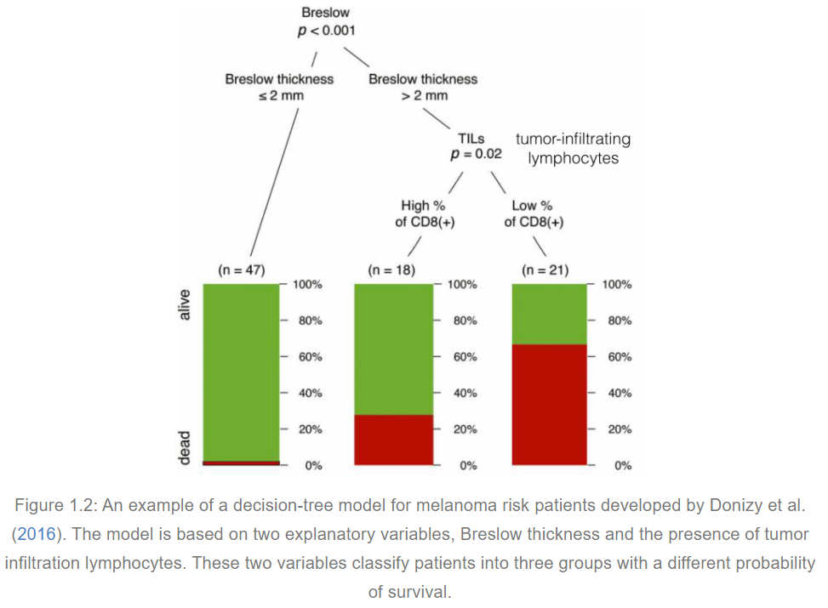
Biecek P. & Burzykowski T. (2020). Explanatory Model Analysis. http://ema.drwhy.ai/

Slide 11
Layout – ML EDA
Input data, pre-processing step, summarize, select target variables
Use {Rdimtools} to estimate the internal data dimensionally, idd^
Create a stepwise tour; initialize pca/olda-space and basis, display at p = idd^, as part of ensemble graphics[Unwin, 2018] for EDA before ML.
Step wise tour -> local tour/grand tour, tsne or umap, PC density, etc.
Tooltip pointing back to observations in the original data space
Options for occlusion, k2Density, alpha~1/density, etc.
Export
Embedded PC-space
Preprocessed data
ensemble graphics

Slide 12
Tab 1) Input (.csv, .rds, .rda)
-DT table, see gallery example:
--include buttons,
--target factor button
--summary or head of data
-Force remove NA rows, with message, # and percent% obs removed.
-scale_sd(default), scale_10
-sphere data
Tab 2) PCA & stepwise tour
- Benchmark prcomp and alternative?
- Scree plot and scree table
- Permuted PC importance? → suggested number of PC (how long of a wait, how many permutations?)
- Initial dimensionality for vis with interpretation of %var, and % of dimensionality
- Histograms w/ rug?
- Stepwise tour
Tab 3) Vis [in PC space] (all as plotly? Vega?)
~This feels like Liminal, make sure to explore that.
Global or local tour?
TSNE (force load last? Include hyperparameters)
Tab 4) Output
- PC space, (list storing what elements? Output format RDS?)
- Some tour offering output to .gif or self-contained HTML. What graphics and res? May be prohibitively hard to host a remote {gifsky} generation
- Current Basis?
- tSNE with hyperparameters
Tab 5) About
- Context and scope
- Try to rationalize and explain some of the ideas
- Use video?

Slide 13
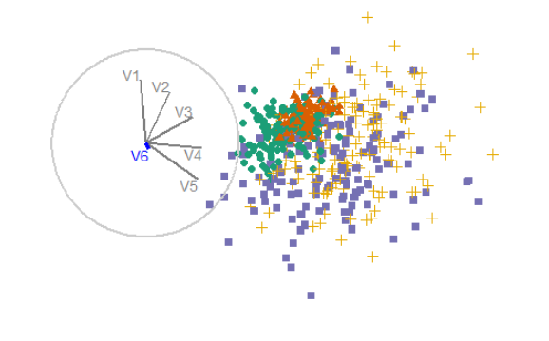
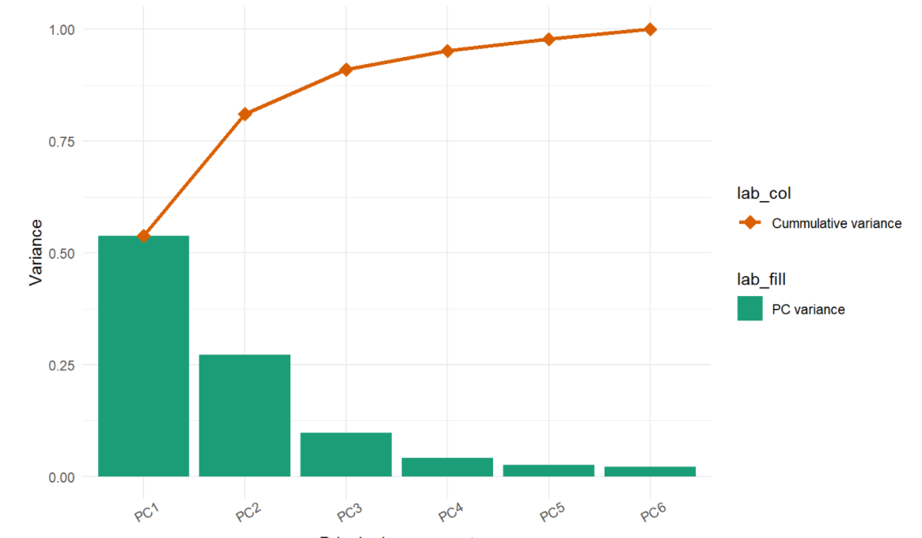
Sketch for stepwise tour
< Remove next variable
Add next variable >
Interaction: radially add or remove the next lowest component based on the defined univariate function
Purpose: explore the marginal change of adding/removing next variable
Setup: produce scree table, find all basis removing latest variable. This ensures you go back to exactly where you were
Limitation: the marginal cost/benefit of the variable is contingent on the starting basis.
In the context of XAI (explainable AI)?

Slide 14
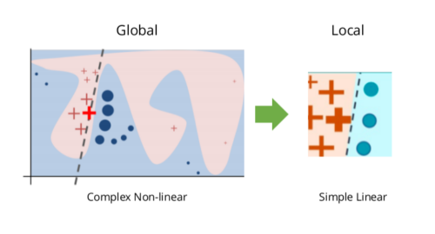
Concern – abstraction from LIME?
local interpretable model-agnostic explanations (LIME) [Peltola, 2018], is a popular, new technique for examining observations in non-linear models.
Do we lose this interpretability if we embed in PC/OLDA-space upfront?
Models already use PCA init; presumably can map back or otherwise interpret based

Slide 15
Notes
Remember half baked spinifex apps including gallery, DT table.
Good use of: Shinythemes, shinyJS, notifications.
Plots as plotly objs? Look into Carson S’s UseR2018 workshop.
Make sure to review Liminal (errors from main 2 tour options, last push Oct 2020?)

Slide 16
tSNE and multivariate viz implementaions
Blog, parameterization: https://jef.works/blog/2018/04/10/interactive-tsne/
Blog, vignette: https://www.kaggle.com/maniyar2jaimin/interactive-plotly-guide-to-pca-lda-t-sne
https://cs.stanford.edu/people/karpathy/tsnejs/csvdemo.html
tweets
https://distill.pub/2016/misread-tsne/]
https://sirselim.github.io/tSNE_plotting/
paper: https://github.com/sirselim/immunecell_methylation_paper_data
https://cs.stanford.edu/people/karpathy/tsnejs/
https://nicola17.github.io/tfjs-tsne-demo/
Blog: https://ai.googleblog.com/2018/06/realtime-tsne-visualizations-with.html
Paper: https://arxiv.org/abs/1805.10817
VIS 2019 pptx
Paper: https://arxiv.org/pdf/2002.06910.pdf
Hosting, shiny-like: https://bokeh.org/
Stand alone: https://www.cytosplore.org/
Stand alone: https://glueviz.org/
Stand alone: http://ggobi.org/index.html
ORCA (T. Lumley)
Stand alone: http://www.theusrus.de/Mondrian/
Liminal: https://github.com/sa-lee/liminal/

