Slide 1
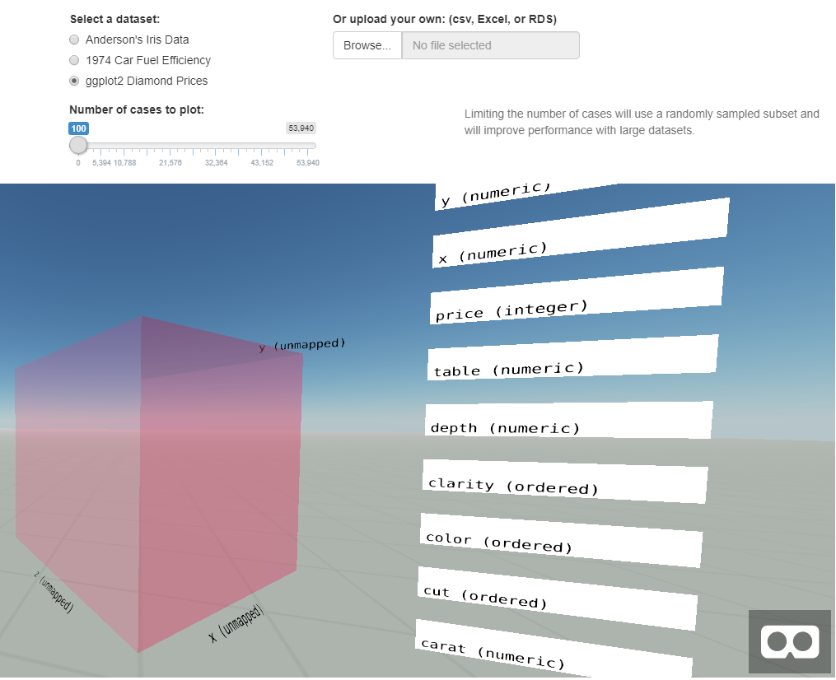
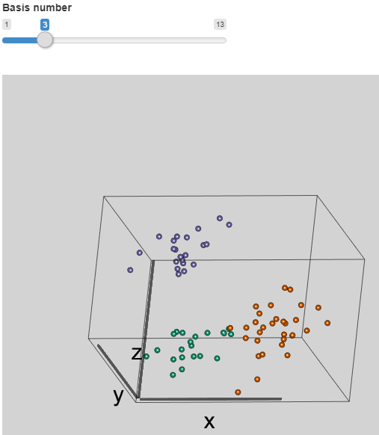
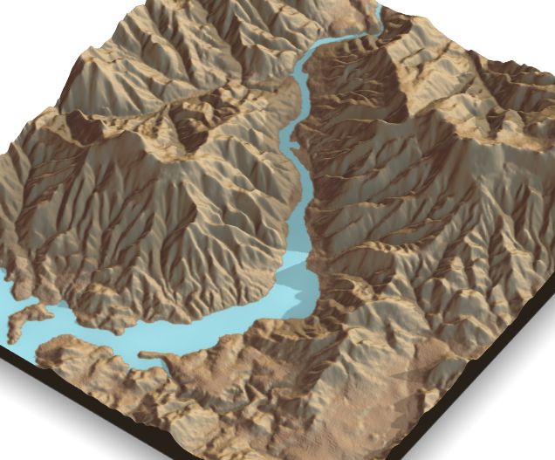
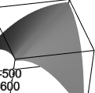
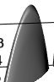
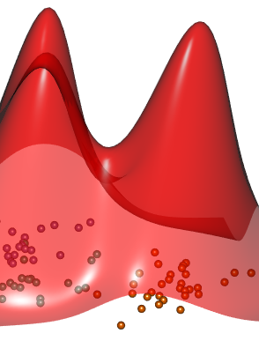
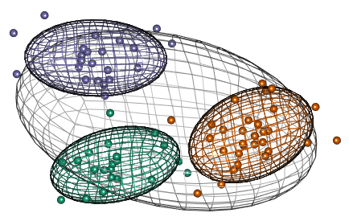
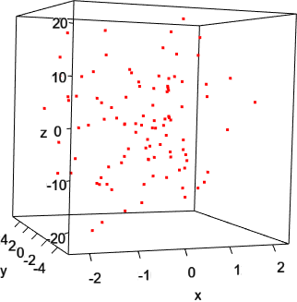
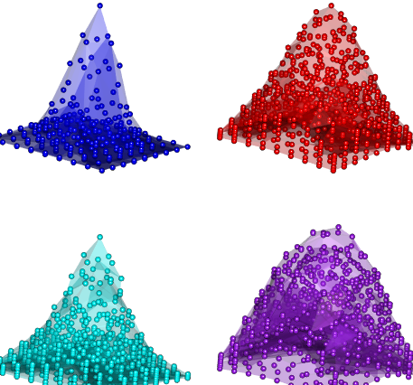
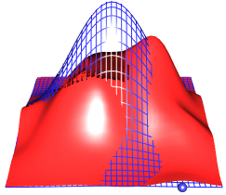




Search for suitable 3D graphics package
github.com/nspyrison/PoC_WebGL_shiny Nicholas Spyrison*
NUMBATS seminar, 10/08/2020
Goal:
Identify a graphics engine, then make interactive interface for:
Touring in 3D
function visualization of multivariate data
Optimize:
Quality
Fast; for interactive use
Extensible; web and XR
Backend:
WebGL vs HTML
3D, speed, quality
Review R packages with WebGL backend:
Explore {rgl} geoms and displays:
{adit}, github only
William Murphy (2016)
Shiny and VR,
public dev hidden when hired
3D scatter plot
Tour - animation of many linear projections of multivariate data
{rayshader}
Tyler Morgan-Wall (2020)
High fidelity
Too slow for interactive use
Function surfaces
by equation
Meshes and surfaces
2D/3D Kernel Densities
{rgl}
Duncan Murdoch (2008-2020)
Extensible
Exportable as html widget
3D scatter plot with triangles between points
alpha hull
Delaunay triangulation
{shinyRGL}
Jeff Allen (2013)
Allows {rgl} use in shiny
Annoying wall of text
Consumed into {rgl} directly
*
ebsmonash.shinyapps.io/MultivariateFunctionVis/
monash.edu
numbat.space
ialab.it.monash.edu

