Slide 1
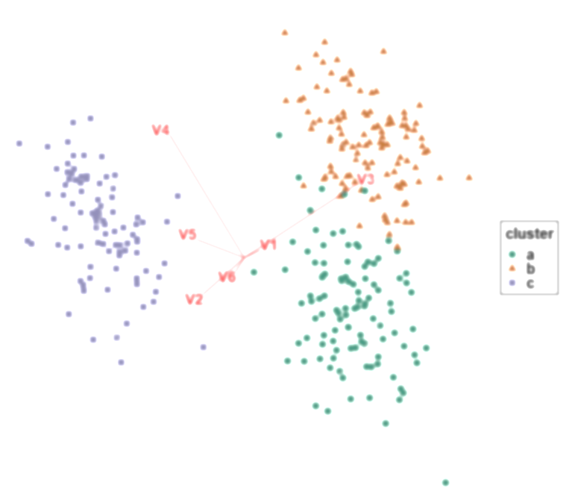
Multivariate data visualization study
Training video

Slide 2
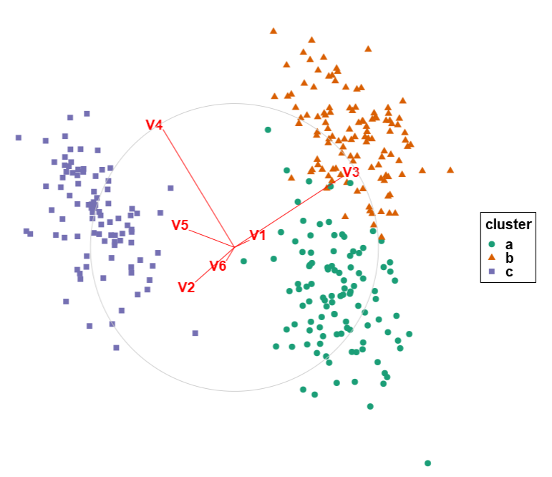
Linear projections
Given multivariate data (p > 2):
Project down to 2 dimensions (a shadow!)
Scatterplots
This data has groups, sometimes colored
Variable map depicts the basis (magnitude and direction each variable contributes)
Notes:
-Data: shown as scatterplot.
-All data contains clusters/ groups which is sometime shown in color and shape.
-variable map depicts the magnitude and direction each variable contributes.
-3 different visual factors

Slide 3
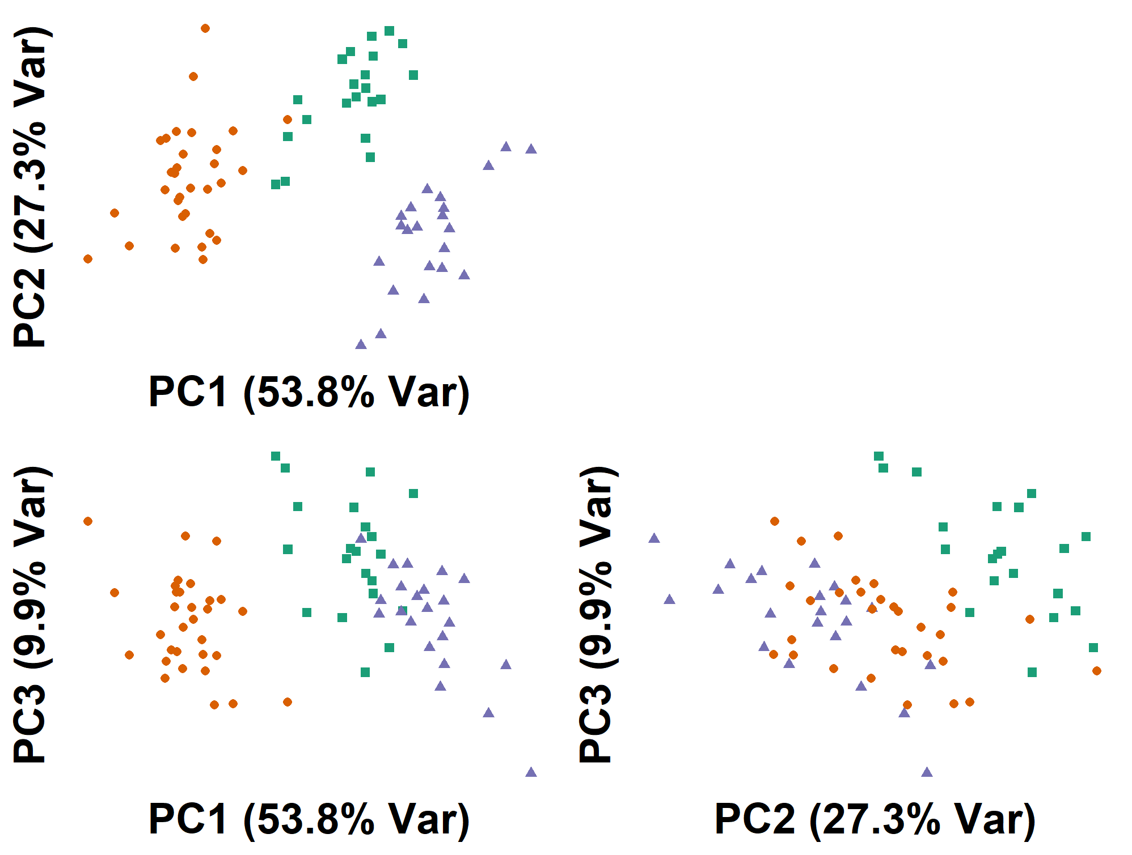
Principal component analysis (PCA)
Defines principal components:
Directions that explain the most variation
Ordered in decreasing variation (PC1:3: 53.8%, 27.3%, 9.9%)
Plot a pair of these principal components

Slide 4
Grand tour
Animation of many interpolated planes
Visits randomly selected planes
Can choose the location or speed of the animation, but not the path

Slide 5
Manual tour
Controls the contribution a selected variable has on the projection
Contributions of other variables move (fixed shape of the data)
Allows for users to explore contributions from individual variables

Slide 6
Factor similarities
OLD – DO NOT USE
Given multivariate data (p > 3):
Linear projection, down to 2 dimensions (a shadow!)
Scatterplots
This data has groups, sometimes colored
Variable map depicts the basis (magnitude and direction each variable contributes)
Notes:
-Data: shown as scatterplot.
-All data contains clusters/ groups which is sometime shown in color and shape.
-variable map depicts the magnitude and direction each variable contributes.
-3 different visual factors

Slide 7
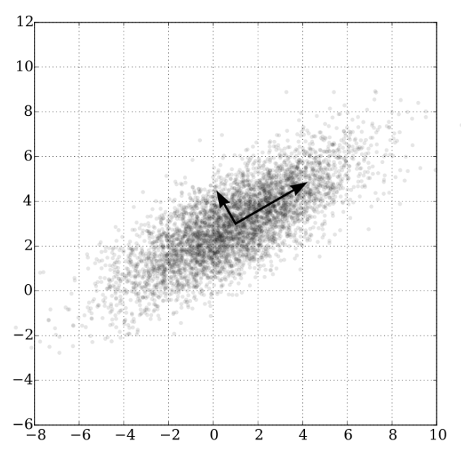
Principal component analysis (PCA)
OLD – DO NOT USE
Defines principal components:
Explain the most remaining variation
Orthogonal (at right angles)
Ordered in decreasing variation
Plot a pair of these principal components

Slide 8
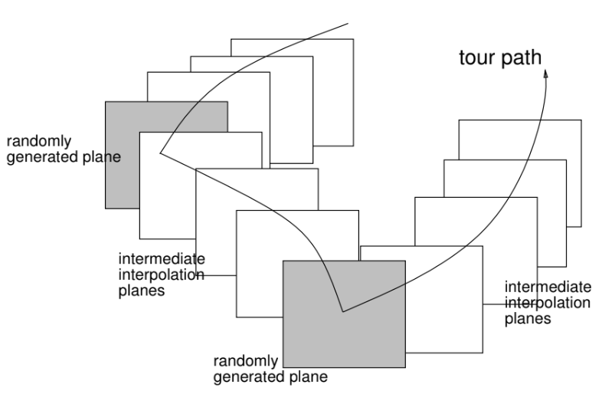
Grand tour
OLD – DO NOT USE
Identifies a few random planes
Interpolates many planes between them
Viewed as an animation of these planes

Slide 9
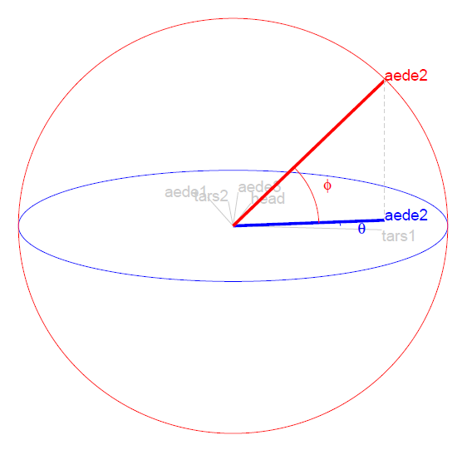
Manual tour
OLD – DO NOT USE
Manipulates a selected variables contribution to the basis
Contributions of other variables move (fixed shape of the data)
Allows for user interaction to choose a path

