Slide 1

Multivariate data visualization user study

Slide 2
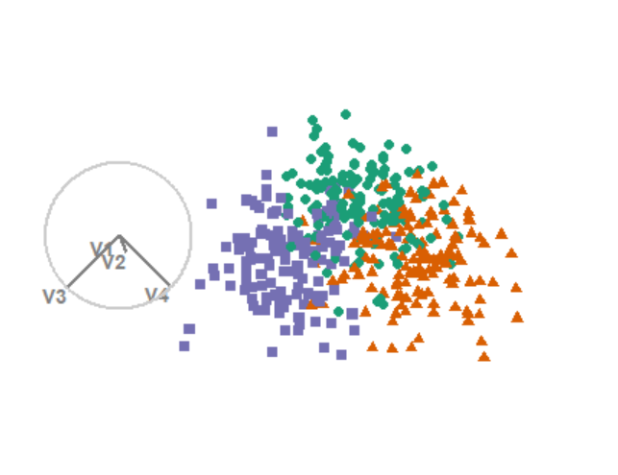

Groups and task
Groups are shown in their own color and shape
The gray circle shows the direction and size that each variable contributes
Task: select any/all variables that separate the green circles from the orange triangles

Slide 3
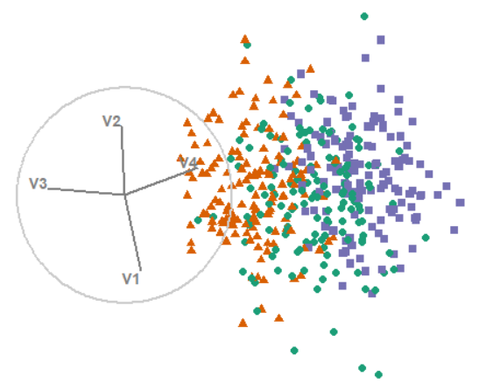
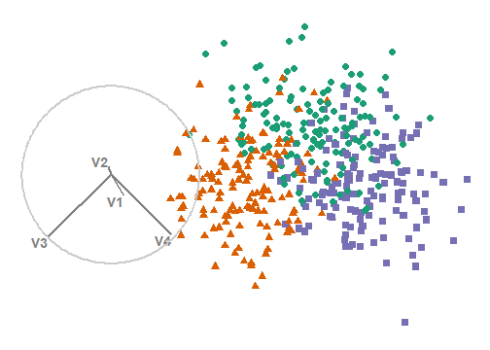
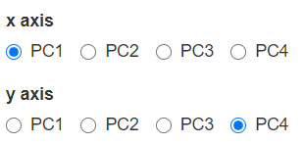
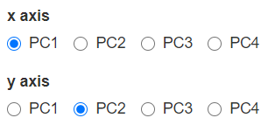


Methods
PCA
Select x and y axes
No animation
Grand
No selection
Random animation
Radial
Select a variable
Animates based on selection
(loops every 15 sec)
Start: x1y4
Then, w/e
Start:v3
Then, w/e

Slide 4
Process
Use the input to find a frame that separate the green circles from the orange triangles
Look at the orientation of the variables (gray circle)
Select 1 or more variable that have a large contribution in the direction of the separation
Keep in mind we are evaluating the visual methods not you
Some datasets have 6 variable
and another noise group

