Slide 1
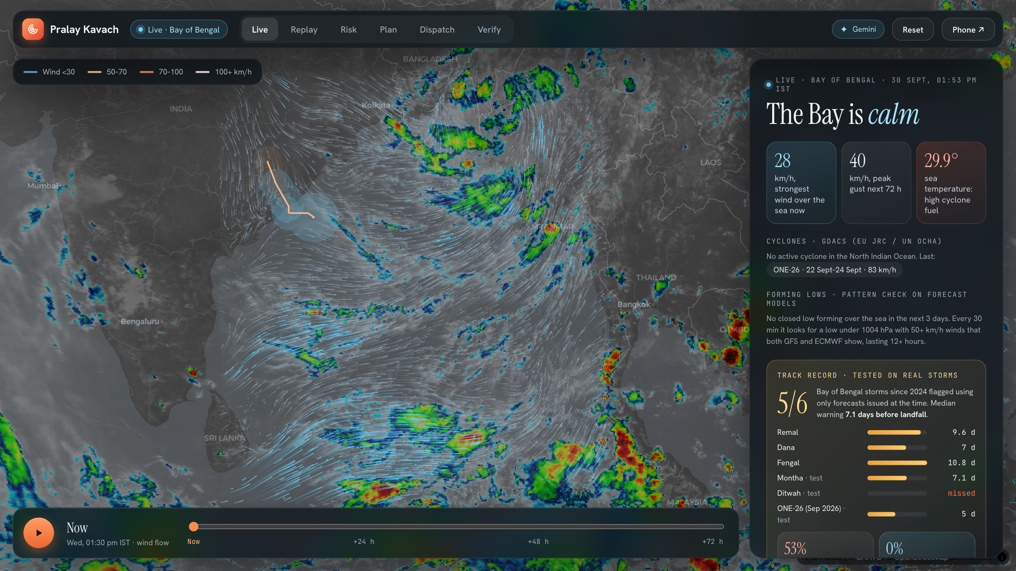
Pralay Kavach
a shield against the deluge
AI cyclone early warning and anticipatory action for India's east coast: from the first forecast to families in shelters.
Build with AI: Code for Communities
Resilience track · Gemini · Earth Engine · Cloud Run
Notes:
Pralay Kavach means "shield against the deluge". One line: we take a cyclone from the first forecast to people in shelters, with Gemini doing the reading, writing and talking, and every number checked against what really happened in Cyclone Fani.

Slide 2
THE PROBLEM
Forecasts got better. The last mile didn't.
1
Who must move?
Cyclone Fani, Odisha, 3 May 2019
Surge, wind and population are separate maps; officers merge them by hand under time pressure.
185 km/h
2
Warn everyone in their language
at landfall near Puri: an extremely severe cyclonic storm
Advisories in Odia, Telugu, Bengali and English, written, checked and approved at 2 a.m.
~12 lakh
3
Reach people, not just phones
Residents need their own shelter, a safe route and someone to ask, in their language.
people evacuated by the Odisha government, a massive, largely manual effort
4
Where did the water actually go?
Relief and insurance need the real flood footprint, days before surveys finish.
Notes:
Forecasting is not the gap any more: IMD tracked Fani days ahead. The gap is the manual last mile in the district control room, and knowing afterwards where help is needed.

Slide 3
THE SOLUTION
One flow from forecast to shelter.
01
02
03
04
05
Watch
Assess
Plan
Warn
Verify
Live wind, satellites and a forming-storm detector over the Bay, every day.
Storm surge, wind and waterlogging on real terrain: who and what is exposed.
A Gemini agent reads the bulletin and satellite image, ranks villages and explains why.
Advisories in four languages, two-person approval, CAP alerts, a voice helper on every phone.
Sentinel-1 radar shows where water stood; relief goes there first; parametric payouts trigger.
Gemini powers Plan, Warn (advisories, voice helper) and photo checks. Earth Engine powers Assess and Verify.
Notes:
One flow for the control room, one helper for the resident. Walk the five steps; each is a screen in the live demo.

Slide 4
WATCH: EVERY DAY, NOT JUST IN A DISASTER
Spots forming storms a week out, without crying wolf.
0 of 7
5 of 6
7.1 d
false alarms on held-out 2025–26 (first version: 18 of 34)
storms spotted before landfall
median warning lead
Live: GFS wind flow, Himawari clouds, GPM rain, GDACS storms and a plain-language outlook for any place.
Notes:
The detector was tuned on 2024 only and scored on 2025-26, which it never saw, using forecasts as they were issued. Ditwah was missed, and we say so. Six storms is a small sample.

Slide 5
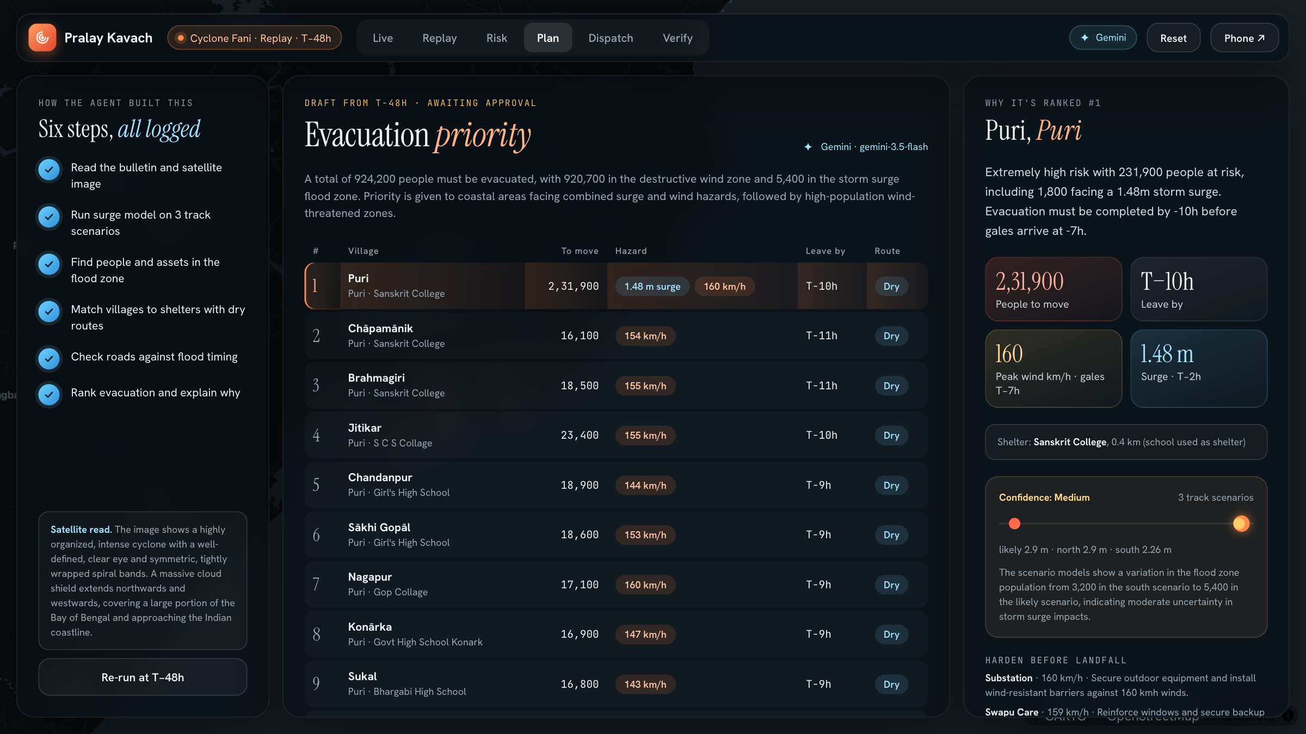
PLAN: A GEMINI AGENT IN THE CONTROL ROOM
Who moves first, and why.
Reads the cyclone bulletin and the satellite image together (Gemini multimodal).
Runs surge on three track scenarios, wind exposure, shelters and road cut-off timing.
Ranks villages by people at risk and leave-by time, with a reason for each.
Logs all six steps on screen; it may only use numbers the models produced.
Never breaks if the model is slow or down, rules take over and the screen says so.
Notes:
This is the Gemini agent. It reads the bulletin text and a MODIS satellite image together (multimodal), runs our physical models, and only uses numbers the models give it. Each of the six steps streams to the screen.

Slide 6
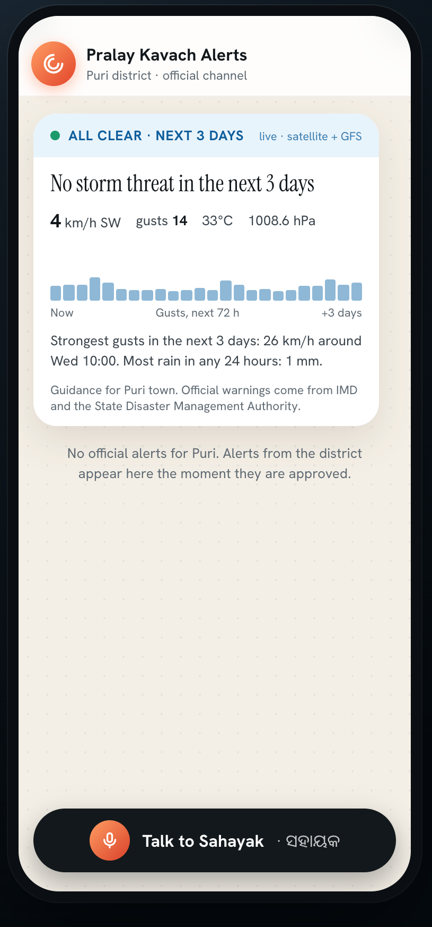
WARN: IN EVERY LANGUAGE, TO EVERY PHONE
From approval to a ringing phone in seconds.
In the control room
Sahayak
voice helper on the resident's phone
1
Draft Gemini writes the advisory in Odia, Telugu, Bengali and English, action first, under 60 words, only from the model facts.
6 languages, spoken aloud
Grounded on the person's own alert, shelter and route
Acts: files SOS and water reports that reroute others
Safety in code: "Call 112" first on danger words
2
Check Each language comes with an English back-translation so the officer can verify it.
3
Approve Duty officer, then Relief Commissioner: two-person sign-off.
4
Send A standard CAP 1.2 alert; the phone rings within seconds.
Notes:
Two audiences. The officer gets a draft in four languages with back-translations to check, and two people must approve. The resident gets a call, the alert read aloud, their own shelter, and Sahayak, which answers in six languages and can file an SOS.

Slide 7
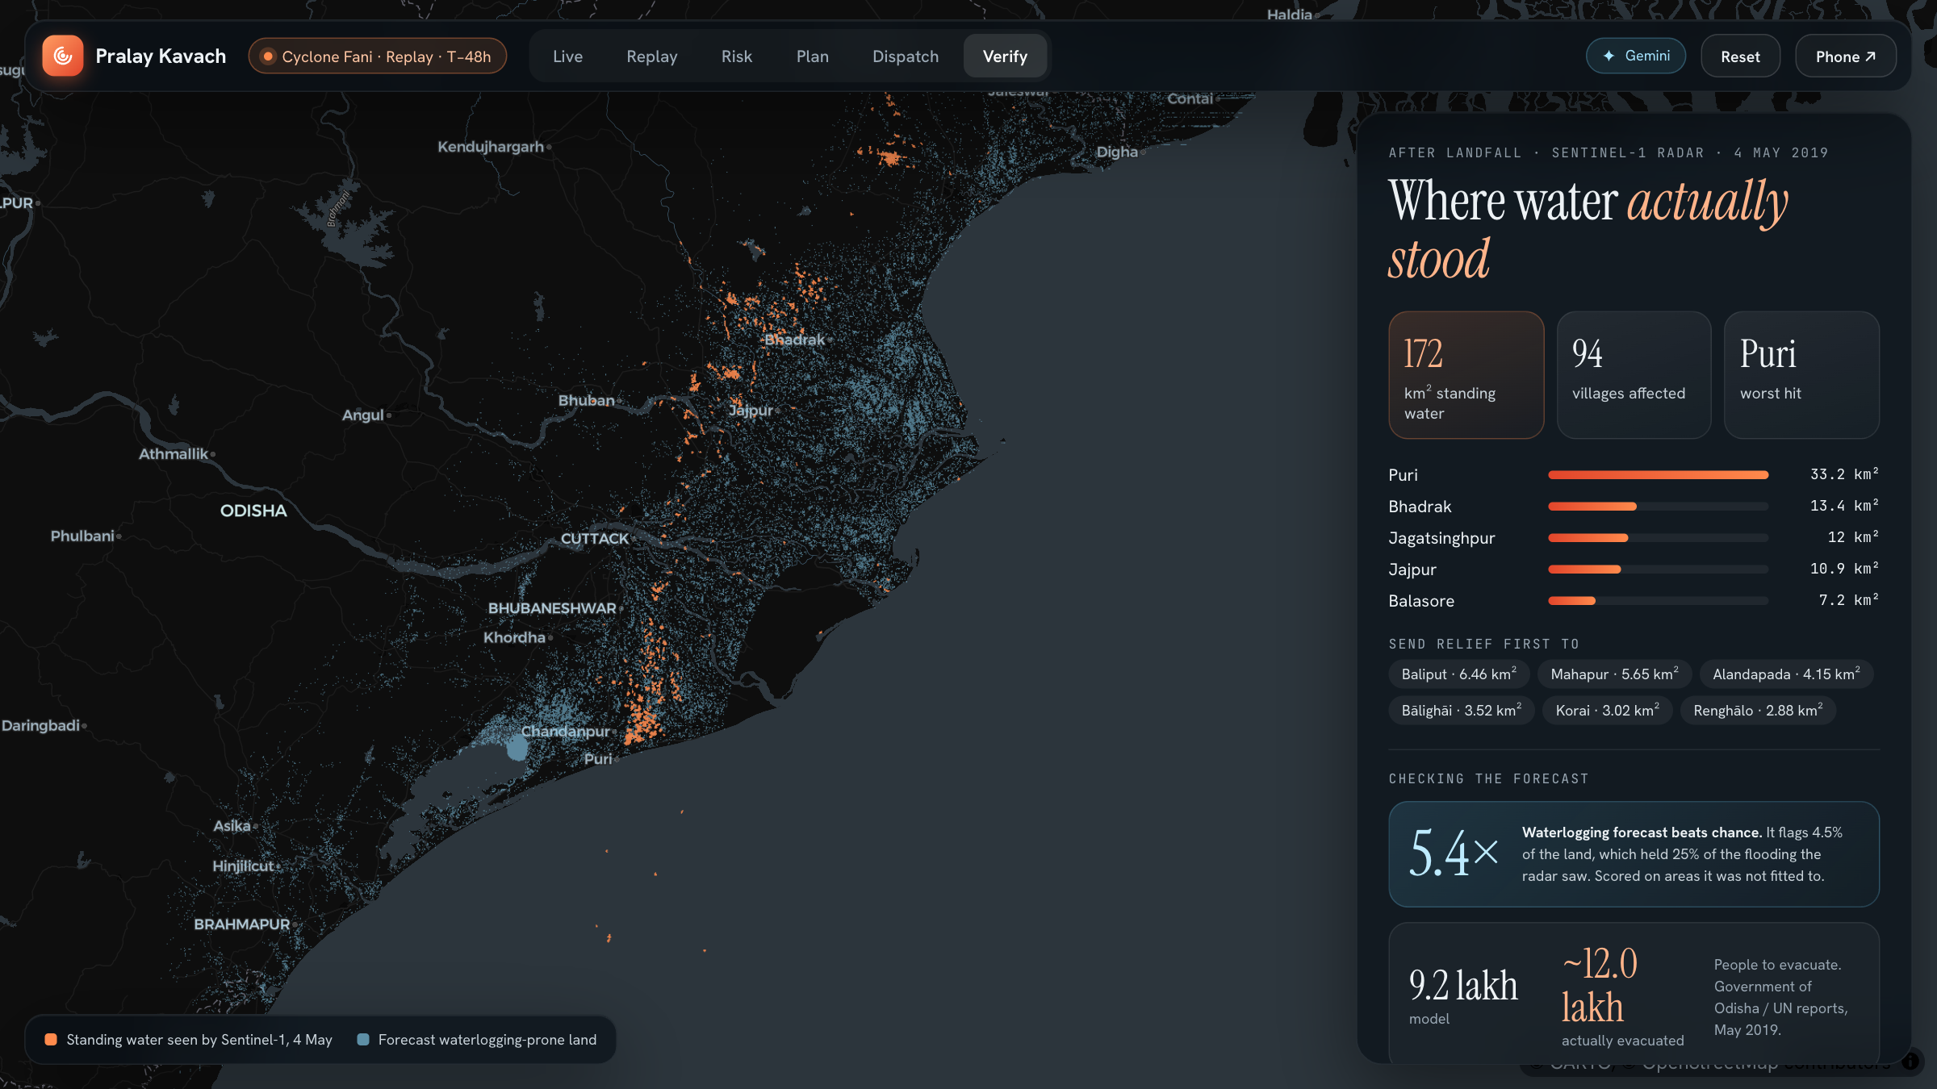
VERIFY: CHECKED AGAINST CYCLONE FANI
Where water actually stood.
5.4×
better than chance: waterlogging forecast vs Sentinel-1 radar, on areas it was not fitted to
~9 vs ~12 lakh
people to evacuate: our model vs what Odisha actually moved
Honest about limits. Surge drained before the radar pass, so it is not scored.
Relief list and parametric payouts come from the same radar map.
Notes:
We checked ourselves against what really happened in Fani. The evacuation estimate is close to the real figure. The waterlogging layer is 5.4 times better than chance on held-out areas. Surge cannot be checked with radar because the water drained before the satellite passed, and the app says so instead of showing a fake score.

Slide 8
ARCHITECTURE
Built on Google Cloud and Gemini.
Google Cloud project: pralay-kavach
Control room
district officers, SDMA
Gemini API
3.8 Flash; 3.7 / 3.5 Flash backups; JSON out, rules fallback
prompt + image
Cloud Run
FastAPI API + React web app in one container
flood layers
Citizen phone
alerts + Sahayak voice
Earth Engine
Sentinel-1 radar, GPM IMERG rain, MERIT Hydro, JRC water
Open data
IBTrACS, GFS + ECMWF, NASA GIBS, GDACS, WorldPop, OSM
Gemini: agent planning (multimodal) · multilingual advisories · Sahayak voice helper · flood photo checks
Notes:
Everything runs in one Google Cloud project. Cloud Run hosts the API and web app. Gemini does all language and image reasoning through one function with timeouts, backup models and a rule-based fallback. Earth Engine produces the radar flood map and waterlogging layers.

Slide 9
IMPACT AND SCALE
Built for one coast, ready for others.
Residents
Same pipeline, other coasts
A call in their language, their own shelter and route, and someone to ask for help.
India: Andhra Pradesh, West Bengal Sundarbans, Gujarat
Mozambique: Idai, Freddy (Portuguese)
South Africa: KwaZulu-Natal coast (Zulu, English)
China: Guangdong typhoon coast (Mandarin)
Brazil: southern coast, Catarina (Portuguese)
District control rooms
Hours saved on who-moves-first, advisories and sign-off, with every step logged.
Relief and insurers
Inputs are global: IBTrACS, GFS/ECMWF, Copernicus, NASA, WorldPop, OSM. Change the map extent and language list.
Radar-based relief lists and parametric payouts days before ground surveys.
Notes:
Who benefits, and why this travels. Nothing in the pipeline is Odisha-specific: all inputs are global datasets, and Gemini handles local languages without new templates.

Slide 10
WHAT'S NEXT
Pilot before the next cyclone season.
Now
Working prototype: live Bay watch, Fani replay, Gemini agent, voice helper, radar checks.
Next 3 months
Official shelter registry (OSDMA), Google Maps Routes for real road routing, IVR and WhatsApp on the same Sahayak engine.
Pilot
One Odisha coastal district, run alongside IMD and SDMA warnings during the season.
Code github.com/nsquaredzz/Hackathons (folder 2026-09-pralay-kavach-cyclone-early-warning) Guidance only: official warnings come from IMD and the SDMA.
Notes:
Close with the ask: a pilot with one coastal district before the next cyclone season.

