Slide 1
Cloud RTR: Cloud Infrastructure for Apps with Hardware
Thesis Defense – April 16th 2015
Ali Yasser Ismail

Slide 2
Goal

Slide 3


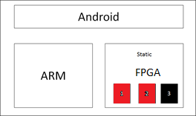
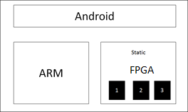
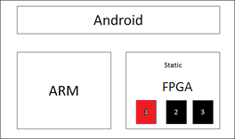
Apps with Hardware (Mōbware)
Give mobile phones re-programmable hardware (FPGA)
Allow applications to utilize hardware
Give developers a way to create and deploy their own hardware
The App Store
App + HW
App + HW
Smart Phone

Slide 4
Benefits

Slide 5
What do we gain?
New Hardware Functionality
Software Defined Radio
Digital Signal Processing Hardware (FFT and FIR)
Cryptography Processing Hardware(AES and RSA)
Better Performance
Microsoft accelerates datacenters with FPGA (Project Catapult)
(Intel in talks to acquire Altera)
Power Savings

Slide 6
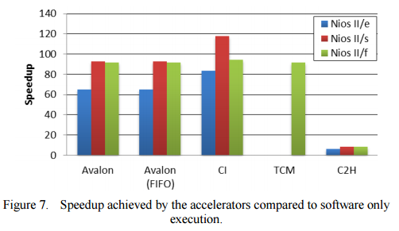
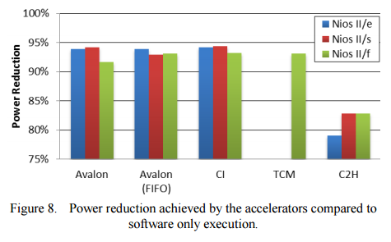
Case Study 1
Possa et al. [2]
Implemented a 15th order FIR filter
Compared FIR software implementation to hardware implementation
Used Nios II 32-bit RISC embedded processor and Altera Cyclone III FPGA

Slide 7
Case Study 2
Che et al. [4]
Studied performance of GPU vs FPGA
Implemented 3 Applications
Gaussian Elimination (Linear Algebra)
DES (64-bit block – FPGA took 83 cycles and GPU took 5.80 x 10⁵ cycles)
Needleman-Wunsch (DNA Sequencing)
Hardware Used
Intel Xeon Processor (3.2 GHz, 4 Threads)
NVIDIA GeForce 8800 GTX (128 stream processors at 575 MHz)
Xilinx Virtex-II Pro (100 MHz)

Slide 8
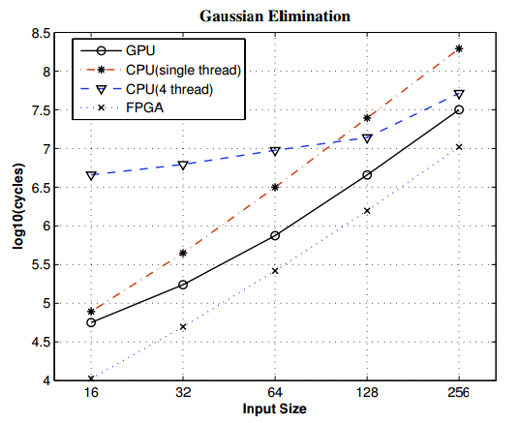
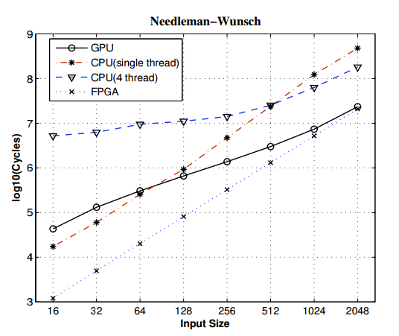
Case Study 2 Cont.

Slide 9
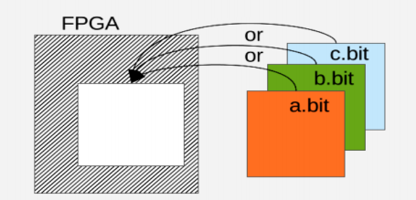
FPGA’s in cell phones!
Industry moving towards SoCs
Off-the-shelf systems with FPGA’s and ARM Cortex A9 coupled together on the same chip
High Level Synthesis (HLS) tools gaining momentum
Built-in Libraries
Simple IP generation process
Test Environment
Xilinx supports run-time reconfiguration
Partial Reconfiguration Technology [5]
Notes:
Mention that ARM cortex A9 is both present on this SoC and in the Iphone

Slide 10
Challenges

Slide 11
Run-time Reconfiguration Approaches

Slide 12
Option 1: Reconfigure the Entire FPGA Design
Re-define and compile an FPGA design
Deploy
Advantage
Simple
Disadvantages
Disrupt other running hardware
Must compile and then deploy (Expensive)
Slow

Slide 13
Option 2: Xilinx Partial Reconfiguration
Hardware Developer wants to support design variants
Not enough space
Flexibility
Hardware Developer Design
FIR Filter
Swap 15 tap filter with 20 tap filter
Xilinx Design Flow
Define partitions in the FPGA
Define Reconfigurable Modules (Variants)
Place RMs into each partition, place & route, generate full and partial bitstreams

Slide 14
Option 2: Xilinx Partial Reconfiguration
Advantage
Supported in Xilinx mainstream tools (Vivado)
Floor planning is done by hand, thus, area is used optimally
Disadvantages
Not general, everything known at compile time
Everything dictated by the developer, thus, does not support multiple party involvement

Slide 15


But this is what we want!
Support for multiple parties
Phone Manufacturers (Static Design)
Developers (Reconfigurable Modules)
User (End-System)
Phone manufacture and developer do not have control of end system
Need a general deployment model!
Phone Manufacturers
Developers
User

Slide 16
Option 3: General RTR (Academic)
Two main approaches to obtain general RTR
Run-time place & route
Pre-defined slots
Many variations of the two approaches in decades of work

Slide 17
Run-time Place & Route

Slide 18
Run-time Place & Routing
Developer provides “source” design
End system handles place route at runtime to integrate into the design (more general)
General Limitations
Tied to specific architectures
Not adopted in mainstream tools
Forced to reverse engineer bitstreams
Inefficient (Slow, doesn’t always work, poor performance)

Slide 19
Run-Time Routing Related Work
JBits – API into Xilinx bitstream[11]
API to access Xilinx FPGA bitstream
Access to LUTs, routing, Flip-Flops
JRoute [12]
API that routes Xilinx FPGA devices
Routing at run-time
Slotless Module-Based Reconfiguration [13]
Compile-time vs Run-time
Allocate large sandbox (Place Modules Optimally)
BitShop
Notes:
At compile time, they compile individual module that have been wrapped (handle feed-through signals and connections to adjacent modules) and fitted with Latol.
At run-time, place modules in sand-box, route channels, and complete module connections

Slide 20
Slot-based Solutions

Slide 21
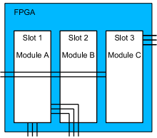
Slot-based Run-time Reconfiguration
Pre-placed slots in the FPGA
Download configuration bits to the slots
General Limitations
Forced to reverse engineer bitstreams
Force heavy constraints on routing

Slide 22
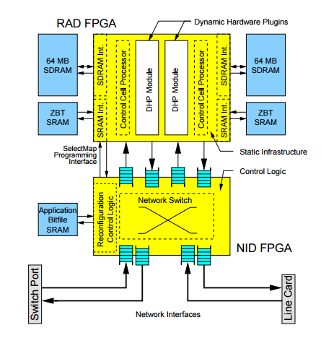
Slot-based Related Work
Horta et al. [14] 2002
Dynamic Hardware Plugins (Slots)
PARBIT
Original bitfile
Target bitfile
Configuration Parameters
Routing constraints happen during static design bitstream generation
Notes:
First need a target bitfile that contains DHPs
From original bitfile, extract module wanted to relocate.
Module is extracted and placed into target bitfile

Slide 23
Our New Approach

Slide 24
Our Approach
Use Xilinx mainstream tools to create a general RTR solution
How?
Leverage deployment model of apps

Slide 25







Cloud RTR Approach
Google Play Store
The Cloud Compiler
App1 + partial bitstream1
App4 + partial bitstream4
Manufacturer
App2 + partial bitstream2
App3 + partial bitstream3
Consumer
Developer
Notes:
Cloud deployment of partial bitstreams
Compilation occurs when uploaded by developer
User not forced to wait, compilation has already occurred
Use brute force compilation method
Can use Xilinx tools as is (handles PR)
Bitstream manipulation and quick routing is unnecessary

Slide 26
Our Contributions

Slide 27
Our Contributions
Worked out nuances of Xilinx partial reconfiguration [5]
Developed tools to automate and simplify this process
Built cloud-based system and did an evaluation of the brute-force method

Slide 28
Partial Reconfiguration

Slide 29
Background Terms
Synthesis
HDL into a netlist (connecting gates or flip-flops)
Place & Route (Implementation)
Process to place and map netlist to FPGA physical resources
Partial Reconfiguration (PR)
Reconfigurable Module (RM)
Processing System (PS)
ARM Cortex A9
Programmable Logic (PL)
FPGA (Fabric)
Out-of-context (OOC) Synthesis
Separate netlist for module
No optimizations

Slide 30
Define Static Design
Hardware needed by RM
DMA
Reset Hardware
Interconnect
GPU
I/O
AXI
HDMI
PS
Reset
AXI
AXI
RM
AXI
DMA
AXI
AXI

Slide 31


PR Clock Boundary
Placing partitions on clock was not enough
FPGA
P
P
P
P
P
Reset
RM
CPU
AXI

Slide 32
Static Design Synthesis
Before any PR can be done we need to instantiate black boxes in HDL static design
Need to make sure interfaces match
Static Design (HDL)
Static Design (Gates)
1
2
3

Slide 33
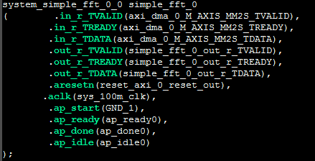
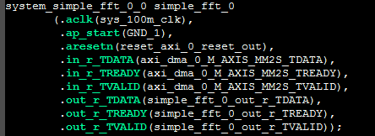
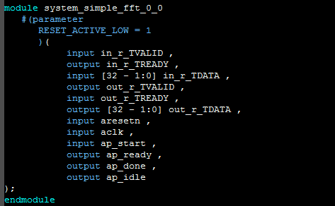
Static Design Synthesis
HDL generated by Vivado from block design
Script to instantiate black boxes

Slide 34
Base PR Tool Flow
Static Design (Gates)
Configure black boxes to be reconfigurable
Load a design into each partition*
Floorplan each block on a clock boundary
Implement design (Place & Route)
Carve out partitions
Save base checkpoint
D
2
R
D
3
1
R
R
D
FPGA
Base Implementation Checkpoint
P
P
P
P
P
P
Static Routed Checkpoint
* Each design must be synthesized OOC so they can be loaded in the partition

Slide 35
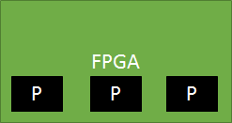
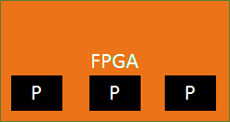
Dynamic PR Tool Flow
Static Routed Checkpoint
Lock Design
Load RM into each partition
Implement design (Place & Route)
Verify
Generate Bitstreams/Binaries
P
P
P
Dynamic Implementation Checkpoint
Base Implementation Checkpoint
Verify
PASS
Full Bitstream
Partial Bitstream1
Partial Bitstream2
Partial Bitstream3
* Each design must be synthesized OOC so they can be loaded in the partition

Slide 36
Evaluation

Slide 37
Experiments
How many slots will be available to developer/user?
Experiment 1: Slot Placement
Place max # of FFT’s
1024 samples/frame
Single channel
16-bit data width
Experiment 2: Base PR execution times
2 – 8 FFT slots
Experiment 3: Dynamic PR execution times
2 – 8 FFT slots
Is the brute force method practical?

Slide 38
Experiment 1

Slide 39
How many slots?
Slot Placement
Place max # of FFT’s
1024 samples/frame
Single channel
16-bit data width
Resources Available
Slices
BRAM
DSPs
Result
Placed 8 FFT’s

Slide 40
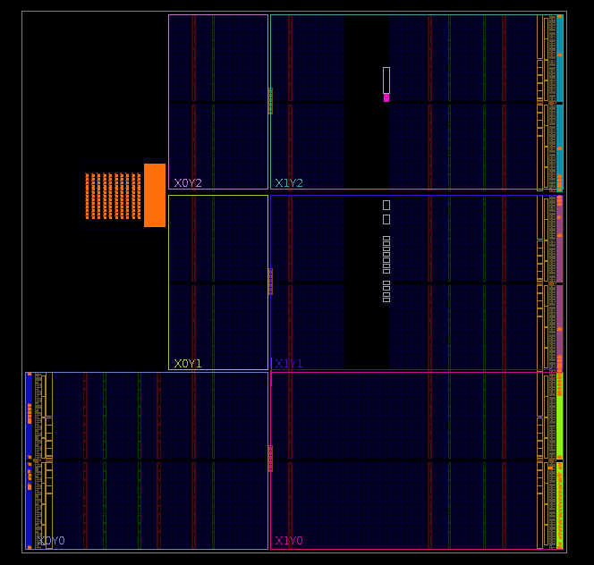
FPGA Layout

Slide 41
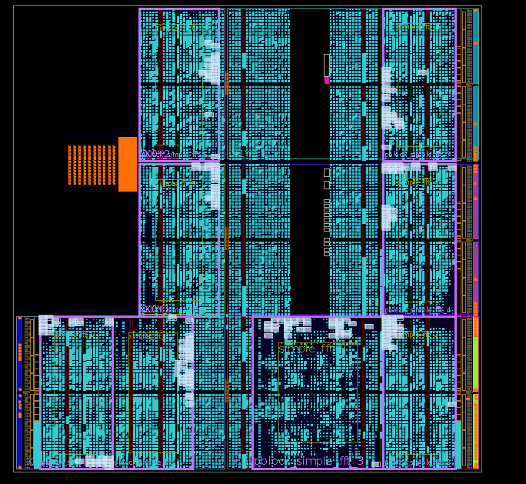
FFT Slot Layout

Slide 42
Slot Design Layout Considerations
What did we learn?
Best to allocate all three resources to slots
DSPs and/or Slices will likely be bottleneck
Potentially reduce number of slots and allocate more space
Hardware support will grow with RMs (Less slots means more space can be used)
Hardware | Most Used Resource | % Utilization
FFT IP | LUTs | 6.12
Reset IP | LUTs | 0.07
DMA IP | LUTs | 2.21

Slide 43
Experiment 2

Slide 44
Base PR Execution Time
Intel Xenon 2.1 GHz (6 cores with 48 GB RAM)
2 – 8 Slots
FFT
1024 samples/frame
Single channel
16-bit data width
Note: This process is done once for each phone variant (or when manufacturer updates static design)

Slide 45
Base PR Execution Time

Slide 46
Slot Design Layout Considerations
What did we learn?
More area means more compilation time
Placement of slots affect compilation time
Solution: Use a bigger FPGA or less FPGA area

Slide 47
Experiment 3

Slide 48
Dynamic PR Execution Time
Intel Xenon 2.1 GHz (6 cores with 48 GB RAM)
2 – 8 Slots
FFT
1024 samples/frame
Single channel
16-bit data width

Slide 49
Dynamic PR Execution Time

Slide 50
Slot Design Layout Considerations
Placement of slots affect compilation time more prevalent in dynamic PR flow
Solution: Use a bigger FPGA or less FPGA area

Slide 51
Cloud RTR Deployment Requirements

Slide 52
Google Play Store
Google Play Store Figures
# of Apps as of Dec 14 | 1.43 Million
Average Monthly App Growth | 6.10%
# of Apps for April 15 | 104,187

Slide 53
Dynamic PR Compilation Latency
Compilation Times
# of Slots | Execution Time (M) | RM Synthesis Execution Time(M) | Total Execution Time (M)
2 | 8.21 | 3.71 | 11.92
3 | 11.22 | 3.71 | 14.93
4 | 15.31 | 3.71 | 19.02
5 | 20.50 | 3.71 | 24.21
6 | 24.52 | 3.71 | 28.23

Slide 54
Dynamic PR Compilation Throughput – 2 Slots
Max # of Apps Compiled per day
# of Slots | Apps
2 | 121
3 | 96
4 | 76
5 | 59
6 | 51
2 Slots Requirements | % of April Apps that use Hardware (# of Apps Uploaded per Day)
 | 0.1 (3.47) | 1 (34.72) | 10(347.28)
# of Phone Architectures | # of Machines Required to Compile Apps
1 | 0.03 | 0.29 | 2.87
10 | 0.29 | 2.87 | 28.75
100 | 2.87 | 28.75 | 287.48
1000 | 28.75 | 287.48 | 2874.78

Slide 55
Dynamic PR Compilation Throughput – 6 Slots
Max # of Apps Compiled per day
# of Slots | Apps
2 | 121
3 | 96
4 | 76
5 | 59
6 | 51
6 Slots Requirements | % of April Apps that use Hardware (# of Apps Uploaded per Day)
 | 0.1 (3.47) | 1 (34.72) | 10(347.28)
# of Phone Architectures | # of Machines Required to Compile Apps
1 | 0.07 | 0.68 | 6.81
10 | 0.68 | 6.81 | 68.08
100 | 6.81 | 68.08 | 680.83
1000 | 68.08 | 680.83 | 6808.31

Slide 56
Moving Forward
So far…
Proved PR works (Built many simple use cases)
Proved PS can communicate with PL
Proved that brute force method is viable and not many machines are required
Base and dynamic PR has been automated and works for simple use cases
Mike has designed more interesting use cases (Memory Scanner and AES)
Mike has Android running on the zedboard and can read memory and load bitstreams
Looking forward…
Determine best communication between PS and PL
Create application that uses hardware (Mike is very close)
Study Mikes use cases resource utilization
Plan to submit to paper to Micro-48 (International Symposium on Microarchitecture 2015)

Slide 57
Acknowledgements
The Team
Advisor: Eric Keller
Michael Coughlin
Xilinx Inc.
Philip James-Roxby
Derrick Woods
Xilinx Forums
NGN Group

Slide 58
References
[1] D. A. Patterson and J. L. Hennessy, Computer organization and design,"
M. Kauman, Ed., 2009.
[2] P. Possa, D. Schaillie, and C. Valderrama, Fpga-based hardware acceleration: A
cpu/accelerator interface exploration," in IEEE International Conference on
Electronics, Circuits and Systems (ICECS), 2011.
[3] C. Cullinan, C. Wayant, T. Frattesi, and X. Huang, Computing performance
benchmarks among cpu, gpu, and fpga," MathWorks. 2013.
[4] S. Che, J. Li, J. W. Sheaer, K. Skadron, and J. Lach, \Accelerating
compute-intensive applications with gpus and fpgas," in Symposium on Application
Specic Processors (SASP), 2008.
[5] Xilinx partial reconguration. [Online]. Available:
http://www.xilinx.com/tools/partial-reconguration.htm

Slide 59
References
[6] M. Majer, J. Teich, A. Ahmadinia, and C. Bobda, \The erlangen slot machine: A
dynamically recongurable fpga-based computer," in VLSI Signal Processing Systems,
2007.
[7] D.Koch, C. Beckho, and J. Teich, \Recobus-builder a novel tool and technique to
build statically and dynamically recongurable systems for fpgas," in Proc. Field
Programmable Logic and Applications (FPL), 2008.
[8] C. Conger, R. Hymel, M. Rewak, A. George, and H. Lam, \Fpga design framework for
dynamic partial reconguration," in Proceedings of Recongurable Architectures
Workshop (RAW), 2008.
[9] S. Che, J. Li, J. W. Sheaer, K. Skadron, and J. Lach, \Accelerating
compute-intensive applications with gpus and fpgas," in Symposium on Application
Specic Processors (SASP), 2008.
[10] Xilinx partial reconguration. [Online]. Available:
http://www.xilinx.com/tools/partial-reconguration.htm

Slide 60
References
[11] S. Guccione, D. Levi, and P. Sundararajan, “JBits: Javabased interface for reconfigurable computing”,
Proc. Conf. on Military and Aerospace Application of Programmable Devices and Technology, 1999.
[12] E. Keller, “JRoute: A run-time routing API for FPGA hardware.” in IPDPS Workshops, ser. Lecture
Notes in Computer Science, J. D. P. Rolim, Ed., vol. 1800. Springer, 2000, pp. 874–881
[13] C. Patterson, P. Athanan, M. Shelburne, J. Bowen, J. Suris, T. Dunham, and J. Rice,
Slotless module-based reconguration of embedded fpgas." in ACM Trans. Embedd.
Comput. Syst, October 2006.[8] C. Conger, R. Hymel, M. Rewak, A. George, and H. Lam, Fpga design
framework for dynamic partial reconguration," in Proceedings of Recongurable Architectures
Workshop (RAW), 2008.
[14] E. L. Horta, J. W. Lockwood, D. E. Taylor, D. Parlour, "Applications of reconfigurable computing:
Dynamic hardware plugins in an FPGA with partial run-time reconfiguration", Proceedings of the
39th conference on Design automation, New Orleans, June 2002, pp. 343 – 348

Slide 61
Data Supplemental Slides

Slide 62
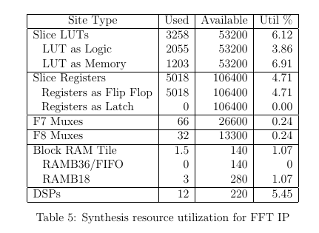
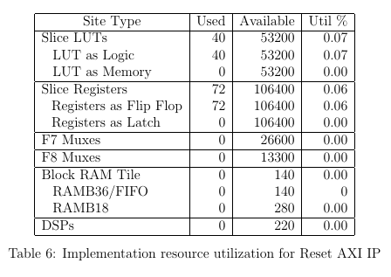
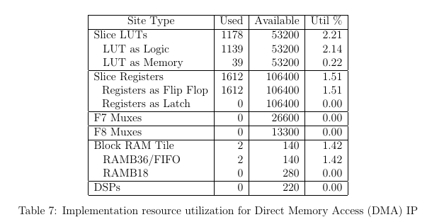
Slot Resource Utilizations

Slide 63
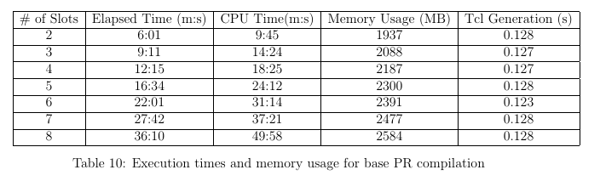
Base PR Execution Time
Note: Does not include bitstream generation or any verification

Slide 64
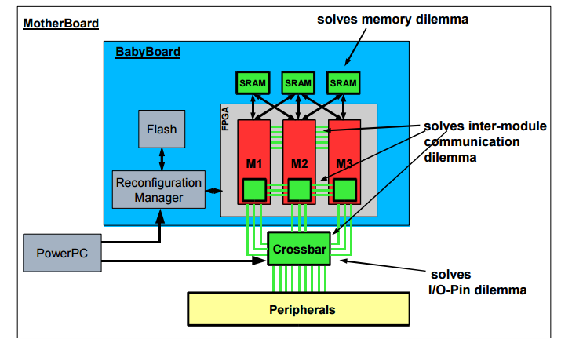
Slot-based Related Work
Majer et al. [6] 2007
Erlangen Slot Machine
Automated tool flow called SlotComposer
External Peripherals (Feed-Through Issue)
Reconfiguration Manager

Slide 65
Related Work Cnt.
Koch et al. [7] 2008
Developed Recobus-Builder – A tool that supports building reconfigurable systems on FPGAs
Simplifies the partial reconfiguration process
Allowed for testing
Optimal Floor planning
Automated Partial Reconfiguration
Limitations they solved
Difficulty of PR tool flow
Lacking
Ignored multipurpose systems (Everything known at compile time)

Slide 66
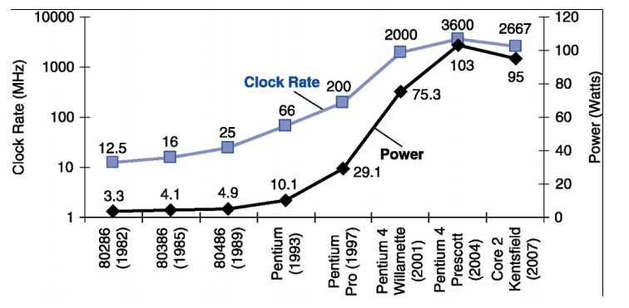
Better Performance and Less
Power?
Hit Power Wall 2000’s [1]
Needed to find alternatives to increase performance and reduce power
Solutions: Multiprocessors, GPU’s, FPGA’s

Slide 67
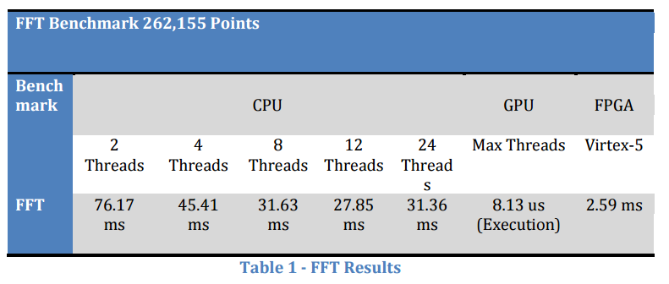
Case Study 2
Cullin et al. [3]
Implemented an FFT on CPU, GPU, and FPGA
Compared each of their execution times
Hardware Used
Intel Xeon X5650 (1.6 GHz, 24 Threads) (69 ms)
NVIDIA GeForce GTX 460 ( 675 MHz, 336 CUDA cores)
NVIDIA GeForce 9800 GTX+ ( 738 MHz, 128 CUDA cores)
Xilinx Virtex-5 (100 MHz)

Slide 68
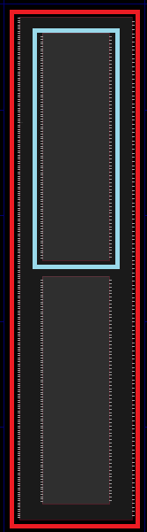
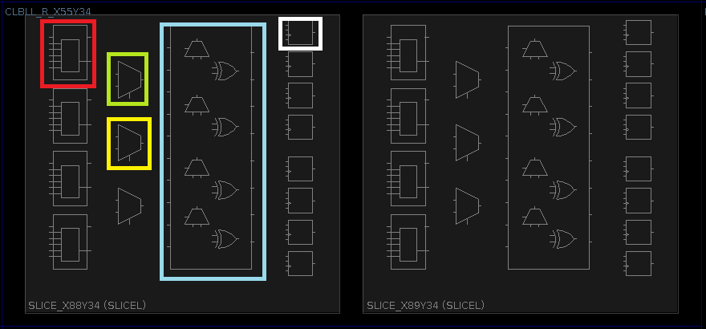
Understanding FPGA Resources
BRAM
Slices

Slide 69
Design Considerations
Generate Tcl scripts (Ok, we wanted this)
Pre-defined floor plans (Fixed # of slots)
Layout on clock boundries
Synthesize RMs separately
All interfaces have to match

Slide 70
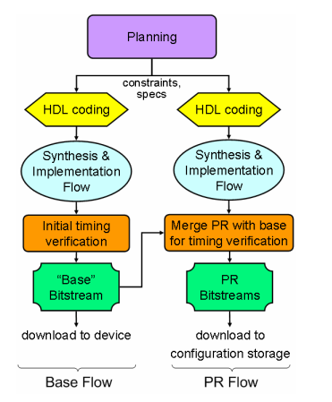
Related Work Cnt.
Conger et al. [8] 2008
Developed a framework that addressed special purpose and multipurpose systems

Slide 71
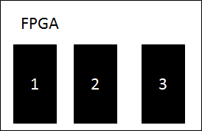
Slot-based Challenges
Allocate fixed size slots to contain RMs
Feed-through signals

Slide 72


Cloud RTR Approach
Compiler
Phone Manufacturer
User
Developer
Notes:
Cloud deployment of partial bitstreams
Compilation occurs when uploaded by developer
User not forced to wait, compilation has already occurred
Use brute force compilation method
Can use Xilinx tools as is (handles PR)
Bitstream manipulation and quick routing is unnecessary

