Slide 1

Toward An Active Network Security Architecture
Thesis Defense By:
Ryan Hand
Notes:
Today I am defending my thesis which supports a larger collaborative research effort toward an active network security architecture.
Security is extremely important, yet our equipment and strategies continue to be an iterative effort to patch systems, plug holes, and wait for the next wave. Our devices perform relatively compartmented functions with little to no context awareness. Digital forensics and incident response in particular have become incredibly important but often are less effective as reaction time between incident and response grow larger.

Slide 2

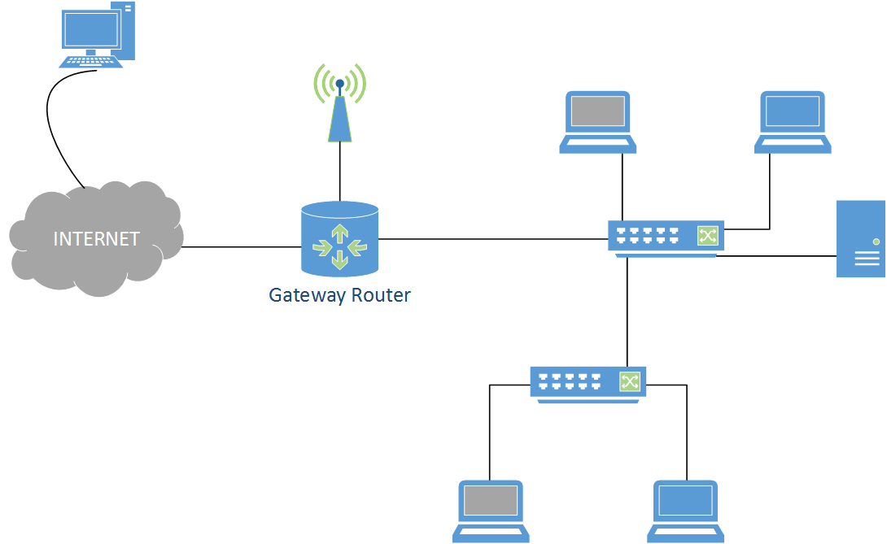


Working in Isolation
Human Reaction Speeds
Notes:
We have capabilities present in network hardware today but this information gives only a small part of a larger picture.
-Limited context awareness or response programmability
-Organizations get tied down to a vendor specific solution that is costly in equipment, support, and training, OR, a multi-vendor environment requires in-house expertise for administration.
-SIEM products have been a step in the right direction by making the multitude of information sources understandable and boiled down for humans, but still lack in the sources of information they gather and in complex remedial actions.
-We unfortunately see that digital forensics and incident response are only as effective as the timeliness of data/evidence collection and the skill of the individual analyst/investigator
-We also see that policy and security models like “defense-in-depth” provide somewhat of a structure, but fail to emphasize the subtleties of each layer and the configuration consistency gaps that exist.
*******************************************************
We need to take a different approach. We need a way to exercise granular control over our network to:
-interact with a variety of sensors
-configure our defense infrastructure to establish a baseline and better defend and monitor our security posture
-collect forensic artifacts in a live environment and use this information in real-time
-and, if desired, counter through reconnaissance or offensive actions

Slide 3
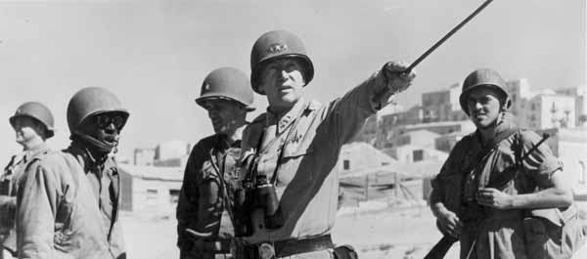
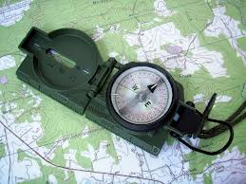

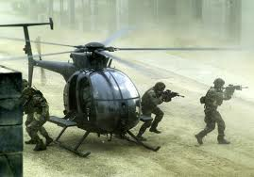

OODA Decision Feedback Loop
Decide
Orient
Time and Information are the dominant parameters…
We’re working at human reaction speed
Information is being used in isolation
Act
Observe
Notes:
-At a high level, we are inspired by the OODA loop which was introduced by US Air Force fighter pilot and renowned pentagon military strategist, Col. John Boyd in 1976.
-Presents a decision making feedback loop previously applied to military operations. OODA stands for Observe Orient Decide Act:
Observe: wherein we collect data and information based on input from our senses and information fed from events currently unfolding
Orient: where we analyze and synthesize the data to form perspective or context
Decide: based on the data and context, we form a hypothesis and choose a course of action
Act: we then physically implement the course of action
And ultimately we reenter this cycle, constantly assessing and reassessing a situation and our surroundings as they unfold.
These principles can and have been applied to many areas of military strategy and business, and Boyd's concept even inspired research projects that produced the lighter weight, more maneuverable fighter jets of our time including the F-16 and F/A18, still in service today.
Time and Information are the dominant parameters. Those who go through the OODA cycle in the shortest time prevails because his opponent is caught responding to situations that have already changed.
This military decision making process can and should be applied to the cyber domain of warfare, we wish to quicken our reaction speed and, when possible, "get inside the opponent's cycle" by disrupting their decision making process and forcing them to react to a changing environment that WE CONTROL.
To help solve this, we introduce Active Security

Slide 4
Active Security
A defense framework that provides:
Intelligent context awareness
Programmatic automation
Consistent security posture across the infrastructure
Real-time reaction speed from detection to remediation
Notes:
We introduce Active Security as a defense framework that cuts across the layers of traditional security models to provide
- intelligent context awareness of the network security state , collecting from many sensors in the network
- programmatic automation of a variety of security functions, by leveraging SDN control
- consistent security posture across all sensors in the infrastructure through reconfiguration
- and "faster than human" reaction speeds from the detection to remediation phases

Slide 5
Active Security OODA Loop
Network Transition Strategy
Orient and Decide
Controller
Collection Module
Programmatic Control
Network Artifacts
Parsed Intel
Forensic Analysis
Act
Observe
Alter Network Config / Gather Information
Volatility Framework
Sensor/Device Information
Security Devices
End systems
Network Devices
Sensor Interaction
Notes:
To realize this OODA concept we envision a security controller that exercises programmatic control.
Applying the OODA concept, we see this as a continued cycle of observing sensory and configuration data from a multitude of device messages, traffic of interest, and alerts.
The intelligence lies in the controller where our ORIENT and DECIDE phases of the OODA loop occur. From here, we may decide to gather further information from adjacent sources to get a better perspective, or we may decide alter the network configuration based on a flaw we have discovered.
Information gathered may also be subjected to forensic analysis where we take network artifacts and seek to obtain parsed intelligence to better ORIENT the controller to the current network state and aid decision making to better protect the network or attribute an attack.
In my thesis:
-I first quickly discuss the security controller architecture which is designed to embody the OODA feedback cycle
-I will discuss an attack scenario and walk you through the workings of an initial prototype that takes sensory information and activates a forensic collection module.
-In the next section we will illustrate the immense value that in-attack forensic collection can gain us in Active Security using the Volatility memory forensics framework.
-And in the last section, I discuss a new transitional network strategy that permits the SDN control we desire with no requirement to modify the enterprise hardware already in production until the organization is ready, which allows quicker adoption of the overall architecture.

Slide 6
Active Security Architecture
Active security controller
Operator Interface
Security Applications
Control Platform
Plug-ins
Sense (detection)
Collect (forensics)
Adjust (configure)
Counter (attack, recon)
Controller to infrastructure communication channel
Security devices -----------
e.g. IDS firewall
End-hosts
---------------
e.g. server, smart phone
Network devices ----------------------- e.g. routers, switches, WAP
Cyber Infrastructure
Notes:
This is a basic depiction of our Active Security architecture where the top box represents our security controller and its components and the bottom box represents the computer network infrastructure we are defending.
We begin with a set of running active security applications that describe what information to use, synthesize it, and decide what actions to take.
The key to allowing this to be an extensible and modular framework is through the use of a variety of plugins, that represent the 5 core capabilities,
The first of which is SENSE. Here we wish to interface with a wide variety of sensors on the network. These include the plethora of security devices out there but certainly must not be limited to these. Our end-hosts and network devices capture a great deal of the picture for us as well.
The next capability is COLLECT. We argue that active, in-attack forensics is necessary to speed our feedback loop by capturing information that falls into two main categories.
- Information useful for damage assessment, attribution to an individual or organization, and evidence preservation.
Information useful for better protection (reference back to OODA loop forensics)
The next 2 capabilities of PROTECT and ADJUST may be described together as they both relate to better protecting the network through reconfiguration of equipment as we discover security holes, and also adjusting the network state to disrupt an attacker's reconnaissance and exploit development lifecycle (attacker's OODA loop). As described in the active security OODA loop slide, here we are forcing the attacker to become reactive which gives the defender the advantage.
There may be the potential need or desire for an organization to COUNTER through reconnaissance as an attack is occurring, or a subsequent counter-attack of sorts to thwart an attack that may seek to consume your resources. We have seen solutions in industry that show a desire for such action, like Cisco’s CSMARS which provides some level of defense against denial of service attacks.

Slide 7
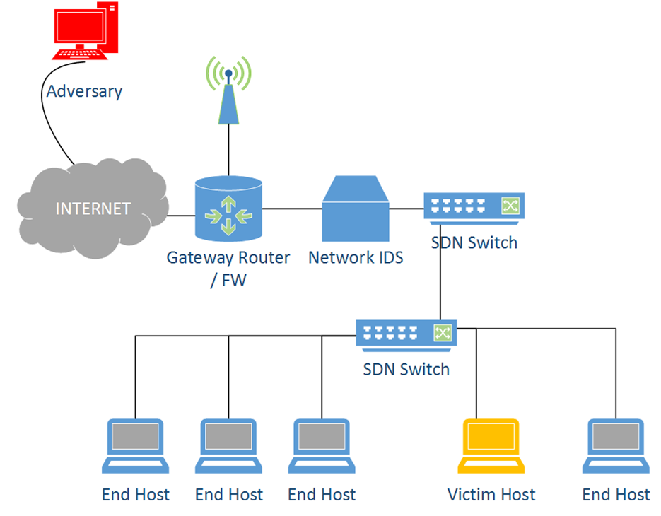
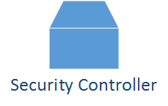


Forensic Collection Prototype
*COLLECT*
*Adjust*
*Sense*

Slide 8
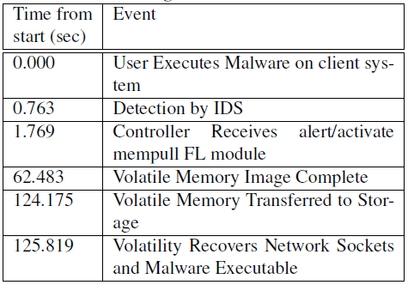
Prototype Components
Floodlight Software Defined Network Controller
Snort IDS
Linux Memory Extractor
Volatility Scripting
Notes:
In our prototype we implemented our security controller through a customized Floodlight SDN Controller module.
To the right, we have displayed the actual time of events during our trials. This illustrates the automated actions from execution of the malware, to the final parsing of forensic artifacts obtained from the victim host.
We wrote middleware (representing our SENSE plugin) to interface between the controller application and Snort IDS to process and deliver pertinent information to the controller application.
The controller took this information and activated our volatile memory imaging module, which in this case established secure communication with the victim, took a forensic image of RAM, and securely copied it back for preservation and parsing by Volatility.

Slide 9
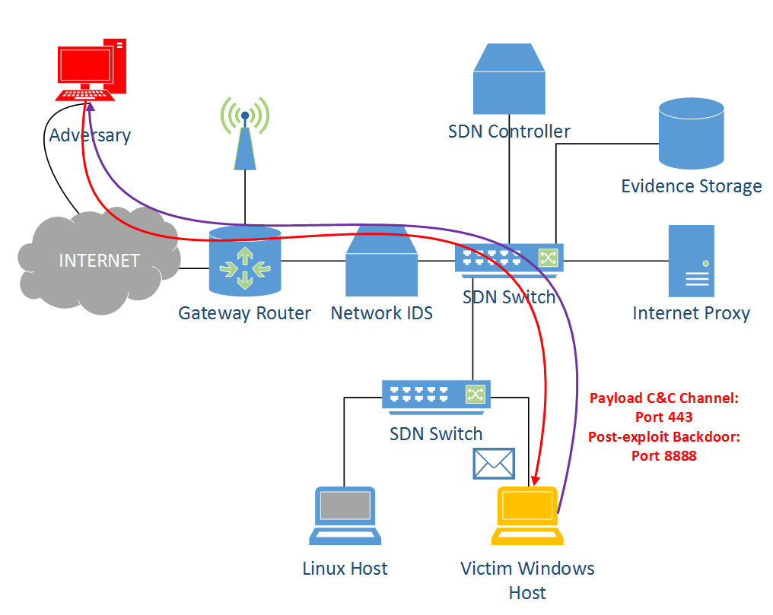
Collection = Better Protection
11
Notes:
Now lets show that, the fact that we can collect forensic evidence in the live environment when an anomaly is detected can lead to better protection and evidence preservation.
We encoded a malicious payload within an otherwise seemingly benign executable Putty.exe. Once the application is opened, it will attempt to establish a command and control channel over port 443. It will also run a post exploit script that installs a persistent backdoor as a windows registry key entry designed to re-hook the victim system on reboot or login on port 8888.

Slide 10

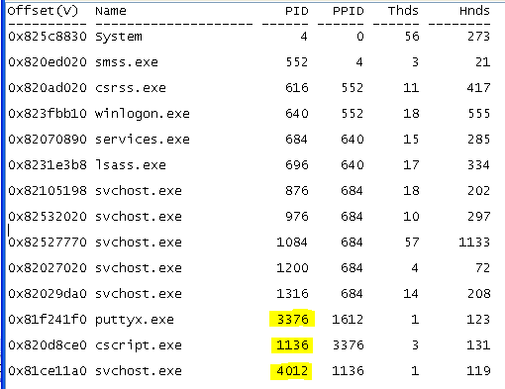
11
Notes:
We take what we know from the IDS alert: source and destination IP, source and destination port
“CONNECTIONS” --We use volatility to dig out network connections that match these parameters and seek out the process IDs that were associated with them. We find the offending connection that corresponds to the command and control channel and also find another process on port 8888 that we did not originally pick up, possibly due to misconfiguration, etc.
“PSLIST” --We them investigate the process tree from the victim host and look for anomalies with these PIDs. We notice a few very interesting and troubling things about this process tree. We quickly find our offending processes. Starting with 3376, we see that an executable established a network socket. Putty is a pretty normal application but if we examine further, we see that it spawned a Windows Command Script as a child process. We go one step further and see that the Command Script spawned an additional process, 4012, which was previously associated with our second network socket on port 8888. Worse, the command script spawned svchost.exe, whose only parent process should be services.exe above at PID 684.
This is indicative of a possible persistent backdoor on this Windows system. We will attempt to discover the origins in some more common locations, for this example, the Windows Registry.

Slide 11
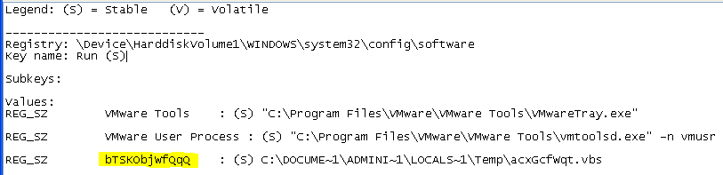
Examining The Windows Registry
Notes:
“printkey” –A quick examination of the “RUN” registry key shows that an entry was made that will call a .vbs script in the \TEMP directory upon login and/reboot.
To preserve evidence and learn more about the malware that originated from our puttyx.exe, we can easily extract the executable with the “procexedump” utility. This executable was built with an encoding scheme to evade AV on disk storage, because we captured the it from memory, we will have the code in its decoded form, and likely its encoding scheme that it used to decode itself in memory.

Slide 12
Volatility Framework Utilities
Process information
PE file extraction
Active and residual networking information
Kernel memory information and API hooks
Injected code discovery
Event logs and history information
Timeline analysis
File system resources and password recovery

Slide 13
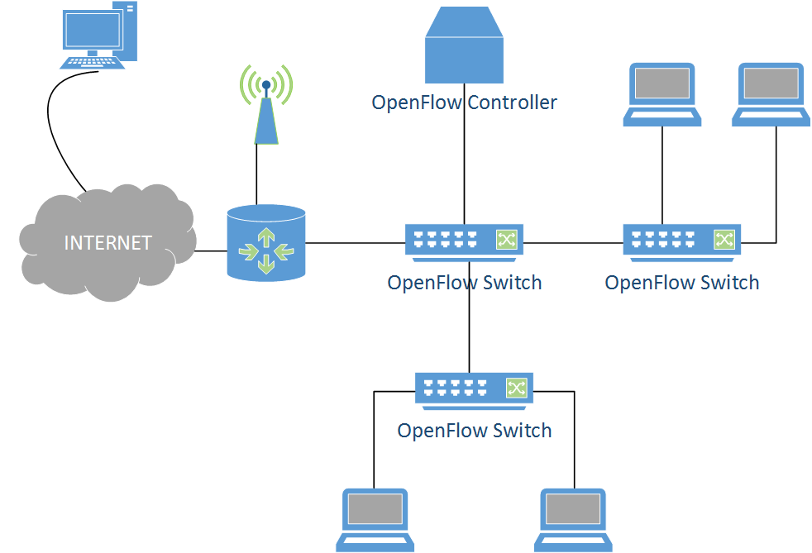



Security and SDN
Fresco: Modular Composable Security Services for Software Defined Networks, NDSS 2013
Notes:
Several works have already illustrated that security innovation can be greatly enhanced in a network that uses SDN control and a programmable infrastructure.
Fresco, presented a rapid application development framework that used a language abstraction of inputs, outputs, events, parameters, and actions to mimic security functionality in OpenFlow switches including, firewalls, IDS logic, reflectors, and scan detectors.
---We believe that go further to integrate the various existing security devices in a modular fashion to configure, monitor, and control the entire infrastructure.

Slide 14
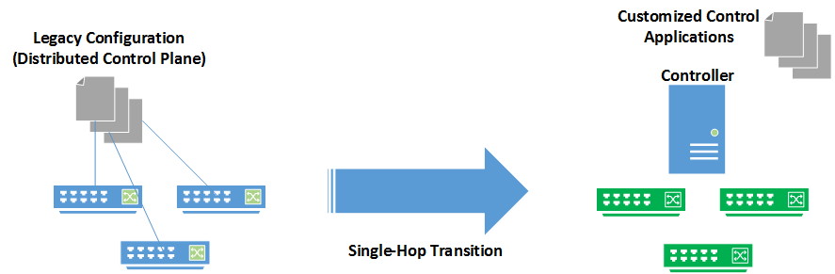
Enterprise Barrier To Entry
Notes:
Although the benefits and creative innovation SDN brings is pretty clear, the requirement to have a completely SDN hardware infrastructure and controller application transition can be barriers to entry by organizations either financially, due to lack of technical expertise, or even a failure to motivate executive leadership to endorse it.
We saw this as a direct obstacle to the quick adoption of Active Security and sought to find a solution.

Slide 15
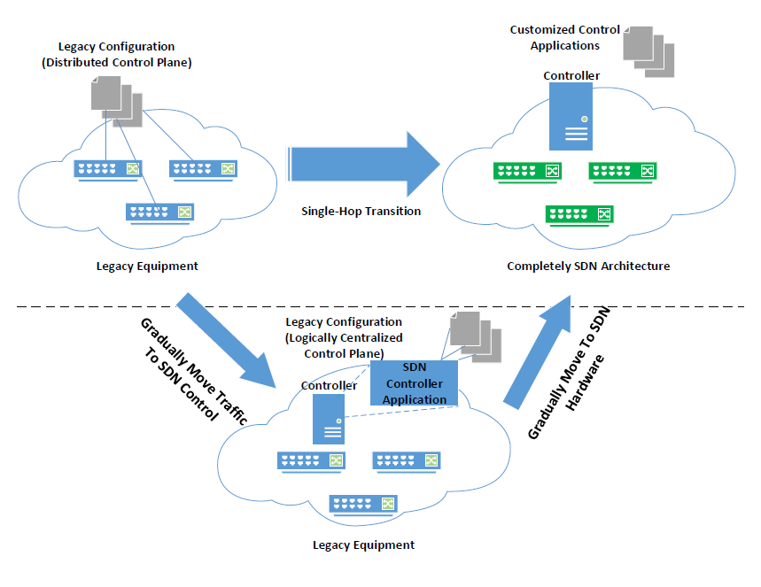
Proposed Network Transition
ClosedFlow
Notes:
Currently under submission to the HotSDN ACM Workshop, we present ClosedFlow, an alternative SDN transition that allows us to exercise SDN control and network programmability using existing legacy, proprietary equipment.
The top half of this figure depicts a single phase transition approach that requires full replacement of legacy equipment over to SDN hardware, and a complete single phase transition to SDN control applications.
ClosedFlow allows us to gradually transition traffic from legacy configuration and protocols, to those controlled by SDN applications. Once the host organization has transitioned its traffic it can easily and gradually transition its hardware to SDN.

Slide 16
Realizing ClosedFlow
Achieve full hardware forwarding speeds, installing flow rules in TCAM
Controller-switch communication channel
Topology Discovery and State Awareness
Packet matching and applying forwarding behavior
Handling “packet-in” events
Notes:
To realize this functionality, we approached 5 main problems we sought to solve:
--decoupling data and control plane leveraging full hardware forwarding speeds in switches
--Establishing a controller to switch communication channel
--Topology discovery and state awareness
--Matching packets and applying forwarding behavior
--Handling the special “send-to-controller” action, i.e. packet-in events

Slide 17
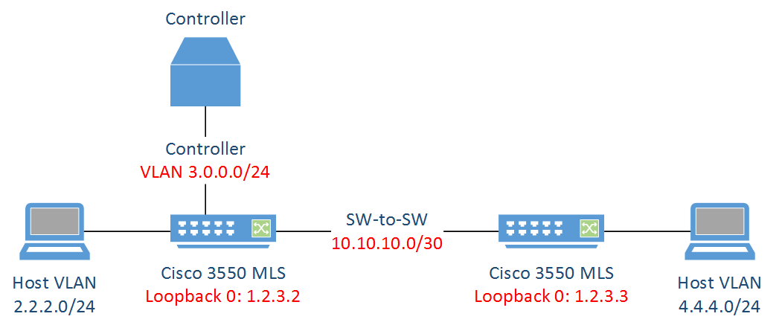
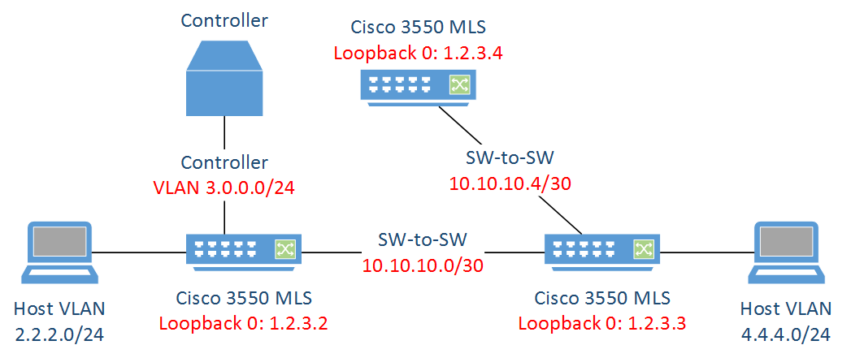
Controller-Switch Communication
Topology Discovery/State Awareness
Node ID: 1.2.3.4
OSPF Process: 1
State: Loading to Full
Int: F0/47
Topology Info
Node config state
Node ID: 1.2.3.3
OSPF Process: 1
State: Loading to Full
Int: F0/48
Notes:
-The first main requirement we needed to solve was to facilitate communications between each switch node and the controller without requiring a direct connection to each switch.
-Ethane achieved this through the use of a modified spanning tree algorithm.
-Because we will later ask our switches to perform IP switching, match on layer 3 and 4 fields, and leverage route-maps, each switch to switch connection will utilize “routed” interfaces, which takes away our ability to use several layer-2 protocols.
-We chose to circumvent this by running a minimal instance of OSPF, only advertising the addresses shown in red, Loopback 0 (our router-IDs), our point to point links between switches, and a VLAN dedicated for our controller(s).
-Coupling our OSPF instance with remote access via SSH enables us to segregate control from data traffic, facilitate storage of the topology state at the controller, and push configuration.
-So as we introduce a new switch, we will register it with the controller by configuring some basic information:
Loopback IP address
Configure any point to point “routed” interfaces
Set up an OSPF instance and set its router-ID to loopback 0
Advertise loopback and point to point networks in OSPF
Set up remote access (telnet or SSH)
Set an enable mode password
Enable remote logging of OSPF adjacency changes

Slide 18

Matching Packets and Applying Actions
Access-Control Lists
Route-maps
Interface Configurations
access-list 101 permit tcp host 2.2.2.1 host 4.4.4.1 eq 80
access-list 101 permit ip any any
access-list 102 deny tcp host 2.2.2.3 host 4.4.4.1
route-map SW1_OUT permit 5
match ip address 101
set ip next-hop 10.10.10.2
ip policy route-map SW1_OUT

Slide 19
Packet-In Events
1. New packet arrives at switch
2. Switch does not have a match and generates remote syslog
?
2
%SEC-6-IPACCESSLOGP: list 101 denied tcp 2.2.2.1 (4321) -> 4.4.4.1 (80), 1 packets
New Traffic
1
access-list 101 deny tcp any gt 0 any gt 0 log-input
access-list 101 dent udp any gt 0 any gt 0 log-input
access-list 101 deny ip any any log-input
logging discriminator TblMiss includes msg-body “101 denied”
logging host <<controller IP>> transport udp port 23456 discriminator TblMiss
Notes:
-Another challenge we face is handling traffic that we have never seen before, that is, the “Packet-In” event.
We have a couple of options we explored:
-The first is to use explicit deny access-control list entries using the “log-input” keyword to generate a syslog message that will be received by the controller with pertinent information about the flow (i.e. IPs, ports, inbound interface, node ID).
-The second is to add a special “send-to-controller” route-map entry at the end of our route-maps. This would specify a special forwarding behavior which sends the entire traffic flow to the controller.

Slide 20
Evaluation
1. New packet arrives at switch
2. Switch does not have a match and generates remote syslog
3. Controller parses message and passes parameters to flowPush.py
4. Flow rules for forward and reverse direction are pushed to switch
3
2
4
5. Traffic proceeds to next node along the path
1
5
5

Slide 21
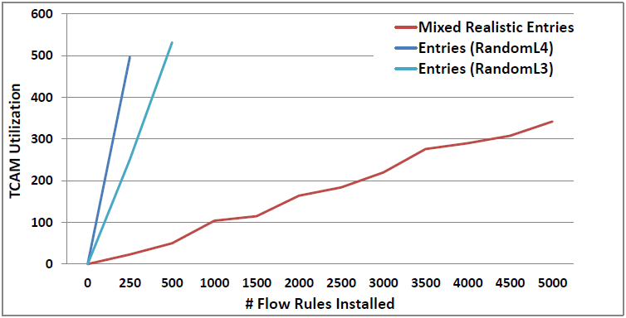
TCAM Utilization Results

Slide 22
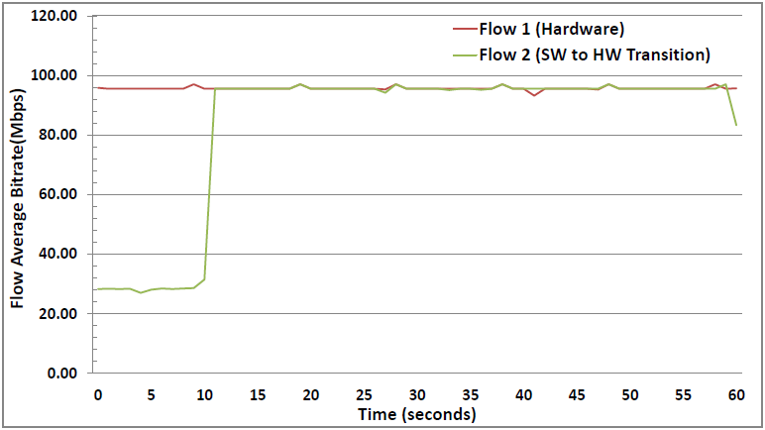
Flow Performance

Slide 23
Conclusion and Future Work
System of security inspired by SDN and OODA loop
Illustrated prototype of in-attack forensic collection
Presented a new SDN network transition alternative
Explore expanded sensor diversity
Stealthy and efficient automated forensic analysis
Other switch vendors and NBAR

Slide 24
Conclusion and Future Work
Orient and Decide
Programmatic Control
Network Artifacts
Parsed Intel
Forensic Analysis
Act
Observe
Alter Network Config / Gather Information
Sensor/Device Information
Security Devices
End systems
Network Devices
Notes:
System of security inspired by the OODA feedback loop and leverages SDN control
Illustrated prototype of in-attack forensic collection
Presented a new SDN network transition alternative that can enable quicker adoption in the enterprise
Explore expanded sensor diversity
Stealthy and efficient automated forensic analysis
Other switch vendors and NBAR

Slide 25
Questions?
Thank you!

