Slide 1
Lecture 10
Search Visualization
  “Search User Interfaces” by Hearst
  Visual Query Formulation
  Search Result Visualization
  InfoCrystal ➔ MetaCrystal ➔ searchCrystal
  Visual Search Tools on the Web

Slide 2
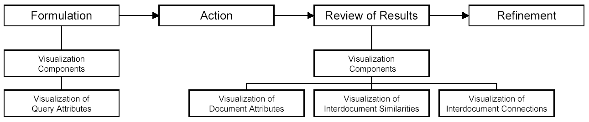
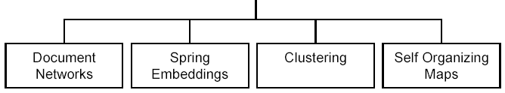
Search Visualization
Information Access = Iterative process
Visual User Interface should help users
Formulate Queries
Understand Search Results
Refine and Track Progress of Search
Source
  Thomas Mann (PhD Thesis Uni of Konstanz)
  Visualization of search results from the World Wide Web
  http://www.ub.uni-konstanz.de/v13/volltexte/2002/751//pdf/Dissertation_Thomas.M.Mann_2002.V.1.07.pdf

Slide 3
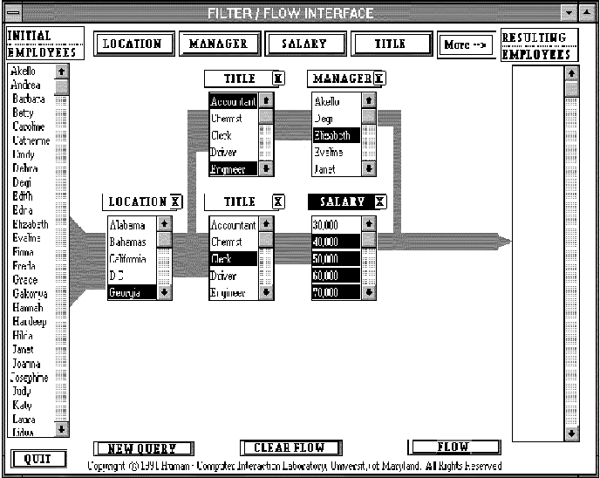
Visual Query Formulation – Boolean ➔ FilterFlow
Coordination Problem: which operator to choose?
Most people find the basic Boolean syntax counter-intuitive.
  AND “implies” broadening (opposite true).
  OR “implies” narrowing (opposite true).
AND
OR

Slide 4
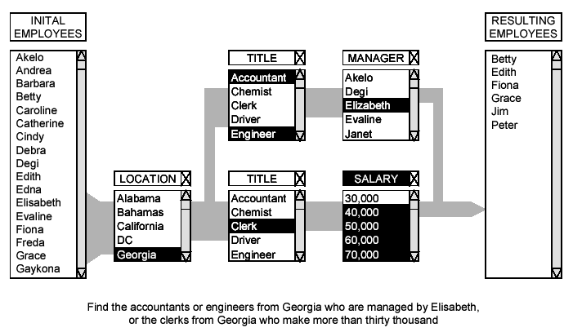
Visual Query Formulation – Boolean ➔ FilterFlow
( A or B or C) and (D or E) and (not F) ➔ express common queries
Difficult to express complex queries
How? ➔ Visualize “Power Set”

Slide 5
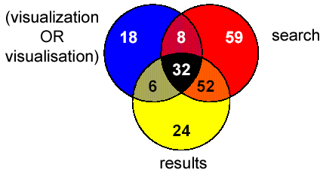
Visual Query Formulation – Venn Diagrams ➔ TeSS

Slide 6
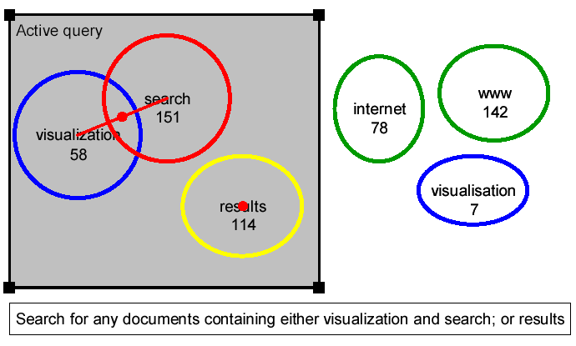
Visual Query Formulation – Venn Diagrams ➔ VQuery
1. “AND” “OR” “NOT” ➔ low visual saliency
2. How to generalize to higher number of sets?

Slide 7
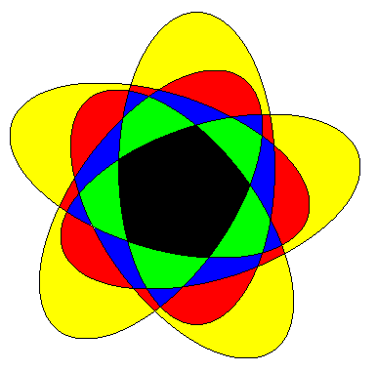
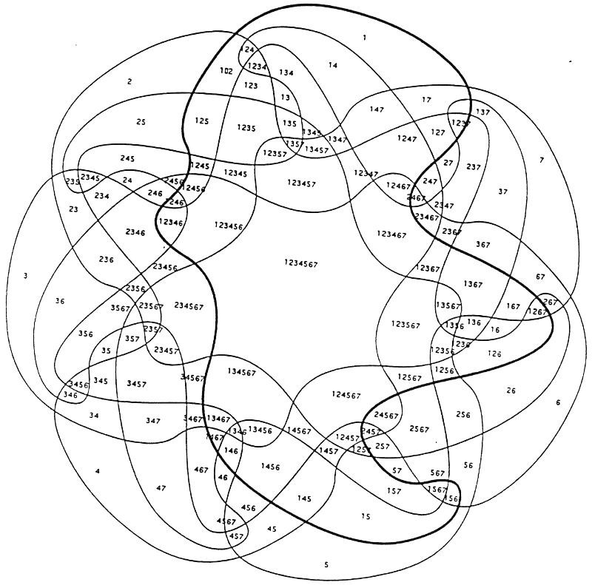
Generalize Venn Diagrams

Slide 8
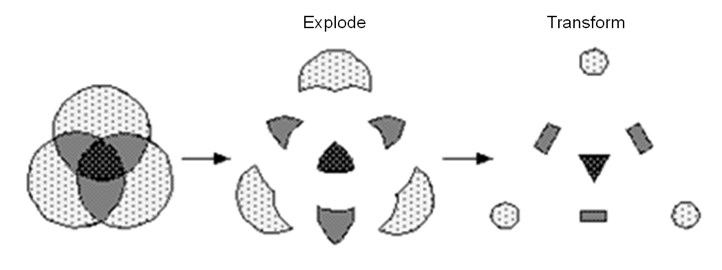
Goal – Compare Search Results
Can be Generalized to N Sets

Slide 9
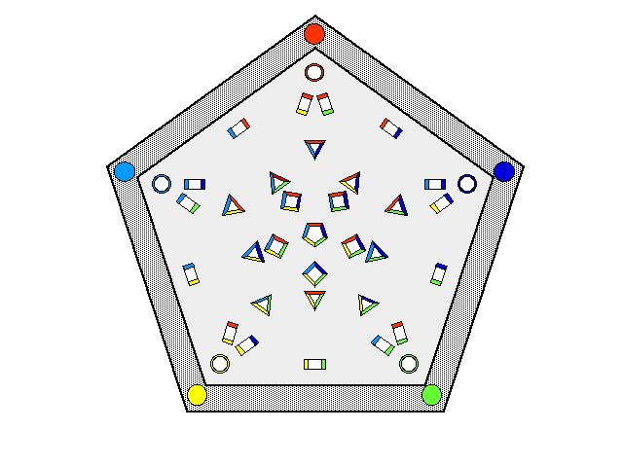
InfoCrystal

Slide 10
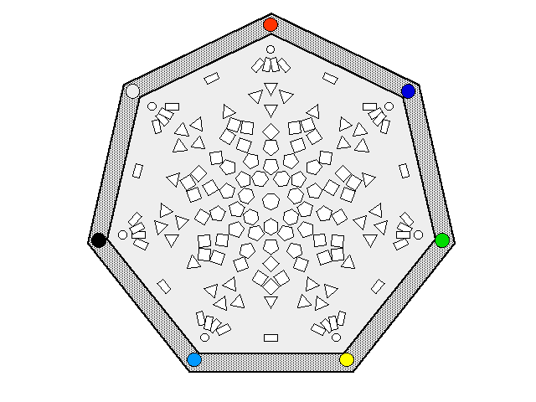
InfoCrystal

Slide 11
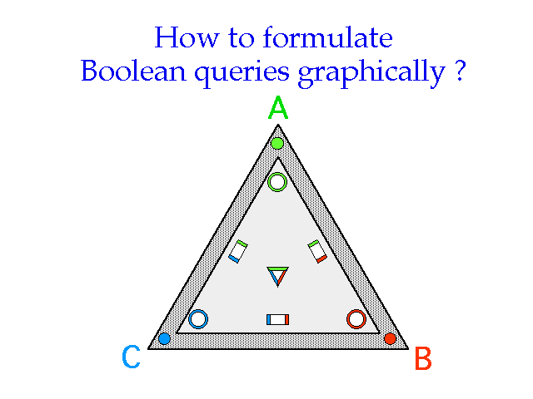
InfoCrystal
A and B and C
A and C and (not B)
A and B and (not C)
A and (B or C)

Slide 12
InfoCrystal
A and (not (B or C))
A and B and C
A and C and (not B)
A and B and (not C)
C and (not (A or B))
B and
(not (A or C))
B and C and (not A)
(not (A or B or C))

Slide 13
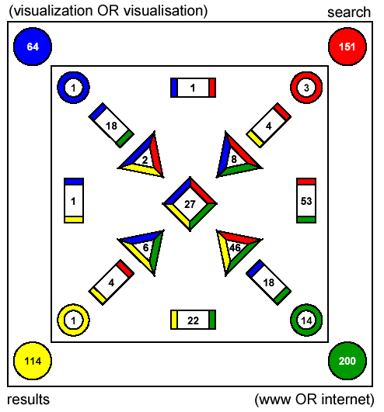
Visual Query Formulation – Boolean Power Set ➔ InfoCrystal

Slide 14
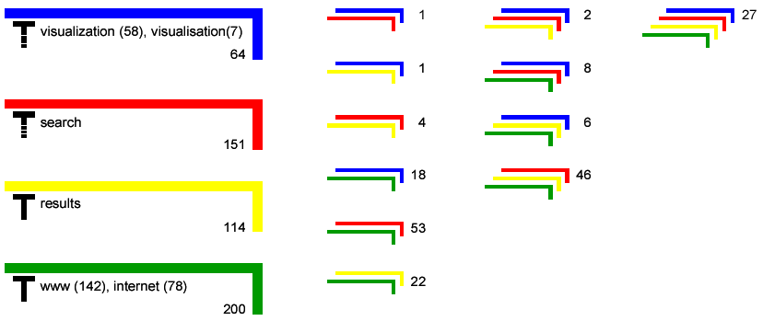
Visual Query Formulation – Other “Power Set” Visualizations
“Bracket”-visualization [Eibl 1999]

Slide 15
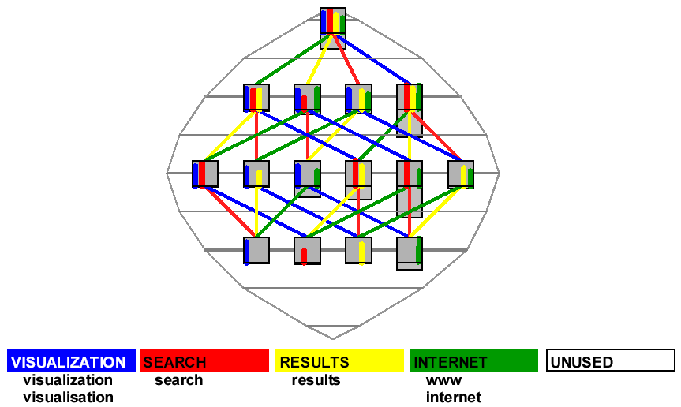
Visual Query Formulation – “Power Set” – NIRVE

Slide 16
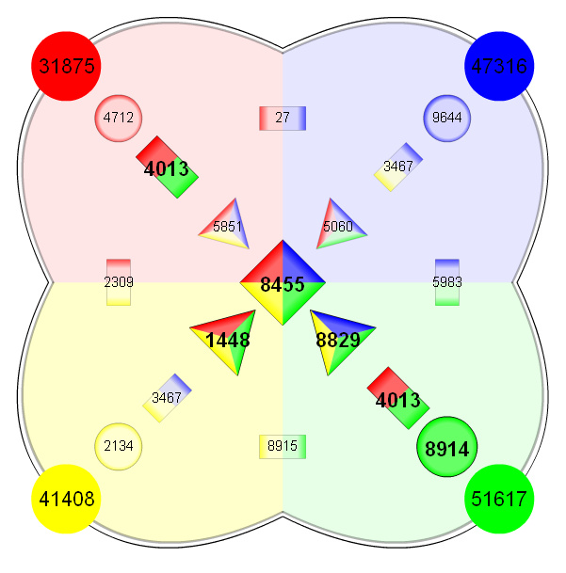
Visual Query Formulation – “Power Set” Visualizations

Slide 17
Visualization of Search Results & Inter-Document Similarities

Slide 18
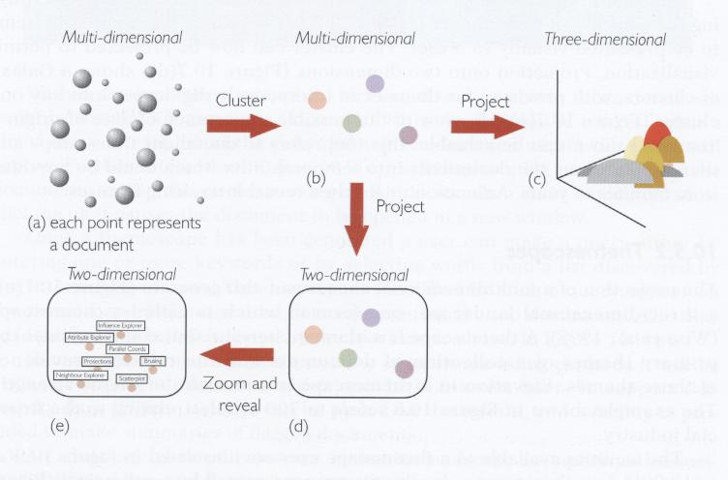
Visualization of Search Results & Inter-Document Similarities

Slide 19
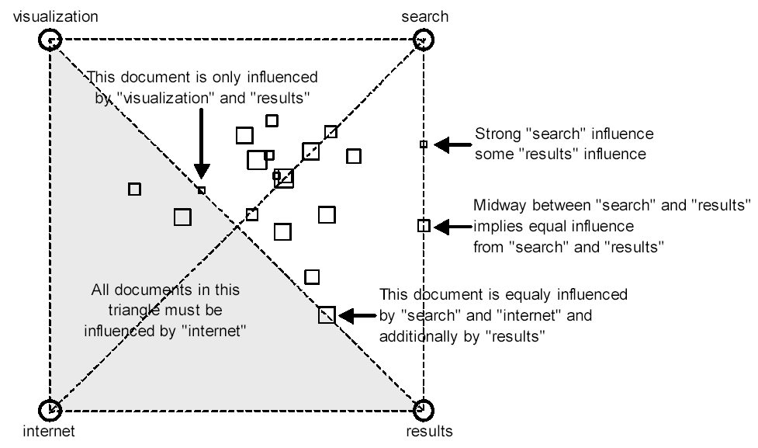
Search Result Visualization ➔ VIBE

Slide 20
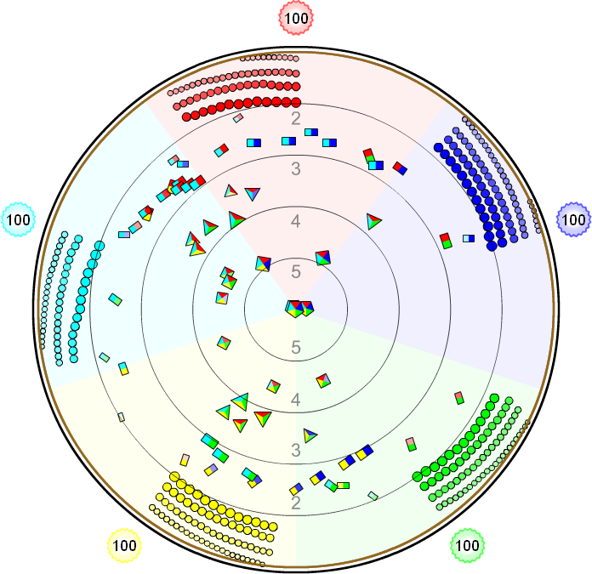
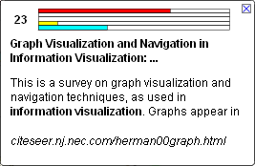

Search Result Visualization ➔ MetaCrystal: Cluster Bull’s Eye
Radial Mapping
Radius = Total Ranking
Angle Reflects Rankings
Size = Rankings by
Engines
Google
MSN
Teoma
Lycos
AltaVista

Slide 21
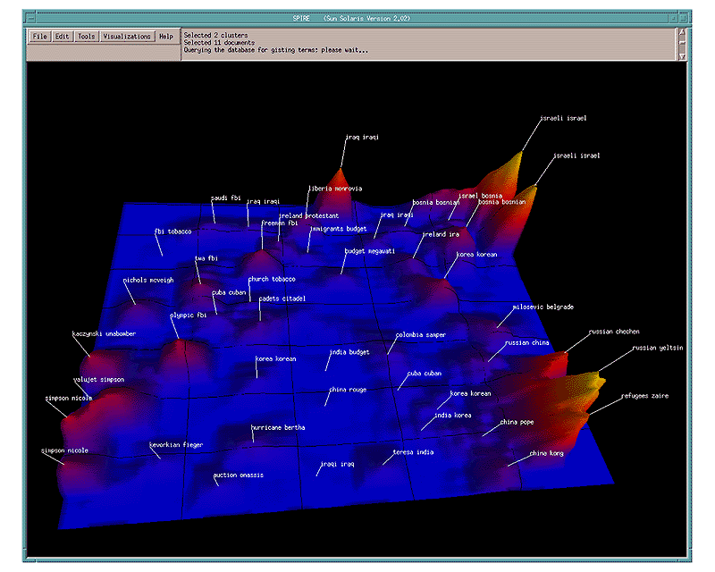
Search Result Visualization ➔ ThemeScapes

Slide 22
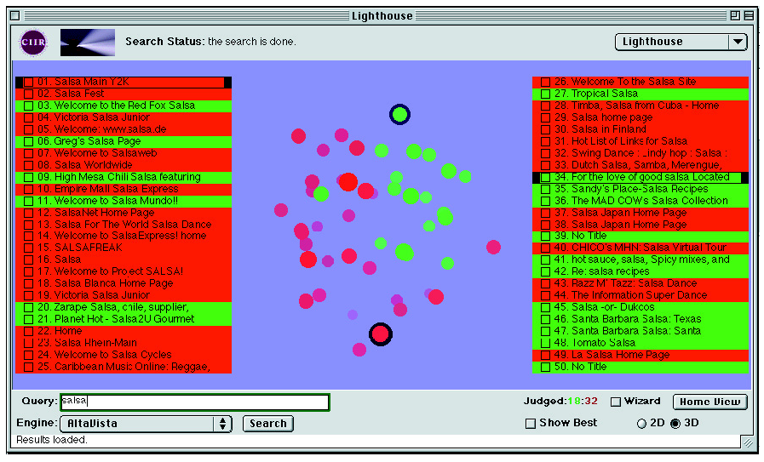
Search Result Visualization ➔ Lighthouse
Cluster Hypothesis – related documents relevant to same requests
and should be in close spatial proximity.

Slide 23
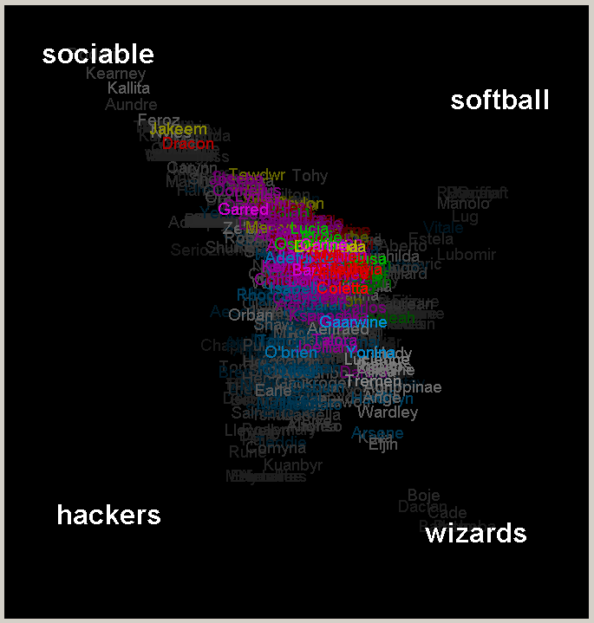
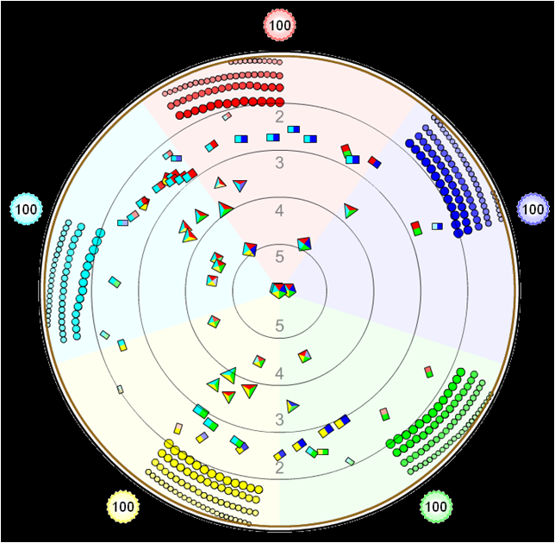
Search Result Visualization ➔ Point of Reference
VisualWho
MetaCrystal

Slide 24
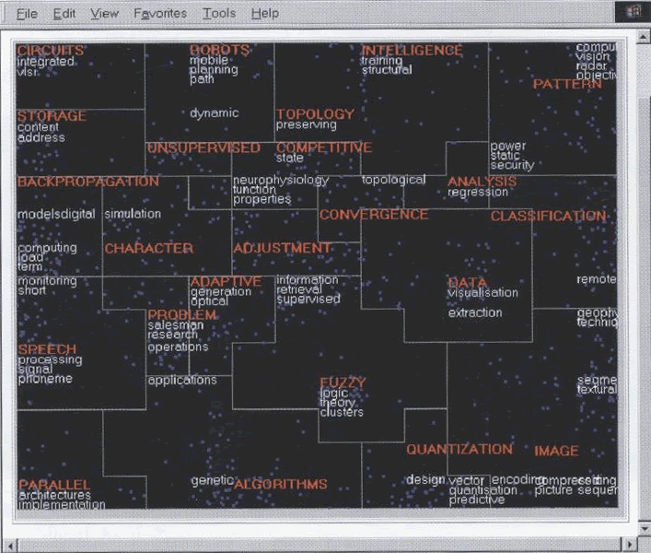
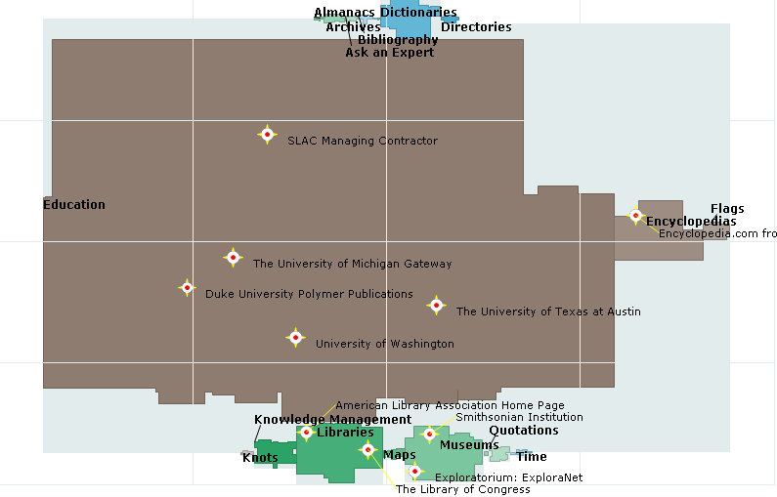
Search Result Visualization ➔ 2D Maps
Self-Organizing Map
Map.net

Slide 25
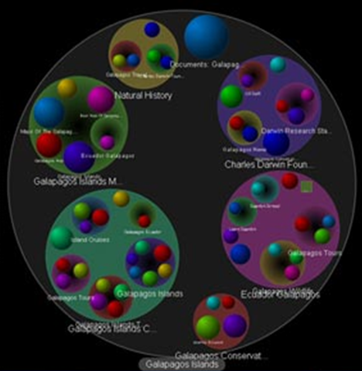
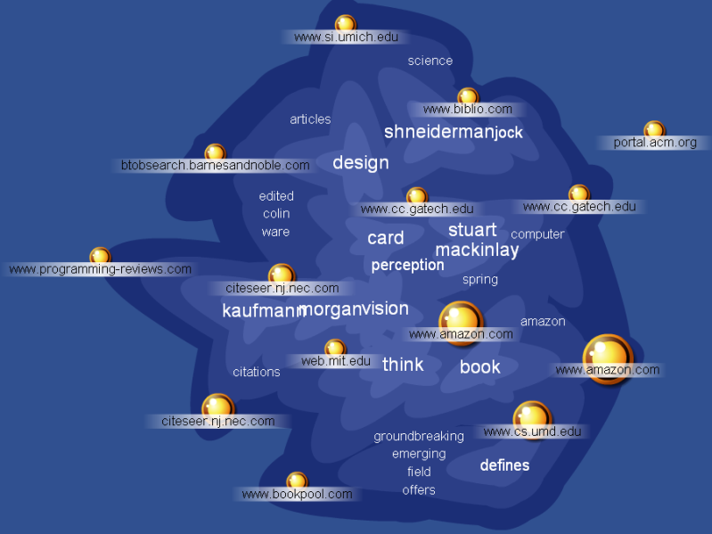
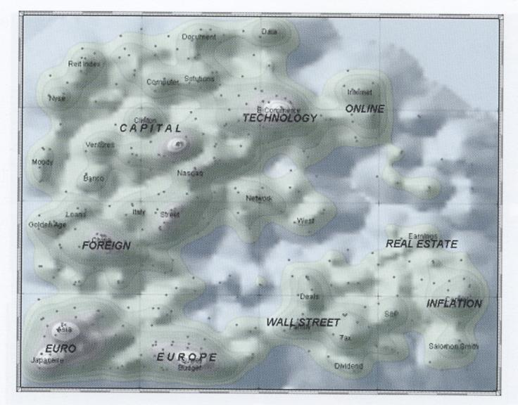
Search Result Visualization ➔ 2.5D Maps
Grokker
Kartoo
ThemeScape / Aureka

Slide 26
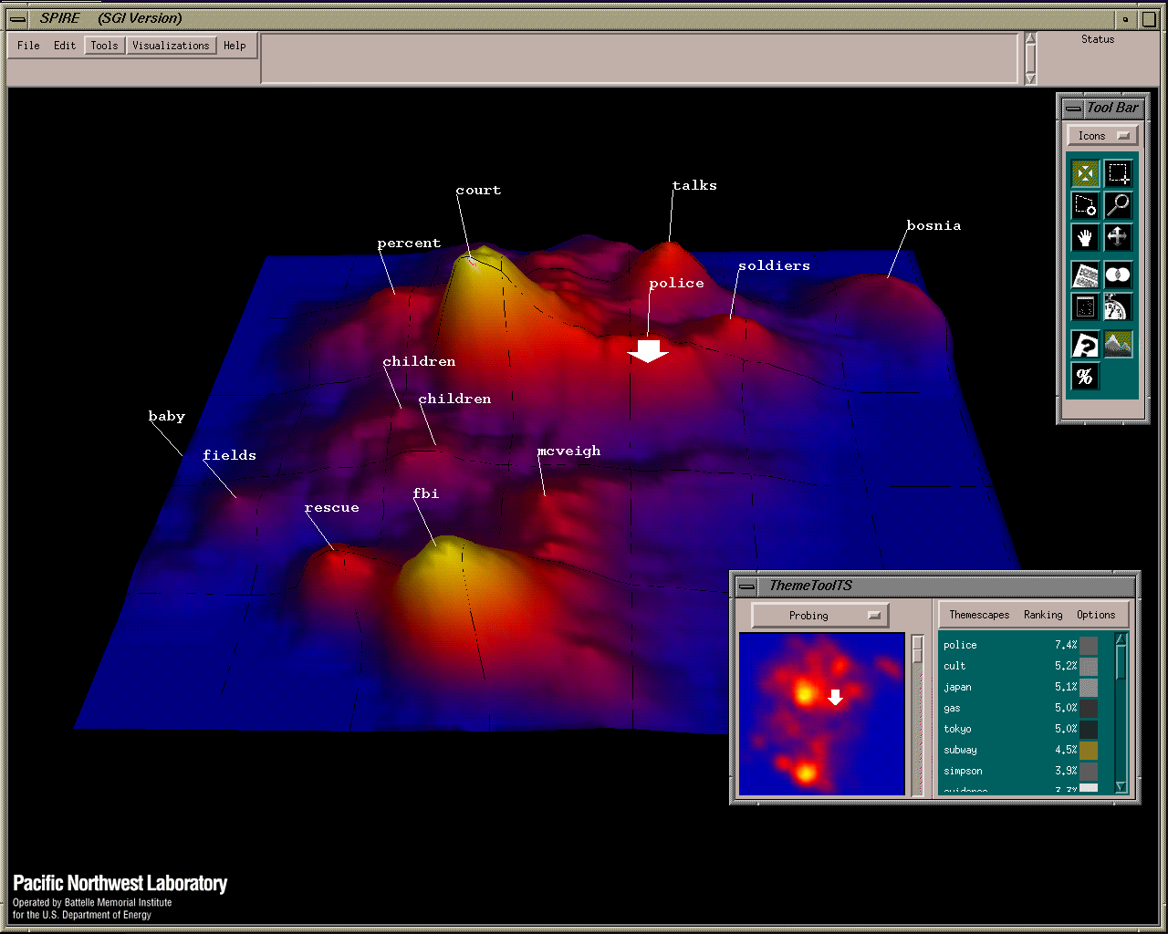
Search Result Visualization ➔ 3D
Lighthouse
Themescapes

Slide 27
InfoCrystal ➔ MetaCrystal ➔ searchCrystal
InfoCrystal
  Visualize Overlap between Search Results ➔ Visualize Power Set
MetaCrystal
  Visualize Overlap between Result Sets from Different Search Engines
  Authority Effect: The more engines that find a result, the greater its probability of being relevant.
  Ranking Effect: The higher up a result is placed and the more engines that find it, the greater its probability of being relevant.
searchCrystal
  Compare, remix and share results from web, image, video, blog, tagging, news engines, Flickr images or RSS feeds.
  Embed on a web or blog page
  Demo of Most Visited Wikipedia pages (Sept 06 – Jan 07)
You may find interesting two papers published in First Monday:
http://firstmonday.org/htbin/cgiwrap/bin/ojs/index.php/fm/article/view/1764/1644
http://firstmonday.org/htbin/cgiwrap/bin/ojs/index.php/fm/article/view/1765/1645

Slide 28
Search Visualization – Tools
Viewzi http://www.viewzi.com/search/whitevoid-photocloud/
Quintura http://www.quintura.com/
SpaceTime http://www.spacetime.com/
AquaBrowser http://demo.aquabrowser.com/?q=visualization
Aduna / Vound http://www.vound-software.com/
Closed Down
  Kartoo
  Grokker
  SearchMe

