Slide 1
Lecture 11
Text Visualization
  Visualization for Text Analysis by Hearst
  http://searchuserinterfaces.com/book/sui_ch11_text_analysis_visualization.html
  Visualization of Document Attributes
  Some Tools

Slide 2
Text & Document Visualization
Text not pre-attentive
Text = Abstract Concepts = Very High Dimensionality
  Multiple & ambiguous meanings
  Combinations of abstract concepts more difficult to visualize
  Different combinations imply different meanings
  Language only hints at meaning
  ➔ based on common understanding “How much is that doggy in the window?”
Facilitate Information Retrieval
  Collection Overview
  Visualize which parts of query satisfied by document / collection
  Understand why documents retrieved
Cluster Documents Based on Words in Common
  Finds overall similarities among groups of documents
  Picks out some themes, ignores others
Map Clusters onto 2D or 3D Representation
  Minimize time/effort to decide which documents to examine

Slide 3
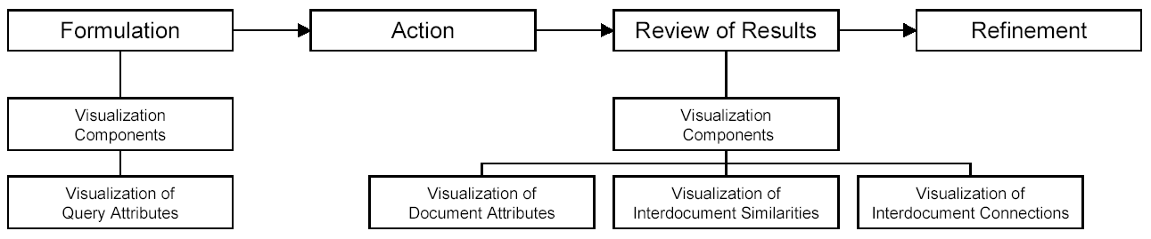
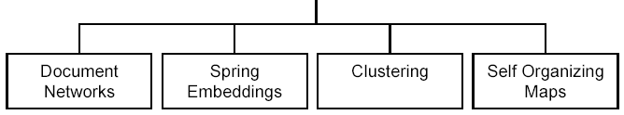
How to Use Visualization to Support Search
Source
  Thomas Mann (PhD Thesis Uni of Konstanz)
  Visualization of search results from the World Wide Web
  http://www.ub.uni-konstanz.de/v13/volltexte/2002/751//pdf/Dissertation_Thomas.M.Mann_2002.V.1.07.pdf

Slide 4
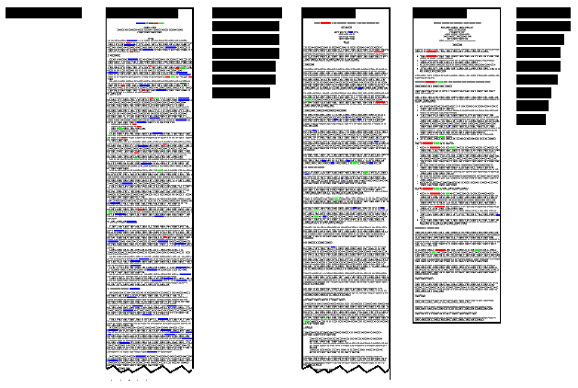
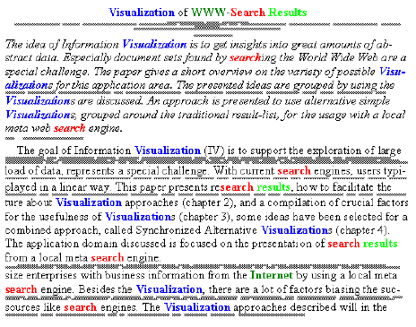
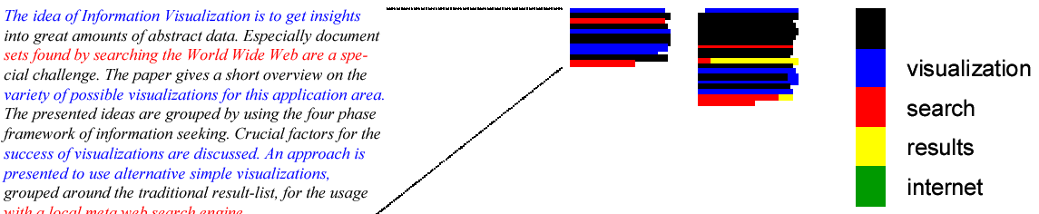
Visualization of Document Attributes
Thumbnails
SeeSoft

Slide 5
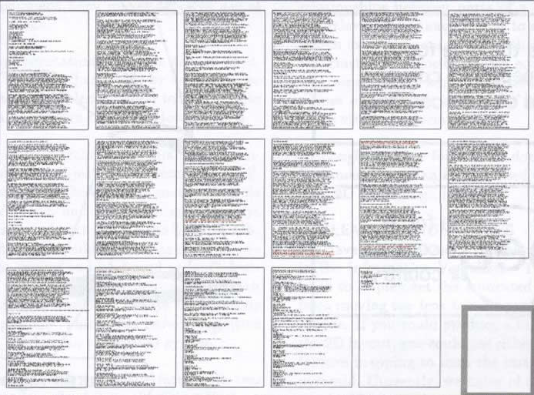
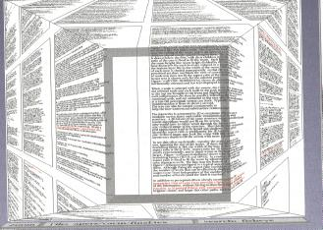
Visualization of Document Attributes ➔ Document Lens
Problem: Text can be too small to read
  ➔ Focus + Context Fisheye Distortion
Does it work?

Slide 6
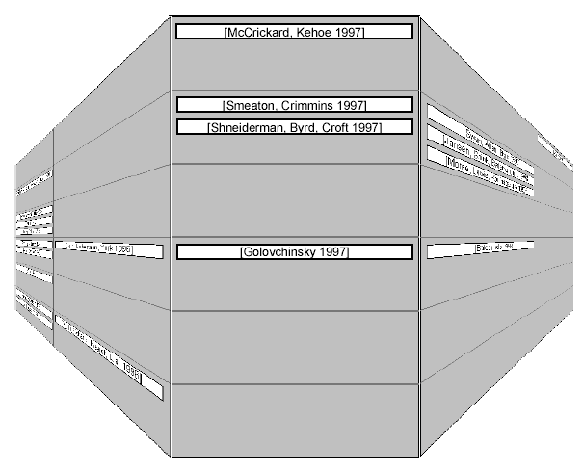
Visualization of Document Attributes ➔ Perspective Wall

Slide 7
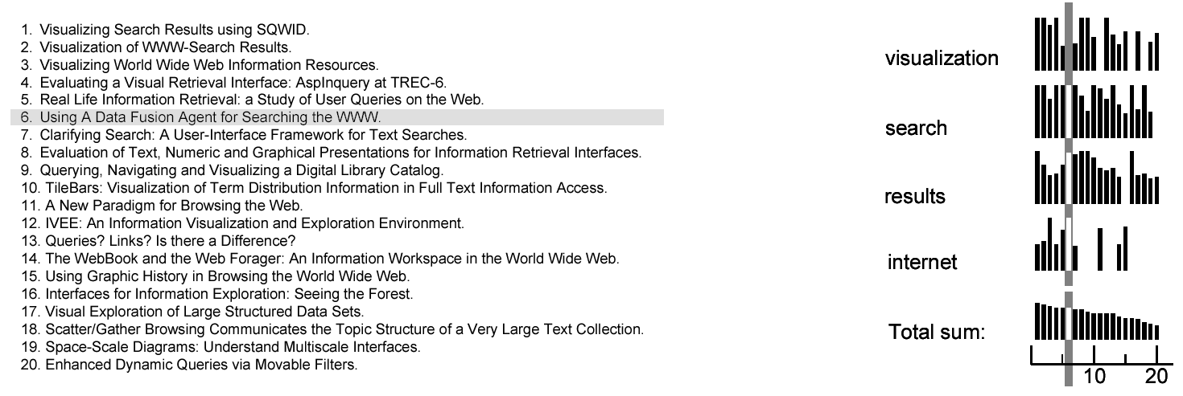
Visualization of Document Attributes ➔ Bar Graphs
[Veerasamy 1996] / [Veerasamy, Belkin 1996]

Slide 8
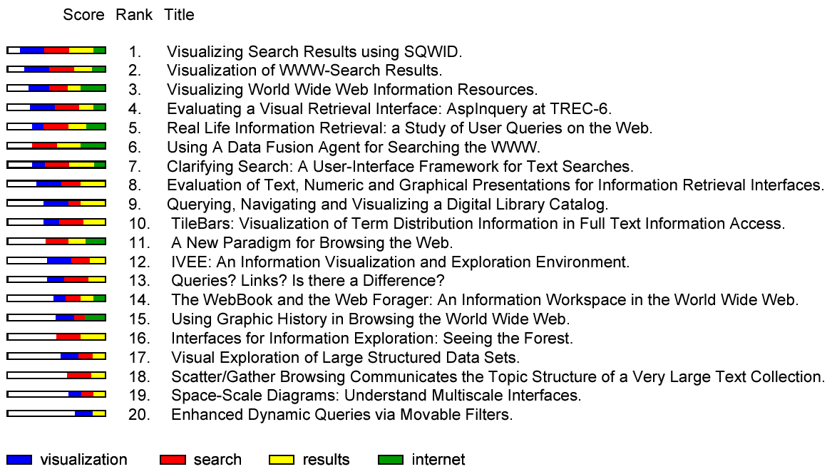
Visualization of Document Attributes ➔ Stacked Bar Graphs
VQRa of the WInquery system [Shneiderman, Byrd, Croft 1997]

Slide 9
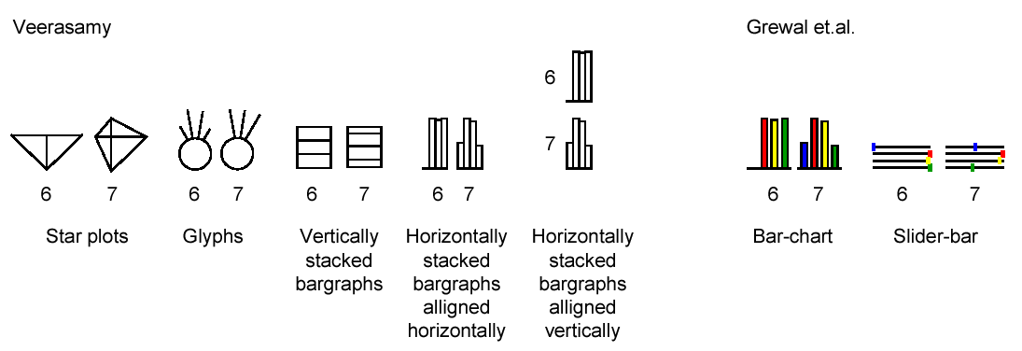
Visualization of Document Attributes ➔ NIRVE & R-Wheels

Slide 10
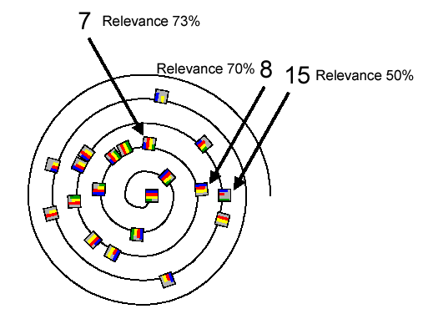
Visualization of Document Attributes ➔ NIRVE

Slide 11
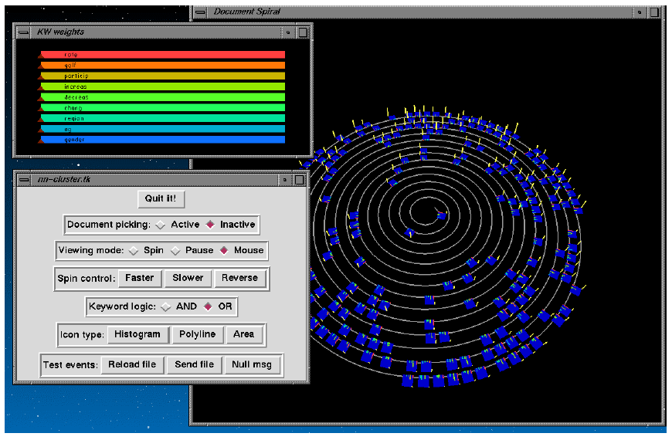
Visualization of Document Attributes ➔ NIRVE

Slide 12
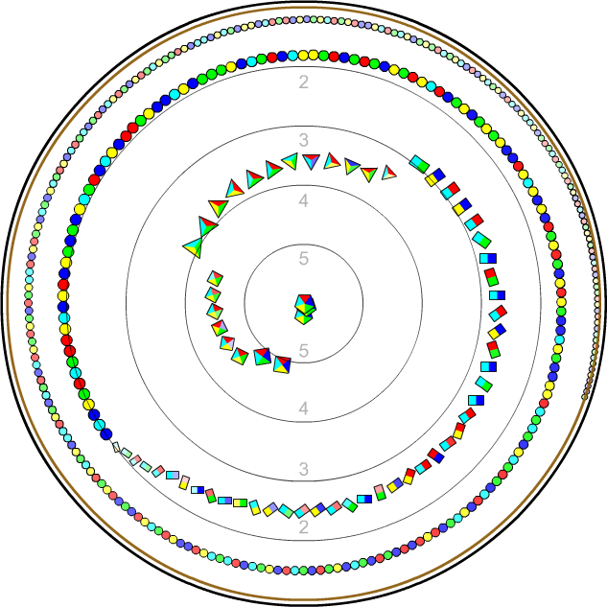
Visualization of Document Attributes ➔ RankSpiral

Slide 13
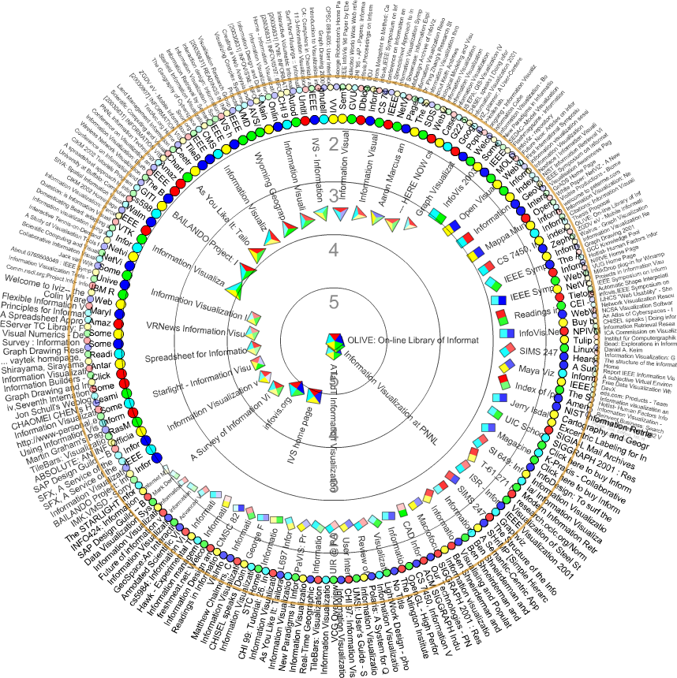
Visualization of Document Attributes ➔ RankSpiral

Slide 14
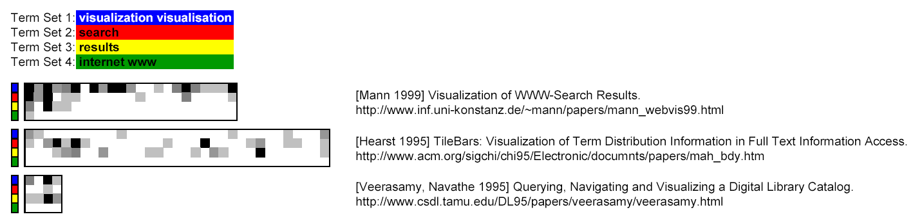
Visualization of Document Attributes ➔ TileBars

Slide 15
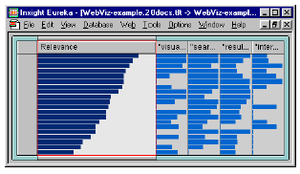
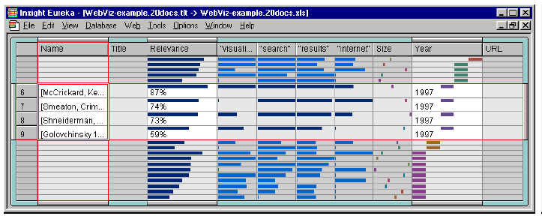
Visualization of Document Attributes ➔ Table Lens

Slide 16
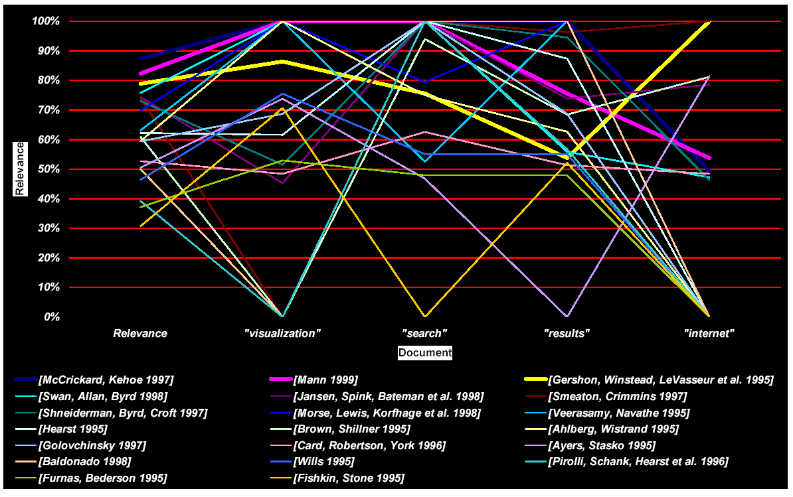
Visualization of Document Attributes ➔ Parallel Coordinates

Slide 17
Text Visualization – Some Tools
Wordle – http://www.wordle.net/
TextArc – http://www.textarc.org/
CapitolWords – http://capitolwords.org/
NYTimes State of the Union – http://www.nytimes.com/ref/washington/20070123_STATEOFUNION.html

