Slide 1
Lecture 12
Heuristic Evaluation Assignment

Slide 2
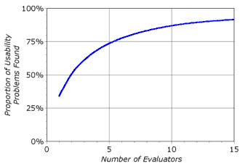
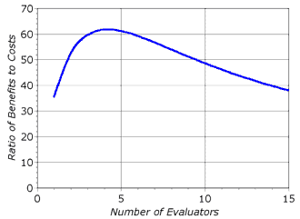
User-Centered Design Methods
Heuristic Evaluation
  Quick and cheap
  Suitable for early use in usability engineering lifecycle
  Evaluate compliance with recognized usability principles
  (the "heuristics").
  Three to five evaluators: more ➔ diminishing returns
Nielsen's Ten Usability Heuristics
  Visibility of system status
  System matches the real world
  User control and freedom
  Consistency and standards
  Error prevention
  Recognition rather than recall
  Flexibility and efficiency of use
  Aesthetic and minimalist design
  Help users recognize, diagnose, and recover from errors
  Help and documentation
➔ Find Flaws & Suggest Improvements

Slide 3
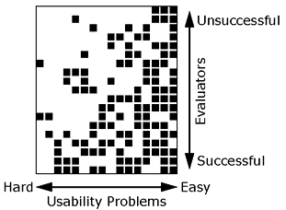
How to conduct Heuristic Evaluation
Evaluator goes through the interface several times and inspects it
Interface = List of Heuristics?
Single individual will never be able to find all the usability problems.
Different people find different usability problems
Evaluation results ➔ Written Report

Slide 4
Nielsen's Ten Usability Heuristics
1. Visibility of system status
Always keep users informed about what is going on.
Provide appropriate feedback within reasonable time.
2. Match between system and the real world
Speak the users' language, with words, phrases and concepts familiar to the user, rather than system-oriented terms.
Follow real-world conventions, making information appear in a natural and logical order.
3. User control and freedom
Users often choose system functions by mistake.
Provide a clearly marked "out" to leave an unwanted state without having to go through an extended dialogue.
Support undo and redo.
4. Consistency and standards
Users should not have to wonder whether different words, situations, or actions mean the same thing.
Follow platform conventions.
5. Error prevention
Even better than good error messages is a careful design which prevents a problem from occurring in the first place.

Slide 5
Nielsen's Ten Usability Heuristics (cont.)
6. Recognition rather than recall
Make objects, actions, and options visible.
User should not have to remember information from one part of the dialogue to another.
Instructions for use of the system should be visible or easily retrievable whenever appropriate.
7. Flexibility and efficiency of use
Accelerators -- unseen by the novice user -- may often speed up the interaction for the expert user so that the system can cater to both inexperienced and experienced users.
Allow users to tailor frequent actions.
8. Aesthetic and minimalist design
Dialogues should not contain information which is irrelevant or rarely needed.
Every extra unit of information in a dialogue competes with the relevant units of information and diminishes their relative visibility.
9. Help users recognize, diagnose, and recover from errors
Expressed in plain language (no codes) and precisely indicate the problem.
Constructively suggest a solution.
10. Help and documentation
Even though it is better if the system can be used without documentation, it may be necessary to provide help and documentation.
Help information should be easy to search, focused on the user's task, list concrete steps to be carried out, and not be too large.

