Slide 1
Information Visualization Course
Information
Visualization
Prof. Anselm Spoerri
aspoerri@rutgers.edu

Slide 2
Course Goals
Information Visualization = Emerging Field
  Provide Thorough Introduction
Information Visualization aims
  To use human perceptual capabilities
  To gain insights into large and abstract data sets
  that are difficult to extract using standard query languages
Abstract and Large Data Sets
  Symbolic
  Tabular
  Networked
  Hierarchical
  Textual information

Slide 3
Course Approach
Foundation in Human Visual Perception
  How it relates to creating effective information visualizations.
Understand Key Design Principles
for Creating Information Visualizations
Study Major Information Visualization Tools
  Data & Map Visualizations ... Visualization of Large Abstract Spaces
Use Visualization Tools
  ManyEyes, Google Motion Chart, Tableau, Google Fusion Table
Evaluate Information Visualization Tools
  Heuristic Evaluation & Usability Studies
Design New, Innovative Visualizations

Slide 4
Course Approach (cont.)
1 Human Visual Perception + Human Computer Interaction
  “Information Visualization: Perception for Design” by Colin Ware
2 Key Tools in Information Visualizations
  Data & Statistical – Interactive Infographics – Map & Geographic
  Image & Gigapixel – Multimedia & Augmented Reality
  Search & Text – Blog & Social Media – Social Network
3 DataStory Design Principles & Examples
Collaboratively develop the “DataStory” concept, its key design principles and showcase examples.
4 Term Projects
  Review + Analyze Visualization Tools or How to Guide
  Evaluate Visualization Tool
  Design Visualization Prototype

Slide 5
Gameplan
Course Website
http://comminfo.rutgers.edu/~aspoerri/Teaching/InfoVisOnline/Home.htm
Assignments & Grading
  Participation - 5%
  Short Reports - 15%
  Visualization Tasks - 25%
  Heuristic Evaluation of InfoVis Tool - 15%
  DataStory Design Principles & Examples - 15%
  Term Project - 25%

Slide 6
Gameplan (cont.)
Schedule
  Link to Lectures page
  http://comminfo.rutgers.edu/~aspoerri/Teaching/InfoVisOnline/Schedule.htm
Lecture Slides
http://comminfo.rutgers.edu/~aspoerri/Teaching/InfoVisOnline/Lectures/Lectures.htm
  Narrated Lecture Slides posted by Monday Noon each week
  Links to Related Info: articles, videos and online tools
  (will be continuously updated throughout semester)
  Slides Handout available for download & print-out
    Open in Powerpoint
    File > Print …
      “Print what” = “Handout”
      Select “2 slides” per page

Slide 7
Term Projects
Review + Analyze InfoVis Tools or How-to-Guide
  Review and Analyze existing visualization tools for specific data domain
  OR
  Create a How to Guide that describes how to visualize certain data sets and which tools can be used
  Describe topic and approach taken
Evaluate Visualization Tool
  Describe tool you want to evaluate as well as why and how
  Describe and motivate evaluation design
  Conduct evaluation with 3 to 5 people
  Report on evaluation results
Design Visualization Prototype
  Describe data domain, motivate your choice and describe your programming expertise
  Describe design approach
  Develop prototype
  Present prototype

Slide 8
Term Projects (cont.)
Group Project
  Collect Large Data Set for specific data domain and/or Use Data APIs to access large data domain
  Use Visualization Tool(s), such as ManyEyes, Google Motion Charts, Tableau, and/or Google Fusion Tables to visualize data
  Develop DataStory for selected data domain and presented data
Provide more specific instructions & examples from previous classes in future lecture.
Send instructor email with short description of your project idea by Week 7

Slide 9
Your Guide
Anselm Spoerri
  Computer Vision
  Filmmaker – IMAGO
    Click on the center image to play video
  Information Visualization – InfoCrystal ➔ searchCrystal
  Media Sharing – Souvenir
    In Action Examples: click twice on digital ink or play button
  Rutgers Website

Slide 10
Goal of Information Visualization
Use human perceptual capabilities
to gain insights into large data sets
that are difficult to extract
using standard query languages
Exploratory Visualization
  Look for structure, patterns, trends, anomalies, relationships
  Provide a qualitative overview of large, complex data sets
  Assist in identifying region(s) of interest and appropriate parameters for more focussed quantitative analysis
Shneiderman's Mantra:
  Overview first, zoom and filter, then details-on-demand
  Overview first, zoom and filter, then details-on-demand
  Overview first, zoom and filter, then details-on-demand

Slide 11
Information Visualization - Problem Statement
Scientific Visualization
  Show abstractions, but based on physical space
Information Visualization
  Information does not have any obvious spatial mapping
Fundamental Problem
  How to map non–spatial abstractions
  into effective visual form?
Goal
  Use of computer-supported, interactive, visual
  representations of abstract data to amplify cognition

Slide 12
How Information Visualization Amplifies Cognition
Increased Resources
  Parallel perceptual processing
  Offload work from cognitive to perceptual system
Reduced Search
  High data density
  Greater access speed
Enhanced Recognition of Patterns
  Recognition instead of Recall
  Abstraction and Aggregation
Perceptual Interference
Perceptual Monitoring
  Color or motion coding to create pop out effect
Interactive Medium

Slide 13
Information Visualization – Key Design Principles
Information Visualization = Emerging Field
Key Principles
  Abstraction
  Overview ➔ Zoom+Filter ➔ Details-on-demand
  Direct Manipulation
  Dynamic Queries
  Immediate Feedback
  Linked Displays
  Linking + Brushing
  Provide Focus + Context
  Animate Transitions and Change of Focus
  Output is Input
  Increase Information Density

Slide 14
Information Visualization – “Toolbox”
Perceptual Coding
Interaction
Position
Size
Orientation
Texture
Shape
Color
Shading
Depth Cues
Surface
Motion
Stereo
Proximity
Similarity
Continuity
Connectedness
Closure
Containment
Direct Manipulation
Immediate Feedback
Linked Displays
Animate Shift of Focus
Dynamic Sliders
Semantic Zoom
Focus+Context
Details-on-Demand
Output ➔ Input
Maximize Data-Ink Ratio
Maximize Data Density
Minimize Lie factor
Information Density

Slide 15
Spatial vs. Abstract Data
"Spatial" Data
  Has inherent 1-, 2- or 3-D geometry
  MRI: density, with 3 spatial attributes, 3-D grid connectivity
  CAD: 3 spatial attributes with edge/polygon connections, surface properties
Abstract, N-dimensional Data
  Challenge of creating intuitive mapping
  Chernoff Faces
  Software Visualization: SeeSoft
  Scatterplot and Dimensional Stacking
  Parallel Coordinates and Table Lens
  Hierarchies: Treemaps, Brain,Hyperbolic Tree
  Boolean Query: Filter-Flow, InfoCrystal

Slide 16
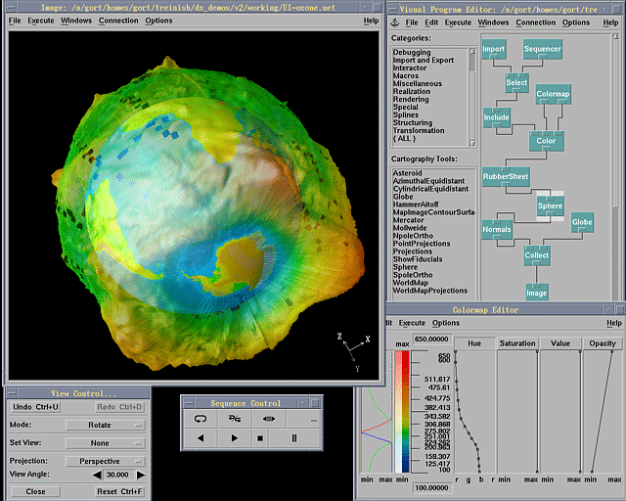
"Spatial" Data Displays IBM Data Explorer http://www.research.ibm.com/dx/

Slide 17
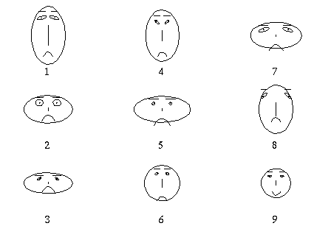
Abstract, N-Dimensional Data Displays
Chernoff Faces

Slide 18
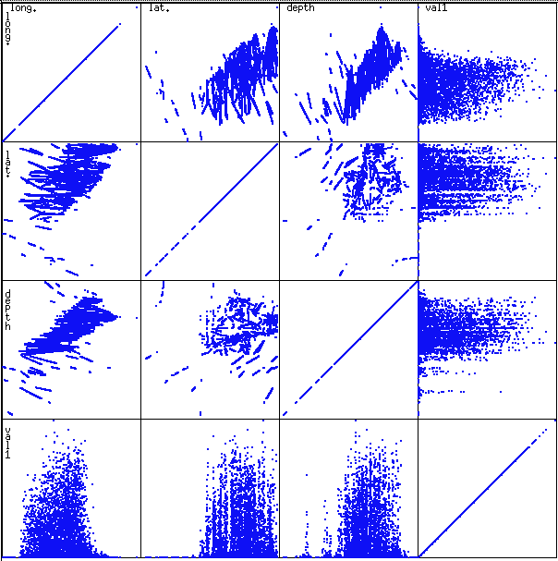
Abstract, N-Dimensional Data Displays
Scatterplot and Dimensional Stacking

Slide 19
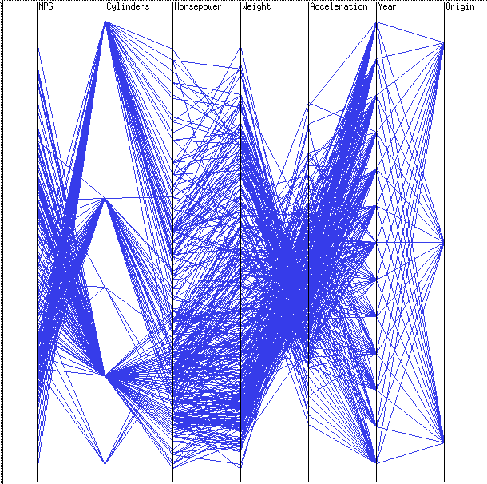
Abstract, N-Dimensional Data Displays
Parallel Coordinates by Isenberg (IBM)

Slide 20
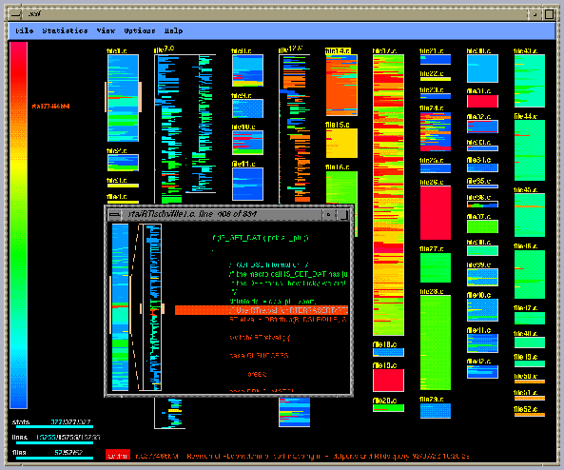
Abstract, N-Dimensional Data Displays
Software Visualization - SeeSoft
Line = single line of source code and its length Color = different properties

Slide 21
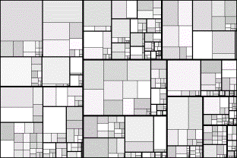
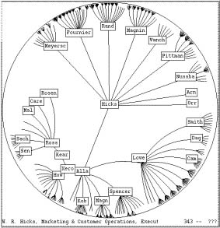
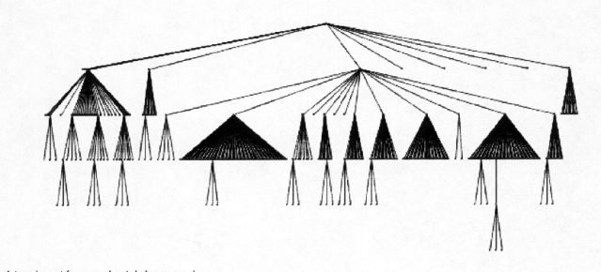
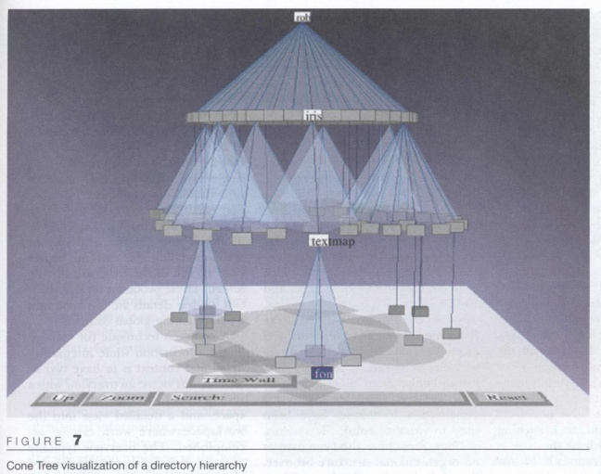
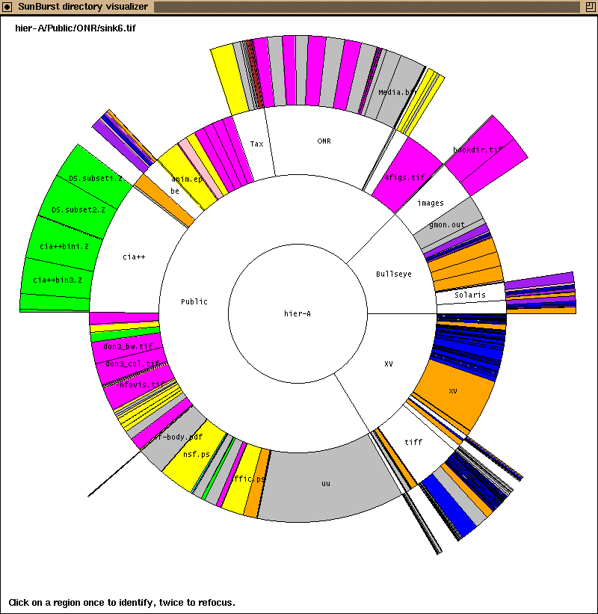
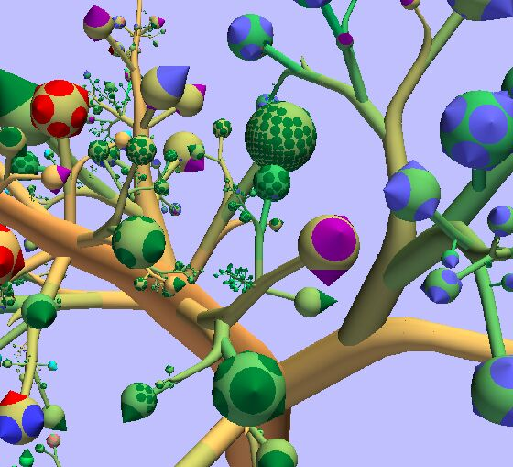
Abstract ➔ Hierarchical Information – Preview
Traditional
Treemap
Hyperbolic Tree
ConeTree
SunTree
Botanical

Slide 22
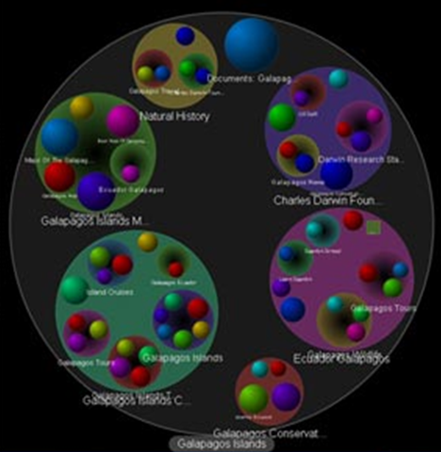
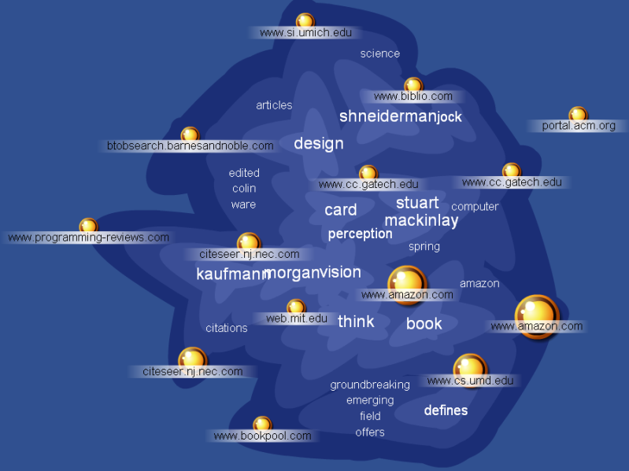
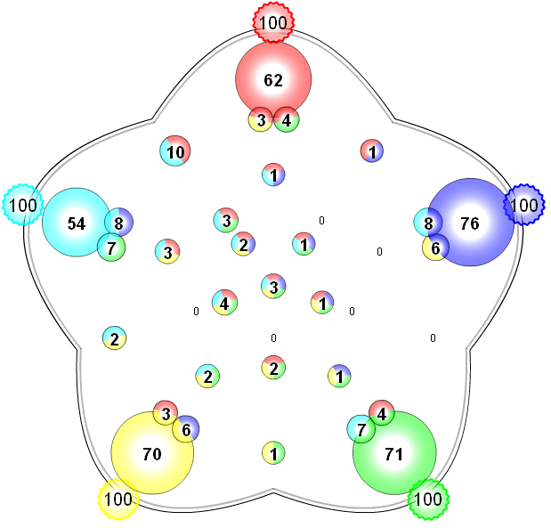
Abstract ➔ Text – MetaSearch Previews
Grokker
Kartoo
MSN
Lycos
AltaVista
MetaCrystal ➔ searchCrystal

Slide 23
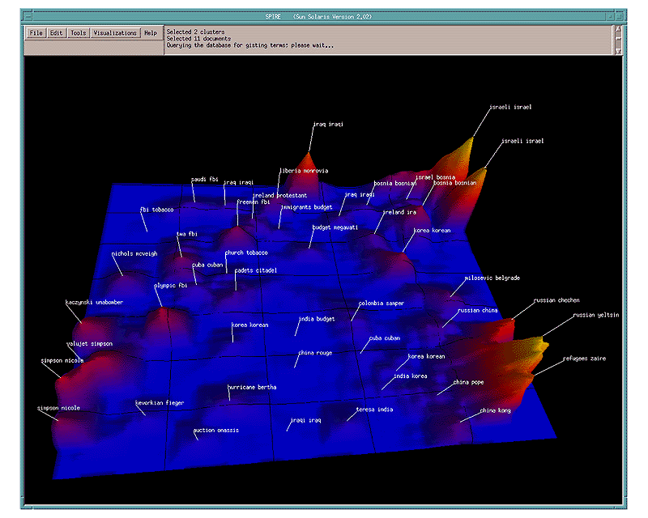
Abstract ➔ Text
Document Visualization - ThemeView

