Slide 1
Lecture 3
Tufte – Envisioning Information
  Tufte’s Measures and Design Principles
Human Computer Interaction
  Theories
  Three Pillars of Interface Design
  LUCID
  Recognize Diversity
  Interaction Styles
  User-Centered Design Methods
  Eight Golden Rules of Interface Design

Slide 2
Edward Tufte
Books
The Visual Display of Quantitative Information
Envisioning Information
Visual Explanations

Slide 3
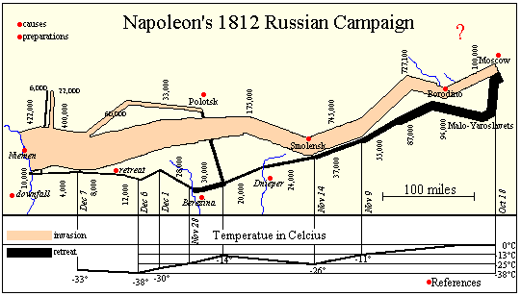
Tufte - Minard's Napoleon's March to Moscow

Slide 4
Tufte - Escape Flatland: Napoleon's March
Enforce Visual Comparisons
Width of tan and black lines gives you an immediate comparison of the size of Napoleon's army at different times during march.
Show Causality
Map shows temperature records and some geographic locations that shows that weather and terrain defeated Napoleon as much as his opponents.
Show Multivariate data
Napoleon's March shows six: army size, location (in 2 dimensions), direction, time, and temperature.
Use Direct Labeling
Integrate words, numbers & images
Don't make user work to learn your "system.”
Legends or keys usually force the reader to learn a system instead of studying the information they need.
Design Content-Driven

Slide 5
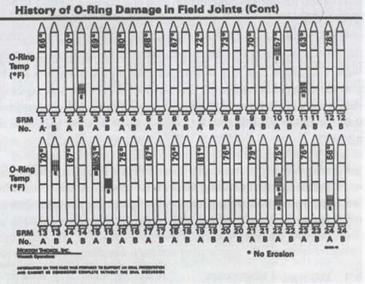
Tufte – Challenger Data: Launch?
Graph obscures important variables of interest: temperature is shown textually and graphically; degree of damage is not mapped onto a nominal scale

Slide 6
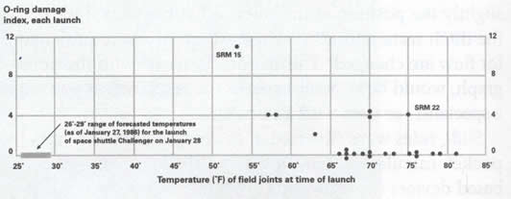
Tufte – Challenger Data: Launch?
Diagrams can lead to great insight, but also to lack of it

Slide 7
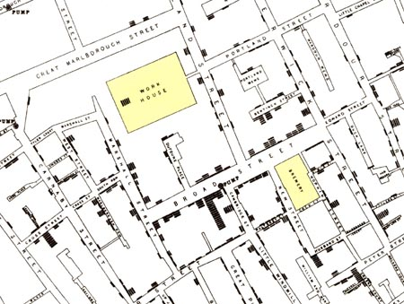
Cause of cholera epidemic in London in 1854?
John Snow’s deduction that a cholera epidemic was caused by a bad water pump
Modified in Visual Explanations by Edward Tufte, Graphics Press, 1997

Slide 8
Tufte’s Measures
Maximize data-ink ratio
Data ink
Data ink ratio =
Total ink used in graphic
Maximize data density
Number entries in data matrix
Data density of graphic =
Area of data graphic
Measuring Misrepresentation ➔ close to 1
Size of effect shown in graphic
Size of effect in data
Lie factor =

Slide 9
Tufte - Graphical Displays Should
Show Data
Focus on Content instead of graphic production
Avoid Distorting what Data has to say
Make Large Data Sets Coherent
Encourage Eye to Compare Different Pieces of Data
Reveal Data at several Levels of Detail
Closely integrate Statistical and Verbal Descriptions

Slide 10
Example
Stock market crash?
500
475
450
1998
1999
2000
2001
2002

Slide 11
Example
500
250
Show entire scale
0
1998
1999
2000
2001
2002

Slide 12
Example
500
250
Show in context
0
1960
1970
1980
1990
2000

Slide 13
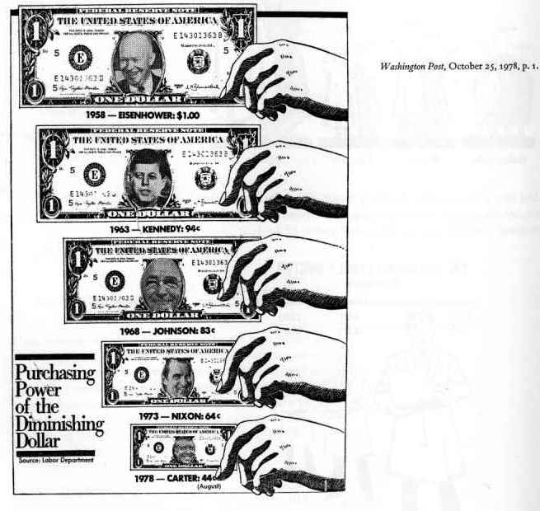
Tufte - How to Exaggerate with Graphs
“Lie factor” = 2.8
Error:
Shrinking along both dimensions

Slide 14
Tufte - Graph & Chart Tips
Avoid Separate Legends and Keys
Make Grids, labeling, etc., Very Faint so that they recede into background
Graphical Integrity
  Where’s baseline?
  What’s scale?
  What’s context?
  Watch Size Coding: Height/width vs. area vs. volume
Using Color Effectively
  To label
  To measure
  To represent or imitate reality
  To enliven or decorate

Slide 15
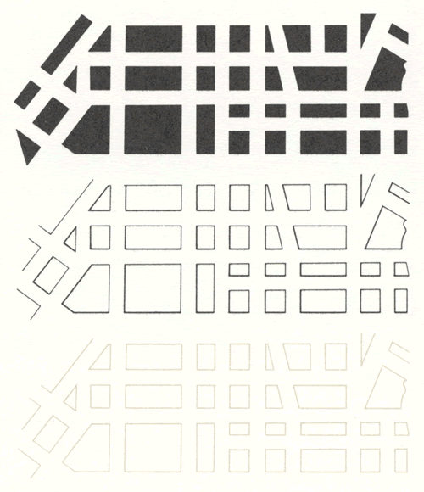
Tufte – Hierarchy of Visual Effects

Slide 16
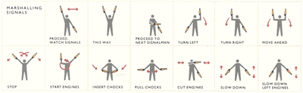
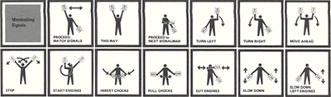
Tufte – Hierarchy of Visual Effects

Slide 17

Tufte – Hierarchy of Visual Effects in Maps

Slide 18

Tufte – Be aware of visual artifacts

Slide 19
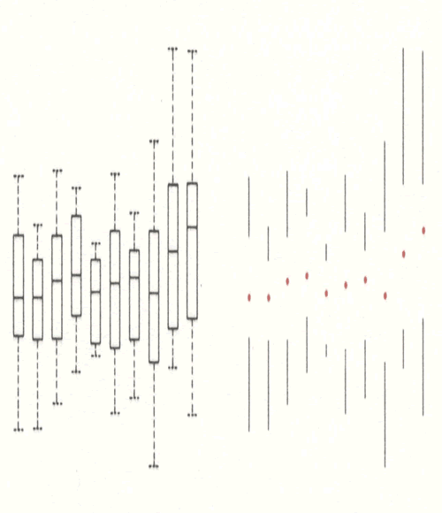
Tufte – Leverage Illusionary Contours

Slide 20
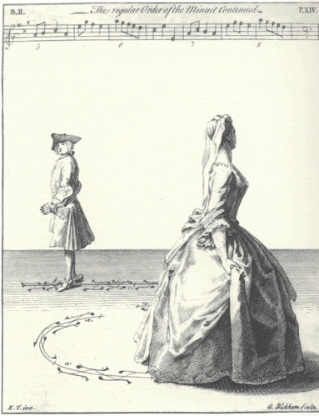
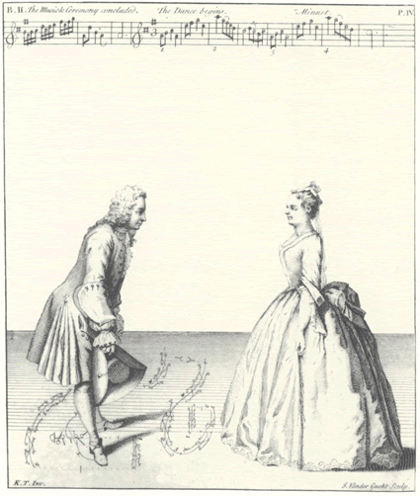
Tufte – Narratives of Space & Time

Slide 21
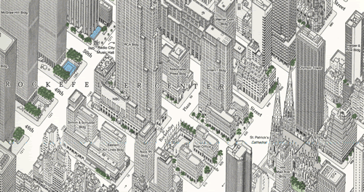
Tufte – Micro / Macro Readings - 2½ Displays
Axonometric Projection
To Clarify, Add Detail

Slide 22
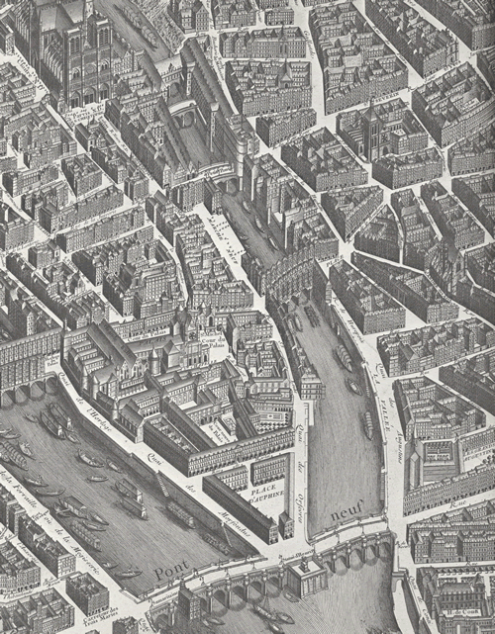
Tufte – Micro / Macro Readings - 2½ Displays

Slide 23
Tufte’s Principles – Summary
Good Information Design = Clear Thinking Made Visible
Greatest number of Ideas
in Shortest Time
with Least Ink in the Smallest Space
Principles
  Enforce Visual Comparisons
  Show Comparisons Adjacent in Space
  Show Causality
  Show Multivariate Data
  Use Direct Labeling
  Use Small Multiples
  Avoid “Chart Junk”: Not needed extras to be cute

Slide 24
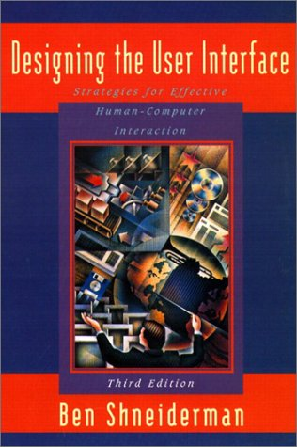
HCI – Source
Designing the User Interface
3rd Edition
Ben Shneiderman
Addison-Wesley Publishing

Slide 25
HCI – Usability Value Proposition
Low Road for Selling Usability
  Reduced development and support costs
  Point out frustration, high error rates due to complex systems
  Point out successes of competitors
High Road for Selling Usability
  Greater quality and user satisfaction
  Well designed interfaces ➔ shorter learning times, lower error rates
Business Case
  Karat (IBM) reports $100 payoff for every $1 spent on usability
Management Support Crucial
  Awareness of importance of usability
  Battles for control between usability and software engineers

Slide 26
HCI – Theories & Trends
Descriptive v.s. Predictive Theories
  Descriptive: Object/Action Interface Model
  Predictive: GOMS (Goals, Operators, Methods & Selection rules) and keystroke-level model to predict execution time or error rates
Object-Action Interface Model
  Understand Task in terms of objects & actions
  Metaphoric Representations of interface objects & actions
  Visible Representation of interface actions
  Task and Interface Hierarchies
  ➔ Observation: Menu Interface reflects Task Analysis
Disappearance of Syntax
  Syntactic knowledge is system and application dependent
Shift to Direct-Manipulation Systems

Slide 27
HCI – Task Analysis & Implementation
Task Analysis to ensure proper functionality
  Define Tasks and Subtasks
  Focus on Occasional Tasks – common tasks are easy to define
  Complete Functionality – so that users won’t reject / underutilize product
Implementation
  Standardization: use existing industry standards
  Integration: with different software tools
  Consistency & Compatibility: different versions / usage contexts
  Portability: of data across multiple software / hardware platforms
  ➔ Create & Test Design Alternatives

Slide 28
HCI – Users & Evaluation
Define Target User Community
  Accommodate Human Diversity: no average user
  Account for variances in sense perception
  Communities evolve and change
  Usage Profiles
Evaluation Measures
  Time to learn
  Speed of performance for key benchmarks
  Rate and nature of common user errors
  Retention over time
  Subjective satisfaction
    Collect user feedback free-form comments and satisfaction scales
Create & Test Design Alternatives
  Use a wide range of mock-ups and prototypes

Slide 29
Three Pillars of Interface Design
Guidelines Documents and Processes
  Inspired by HCI theories and models
  Provides social process for developers, records decisions for all to see, promotes consistency and completeness
User Interface Software Tools
  Based on Prototypes
Expert Reviews and Usability Testing
  Grounded in controlled experiments

Slide 30
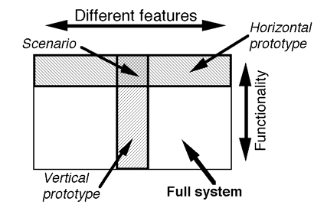
Prototyping

Slide 31
Building the Interface
User Interface Independence
  Separate interface design from internals
Methodology & Notation
  Develop design procedures and ways to talk about design
Rapid Prototyping
  Test early, revise, test, revise,...
  Engage end users, managers, and others
Software Support
  Increase productivity
  Offer some constraint & consistency checks
GUIs Productivity Gains of 50% - 500%

Slide 32
Building the Interface (cont.)
Design Tools
  User-Interface Mockups
    Powerpoint, Dreamweaver, Flash
  Computer-Assisted Instruction Tools
    Authorware, Macromedia Director, Asymetrix Toolbook
  Visual Development Tools
    Microsoft Visual Basic, Borland Delphi, Symantec Visual Cafe
  Software Engineering Tools
    Tcl, Java
Evaluation and Critiquing Tools
  Run-Time Logging Software
Menu-Tree Structures
  Popular and Show detailed system coverage

Slide 33
LUCID
Software Projects
  60% failure rate
    25% never finished
    35% partial success
  ➔ Early User-Centered Design saves money & time
Logical User-Centered Design Methodology
Developed by Kreitzberg (Cognetics, Princeton Junction, NJ)
  Stage 1: Develop Product Concept
  Stage 2: Research and Needs Analysis
  Stage 3: Design Concepts & Key Screen Prototype
  Stage 4: Iterative Design and Refinement
  Stage 5: Implement Software
  Stage 6: Provide Roll-Out Support

Slide 34
Six Stages of LUCID
Stage 1: Develop Product Concept
  Create high concept
  Establish business objectives
  Set up the usability design team
  Identify the user population
  Identify technical and environmental issues
  Produce a staffing plan, schedule, and budget
Stage 2: Research and Needs Analysis
  Partition the user population into homogeneous segments
  Break job activities into task units
  Conduct needs analysis through construction of scenarios
  and participatory design
  Sketch the process flow for sequences of tasks
  Identify major objects and structures used in interface
  Research and resolve technical issues and other constraints

Slide 35
Six Stages of LUCID (cont.)
Stage 3: Design Concepts & Screen Prototype
  Create specific usability objectives based on user needs
  Initiate the guidelines and style guide
  Select a navigational model and a design metaphor
  Identify the set of key screens: login, home, major processes
  Develop key screens using rapid prototyping tool
  Conduct initial reviews and usability tests
Stage 4: Iterative Design and Refinement
  Expand key-screen prototype into full system
  Conduct heuristic and expert reviews
  Conduct full-scale usability tests
  Deliver prototype and specification

Slide 36
Six Stages of LUCID (cont.)
Stage 5: Implement Software
  Develop standard practices
  Manage late stage change
  Develop online help, documentation and tutorials
Stage 6: Provide Roll-Out Support
  Provide training and assistance
  Perform logging, evaluation, and maintenance

Slide 37
HCI – Recognize Diversity – Overview
Usage Profiles
User Characteristics
Task Profiles
Interaction Styles

Slide 38
Recognize Diversity – Usage Profiles
Usage Profiles – designing for several profiles is difficult
Novice Users
  Arrive with anxiety ➔ inhibits learning
  Use familiar vocabulary
  Restrict choices and keep number of actions small
  Informative feedback
  Constructive, specific error messages
Knowledgeable Users
  Stable task concepts
  Broad knowledge of interface concepts
  Difficulty retaining structure of menus and location of features
  Orderly organization of menus
  Emphasize recognition instead of recall
  Consistency helps user rediscover and fill in the missing pieces
Expert Users
  Thorough knowledge of task and interface concepts
  Seek to get work done quickly
  Demand rapid response times
  Macros

Slide 39
Recognize Diversity – User Characteristics
User Characteristics
  Age
  Gender
  Physical abilities
  Education
  Cultural or ethnic background
  Training
  Motivation
  Goals
  Personality
Cultural and International Diversity
  Left-to-right versus right-to-left versus vertical input and reading
  Date and time formats
  Sorting sequences
  Icons, buttons, colors
  Etiquette, policies, tone, formality, metaphors

Slide 40
Recognize Diversity – Task Profiles & Interaction Styles
Task Profiles
  Decomposition into multiple middle-level task actions,
  which are refined into atomic actions
  Task frequencies of use
  Matrix of users and tasks helpful
Interaction Styles
  Direct manipulation
  Menu selection
  Form fillin
  Command language
  Natural language
➔ Blending of interaction styles need for diverse tasks and diverse users

Slide 41
Interaction Styles
Direct Manipulation
  Creativity needed
  Clever designer creates visual representation of domain using familiar conventions and metaphors
  Desktop metaphor, CAD, video games
Advantages
  Visual representation of task concepts
  Easy learning and retention
  Errors avoided
  Encourages exploration
  High subjective satisfaction
Disadvantages
  May be hard to conceive and/or program
  Requires increased system resources (possibly)
➔ Good for Novices

Slide 42
Interaction Styles
Menu Selection
  Read list of items, select most appropriate, observe effect
  Requires careful task analysis and consistency
Advantages
  Shortens learning
  Reduces keystrokes
  Structures decision making
  Use of dialog-management tools
  Easy support of error handling
Disadvantages
  Danger of many menus
  May slow frequent users
  Consumes screen space
  Requires rapid display rate
➔ Good for Novices and Intermittent Users

Slide 43
Interaction Styles
Form Fillin
  Data entry
Advantages
  Simplifies data entry
  Requires modest training
  Gives convenient assistance
  Use of form-management tools
Disadvantages
  Consumes screen space
  User must understand field labels and permissible values
➔ Good for Intermittent, Experienced Users

Slide 44
Interaction Styles
Command Language
  Users can syntax to express complex possibilities rapidly
  Macros, Excel functions, Programming
Advantages
  Flexible
  Appeals to “power” users
  Supports strong locus of control and user initiative
  Simplifies data entry
  Convenient creation of user-defined macros
Disadvantages
  High error rate
  Poor error handling because of diversity of possibilities
  Requires substantial training and memorization
➔ Good for Expert Frequent Users

Slide 45
Interaction Styles
Natural Language
  Hope that computer will respond properly to arbitrary natural-language sentences or input
  Limited success so far …
  Users can syntax to express complex possibilities rapidly
Advantages
  Relieves burden of learning syntax
Disadvantages
  May not show context for issuing next command
  Frequently requires clarification dialog
  May require more keystrokes
  Unpredictable
➔ Good for Novices and Intermittent Users

Slide 46
Interaction Styles – Summary
Direct Manipulation
    + Visual, Easy to learn, Avoids errors
    Hard to conceive and develop
    ➔ Novice
  Menu Selection
    + Shortens learning, Structures decision making, Good error handling
    Many menus, Slow, Screen space needed
    ➔ Novice & Intermittent User
  Form Fillin
    + Simplifies data entry, Little Training
    Consumes screen space, User need to understand fields
    ➔ Intermittent, Experienced Users
  Command Language
    + Flexible, Appeals to “power user”
    Error prone, Poor error handling, Training
    ➔ Expert User
  Natural Language
    + No need to learn syntax
    Unpredictable
    ➔ Novice & Intermittent User

Slide 47
Recognize Diversity – Summary
Usage Profiles
  Novice Users
    Use familiar vocabulary and offer few choices
  Knowledgeable Users
    Emphasize recognition instead of recall
  Expert Users
    Seek to get work done quickly ➔ Macros
Interaction Styles
  Direct manipulation ➔ Novices Users
  Menu selection ➔ Novices and Intermittent Users
  Form fillin ➔ Intermittent and Expert Users
  Command language ➔ Expert Users
  Natural language ➔ Novices and Intermittent Users

Slide 48
User-Centered Design Methods – Overview
Pre-Design
  Ethnographic Observation
Designing
  Scenario Development
  Participatory Design
Post-Design
  Expert Reviews
    Heuristic Evaluation
    Guidelines Review
    Consistency Inspection
    Cognitive Walkthrough
    Formal Usability Inspection
  Usability Testing
  Acceptance Testing
  Field Testing

Slide 49
User-Centered Design Methods (cont.)
Ethnographic Observation
  Individual interviews or Questionnaire
    Preparation
    Field Study
    Analysis
    Reporting
Scenario Development
  Day-in-the-life scenarios
  Perform typical task (acted out as a walkthrough)
Participatory Design
  Positive
    more accurate information about tasks, users can influence design decisions, builds investment, increased user acceptance
  Negative
    more costly, lengthen implementation period, exacerbate personality conflicts, role of organizational politics

Slide 50
User-Centered Design Methods (cont.)
Expert Reviews
  Heuristic Evaluation
    Evaluate interface = small list of 8-10 design heuristics
  Guidelines Review
    Can contain 1000 items
  Consistency Inspection
    Consistency across a family of interfaces
  Cognitive Walkthrough
    Simulate users carrying out high freq. task
  Formal Usability Inspection
    Discuss merits and weakness of interface (adversarial)

Slide 51
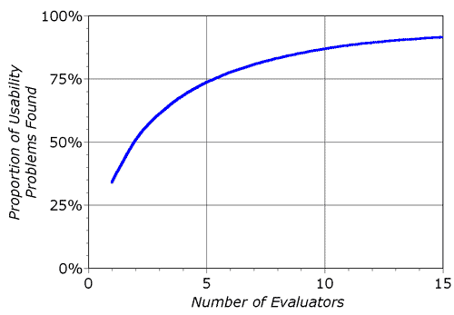
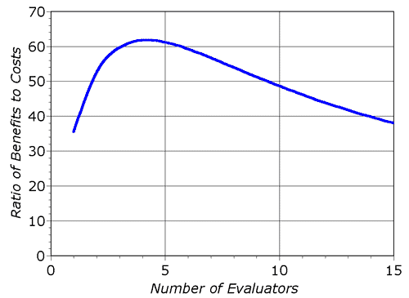
User-Centered Design Methods (cont.)
Heuristic Evaluation
  Interface = List of Heuristics?
  Quick and cheap
  Can evaluate paper based interface
  because evaluator is not using system system
  Suitable for early use in usability engineering lifecycle
  Three to five evaluators: more ➔ diminishing returns

Slide 52
Nielsen's Ten Usability Heuristics
Visibility of System Status
  Always keep users informed about what is going on.
  Provide appropriate feedback within reasonable time.
System Matches Real World
  Speak the users' language, with words, phrases and concepts familiar to the user, rather than system-oriented terms.
  Follow real-world conventions, making information appear in a natural and logical order.
User Control and Freedom
  Users often choose system functions by mistake.
  Provide a clearly marked "out" to leave an unwanted state without having to go through an extended dialogue.
  Support undo and redo.

Slide 53
Nielsen's Ten Usability Heuristics (cont.)
Consistency and Standards
  Users should not have to wonder whether different words, situations, or actions mean the same thing.
  Follow platform conventions.
Error Prevention
  Even better than good error messages is a careful design which prevents a problem from occurring in the first place.
Recognition rather than Recall
  Make objects, actions, and options visible.
  User should not have to remember information from one part of the dialogue to another.
  Instructions for use of the system should be visible or easily retrievable whenever appropriate.

Slide 54
Nielsen's Ten Usability Heuristics (cont.)
Flexibility and Efficiency of Use
  Accelerators -- unseen by the novice user -- may often speed up the interaction for the expert user so that the system can cater to both inexperienced and experienced users.
  Allow users to tailor frequent actions.
Aesthetic and Minimalist Design
  Dialogues should not contain information which is irrelevant or rarely needed.
  Every extra unit of information in a dialogue competes with the relevant units of information and diminishes their relative visibility.
Help users Recognize, Diagnose, and
Recover from Errors
  Expressed in plain language (no codes)
  Precisely indicate the problem
  Constructively suggest a solution.

Slide 55
Nielsen's Ten Usability Heuristics (cont.)
Help and Documentation
  Even though it is better if the system can be used without documentation, it may be necessary to provide help and documentation.
  Help information should be easy to search, focused on user's task, list concrete steps to be carried out, and not be too large.
Based on Factor Analysis
  249 usability problems studied to derive a set of heuristics with maximum explanatory power
http://www.useit.com/papers/heuristic/heuristic_list.html

Slide 56
Nielsen's Ten Usability Heuristics - Summary
Visibility of System Status
System matches Real World
User Control and Freedom
Consistency and Standards
Error Prevention
Recognition rather than Recall
Flexibility and Efficiency of Use
Aesthetic and Minimalist Design
Help users Recognize, Diagnose, and Recover from errors
Help and Documentation

Slide 57
User-Centered Design Methods (cont.)
Usability Testing
  Surprise of Usability Testing
    Sped up many projects and produced dramatic cost savings
  Goal to find flaws and refine interface
  Participants Selection
    Voluntary Participation Critical (obtain informed consent)
  Effective Usability Testing
    Encourage users to think aloud (two people better)
  Usability Lab
    Half–way mirror between observers and subjects
  Videotaping
    Show designers actual user behavior
    Tedious and time-consuming to analyze video
  Limitations of Usability Testing
    Emphasizes first-time usage
    Limited coverage of the interface features
    Expert reviews can supplement usability testing

Slide 58
User-Centered Design Methods (cont.)
Surveys
  Acceptable companion for usability tests and expert reviews
  Keys to successful surveys
    Clear goals in advance
    Tested with small sample and reviewed
  Data to collect:
    Users background, Computer experience, Job responsibilities, Personality style, Familiarity with features, Feeling state after using an interface …
  Potential bias in online surveys
Acceptance Tests
  Establish measurable criteria instead of vague "user friendly
  Outside organization conducts it (can be adversarial)
Goal of Reviews, Surveys and Testing
  Achieve evolutionary development when change is relatively easy and inexpensive to accomplish.
Evaluation During Active Use
  Successful Active Use = Constant Attention
  Strive for Percentage Improvements
  Continuous user-performance Data Logging
  Usage data ➔ Optimize performance, Reduce costs

Slide 59
User-Centered Product Design
High Concept | Ethnographic Observation
Prototype Anticipated Usage Profiles Use different Interaction Styles | Scenario Development Participatory Design
Software Development | Expert Reviews Heuristic Evaluation Guidelines Review Consistency Inspection Cognitive Walkthrough Formal Usability Inspection Usability Testing Acceptance Testing
Product Release | Surveys Field Testing

Slide 60
Eight Golden Rules of Interface Design
Strive for Consistency
  Terminology, Prompts, Menus, Help screens, Color, Layout, Fonts
Enable Frequent Users to use Shortcuts
  Abbreviations, Special keys, Hidden commands, Macro facilities
Informative Feedback
Design Dialogs to Yield Closure
  Sequences of actions should be organized into groups
  Beginning ➔ middle ➔ end
Offer Error Prevention & Simple Error Handling
Permit Easy Reversal of Actions
Support Internal Locus of Control
Reduce Short-term Memory Load

