Slide 1
Lecture 5
Data Visualization
  Demo: Baby Name Voyager
  Common Display Types
  When to Use Which Display Type
  GapMinder | TrendAnalyzer | Google Motion Chart
  Many Eyes: Treemaps
1st Visualization Assignment
  Use Rutgers Libraries Data or Data of Your Choice
    Need to Format Data
  Visualizations To Use
    Google Motion Chart
    Many Eyes Treemap

Slide 2
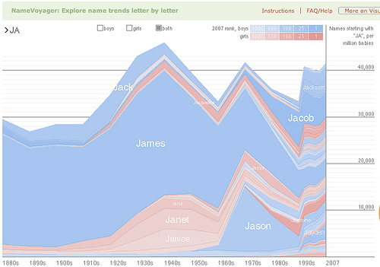
Demo – Baby Names Voyager
http://www.babynamewizard.com/voyager

Slide 3
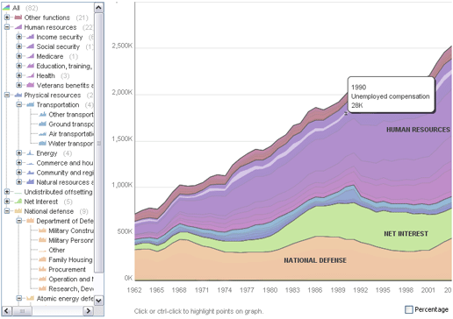
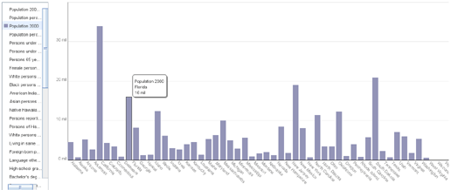
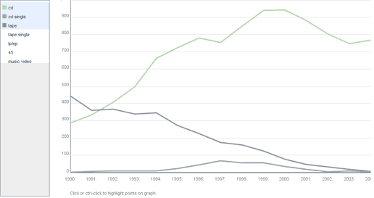
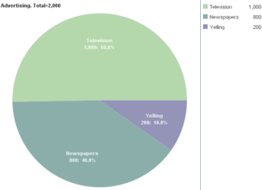
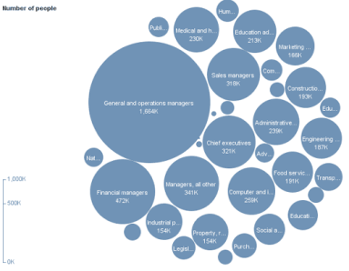
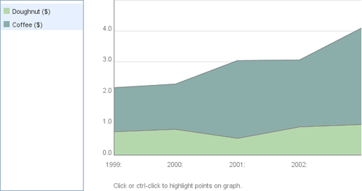
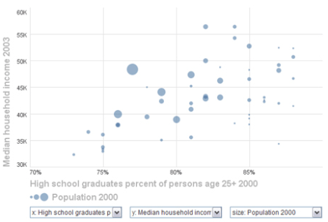
Data Visualization – Common Display Types
Common Display Types
  Bar Charts
  Line Charts
  Pie Charts
  Bubble Charts
  Stacked Charts
  Scatterplots

Slide 4
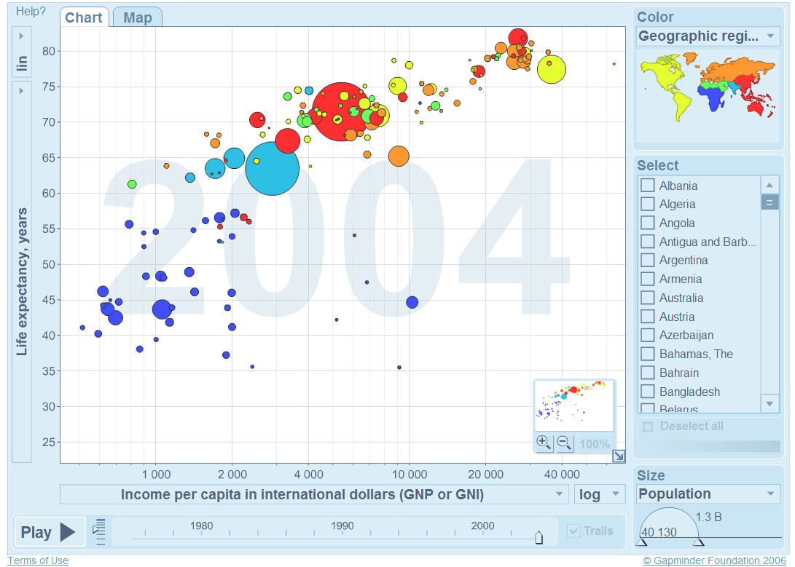
Gapminder – Motion Charts
http://www.gapminder.org/

Slide 5
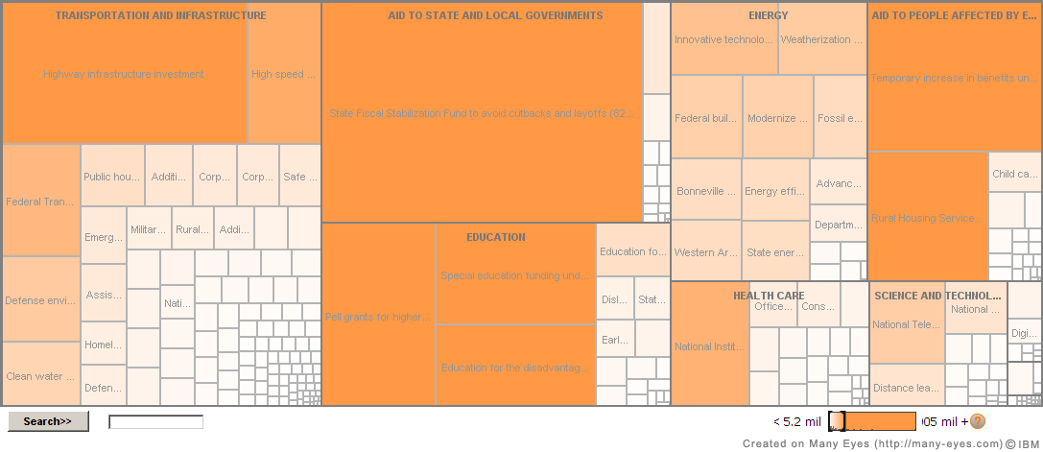
Many Eyes – Data & Information Visualization
http://manyeyes.alphaworks.ibm.com/manyeyes/

Slide 6

Google Motion Chart
Motion Chart |
Format Your Data
Example : what is needed
for effective Motion Chart
1st Visualization – Google Motion Chart Requirements
  Time data dimension
  At least three independent data dimensions that can be displayed on the x and y axes of the scatterplot
  At least one categorical data dimension
  At least one relevant data dimension than be used for size coding
  In Total, at least six data variables

Slide 7

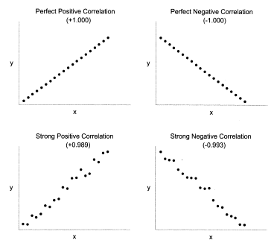
Scatterplot – Visual Correlation Patterns

Slide 8
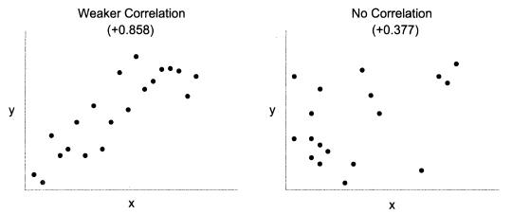
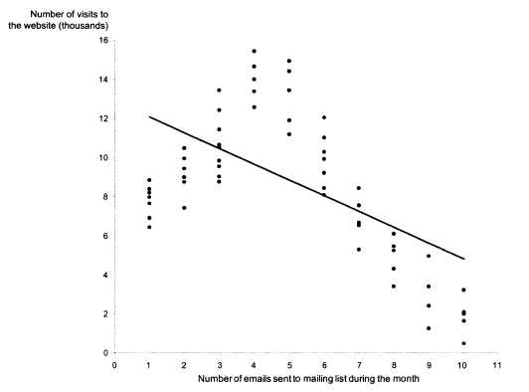
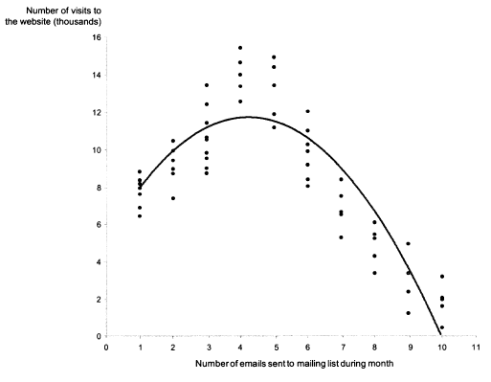
Scatterplot – Visual Correlation Patterns

Slide 9
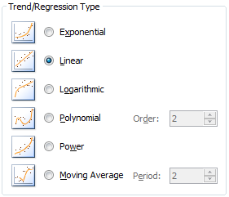
Scatterplot – Visual Correlation Patterns

Slide 10
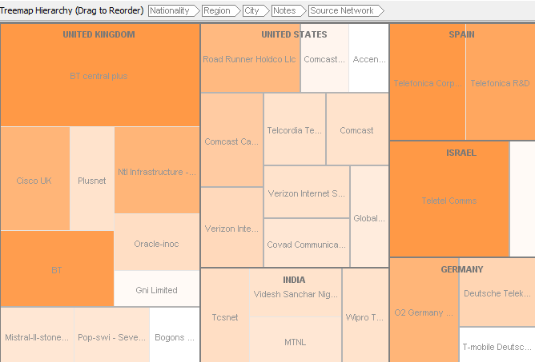
Treemap
How to Create
Example : what is needed
for multiple levels
1st Visualization – Treemap Requirements
  At least three hierarchical levels
  Numerical variable of interest is used for size coding
  Ideally provide a further numerical data variable for color coding
  Tip: temporal data and want "time" (such as "year" or "month") to be hierarchical variable then time period values need to be "string".

