Slide 1
Lecture 6
Infographics
  Definition and Overview
  Relationship to Information Visualization
  Isotype and Infographics Examples
  New York Times Infographics & Visualizations
  Using Information Design & Infographics to Advocate

Slide 2
Infographics
Graphic Representation of
Data, Information, Knowledge
using
Lines, Boxes, Arrows
Symbols, Pictograms
Text, Color, Labels
http://en.wikipedia.org/wiki/Information_graphics

Slide 3
Infographics vs. Information Visualization
 | Infographics | InfoVis
Content | Data Information Knowledge | Data Information
Visualizations | Standard Charts Symbols Diagrams Color Text | Novel Charts InfoVis Principles
Interactivity | Mostly Static | Sliders & Controls Dynamic Queries Animations
Narrative Structure | Medium - High | Low - Medium
Data-Ink Ratio | Medium | Medium – High
Data Size & Data Dimensions | Low – Medium | Medium - High

Slide 4
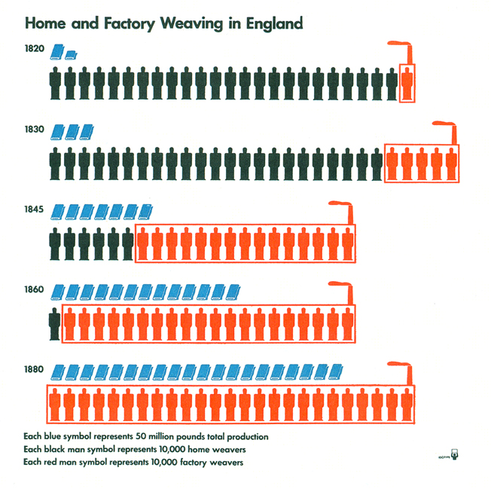
Isotype (International System of TYpographic Picture Education)
http://en.wikipedia.org/wiki/Isotype_(picture_language)

Slide 5
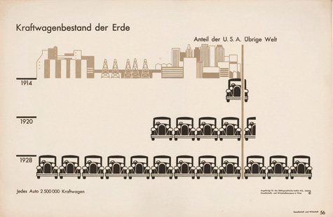
Isotype (International System of TYpographic Picture Education)
http://www.isotyperevisited.org/

Slide 6
Infographics – Some Resources
Cool Infographics
  http://coolinfographics.blogspot.com/
Smashing Magazine
  http://www.smashingmagazine.com/2008/01/14/monday-inspiration-data-visualization-and-infographics/
Six Revisions
  http://sixrevisions.com/graphics-design/40-useful-and-creative-infographics/
Infosthetics
  http://infosthetics.com/cgi-bin/mt/mt-search.cgi?search=infographics&IncludeBlogs=1

Slide 7
New York Times Visualizations
New York Times has Visualization Team
  http://www.nytimes.com/2009/01/19/business/media/19askthetimes.html
  Leading adopter of visualization tools in the news media
  At the forefront of enhancing new stories with interactive content
  Community API http://open.blogs.nytimes.com/2008/10/30/announcing-the-new-york-times-community-api/
Combining Static Infographics and Interactive Visualization
Beginning to Develop “DataStories”
  Remade in America http://projects.nytimes.com/immigration/
  Debt Trap http://nytimes.com/interactive/2008/07/20/business/20debt-trap.html
  Election 2008 http://elections.nytimes.com/2008/results/president/map.html

Slide 8

Using Information Design & Infographics to Advocate
http://upload.wikimedia.org/wikipedia/commons/a/a7/Visualizing_Information_for_Advocacy_-_An_Introduction_to_Information_Design.pdf

