Slide 1
Lecture 8
Gigapixel Visualization
  Motivation
  “Infinite Zooming”: Seadragon DeepZoom
  Gigapan: stitching multiple images into image pyramid
  Photosynth: linking images based on pattern matching
  whereRU: Virtual Experience of Rutgers
  Tools, Links and Definitions

Slide 2
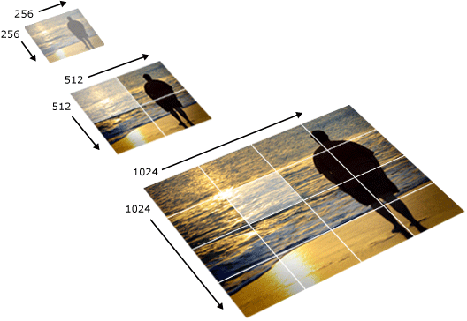
Infinite Zooming” – Seadragon’s DeepZoom
http://seadragon.com/

Slide 3
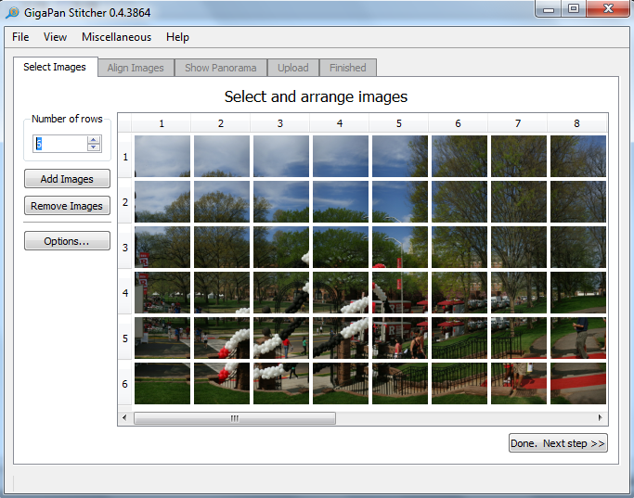
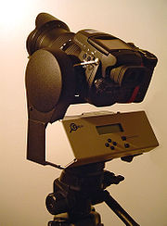
Gigapan – stitching multiple images into image pyramid
Gigapan ➔ Google Earth ➔ “Streetview” Anywhere

Slide 4
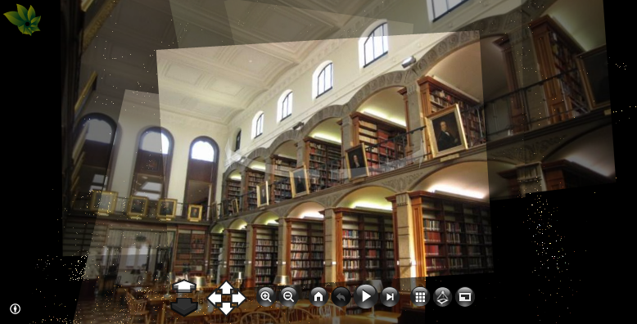
Photosynth – linking images based on pattern matching
http://whereru.rutgers.edu/photosynth.html
whereRU: Virtual Experience of Rutgers using Gigapans & Photosynths

Slide 5
Tools & Links
Photosynth site
Gigapan site
360cities site
Krpano site
whereRU site
Definitions: Gigapixel | Zoomable Interfaces | Map Projections

