Slide 1
Lecture 9
Augmented Reality
  Definition
  Visualization Approaches
  Applications
  Tools and Links

Slide 2

Augmented Reality – Definition
Combines of computer-generated imagery with physical real-world environment
  Superimpose imagery
In Real-time, Interactive and 3D Registered
  Ability to Track User using Computer Vision and Sensors
http://en.wikipedia.org/wiki/Augmented_reality
http://www.howstuffworks.com/augmented-reality.htm

Slide 3
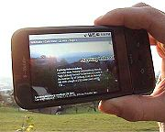
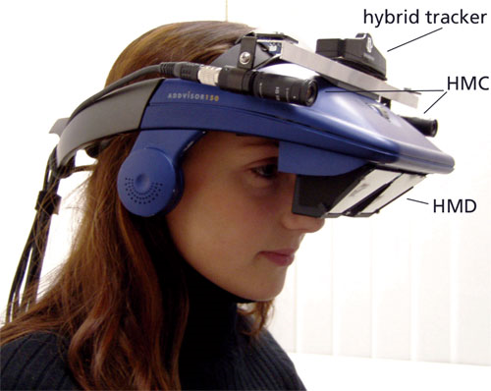
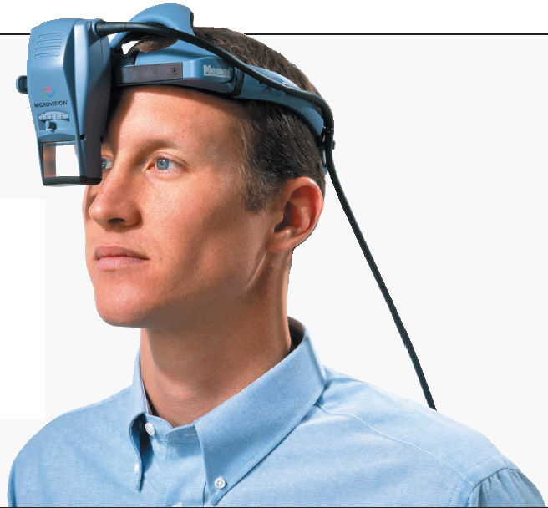
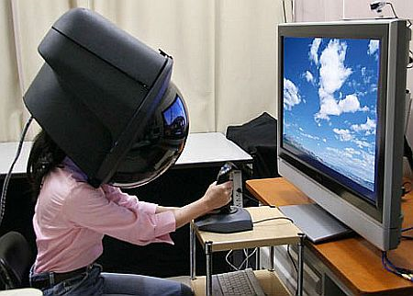
Augmented Reality – Visualization Approaches
Overlay Displays in Mobile Devices
Head-Mounted Displays
Virtual Retinal Displays

Slide 4
Augmented Reality – Possible Applications
Advertising: promote a new product via an interactive, web-based AR application.
Support Complex Tasks: assembly, maintenance, and surgery can be simplified by inserting additional information into the field of view.
Navigation Devices: head-up displays used in fighter jets.
Military and Emergency Services: wearable systems to provide information such as instructions, maps, enemy locations, and fire cells.
Prospecting: in hydrology, ecology, and geology, AR can be used to display an interactive analysis of terrain characteristics.
Architecture: simulate planned construction projects.
Sightseeing: show places as they previously existed.
Collaboration: conferences with real and virtual participants.
Entertainment and Education: virtual objects in museums, theme park attractions and games.

Slide 5
Tools & Links
Wikitude site | video
Layar site | video
Total Immersions site | video
Augmented Environments Lab at Georgia Tech site
Institute for Creative Technologies at USC site
Augmented Reality Start-ups site
John Mayer’s Augmented Reality Music Video site

