Slide 1

APKtool
CACD_SKILL 9

Slide 2


Slide 3
What are the needs of mobile security using APKtool ?
APK tool used to prevent security vulnerabilities against threats such as unauthorized access and modification.
What are the mobile apps testing tools ?
Test IO,Appium,Robotium,Xamarin.UITest,Espresso,XCUI Test,Ranorex Studio

Slide 4
How mobile security framework works ?
A dedicated hardware security layer, in conjunction with third-party software, can be used to safeguard privacy. Comprehensive security requires the Architecture implementation of strong authentication and access controls in order to perform encrypted transmission.

Slide 5
What is APKtool ?
Apktool is a powerful tool that allows you to reverse engineering third party, closed, binary Andriod apps.
Using the Android package, you can decode resource files to the almost original form.
Then modify the source code and rebuild the decoded resources back to APK and finally recompile the application.

Slide 6
Basic knowledge about APKtool
Apktool allows you to decode APK resources, rebuild decoded resources back to binary APK, and organize and handle APKs. And also automating with repetitive tasks. While Apktool is very easy to use, the unique advantage of this tool is to be bidirectional. It allows you to decompile an application and modify it. Then, you will recompile it back using Apktool. In this way, it will recompile and generate a new APK file.

Slide 7
Since reengineering Android APK files is the primary usage of the Apktool, but there are various options available for primary usage. Let’s see what are these important switches in Apktool.
1- Apktool d[ecode]: This switch is used to invoke the decode APK option
2- Apktool b[uild]: This switch is used to invoke the build APK option
3- Apktool if | install-framework: You can use this option to install and store frameworks

Slide 8
How To Install Apktool On Kali Linux
If you are working with Kali Linux and you wish to install Apktool, let me say that Apktool is pre-installed under penetration testing applications as illustrated.
Use the following command to install Apktool on Kali with any other packages on which it depends.
sudo apt-get install apktool
After executing this command, apktool will be installed in your kali.
To check the version of apktool that you have installed type the below given command.
Apktool –version

Slide 9
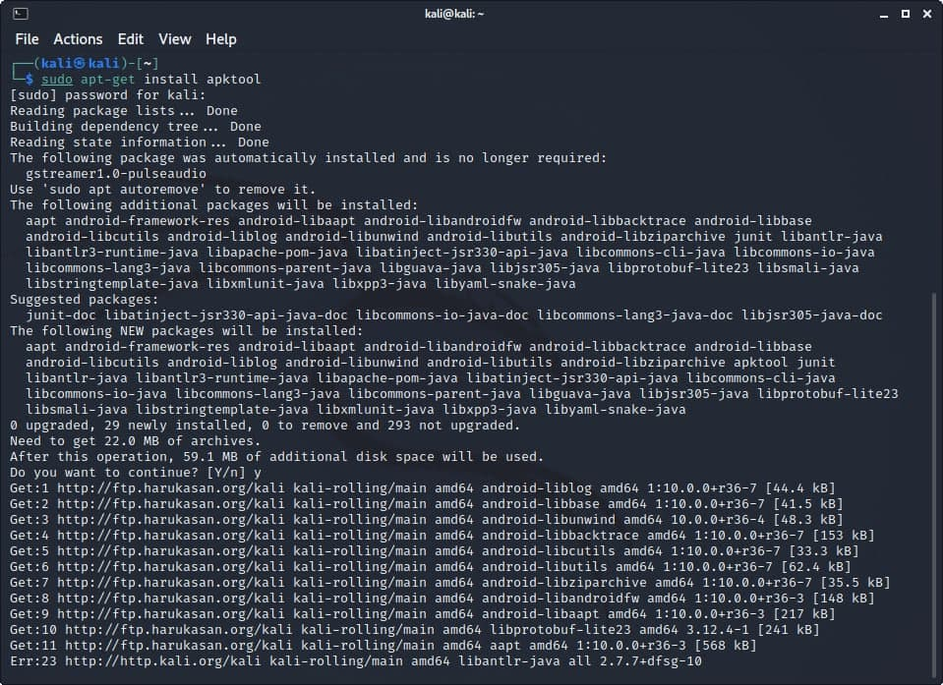

Slide 10
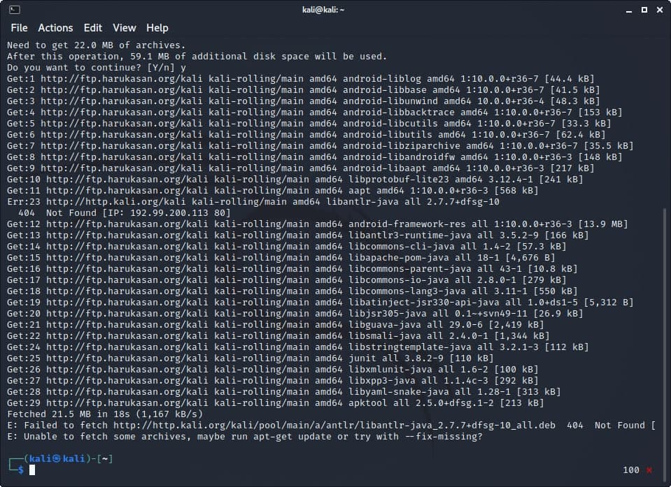

Slide 11
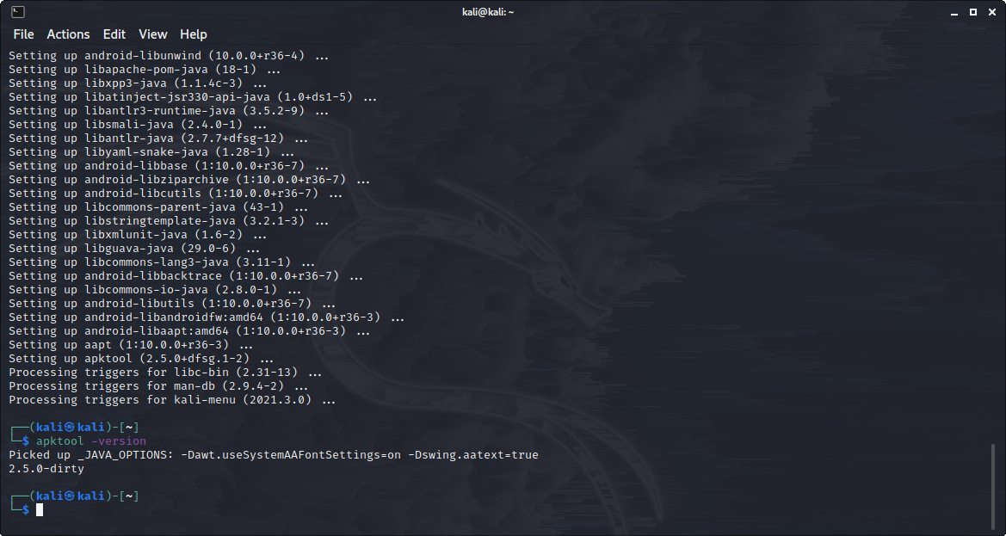
Check your APKtool version by using the command: apktool -version

Slide 12
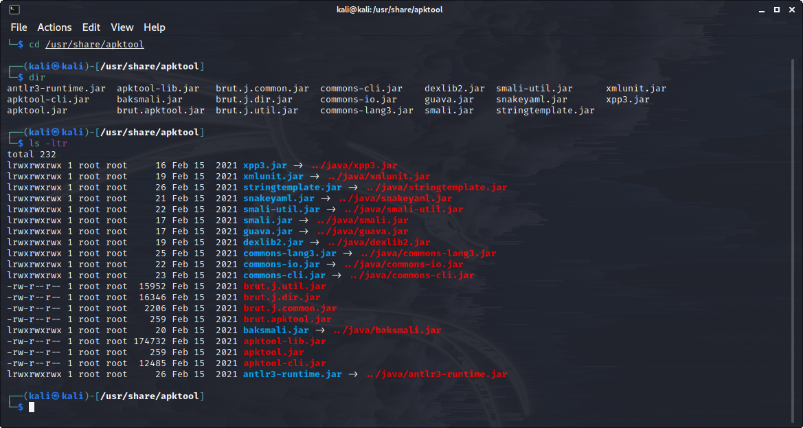
Contents of APKtool

Slide 13
Working of APKtool
Apktool allows you to decode APK resources, rebuild decoded resources back to binary APK, and organize and handle APKs.
It allows you to decompile an application and modify it.
Re-engineering Android APK files is the primary usage of the Apktool, but there are various options available for primary usage.The below are the important switches in Apktool.
Apktool d[ecode]: This switch is used to invoke the decode APK option
Apktool b[uild]: This switch is used to invoke the build APK option
Apktool if | install-framework: You can use this option to install and store frameworks

Slide 14
Apktool usage example (steps)
Use debug mode (d) to decode the given apk file (/root/SdkControllerApp.apk):
root@kali:~# apktool d /root/SdkControllerApp.apk I: Baksmaling… I: Loading resource table… I: Loaded. I: Decoding AndroidManifest.xml with resources… I: Loading resource table from file: /root/apktool/framework/1.apk I: Loaded. I: Regular manifest package… I: Decoding file-resources… I: Decoding values */* XMLs… I: Done. I: Copying assets and libs…

Slide 15
Steps to decode an apk file
First create a folder and download the apk file you want to decode, and save it in that folder.
Navigate to the folder which contains the apk file you want to decode.
Now, type the following command to decode the apk file :
Apktool d apkfilename.apk
After executing this command the apktool will decode the apk file and store its contents in a new folder in the current working directory and will name it as ‘the filename of the apk’.
This folder will contain the decoded contents of the apk file.

Slide 16
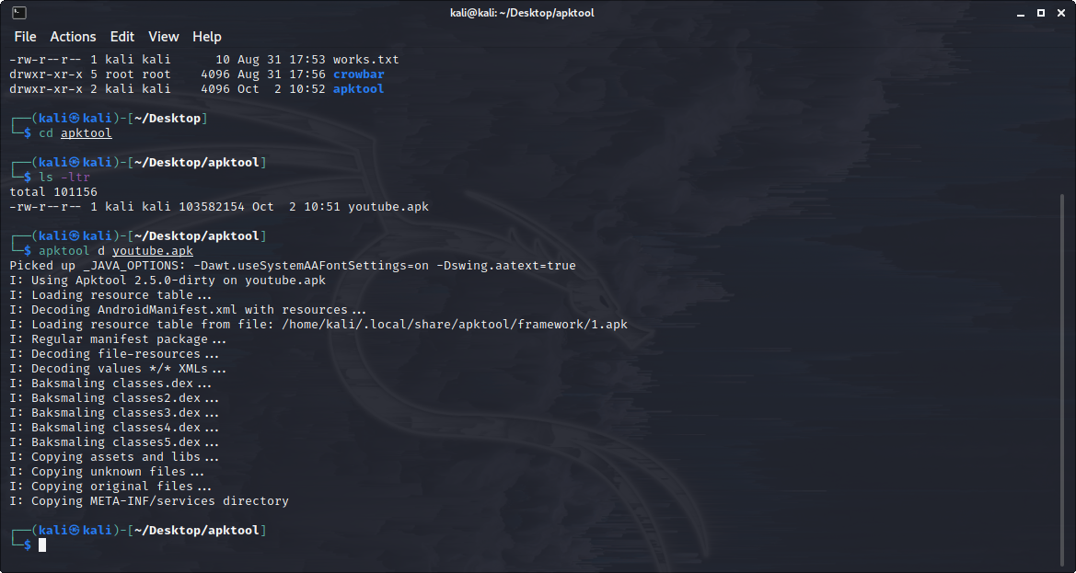
Decoding an apk file using APKtool

Slide 17
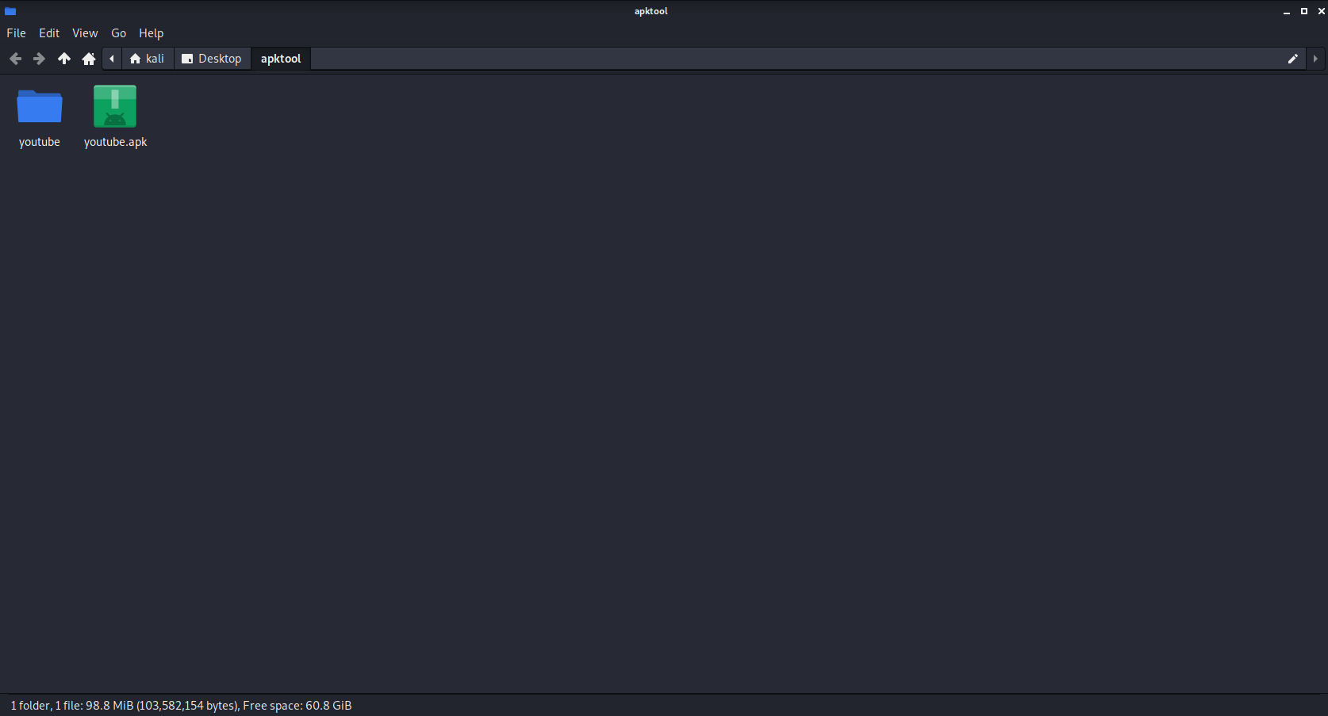
After decoding the apktool creates a folder that contains all the decoded files .. Here are the decoded files of the apk we decoded in the above slide …

Slide 18
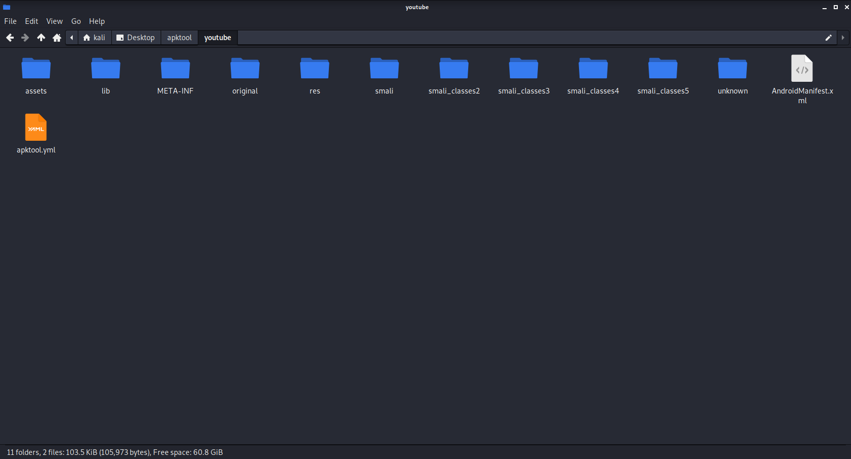
Contents of the decoded apk

Slide 19
How to unistall APKtool from kali linux
It is possible to uninstall Apktool from Kali Linux anytime you need to. To do this, just run the following command and remove just the Apktool package itself.
sudo apt-get remove apktool

