Slide 1

Vehicle Data Web Scraping
By
Nidumukkala Siva Rama Krishna Teja
Batch : 192

Slide 2
About me
Background ? B-tech
Why you want to learn Data Science:
As increasingly data is becoming huge and for businesses it is important to analyse and also get meaningful insights for their performance and as such it is a key skill that one needs to have and as such I want to learn Data Science.
Any work experience No

Slide 3
Objective of the project
To Analyse how the the extracted Primary Price of the vehicle is related to other extracted features from a website.

Slide 4
Web Scraping – Details
Website: www.cars.com
Product focus : Mitsubishi Outlander
Extraction Parameters:
Primary Price
Secondary Price Drop
New/Used
Vehicle Badges
Dealer Name
Rating
Reviews Count

Slide 5
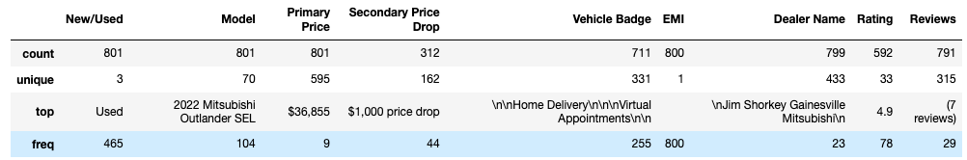
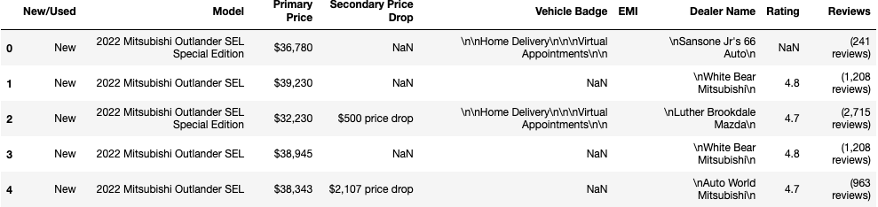
Summary of Data
Data columns (total 9 columns):
# Column Non-Null Count Dtype
--- ------ -------------- -----
0 New/Used 801 non-null object
1 Model 801 non-null object
2 Primary Price 801 non-null object
3 Secondary Price Drop 312 non-null object
4 Vehicle Badge 676 non-null object
5 EMI 798 non-null object
6 Dealer Name 801 non-null object
7 Rating 626 non-null object
8 Reviews 795 non-null object
dtypes: object(9)
memory usage: 56.4+ KB

Slide 6
Exploratory Data Analysis
Data Cleaning & Manipulation Steps
Used Regex to format data.
Since, Secondary Price wasn’t extracted, created a Secondary Price column with both Primary Price and Secondary Price Drop columns.
Created Year column from Model column
Missing values treatment:
Removed EMI column since the entire column had missing values
Imputed missing values in Reviews and Rating with 0.
Imputed mean values for missing values in Primary Price
Mode is imputed for missing values in Year.
For Vehicle Badge column imputed a string “Normal Deal” for missing values

Slide 7
Univariate Analysis
In the Univariate Analysis:
For Numerical columns the plots used are:
Histogram
Box
Violin
For Categorical columns the plots used are:
Count

Slide 8
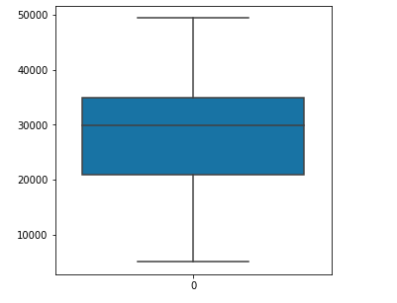
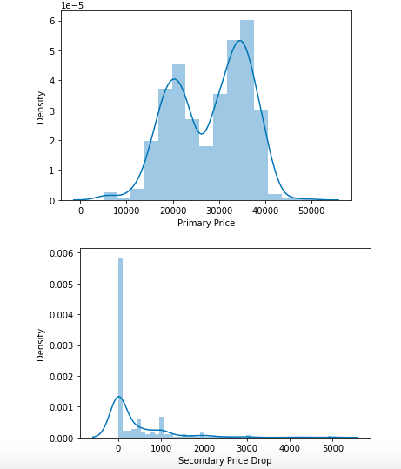
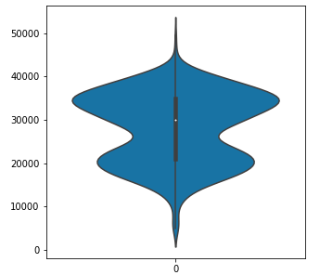

Slide 9
Bivariate Analysis
Bar Charts for:
Vehicle Badge on x-axis and Rating,Reviews, Primary Price and Secondary Price Drop
New/Used on x-axis and Rating,Reviews,Primary Price and Secondary Price Drop
Scatter Plots for:
Primary Price vs Rating and Reviews
Secondary Price Drop vs Rating and Reviews
Rating vs Reviews

Slide 10
Multivariate Analysis
Scatter Plots for:
Primary Price vs Secondary Price Drop with hue= Vehicle Badge
Heatmap for:
All numerical columns
Swarm Plot for:
Year, Primary Price and hue=Vehicle Badge
Rating, Primary Price and hue=New/Used
Strip plot for:
Model, Rating and hue=New/Used
Model, Primary Price and hue=New/Used
Pair Plot:
For all numerical columns

Slide 11
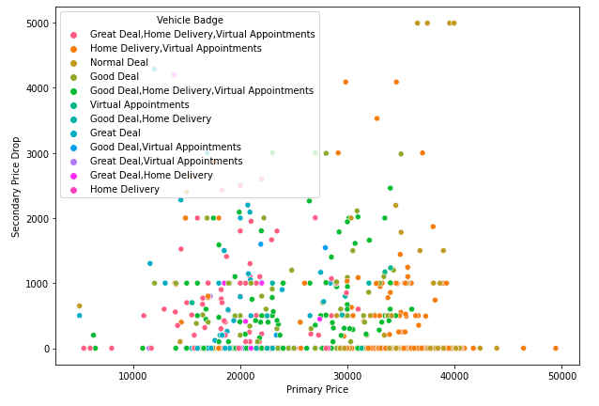
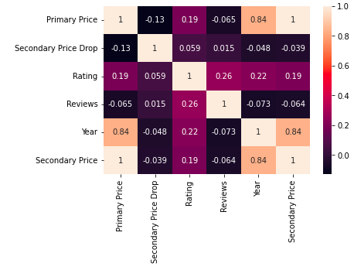

Slide 12
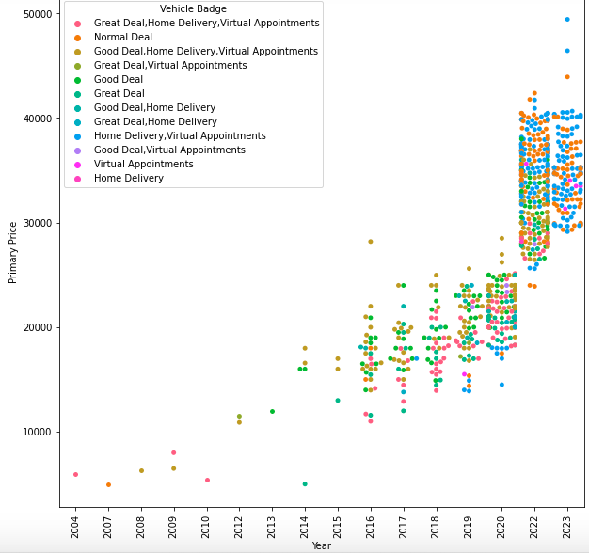

Slide 13
Key Business Question
What makes customers buy the vehicle?

Slide 14
Conclusion
The conclusion I have drawn from these plots are that Primary Price has a good correlation with year whereas with other features it is less correlated. With other categorical features such as New/Used, Primary Price is high for New vehicles and Low for Used vehicle as expected and Vehicle Badges having Great Deal, Good Deal , Home Delivery tags combinations having more than one of the tags made their prices higher.

Slide 15
Challenges working on web scraping
There are some parameters which I wasn’t able to extract as there are multiple class names as such the code is sometimes extracting wrong fields.

Slide 16

THANK YOU

