Slide 1

Strategic Value of Odoo ERP for RDL
Driving Operational Excellence & Future-Proof Scalability

Slide 2





The Pillars of Digital Transformation
Unified Operations
Future Scalability
Consolidating diverse workflows into a single, real-time source of truth.
Designed for RDL’s 10-year vision across multiple business divisions.
Global Reliability
Leveraging world-class AI and open-source flexibility for RDL.

Slide 3
Pillar 1: Unified Operational Excellence

Slide 4





End-to-End Visibility & Control
Inventory Precision
Financial Clarity
Automated Efficiency
Real-time, product-movement tracking across all warehouses and stores.
Fully consolidated accounting reports updated with every single click.
One-click data entry updates all related fields, eliminating redundancy.

Slide 5

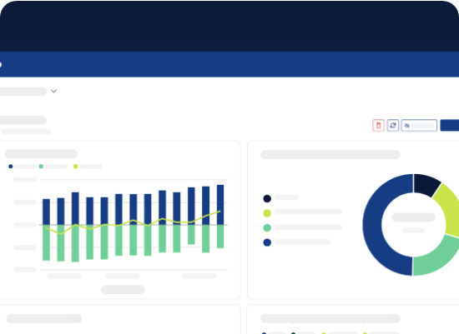
Seamless Adoption & SOP Alignment
Odoo's intuitive interface ensures that your team adapts quickly with minimal friction.
User-Friendly: Designed for modern, fast-paced teams.
SOP Harmony: Odoo standardizes operations to match RDL’s specific business logic.
Reduced Training: Faster time-to-value for new employees.

Slide 6
Pillar 2: Future-Proof Scalability

Slide 7

Managing Diverse Portfolios
RDL Apparel
RDL Home Decor
Advanced SKU management, seasonal trend tracking, and multi-store retail sync.
Specialized inventory handling for unique items and high-value logistics.
Unified Management under One System — Limitless Growth for the Next 10 Years.

Slide 8
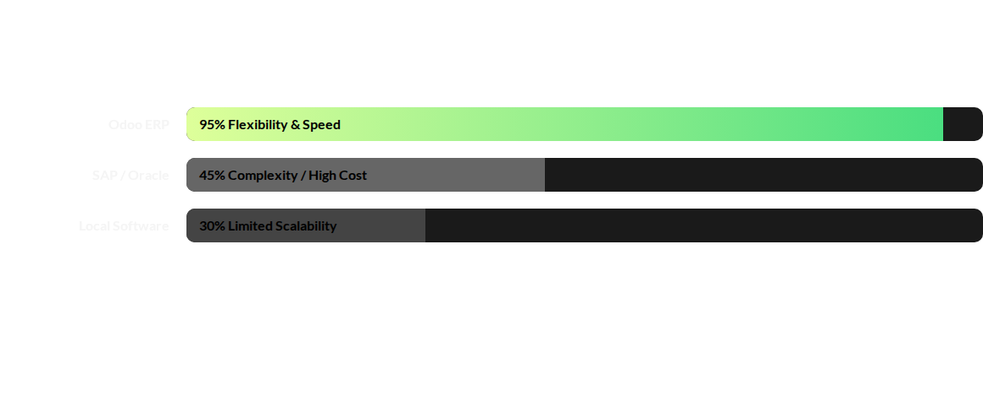
World-Class Reliability Comparison
Odoo eliminates the heavy costs of legacy systems while bypassing the limitations of local software.

Slide 9
The Global Edge with AI
Next-Generation Management
AI
Odoo is equipped with integrated AI to optimize business strategies and predict market trends.
Proactive Security: Continuous monitoring directly from Odoo HQ ensures 99.9% uptime and flawless performance.

Slide 10
Built-in Accountability & Oversight
Odoo-Partner Monitoring: Odoo HQ continuously monitors our project progress to ensure standards.
Checks & Balances: If any implementation errors occur, Odoo intervenes for management.
Direct Feedback Loop: RDL can report any experience concerns directly to Odoo HQ.
Security of Investment: Your digital transformation is protected by the global Odoo ecosystem.

Slide 11

The Implementation Advantage
Bangladesh’s 1st Odoo Partner
Exclusively dedicated to providing highly specialized Odoo solutions with deep local and global insight.
"We don't just sell software; we sell our experience."
Software is a commodity; the best implementation experience is what defines your success.

Slide 12
Ready for Transformation?
Let’s drive RDL into the next decade of digital excellence.
metamorphosis ltd. | Your Strategic Odoo Partner
www.metamorphosis.com.bd

