Slide 1


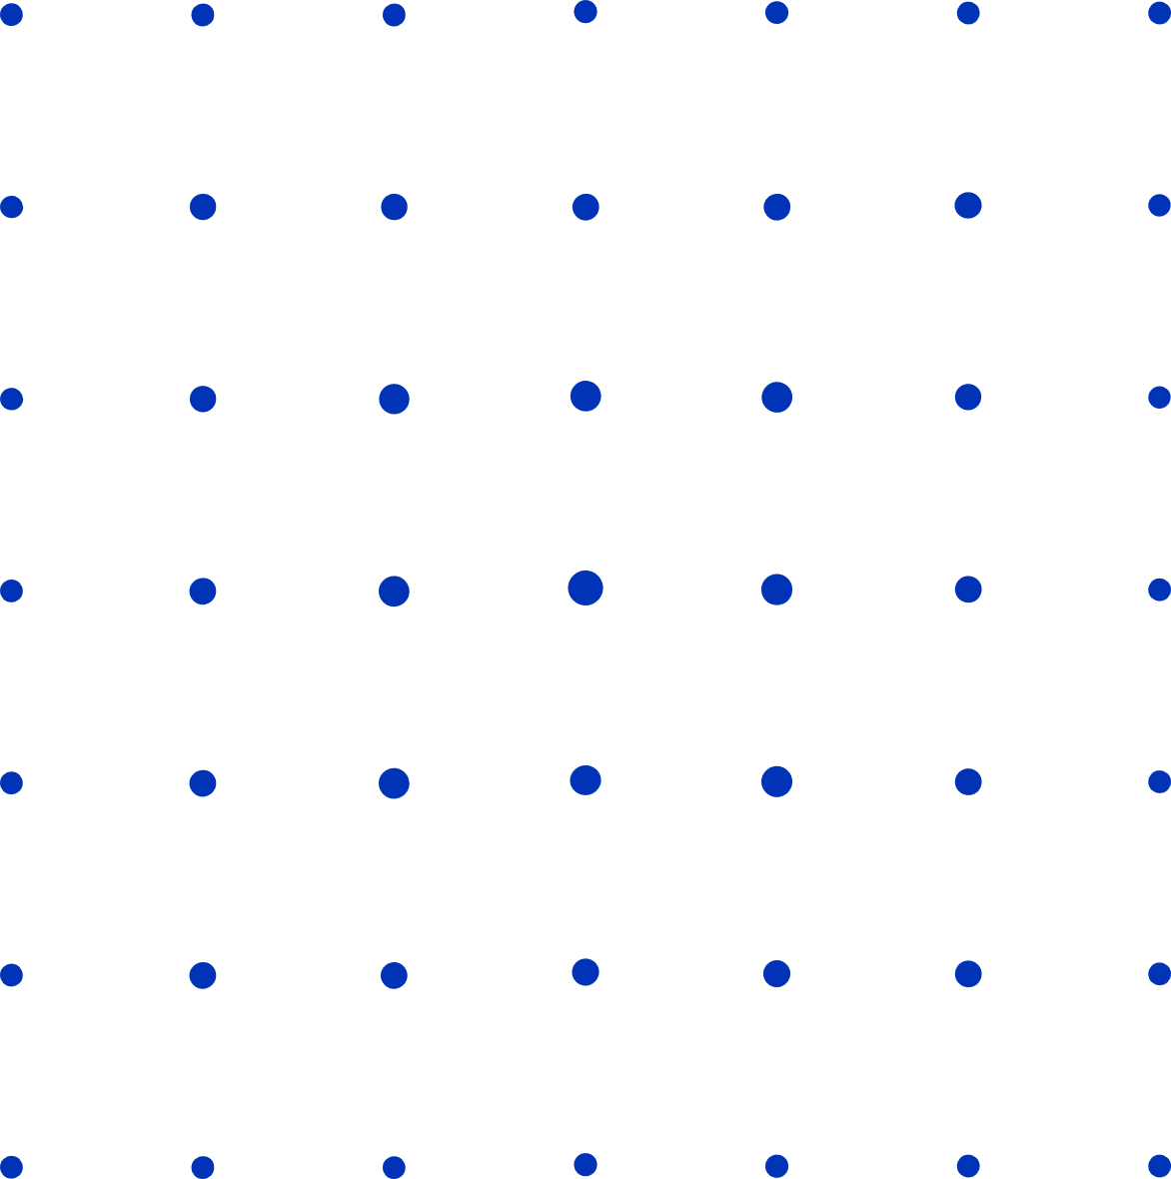

Heart Disease Prediction Using Machine Learning
Batch - 10B
Student Name - N.S.S HARSHITH
Roll Number - 20331A05C8
Student Name - K . DEVARAJU
Roll Number - 20331A0592
Student Name - K.Yeswanth Teja
Roll Number - 20331A0581
Student Name - G.Vasu Devaraju
Roll Number - 20331A0567
Supervised by,
Dr. T. Pavan Kumar
Associate Professor, HOD CSE

Slide 2
1 | Abstract
2 | Introduction
3 | Related Work
4 | Proposed Work
5 | Project Timeline
6 | Implementation & Methodology
7 | Results
8 | Conclusion & Future Work
9 | References
AGENDA

Slide 3
Abstract
The heart is the central part of the circulatory system and pumps blood throughout the body. According to the World Health Organization, 620 million of 8 billion people suffered from cardiovascular diseases in 2023. Examination and diagnosis of heart disease is an important task in medicine. It allows for accurate classification and helps cardiologists provide appropriate treatment to patients.
From this study, we developed a model to predict cardiovascular disease to reduce deaths from cardiovascular disease.in this paper, we introduced a k-type clustering method that can improve classification accuracy. Machine learning methods Random Forest (RF), Decision Tree (DT) classifier, Multilayer Perceptron (MLP), and XG Boost (XGB) are utilized by GridSearchCV.
The proposed model was implemented on a real dataset consisting of 70,000 samples obtained from Kaggle. Data was split in 80:20 ratio and got the following accuracy: Decision Tree: 82.69% (with cross-validation) and 83.93%(without cross-validation), XGBoost: 83.31% (with cross-validation) and 84.46%(without cross-validation), Random Forest: 84.47% (with cross-validation) and 84.13% (without cross-validation), Multilayer Perceptron: 84.23% (with cross-validation) and 84.19% (without cross-validation). The results of this simple study in that the cross-validated random forest outperforms all other algorithms in accuracy. The highest accuracy reaches 84.47%.

Slide 4
Introduction
Cardiovascular disease (CVD) accounts for over 70% of global deaths, with risk factors like unhealthy diets and smoking prevalent worldwide.
Low and middle-income countries are also experiencing increased rates of heart disease, exacerbated by limited access to diagnostic tools.
Predictive modeling using machine learning offers a promising approach to identify individuals at risk of heart disease.
By analyzing various factors including medical history and demographics, advanced techniques such as Decision Trees, Random Forest, XGBoost, and Multi-layer Perceptron achieve an 84.47% success rate in predicting heart disease likelihood.
Preprocessing and scaling the dataset with k-mode clustering further enhance model performance. Utilizing a large dataset of 70,000 instances, this study aims to provide more widely applicable results compared to previous studies with smaller sample sizes.

Slide 5
Related Work
Authors | Novel Approach | Best Accuracy | Dataset
Shorewall, 2021[4] | Stacking of KNN, random forest, and SVM outputs with logistic regression as the metaclassifier | 75.1% (stacked model) | Kaggle cardiovascular disease dataset (70,000 patients, 12 attributes)
Our and ElSeddawy, 2021[15] | Repeated random with random forest | 89.01%(random forest classifier) | UCI cardiovascular dataset (303 patients, 14 attributes)
Waigi et al., 2020[8] | Decision tree | 72.77% (decision tree) | Kaggle cardiovascular disease dataset (70,000 patients, 12 attributes)
Khan and Mondal, 2020[16] | Cross-validation method with logistic regression (solver: lbfgs) where k = 30 | 72.72% | Kaggle cardiovascular disease dataset 1 (462 patients, 12 attributes)
Maiga et al., 2019[26] | -Random forest-Naive Bayes-Logistic regression-KNN | 70% | Kaggle cardiovascular disease dataset (70,000 patients, 12 attributes)

Slide 6
Proposed Work
A diverse dataset collected from Kaggle comprises demographic details, medical history, lifestyle factors, and clinical measurements pertinent to heart disease prediction.
Preprocessing involves handling missing values, outliers, and inconsistencies through imputation, normalization, and outlier removal using boxplots.
Feature selection techniques such as correlation analysis and feature importance from tree-based models identify relevant features, including the engineering of new features like BMI and MAP.
Clustering with the k-modes algorithm is performed to group instances, particularly suitable for categorical data.
The dataset is split into training (80%) and testing (20%) sets for model training and evaluation, utilizing various classifiers such as decision tree, random forest, multilayer perceptron, and XGBoost. Models are trained to learn patterns indicative of heart disease, with hyperparameter tuning conducted via techniques like grid search.
Model evaluation assesses performance using validation data, evaluating metrics like accuracy, precision, and F1-score to ensure robustness and generalization of predictions.

Slide 7
Implementation & Methodology
Data Collection : A diverse dataset is collected from Kaggle, encompassing demographic details, medical history, lifestyle factors, and clinical measurements relevant to heart disease prediction.
Data Cleaning : It involves handling missing values, outliers, and inconsistencies, employing techniques like imputation, normalization, and outlier removal using boxplots.
Feature selection techniques such as correlation analysis and feature importance from tree-based models identify relevant features, with BMI and MAP engineered as new features.
Clustering is performed using the k-modes algorithm, suitable for categorical data, to group instances.

Slide 8
Modelling : The dataset is split into training (80%) and testing (20%) sets for model training and evaluation, respectively using various classifiers decision tree, random forest, multilayer perceptron, and XGBoost
1. Decision Tree Classifier: Utilizes a tree-like structure to make decisions based on dataset attributes.
i. Begins at the root node and traverses down to leaf nodes, making decisions at each step.
2. Random Forest: Ensemble learning method combining multiple decision trees.
i. Each tree votes on the class, and the most common class becomes the prediction.
ii. Reduces overfitting by aggregating predictions from multiple trees.
3. Multilayer Perceptron (MLP): Artificial neural network with multiple layers of nodes.
i. Suitable for solving nonlinear problems by adjusting weights between layers.
ii. Uses activation functions like sigmoid for smooth transitions. Applies backpropagation to minimize error and adjust weights.

Slide 9
4. XGBoost: Gradient boosted decision tree algorithm.Builds trees sequentially, adjusting weights based on errors from previous trees.
i. Merges outputs of individual trees to improve overall prediction accuracy.
Model Training : Models are trained to learn patterns indicative of heart disease, with hyperparameter tuning conducted using techniques like grid search.
Hyperparameter Tuning: Optimized the hyperparameters of the selected models using techniques like grid search or random search. This step helps in finding the best configuration for each model.
Model evaluation is carried out using validation data, assessing performance with metrics like accuracy, precision, F1-score.

Slide 10
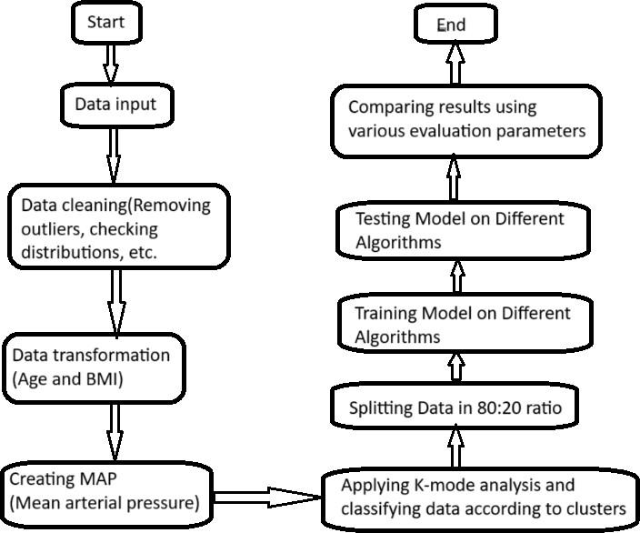
Implementation & Methodology

Slide 11

Results
This project utilized Google Colab on an Intel Core i5 processor and 8 GB of RAM. The dataset comprises 70,000 instances with 12 varying attributes, which are reduced to 62,505 instances and 11 attributes. Outliers are successfully removed to improve model efficiency. Several performance metrics are calculated over different classifiers, such as random forest, decision tree, multilayer perceptron, and XGBoost classifier.
Trained 80% of the dataset for each algorithm, employing an automated hyper-tuning technique, called GridSearchCV. The evaluation metrics of the different classifiers are given in the below table. The result indicates that random forest with cross-validation achieves the highest accuracy of 84.47%, outperforming all other algorithms.
Model | Accuracy |  | Precision |  | Recall |  | F1-Score |  | AUC
 | Without CV | CV | Without CV | CV | Without CV | CV | Without CV | CV
MLP | 84.19 | 84.23 | 84.23 | 88.59 | 86.48 | 78.58 | 83.28 | 82.44 | 0.92
RF | 84.13 | 84.47 | 84.47 | 88.54 | 88.04 | 78.48 | 83.21 | 82.20 | 0.92
DT | 83.93 | 82.69 | 82.69 | 88.72 | 88.39 | 77.83 | 82.92 | 82.04 | 0.92

Slide 12

Conclusion & Future Work
This project classifies heart disease occurrence using various machine-learning models on a large dataset. Employing k-mode clustering and binning methodology aided in feature reduction and selection, improving data transformation efficiency. The elbow curve method determined optimal cluster numbers, while correlation matrices provided insights into category relationships. Applying different classifiers on 80% of the dataset notably boosted accuracy, with Random Forest achieving 84.47%. Limitations include potential variations in accuracy across datasets and overlooking lifestyle and genetic factors. Further research is recommended to address these limitations and understand additional risk factors in heart disease

Slide 13
References
[1] Estes, C.; Anstee, Q.M.; Arias-Loste, M.T.; Bantel, H.; Bellentani, S.; Caballeria, J.; Colombo, M.; Craxi, A.; Crespo, J.; Day, C.P.; et al. Modeling NAFLD disease burden in China, France, Germany, Italy, Japan, Spain, United Kingdom, and United States for the period 2016–2030. J. Hepatol. 2018, 69, 896–904.
[2] Drozd˙ z, K.; Nabrdalik, K.; Kwiendacz, H.; Hendel, M.; Olejarz, A.; Tomasik, A.; Bartman, W.; Nalepa, J.; Gumprecht, J.; Lip, G.Y.H. ˙ Risk factors for cardiovascular disease in patients with metabolic-associated fatty liver disease: A machine learning approach. Cardiovasc. Diabetol. 2022, 21, 240.
[3] Murthy, H.S.N.; Meenakshi, M. Dimensionality reduction using neuro-genetic approach for early prediction of coronary heart disease. In Proceedings of the International Conference on Circuits, Communication, Control and Computing, Bangalore, India, 21–22 November 2014; pp. 329–332.
[4] Shorewala, V. Early detection of coronary heart disease using ensemble techniques. Inform. Med. Unlocked 2021, 26, 100655.
[5] Mozaffarian, D.; Benjamin, E.J.; Go, A.S.; Arnett, D.K.; Blaha, M.J.; Cushman, M.; de Ferranti, S.; Després, J.-P.; Fullerton, H.J.; Howard, V.J.; et al. Heart disease and stroke statistics—2015 update: A report from the American Heart Association. Circulation 2015, 131, e29–e322.

Slide 14
Abstract | Introduction
Related Work | Proposed Work
Implementation & Methodlogy | Results
Conclusion & Future Work | Any Queries?
SUMMARY
12

Slide 15




K.Devaraju
Our Team
Batch - 10B
N.S.S.Harshith
G.Vasu Devaraju
K.Yeswanth Teja

Slide 16

Acknowledgements
We express our sincere gratitude to Dr. T. Pavan Kumar for his invaluable guidance and support as our mentor throughout the project. His unwavering commitment to excellence and constructive feedback motivated us to achieve our project goals. We are greatly indebted to him for his exceptional guidance.
Additionally, we extend our thanks to Prof. P.S. Sitharama Raju (Director), Prof. Ramakrishnan Ramesh (Principal), and Dr. T. Pavan Kumar (Head of the Department) for their unwavering support and assistance, which were instrumental in the successful completion of the project. We also acknowledge the dedicated assistance provided by all the staff members in the Department of Computer Science & Engineering. Finally, we appreciate the contributions of all those who directly or indirectly contributed to the successful execution of this endeavor.

Slide 17


Thank You!

