Slide 1

Question #1 How much impact does being late or too spaced out at the first stop have downstream?
We split this question into two parts.
1# Adherence
2# Headway Deviation

Slide 2
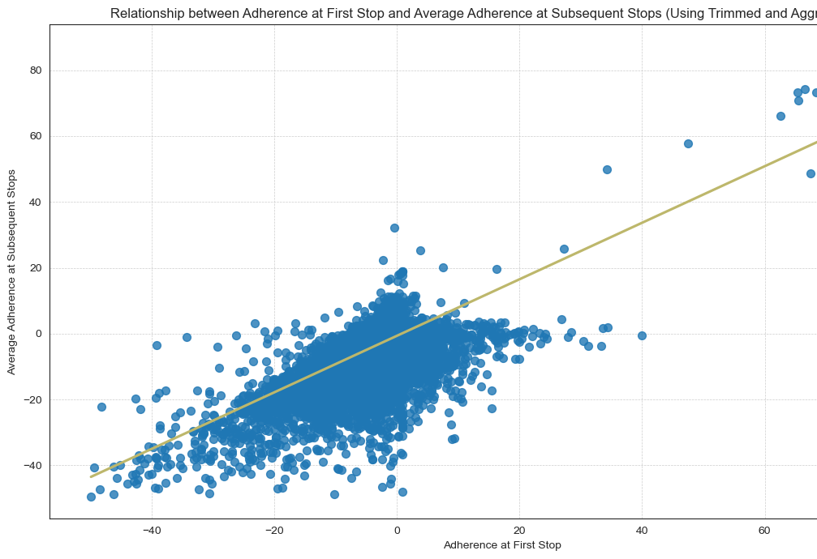
How much impact does being late have downstream?
Notes:
What is adherence=Adherence is a essentially a measure of lateness (or earlyness)
Because there so many outliers, the data cuts
The

Slide 3
What is the Correlation between First Stop and Downstream Adherence?
The Pearson Correlation is0.6185451439913879 The Kendall Correlation is0.33646375747493523
The Pearson Score is 0.6185
The Kendall Tau Score is 0.3365
= Moderate Correlation
Notes:
The Pearson Correlation is sensitive to outliers,
Kendall Tau Correlation may be better fit in this instance.

Slide 4
How much does F.S. Adherence predict Downstream Adherence?
Verification!
Using a glm, 38% of the First Stop Adherence can be explained by Downstream Adherence
Answer=FS Adherence has a moderate predictive effect on downstream stops…

Slide 5
What about Headway Deviation?
What is Headway?
What is Headway Deviation?
Notes:
Recall that Headway = the amount of time between vehicle arrivals at a stop.
HDWY_DEV is the amount of deviation between headway measurements at a given stop.

Slide 6
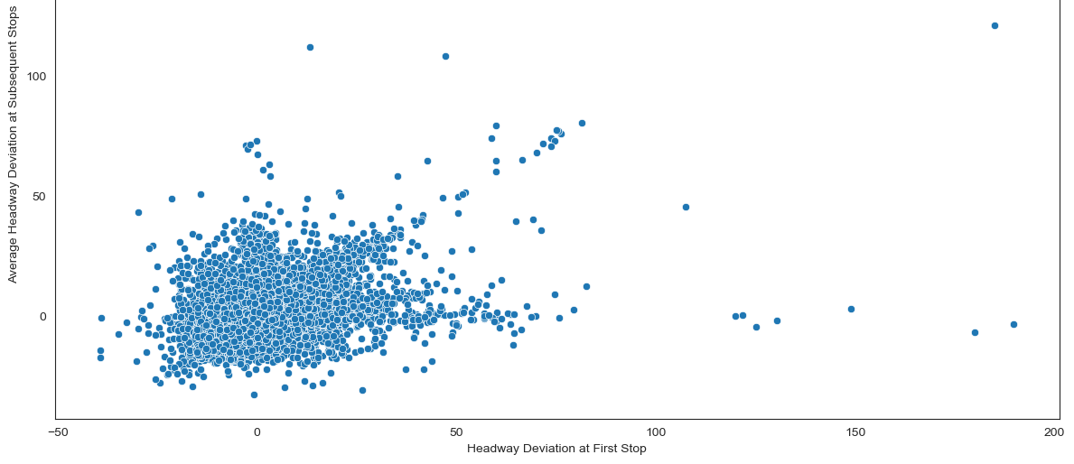
How much impact does being too spaced out at the first stop have downstream?
Notes:
Headway Deviation’s plot and distribution is much more amorphous…
Trimming outliers >200 and re-rerunning a general linear model did not yield much improvement.
The graph at the left is First Stop Headway Deviation vs the Average Downstream Headway in Subsequent Stops.

Slide 7
What about correlation between First Stop and Downstream Headway Deviation?
There was little correlation.
The Pearson Correlation is -0.0023
The Kendall Correlation is -9.580e-05
Notes:
Even after trimming, there was little correlation.
The Pearson Correlation is here,
Kendall Tau Correlation is added as well.

Slide 8
How much does F.S. Headway Deviation predict Downstream Deviation?
Verification!
Less than 1% of the First Stop Hdwy Dev can be explained by Downstream Headway Deviation
Answer=Headway Deviation at the first stop has little predictive effect on downstream stops…
Notes:
Finally, prediction:
We verified that less than 1% of the First Stop Adherence can be explained by the model, using First Stop to predict Downstream Adherence…
Another way to say it: Less than 1% Downstream Headway Deviation can be accounted for with First Stop Headway Deviation.
Answer=Headway Deviation at the first stop has little predictive effect on downstream stops…
Finally, prediction:
We verified that less than 1% of the First Stop Headway Deviation can be explained by the model, using First Stop to predict Downstream Headway Deviation…
Another way to say it: Less than 1% Downstream Headway Deviation can be accounted for with First Stop Headway Deviation.
Answer = Headway Deviation at the first stop has little predictive effect on Downstream Headway Deviation …

