Slide 1

Question #1 How much impact does being late or too spaced out at the first stop have downstream?
We split this question into two parts.
1# Adherence
2# Headway Deviation

Slide 2
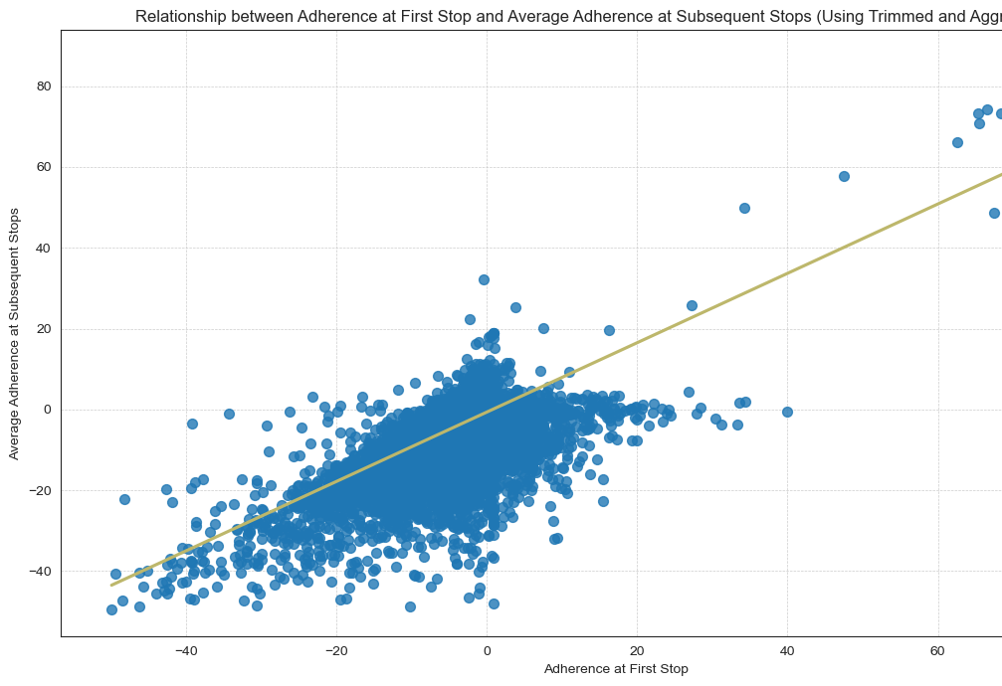
How much impact does being late have downstream?
Being late can be measured with Adherence and loosely fits a general linear model. There are many outliers, which interferes with analysis somewhat.
Trimming Adherence >200 and re-rerunning a general linear model improves fit.
The graph at the left is Adherence at the First Stop vs the Average of Downstream Adherence in Subsequent Stops.

Slide 3
What is the correlation between First Stop and Downstream Adherence?
The Pearson Correlation is0.6185451439913879 The Kendall Correlation is0.33646375747493523
There are many outliers in the data...
The Pearson Correlation is sensitive to outliers,
Kendall Tau Correlation may be better fit in this instance.
The Pearson Score is0.6185451439913879
The Kendall Score is0.33646375747493523

Slide 4
What about Headway Deviation?
Recall that Headway = the amount of time between vehicle arrivals at a stop.
HDWY_DEV is the amount of deviation between headway measurements at a given stop.

Slide 5
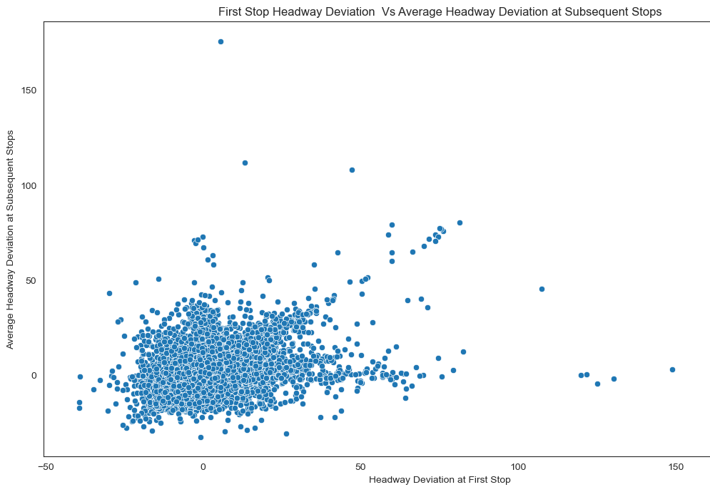
How much impact does being too spaced out at the first stop have downstream?
Headway Deviation’s plot and distribution is much more amorphous…
Trimming outliers >200 and re-rerunning a general linear model did not yield much improvement.
The graph at the left is First Stop Headway Deviation vs the Average Downstream Headway in Subsequent Stops.

Slide 6
What is the correlation between First Stop and Downstream Headway Dev?
Even after trimming, there was little correlation.
The Pearson Correlation is here,
Kendall Tau Correlation is added as well.
The Pearson Correlation is-0.0023193876899118586
The Kendall Correlation is -9.580468279701868e-05

Slide 7
How much does F.S. Headway Deviation predict Downstream Adherence?
Finally, Tto verify, we took random samples and split the data into a training and prediction
Using a glm we verified that less than .1% of the headway deviation can be explained by the model, using First Stop to predict Downstream Headway Deviation…
Another way to say it: Less than 1% Downstream Headway Deviation can be accounted for with First Stop Headway Deviation.
Answer=Headway Deviation at the first stop has little predictive effect on downstream stops…

