Slide 1

Open Secrets: 2020 US House Election Results
max growth
Nitin, Yichuan, Cat, Jeff

Slide 2
Presentation Outline
Part 1
Part 2
Part 3
Project Overview
Research question and data anomalies; districts without elections.
Data Exploration
Initial findings on election winners in terms of money spent/raised and incumbent/non incumbent
Statistical Model
Findings on multiple logistic regression tests comparing money spent on election results.

Slide 3
Part 1: Research question
Part 2: Data Exploration
Part 3: Statistical Model
Data Source: 2020 US House Elections Results/Wikipedia
Data Question: Does the amount of money spent on an election increase a candidate’s chance of winning ?
Unit of Analysis: Elections (State-District Pairs)
Data Findings: Candidate spending did increase the chance of winning an election.

Slide 4

Introducing - Our Political Science Wizard

Slide 5
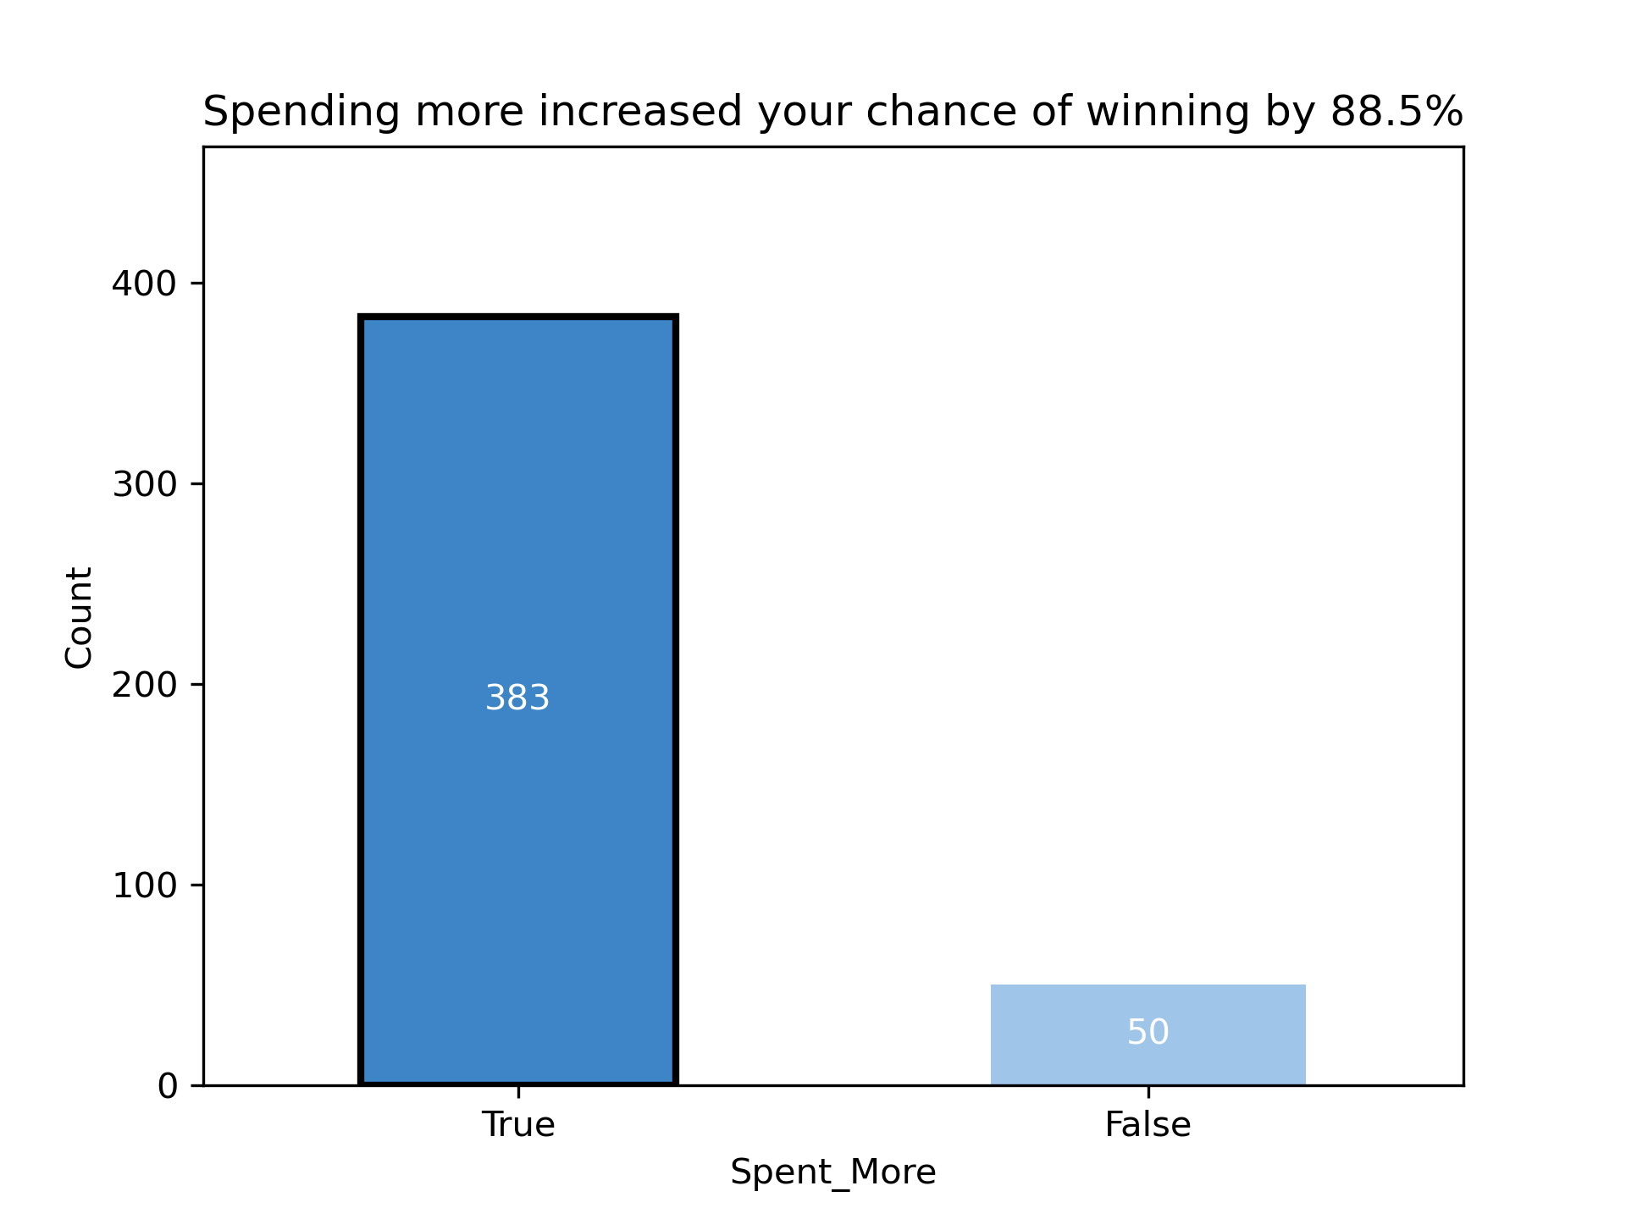

Part 1: Research question/Data challenges
Part 2: Data Exploration
Part 3: Statistical Model
How often did the candidate that spent more win the race?
How often did the candidate that raised more win the race?

Slide 6

Part 1: Research question/Data challenges
Part 2: Data Exploration
Part 3: Statistical Model
How often did the incumbent win the rance ?

Slide 7
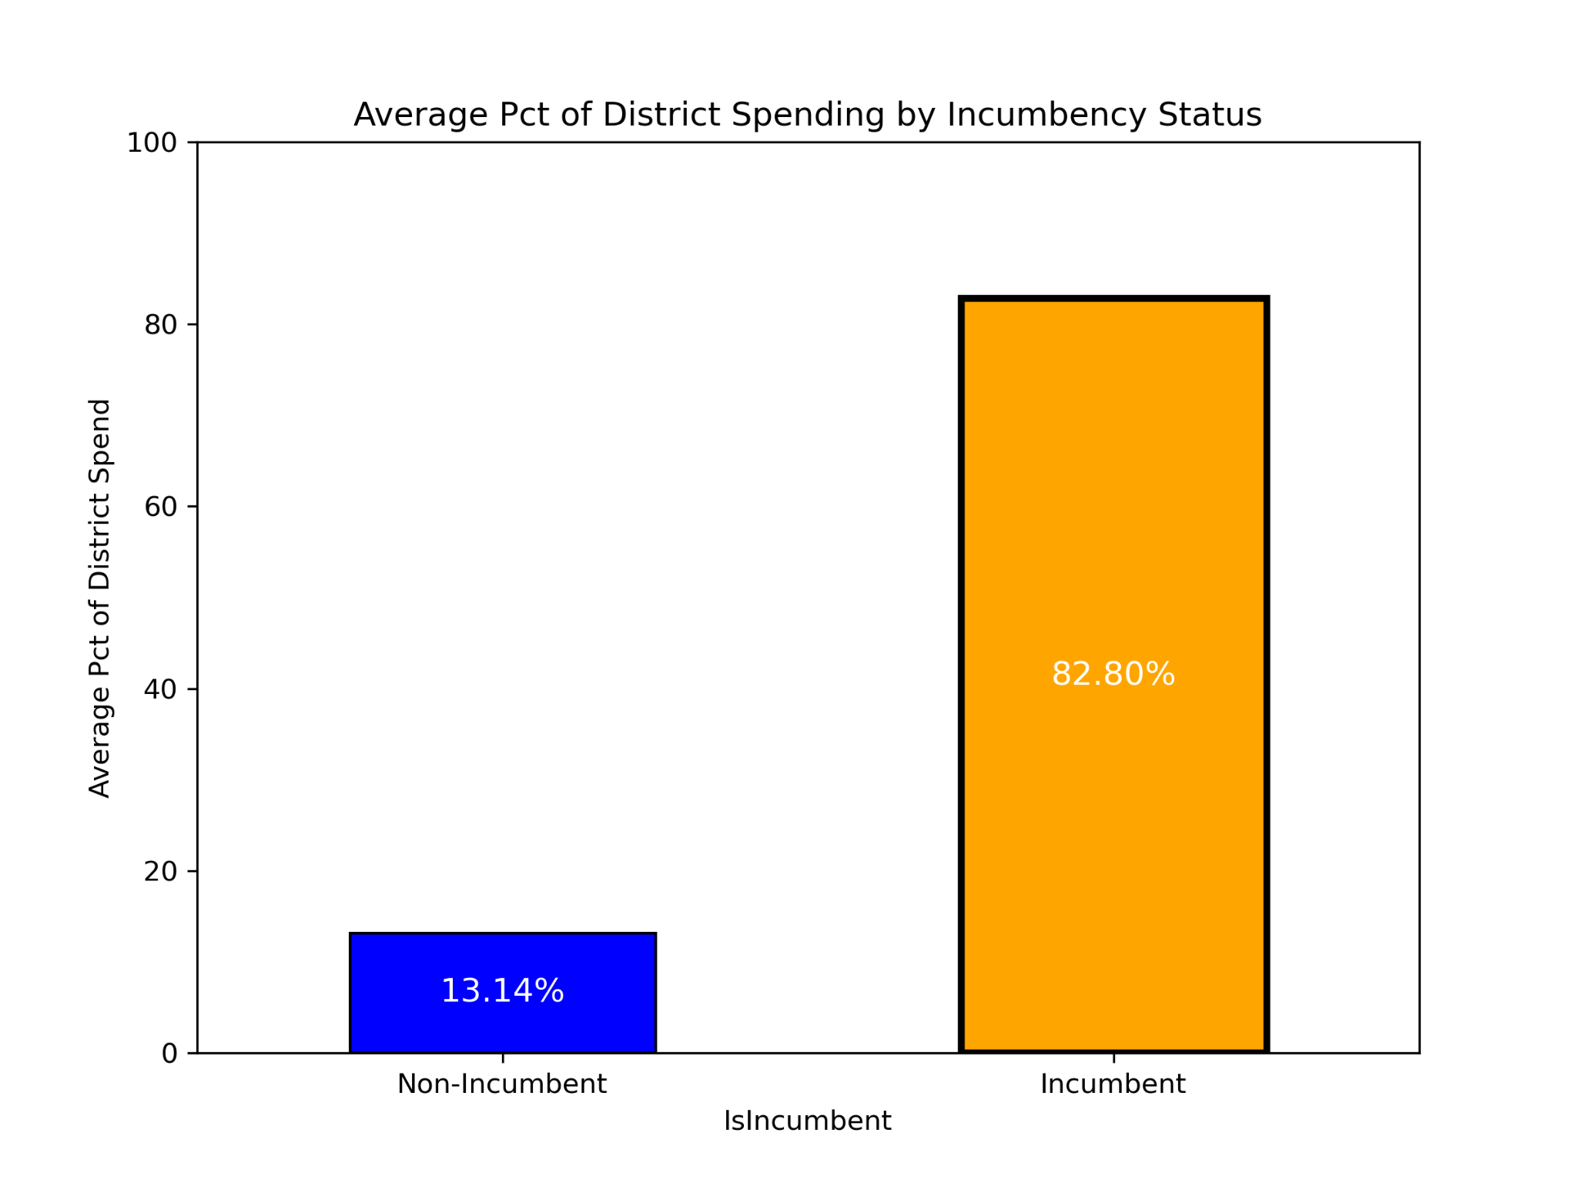
Part 1: Research question/Data challenges
Part 2: Data Exploration
Part 3: Statistical Model
Can you detect any relationship between amount of money raised and the incumbent status of a candidate?
Difference in Means Test
T-statistic: 52.59,
P-value: 2.7006x10^(-320)
Incumbents tend to spend a lot more than non-incumbents. (statistically significant)

Slide 8
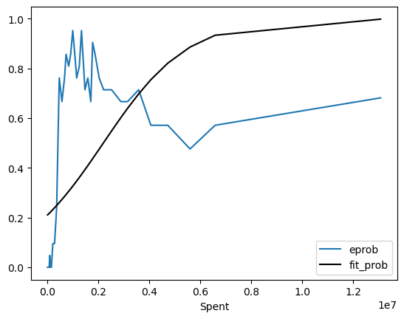
Part 1: Research question/Data challenges
Part 2: Data Exploration
Part 3: Statistical Model
Probability of Winning as a function of Campaign Expenditure: Empirical Observation vs. Fitted Curve from Prediction Model
Probability of Winning
(in USD)
Something doesn’t look right - what’s going on? Let’s reorganize the data then take deeper look →

Slide 9
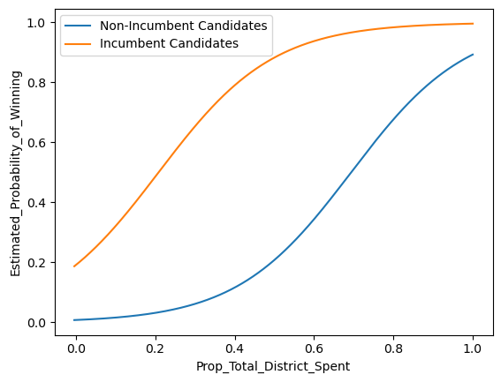
Part 1: Research question/Data challenges
Part 2: Data Exploration
Part 3: Statistical Model
Probability of Winning as a function of Campaign Expenditure and Incumbency
Probability of Winning ~
Incumbency + One’s Campaign Expenditure in Proportion to Total Spending by All the Candidates in One’s District
Chi-Squared Test (p-value < 7.0952 x 10^(-6)) demonstrates that the added complexity to the model is helpful in delineating the presence and impact that each of the independent variables in our analysis had on outcome (probability of winning).
In economics terms, Incumbency shifts the campaign expenditure curve leftward: it takes less spending to achieve the same probability of winning.

Slide 10
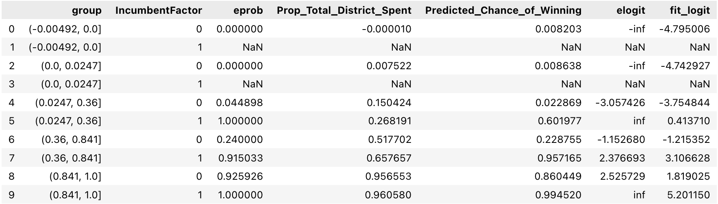
Part 1: Research question/Data challenges
Part 2: Data Exploration
Part 3: Statistical Model
Predicted vs. Empirically Observed Probability of Winning
A more detailed look at the numbers

Slide 11
Questions
Nitin, Yichuan, Cat, and Jeff

