Slide 1

Open Secrets: 2020 US House Election Results
max growth
Nitin, Yichuan, Cat, Jeff

Slide 2
Presentation Outline
Part 1
Part 2
Part 3
Project Overview
Research question
Data Exploration
Initial findings on election winners.
Statistical Model
Findings on multiple logistic regression tests

Slide 3
Part 1: Research question
Part 2: Data Exploration
Part 3: Statistical Model
Data Source: 2020 US House Elections Results/Wikipedia
Data Question: Does the amount of money spent on an election increase a candidate’s chance of winning ?
Unit of Analysis: Elections (State-District Pairs)
Data Findings: Our analysis suggests that higher levels of candidate spending were associated with an increased likelihood of winning an election.

Slide 4
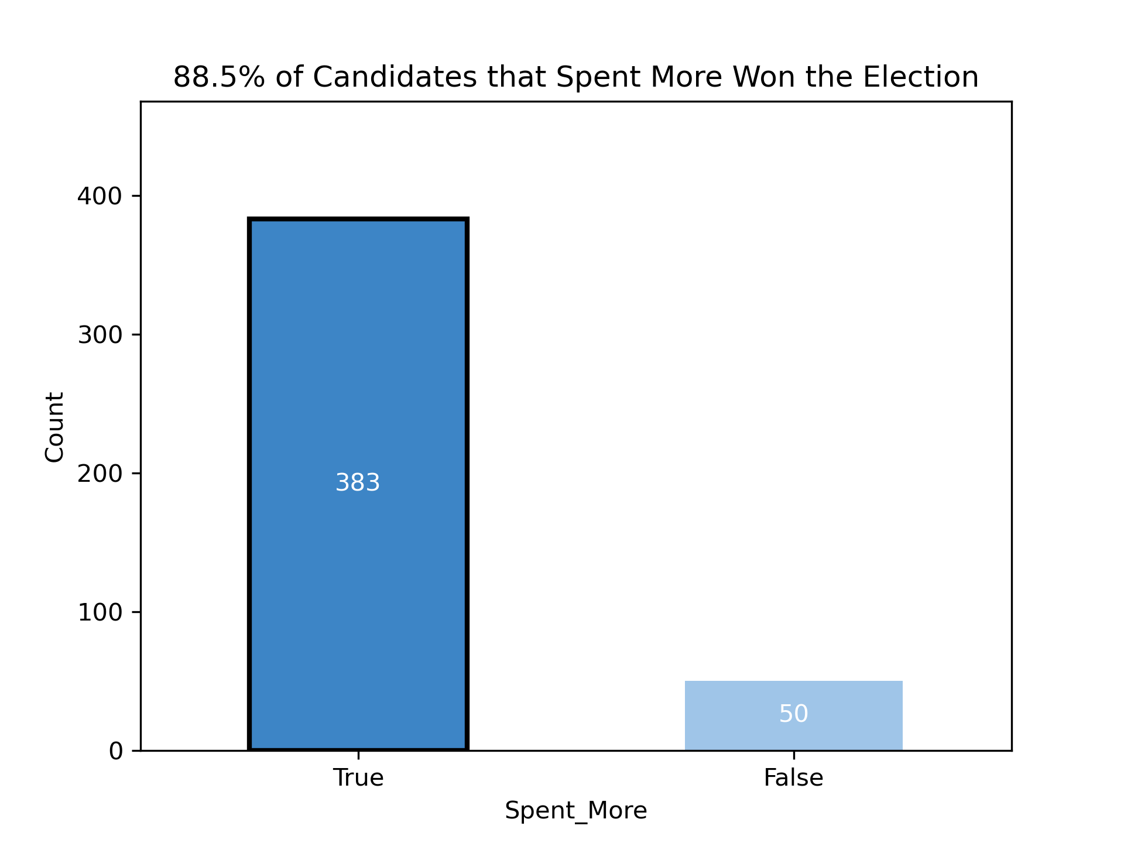
Part 1: Research question/Data challenges
Part 2: Data Exploration
Part 3: Statistical Model
How often did the candidate that spent more win the race?

Slide 5

Part 1: Research question/Data challenges
Part 2: Data Exploration
Part 3: Statistical Model
How often did the incumbent win the race ?

Slide 6
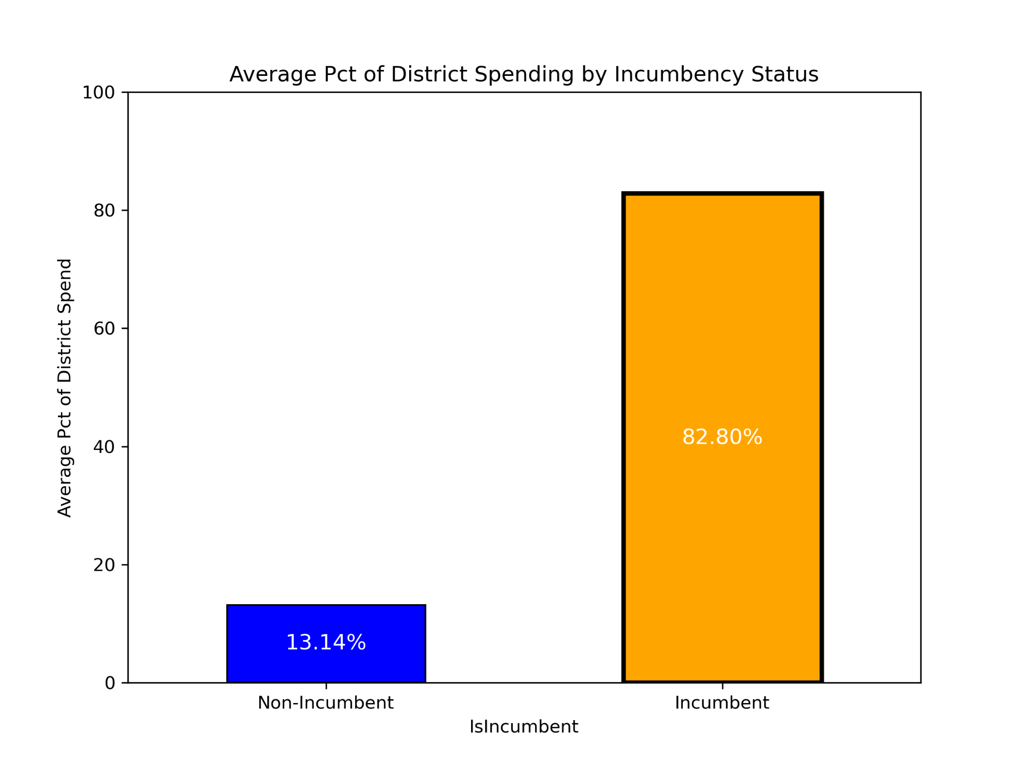
Part 1: Research question/Data challenges
Part 2: Data Exploration
Part 3: Statistical Model
Can you detect any relationship between amount of money spent and the incumbent status of a candidate?
Footnote: Open seat races are not counted here

Slide 7
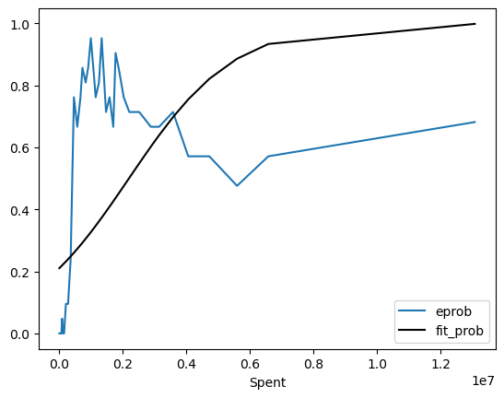
Part 1: Research question/Data challenges
Part 2: Data Exploration
Part 3: Statistical Model
Probability of Winning as a function of Campaign Expenditure: Empirical Observation vs. Fitted Curve from Prediction Model
Probability of Winning
(in USD)
Something doesn’t look right - what’s going on? Let’s reorganize the data then take deeper look →

Slide 8
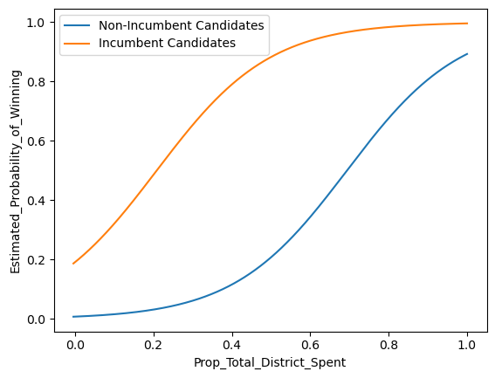
Part 1: Research question/Data challenges
Part 2: Data Exploration
Part 3: Statistical Model
Probability of Winning as a function of Campaign Expenditure and Incumbency
Probability of Winning ~
Incumbency + One’s Campaign Expenditure in Proportion to Total Spending by All the Candidates in One’s District
Chi-Squared Test (p-value < 7.0952 x 10^(-6)) demonstrates that the added complexity to the model is helpful in delineating the presence and impact that each of the independent variables in our analysis had on outcome (probability of winning).
In economics terms, Incumbency shifts the campaign expenditure curve leftward: it takes less spending to achieve the same probability of winning.

Slide 9
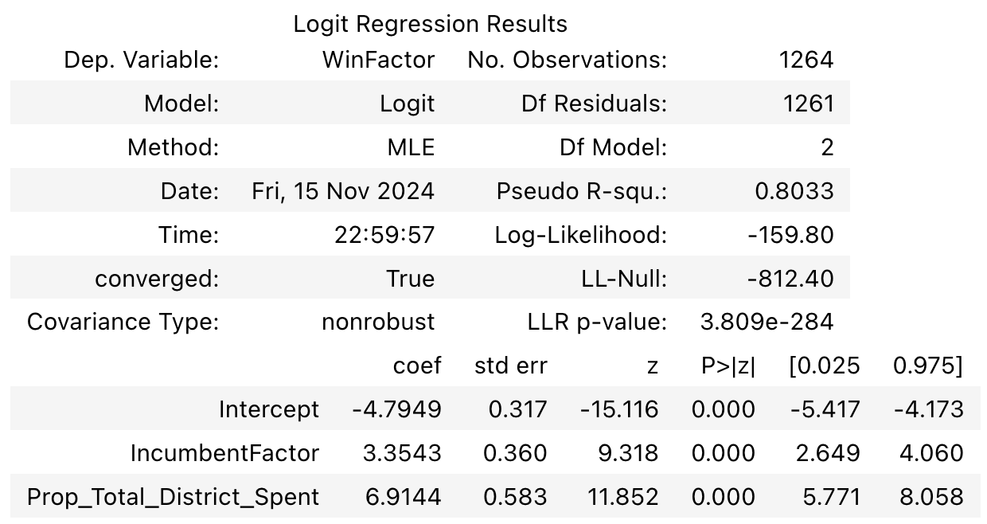
Part 1: Research question/Data challenges
Part 2: Data Exploration
Part 3: Statistical Model
Probability of Winning as a function of Campaign Expenditure and Incumbency
Probability of Winning ~
Incumbency + One’s Campaign Expenditure in Proportion to Total Spending by All the Candidates in One’s District

Slide 10
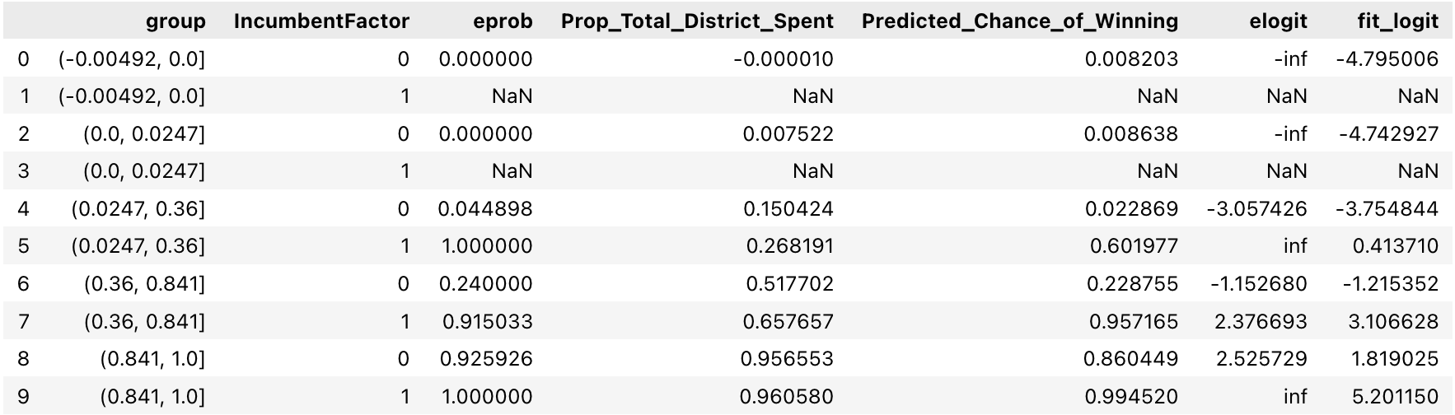
Part 1: Research question/Data challenges
Part 2: Data Exploration
Part 3: Statistical Model
Predicted vs. Empirically Observed Probability of Winning
A more detailed look at the numbers

Slide 11
Questions
Nitin, Yichuan, Cat, and Jeff

Slide 12
Part 1: Research question/Data challenges
Part 2: Data Exploration
Part 3: Statistical Model
Can you detect any relationship between amount of money raised and the incumbent status of a candidate?
Difference in Means Test
T-statistic: 52.59
P-value: 2.7006x10^(-320)
Incumbents tend to spend a lot more than non-incumbents. (statistically significant)

Slide 13

Part 1: Research question/Data challenges
Part 2: Data Exploration
Part 3: Statistical Model
How often did the candidate that raised more win the race?
How often did the candidate that spent more win the race?

