Slide 1


Candidate Name: Nishant Sharma
Registration No: RA2011003020524
Email: nss16040@gmail.com
Phone No.: 8894654165
Name of the Case Study: Data Analysis
Name of the Problem Statement: Analysis as a business manager

Slide 2

Understanding of the problem statement
Approach
The task is to-
Find top 10 customers and top 5 brands each month.
Spot overdue invoices after October 31.
Sort overdue invoices by time: 0-30 days, 31-60 days, 61-90 days, 90+ days.
Suggest ways to reduce overdue payments.
The approach is –
Data wrangling:- Used Python to clean up the data by making sure we didn't miss anything and ensuring everything is accurate and correct.
Loading data in Power BI:- Transferred the cleaned up data into Power BI for easy analysis.
Figuring out answers:- Used logical reasoning to figure out the answers to the questions by understanding and interpreting the data.

Slide 3
Steps Taken
1) Data Cleaning and Preparation:
Used Python with the pandas library to clean up the data.
Took care of missing information, errors and duplicates.
2) Data Analysis:
Examined the dataset.
Extracted key insights from the data.
3) Visualization of result:
Used visualization tool Power BI to make visual representations of the data.
Linked Power BI to the dataset for analyzed data.
Created charts, graphs, and dashboards to show the analysis results in a visual way.

Slide 4
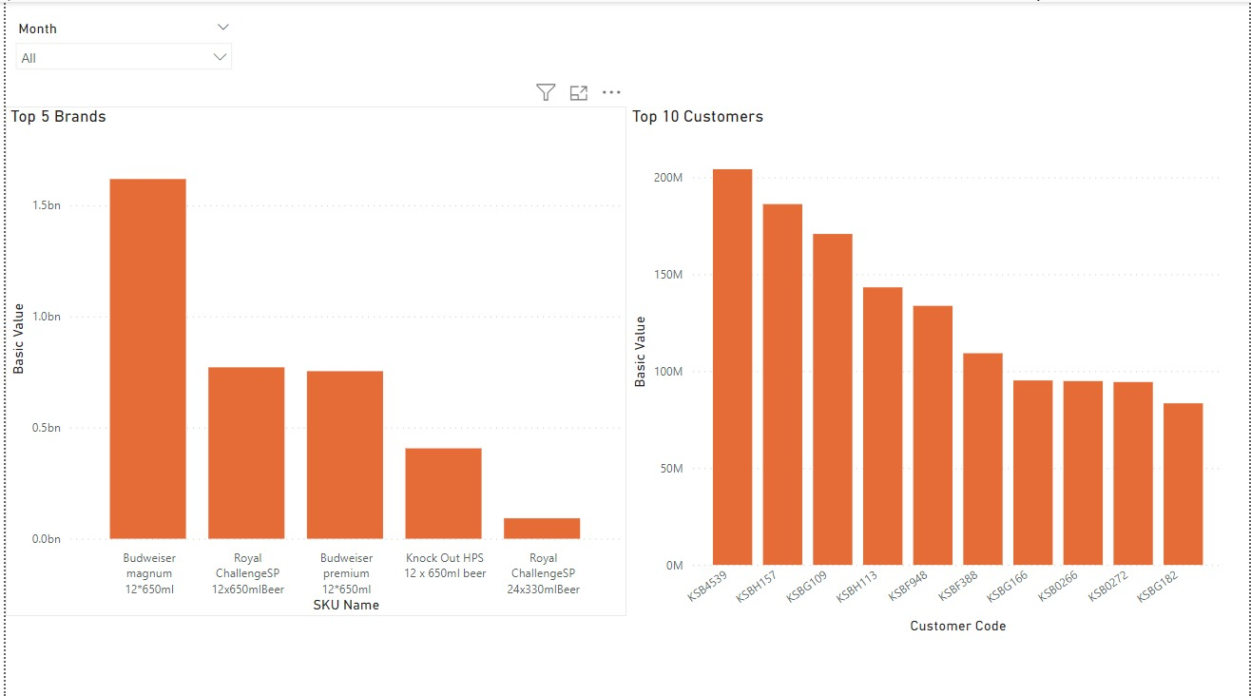
Final Solution Monthly top 10 customers , top 5 Brands
In our sales study "Budweiser magnum 12*650ml" stands out as the top seller, making a whopping $1.6 billion. Close behind are "Royal ChallengeSP 12x650mlBeer" and "Budweiser premium 12*650ml" at $771 million and $753 million, respectively. Meanwhile "Royal ChallengeSP 24x330mlBeer" brings in a modest $92 million. To boost overall sales I recommend focusing on strategies for lower-performing products and understanding what makes the top sellers tick.
Looking at sales numbers tied to customer codes, "KSB4539" takes the lead with around $204 million. Right behind is "KSBH157" with $186 million and "KSBG109" with $170 million. These standout customer codes offer valuable insights for making smart decisions in customer relations and sales strategies.
(Based on Earnings Benefits & Deductions)

Slide 5
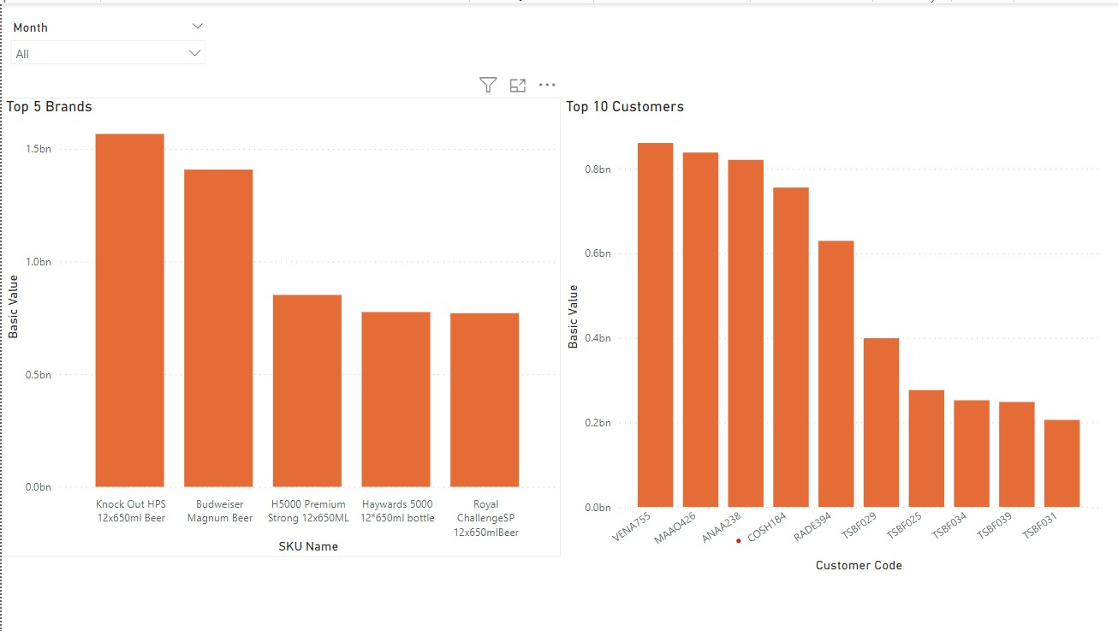
Final Solution Monthly top 10 customers , top 5 Brands
Exploring product sales based on basic values reveals notable figures. "Knock Out HPS 12x650ml Beer" takes the lead with a basic value of approximately $1.57 billion, followed closely by "Budweiser Magnum Beer" at $1.41 billion and "H5000 Premium Strong 12x650ML" at $852 million. The analysis sheds light on these high-performing products, offering valuable insights for strategic decision-making in product management and sales.
Examining the basic values associated with customer codes highlights significant sales figures. Customer code "VENA755" leads with a total value of $860 million, followed closely by "MAAO426" at $838 million and "ANAA238" at $820 million. These top-performing customer codes provide valuable insights for informed decision-making in customer relations and sales strategies.
(Based on quantity)

Slide 6
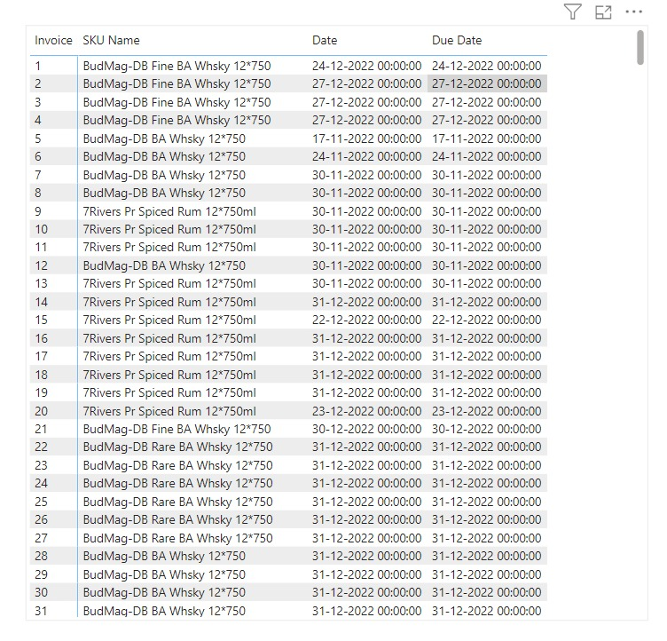
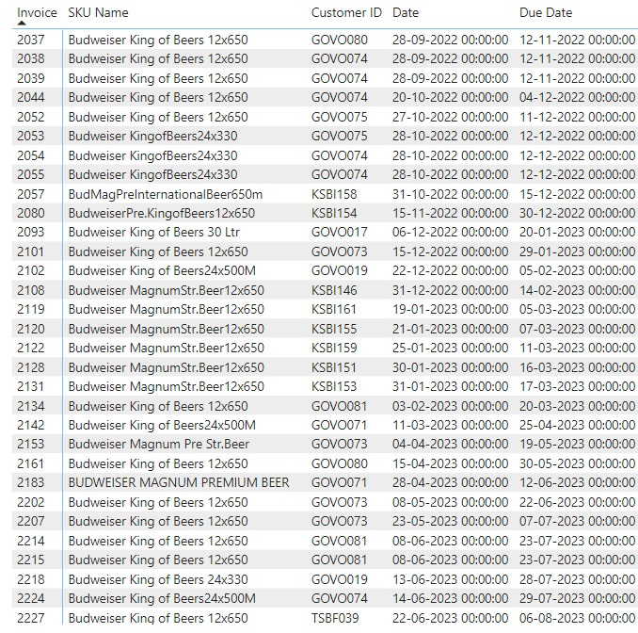
Final Solution
List of invoices that are overdue beyond the October 31st deadline.

Slide 7
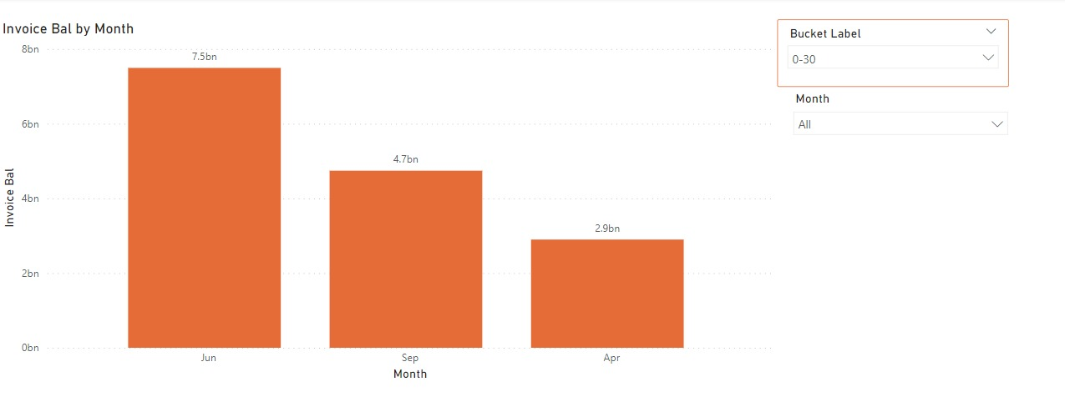
Final Solution Aging buckets on invoice value
The selected aging bucket is 0-30 days, indicating the time elapsed since the due date for invoices in this range. The same principle applies to other aging buckets: 31-60 days, 61-90 days, and 90+ days. For instance, 0-30 days means it's been 0-30 days since the due date, and the same logic applies to the other aging buckets accordingly.

Slide 8
Final Solution
Minimisation of customer wise overdue
After looking at the invoice data and their due dates, a few things stand out to help reduce overdue payments from customers. On average, invoices are due about 27 days after they're issued. The analysis points out 'DTT2440' as the customer with the most overdue invoices. On average, customers tend to delay payments by 21 days past the due date. Some invoices also have due dates extending beyond the usual 30-day period. To cut down on overdue payments, it's recommended to enforce stricter credit limit rules, offer rewards for early payments, and reach out specifically to customers like 'DTT2440' who have a history of delays. Regularly keeping an eye on payment patterns and adjusting credit policies accordingly is essential for managing cash flow and reducing overdue payments.

