Slide 1


Sales Analysis Dashboard
A Data Analytics Project Prepared in Power BI
Presented By
SATHISH N

Slide 2
Project Objective
This project aims to analyze company sales data and build an interactive dashboard in Power BI. The dashboard tracks key performance indicators (KPIs) like Total Revenue, Sales Amount, Quantity Sold, Unit Price, and Unit Cost, providing a comprehensive view of sales trends, performance by region, product category, and month.

Slide 3
Dataset and Tools
Dataset Description
Tools Utilized
Source: Company sales records (sample from Kaggle)
Excel: Initial data inspection and basic cleaning
Key Columns: Region, Product Category, Payment Method, Month, Sales Amount, Revenue, Quantity Sold, Unit Price, Unit Cost
Python (Pandas): Advanced data manipulation and preparation
Power BI: Dashboard development and visualization
Time Period: 12 months of sales data

Slide 4

Key Performance Indicators
We defined essential KPIs using DAX formulas to ensure accurate and actionable insights.
1
2
3
Total Sales Amount
Total Revenue
Total Quantity Sold
SUM(Sales[Sales_Amount])
SUM(Sales[Revenue])
SUM(Sales[Quantity_Sold])
4
5
Average Unit Price
Average Unit Cost
AVERAGE(Sales[Unit_Price])
AVERAGE(Sales[Unit_Cost])

Slide 5
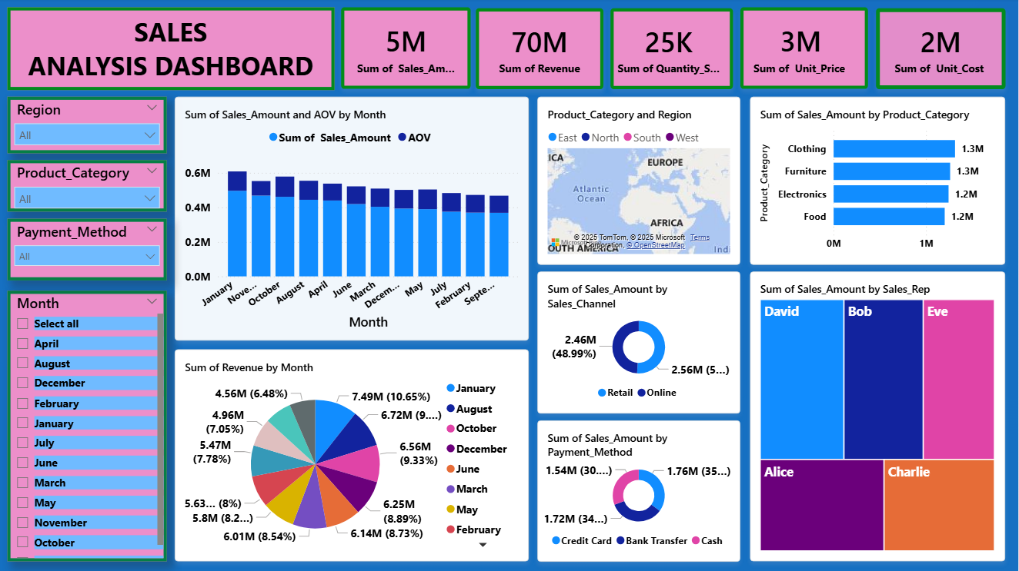
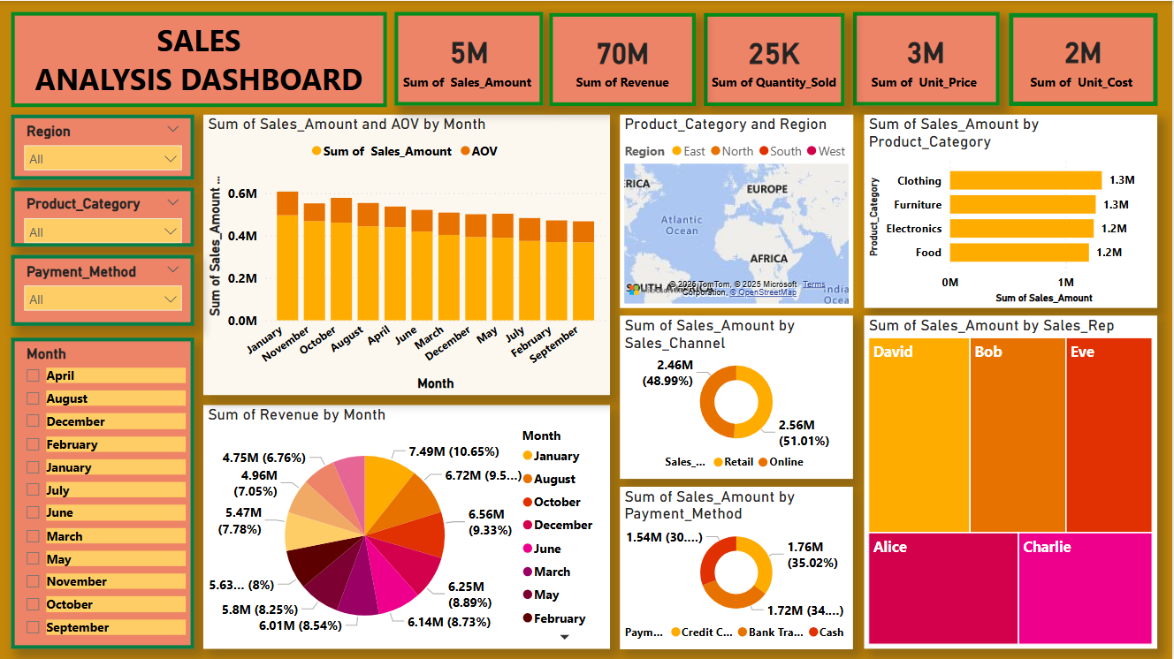
Dashboard Components
The Power BI dashboard provides a comprehensive view of sales performance through various visualizations.

Slide 6





Key Insights from the Dashboard
Seasonal Peaks
Highest sales observed in January and November, indicating potential seasonal trends for targeted campaigns.
Product Performance
Clothing and Furniture categories contribute the most revenue, highlighting areas for strategic focus.
Regional Dominance
The South region dominates sales, suggesting successful regional strategies or untapped potential in other areas.
Payment Preferences
Credit Card is the most used payment method, offering insights into customer payment behavior.
Top Performer
Sales Representative David is the top performer, providing a benchmark for team performance.

Slide 7





Learning Outcomes & Future Impact
Data Mastery
Proficiency in data cleaning and preparation using Excel and Python, ensuring data quality and reliability.
Interactive Dashboards
Expertise in building interactive dashboards in Power BI to present complex data in an accessible format.
DAX Formulas
Skill in creating robust KPIs using DAX formulas for precise business metrics.
Trend Visualization
Ability to visualize sales trends by region, product, and month, identifying growth opportunities.
Data-Driven Decisions
Empowering stakeholders with data-driven insights to improve strategic decision-making and optimize sales performance.

