Slide 1

Accident Reporting w/ OCR

Slide 2
Intro
Nathan Stechschulte
12 years at Union Pacific Railroad – System Engineer
Current role: design, develop and maintain Mechanical department IT software
Relevance to course:
Develop systems that run on “cloud” environment and fix ones that aren’t architected to
Need to understand “cloud” infrastructure to better support Tech enabled railroad operations
but most of this AWS/infrastructure ‘setup’ by small Platforms team for entire enterprise
Class Project Role - Single Person Team – “everything”

Slide 3
Disclaimer
Work full time
Another graduate level class
Based on grades, pretty sure I’ll pass without this project
Understand it may not be “complete” as you might expect, but tried!

Slide 4
Cloud Services Used – p1
Used Week9 Assignment8 as Starting Point
React App
Prisma SQL Lite Database
CloudFormation
EC2
Internet Gateway, Public Subnet, Route Table, Security
App Install Commands (git clone, build, run, etc)

Slide 5
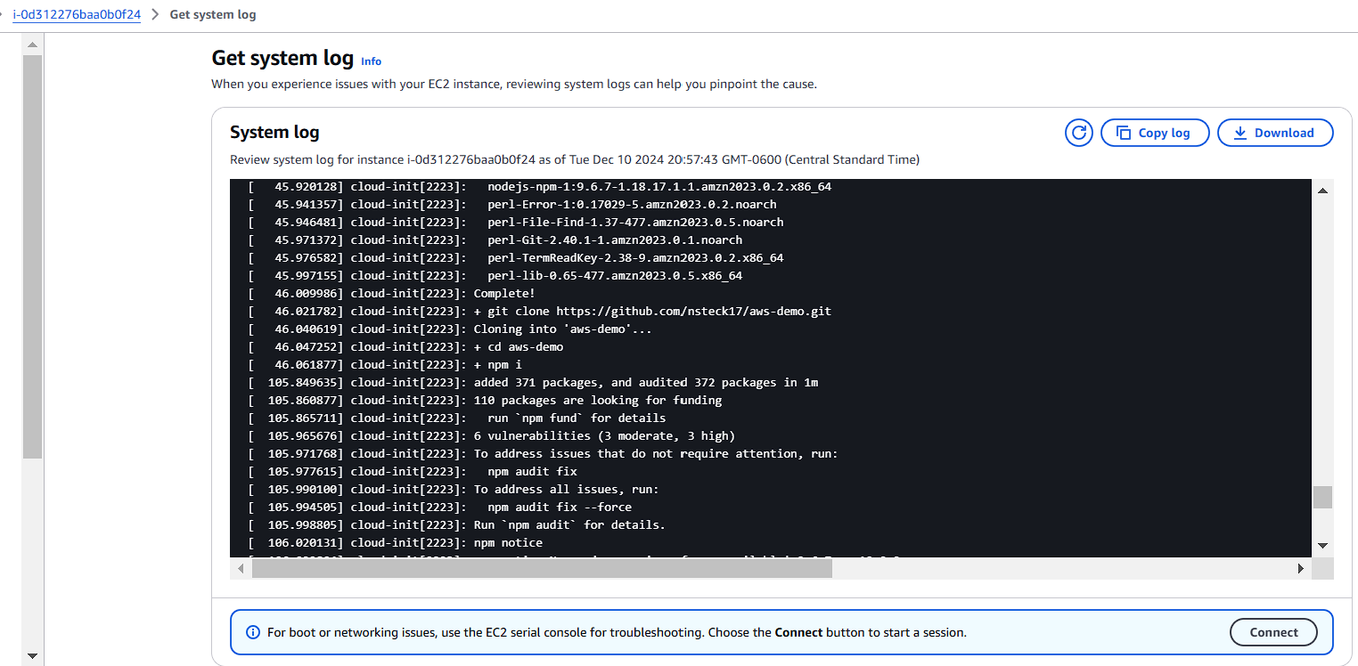
Knowing the different components within CloudFormation helped!
Understanding to go to the EC2 instance spawned helped me debug “install” issues

Slide 6
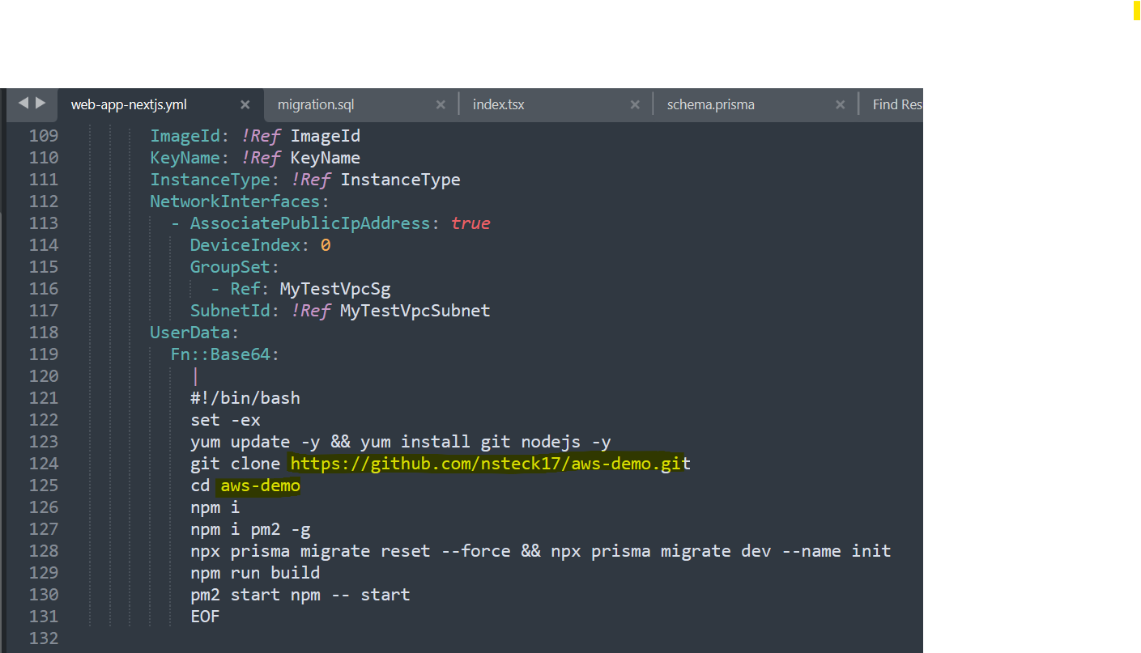
CloudFormation is mainly just “Template” of what to spawn and auto-execute
Based on prior experience it helps to develop local first to debug actual code
Understanding what CloudFormation is and seeing the commands helped debug issues

Slide 7
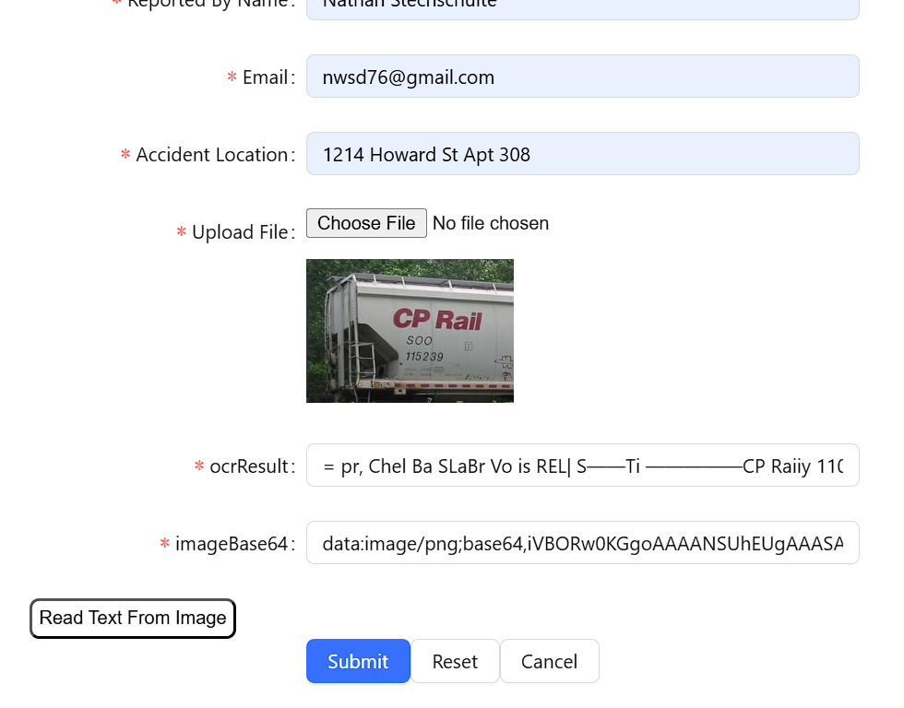
Highlights of Web App
CRUD Operations with Database (Add / Delete)
Added Image Uploading
Encode to Base64, show on UI
Save to Database
Process Text From Image
Used Tesseract.js library to pull Optical Character Recognition from picture
Updated database to store and retrieve additional details

Slide 8
Step-By-Step Instructions – p1
Locate repository of code
https://github.com/nsteck17/aws-demo
Download CloudFormation yml file “web-app-nextjs.yml”
Login to AWS

Slide 9
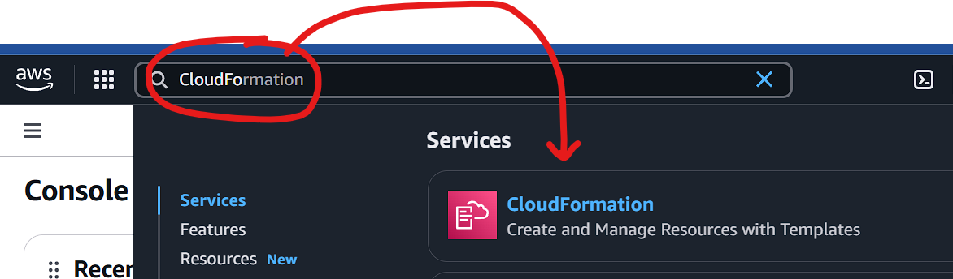
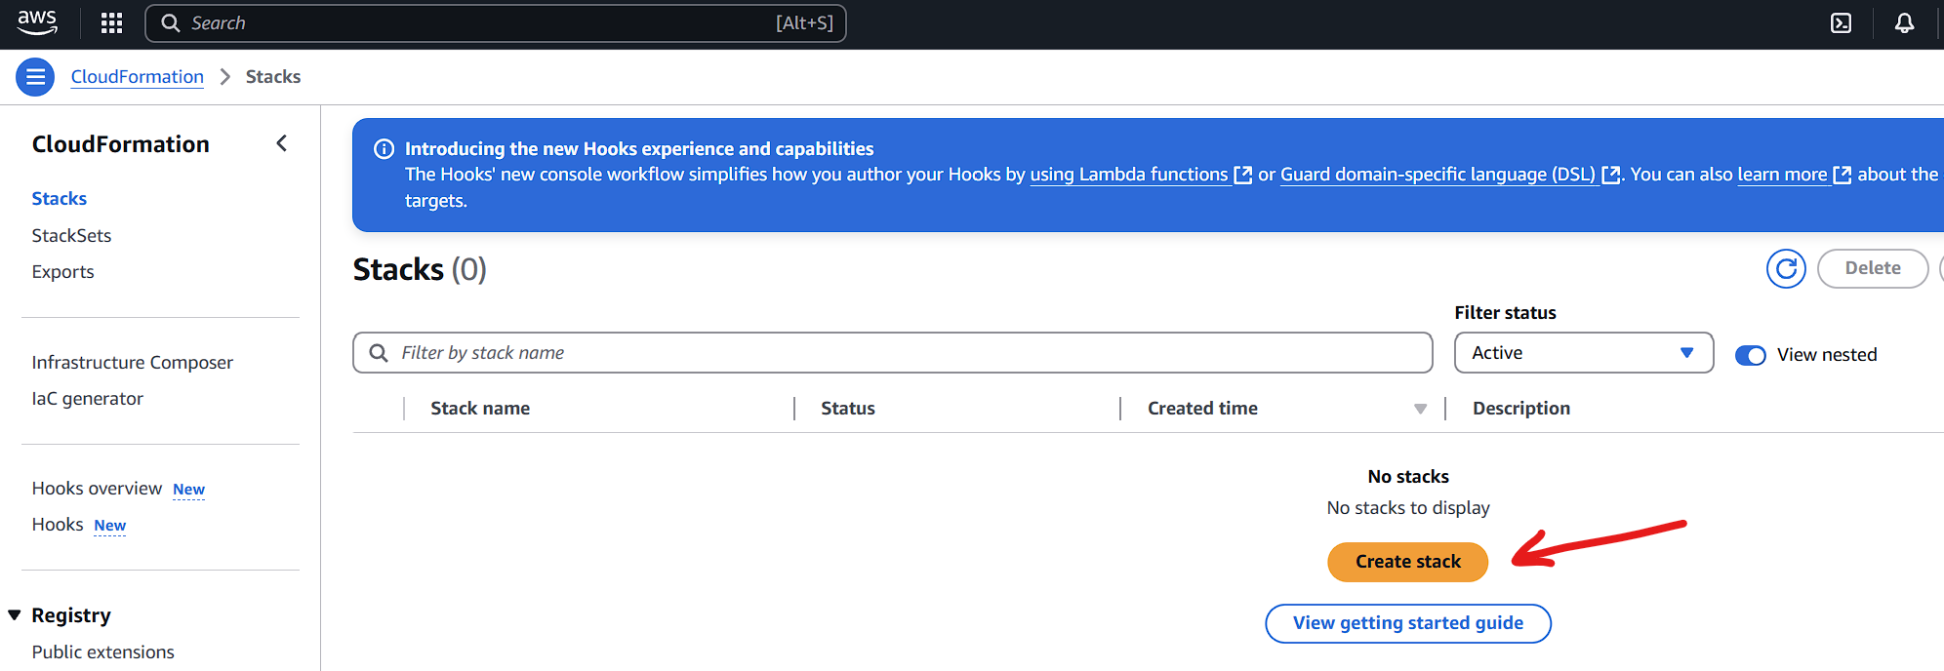
In search at top put “CloudFormation”
Go to “Stacks” and “Create Stack”

Slide 10
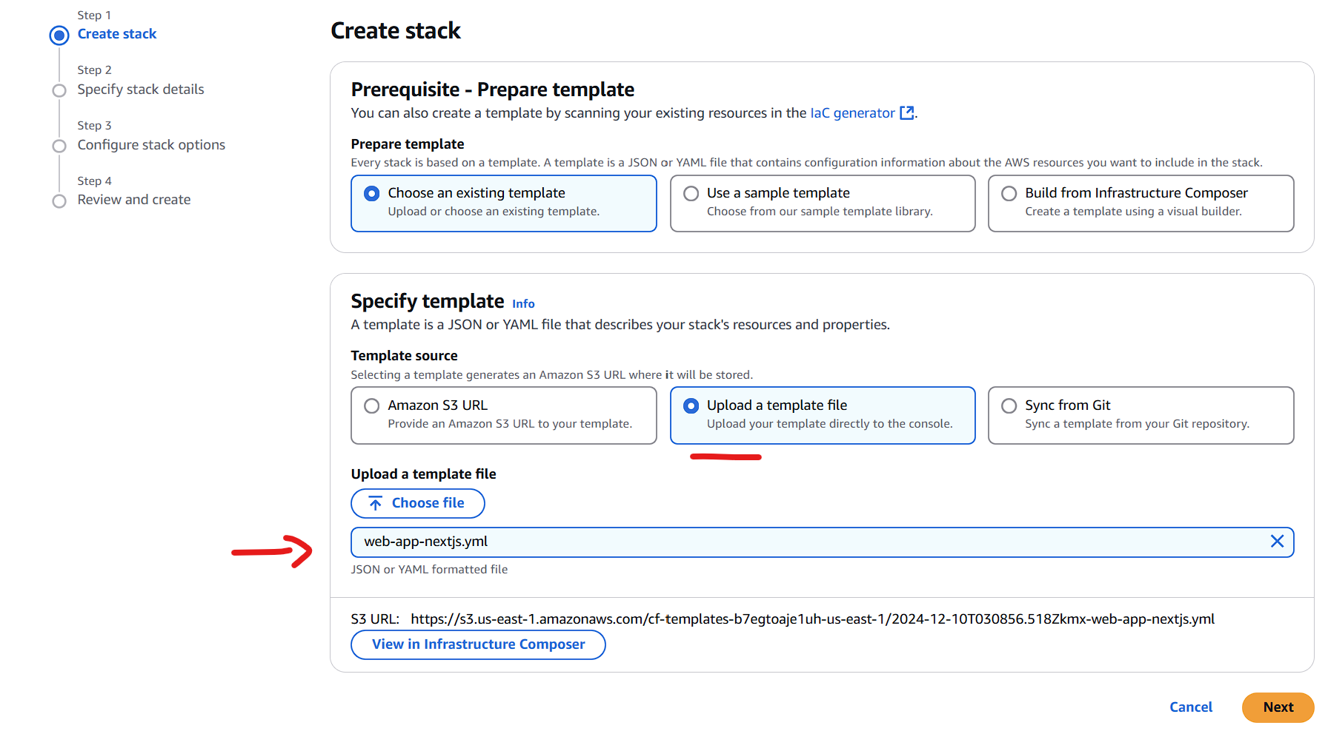
Choose “existing template” option
Choose “Upload a template”
Chose file downloaded in 2nd step
Hit Next

Slide 11
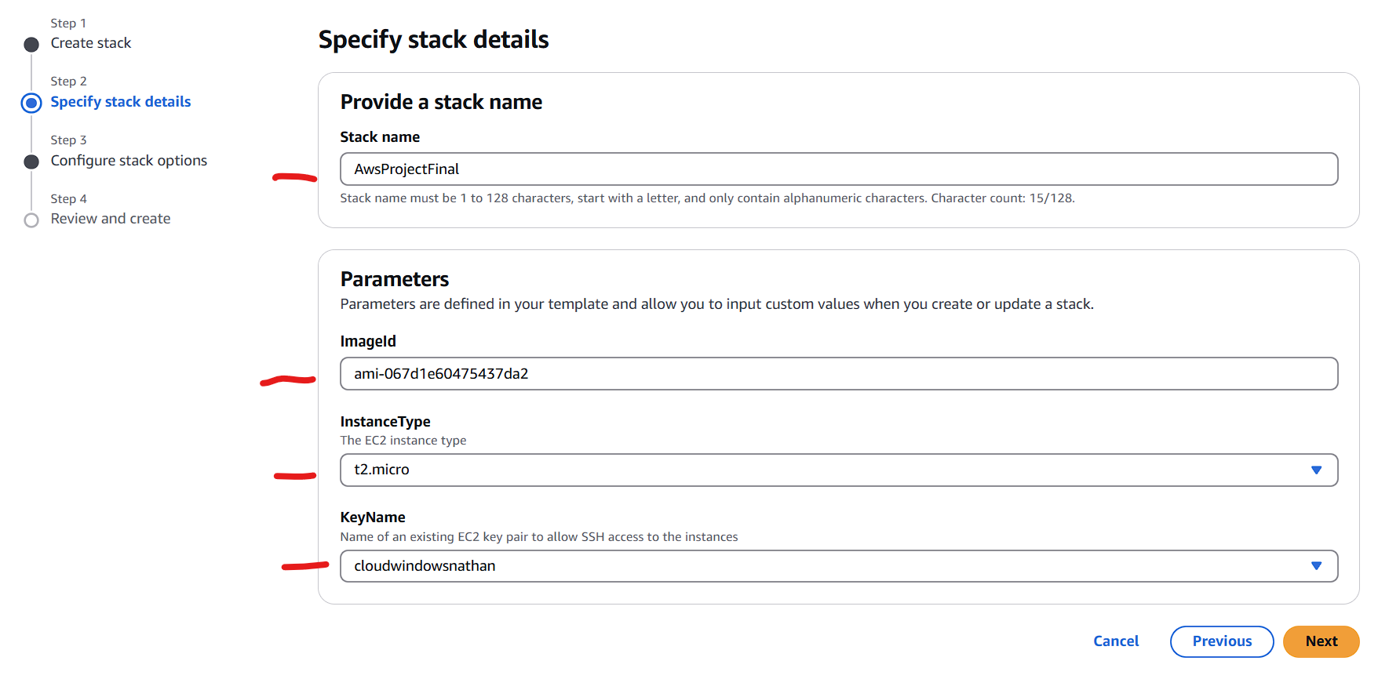
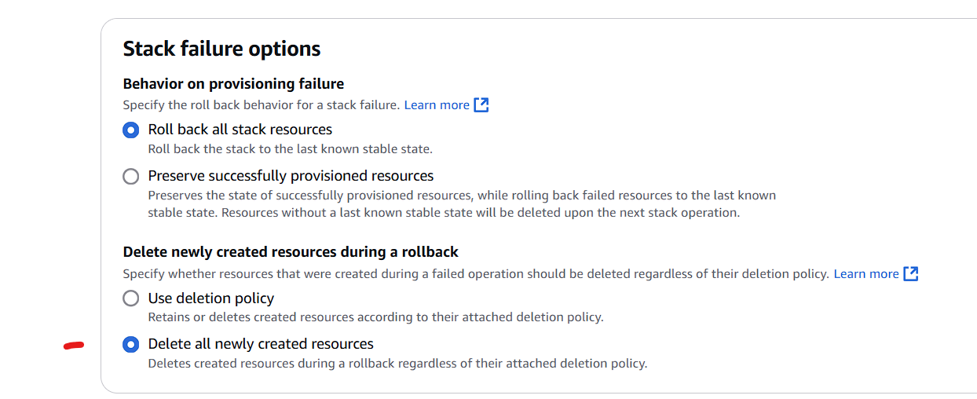
Put in the project name
Put ImageId
Put InstanceType
Put KeyName
Hit “Next”
Then change the rollback option

Slide 12
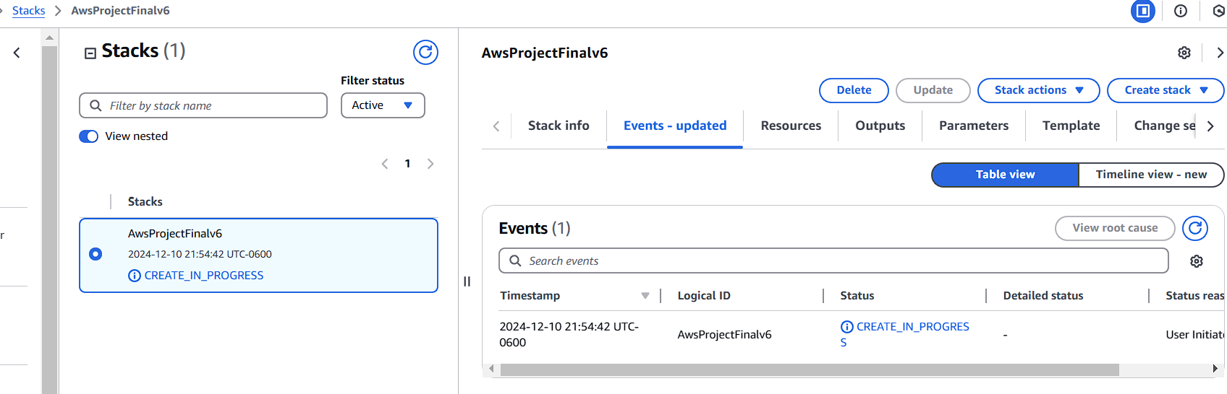
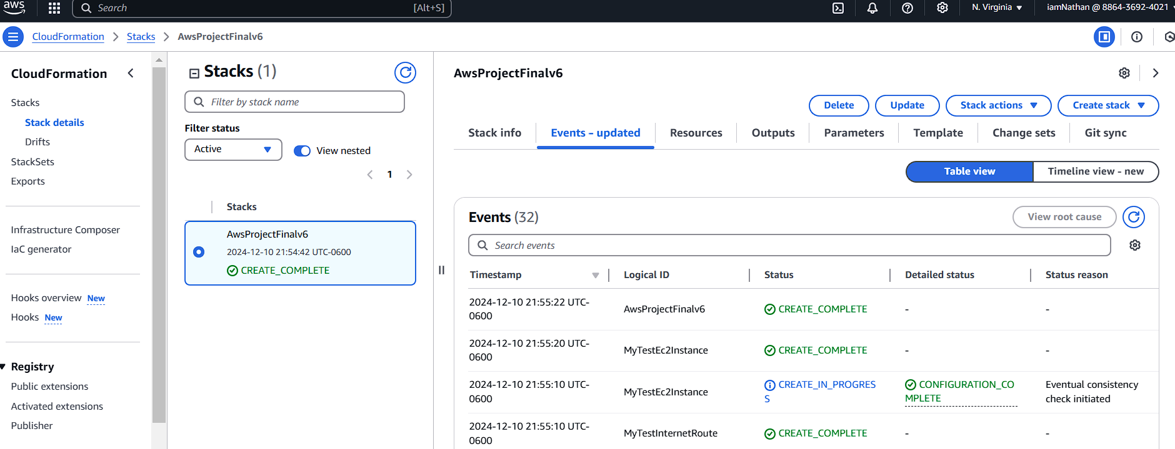
Wait….
Even when “complete”
…. Wait
Just go get some coffee

Slide 13
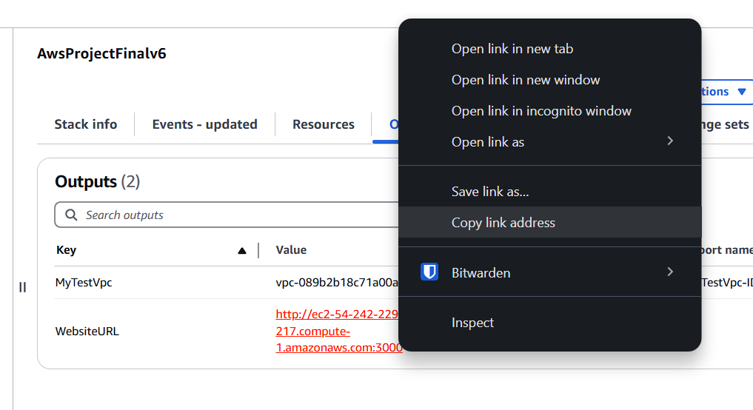
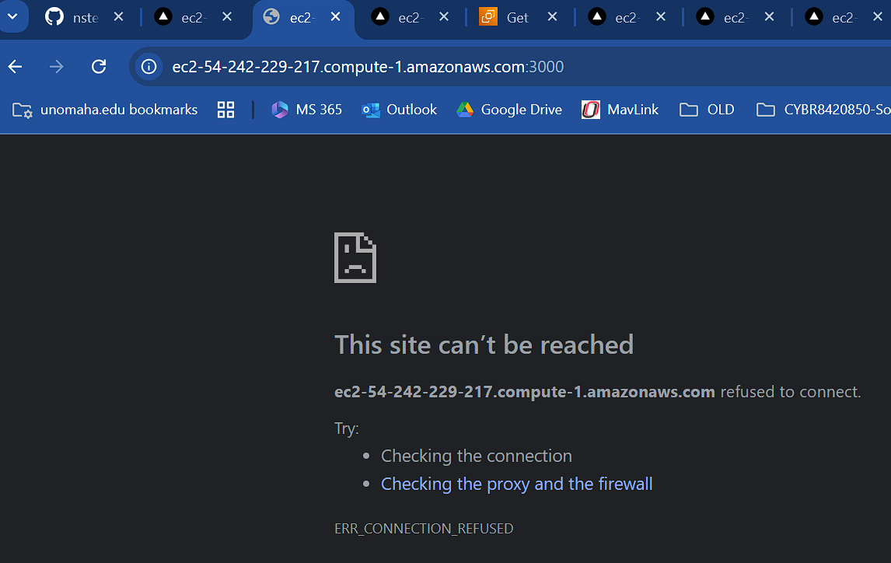
Eventually you can go to “Output” tab
You can see the URL
Right click and “copy link address”
You can then paste it in
Even if you see this “can’t be reach”
You might have to wait
Or check EC2 console

Slide 14
Live Demo – Functionality & Features
Goal would be using better OCR
Need natural language processing to correct OCR results
Have inventory of all valid equipment id
Should be able to “auto correct” to ‘best match’ of what is found on picture
Ideally we want to run OCR on photo upload (not extra button click first)
Less monolithic
Would like DB / Backend to be separate deployments wired together

Slide 15
Challenges
Underestimated work to learn new language / framework
In order to do real development, needed to run “local”
Spent lot of time understanding how React, Prisma, Ant Form based webapp works
Biggest challenge is developing the app, not deploying it
In My Opinion
Should take a working “on-prem” or “local” app and deploy it to cloud

Slide 16
Thoughts
CloudFoundation = Terraform
Smells like AWS sponsored or funded class
Lot of good concepts, but important to focus on aspects of cloud and “best practices”
Code Local -> Take your local app and run in AWS “production” for others to access
Don’t like everything combined into one app
At enterprise level deploy separate layers: DB, Backend, UI
Aspects of SDLC missing
How do I update an app without redeploying entire stack?
How do you build apps with Cloud in mind (design patterns, etc)

