Slide 1
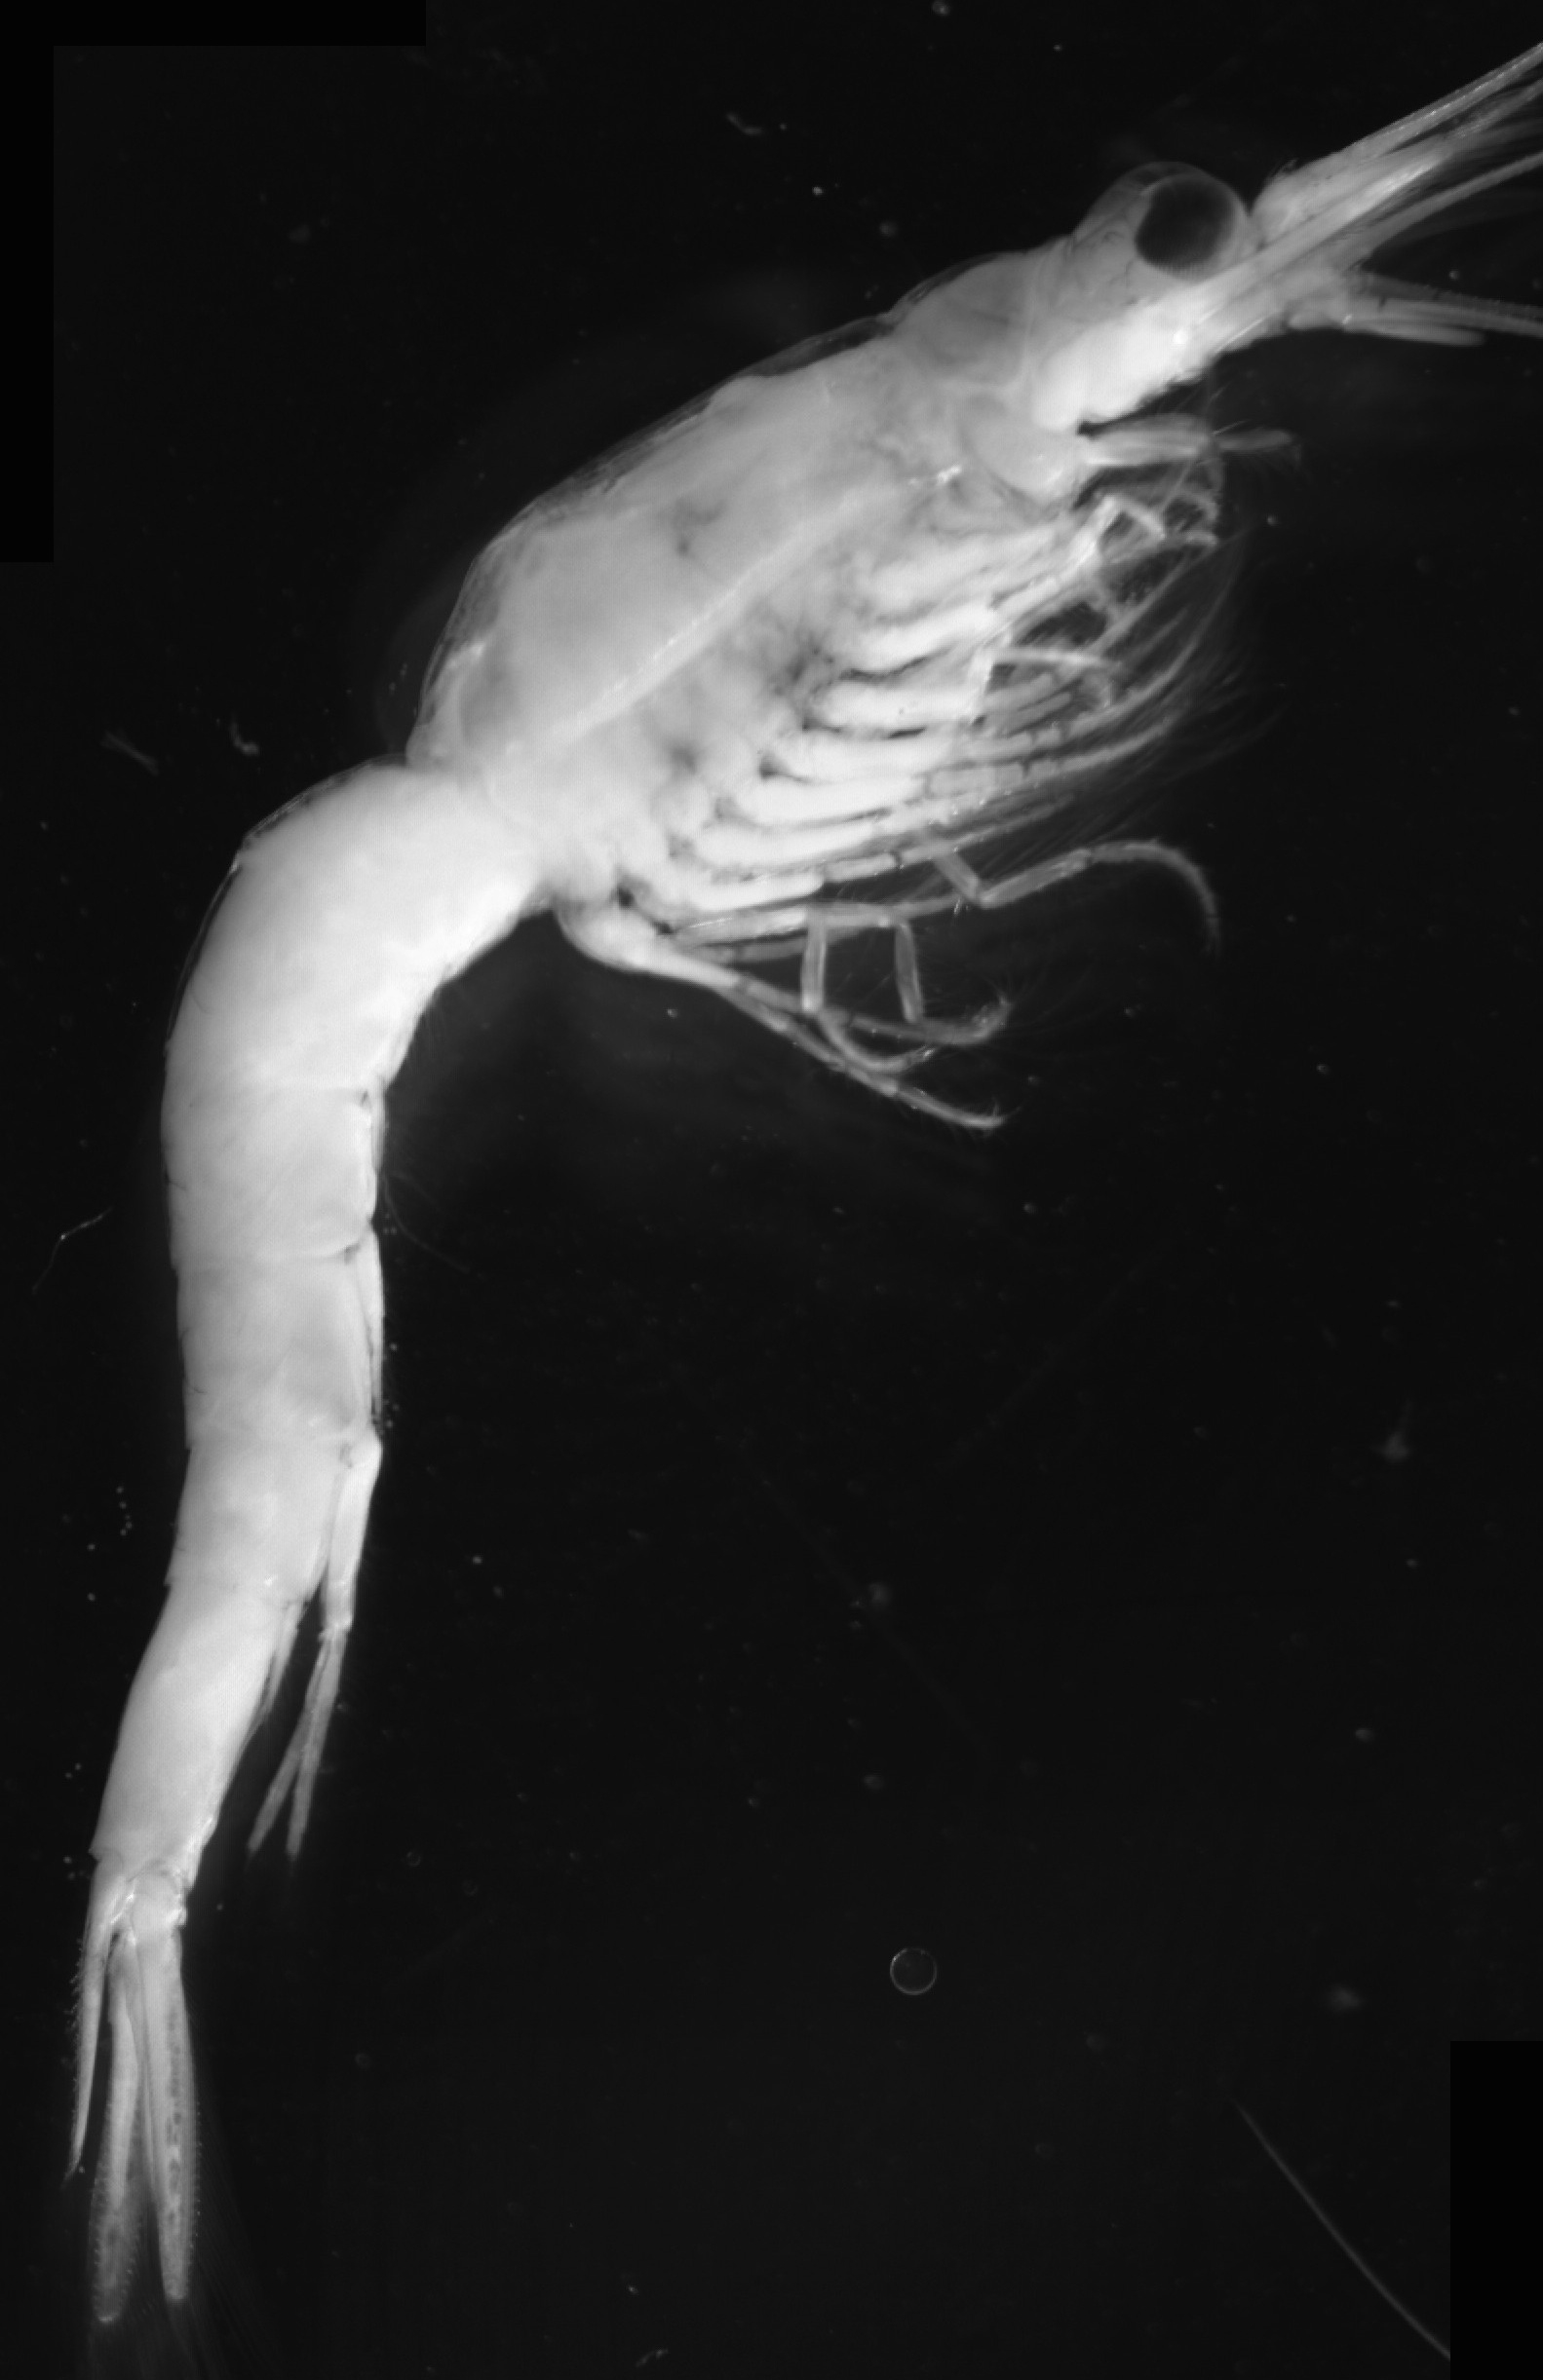
An Agent-Based Model of Diel Vertical Migration in Mysis diluviana
Nick J. Strayer¹, Brian P. O’Malley² Sture Hansson^{3,} Jason D. Stockwell²
¹College of Engineering and Mathematical Sciences, University of Vermont
²Rubenstein Ecosystem Science Laboratory, University of Vermont
³Department of Ecology, Environment, and Plant Science, Stockholm University
Notes:
Italicize mysis throughtout

Slide 2
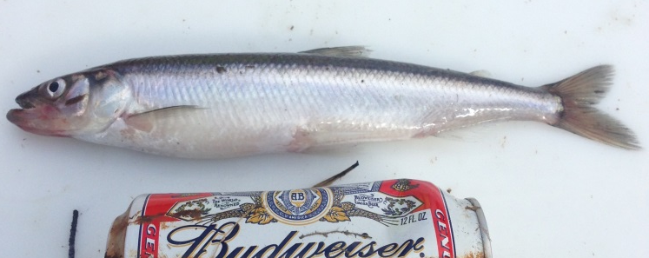
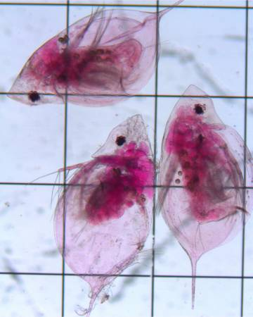
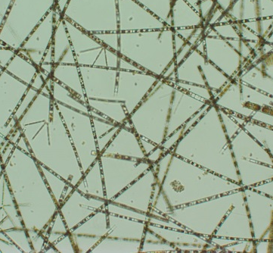
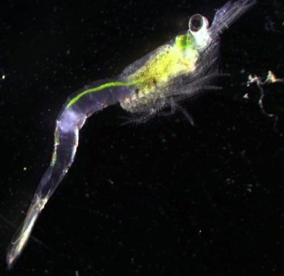
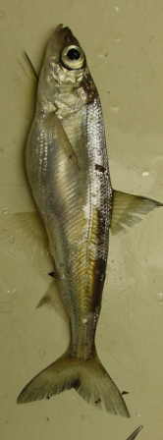
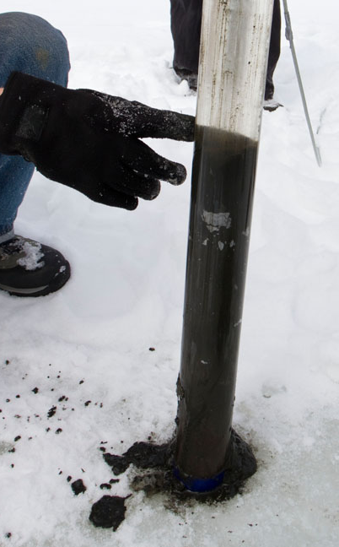
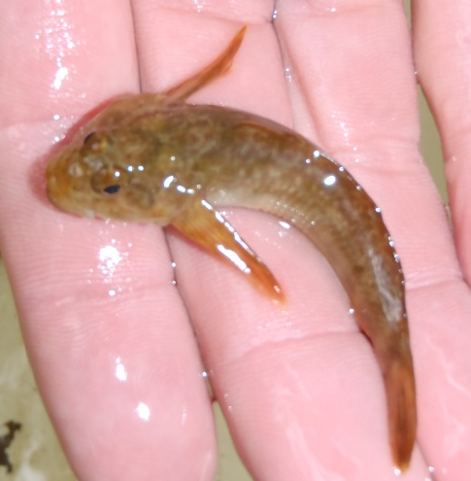
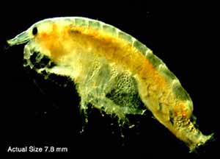
Mysis diluviana is a mid-trophic level omnivore; links upper/lower trophic levels across habitats via DVM
Pelagic and benthic fishes access Mysis
Mysis have multiple foraging options

Slide 3
Driving Motivations
According to Ogonowski et al. 2013 we know that Mysis exhibit partial diel vertical migration.
Why do Mysis exhibit partial diel vertical migration?
Are there multiple stable strategies?
What are the main driving forces pushing them to migrate.
Modeling the migration as a whole will pave the way to understanding decision processes and tease out the motivating factors driving migration.

Slide 4
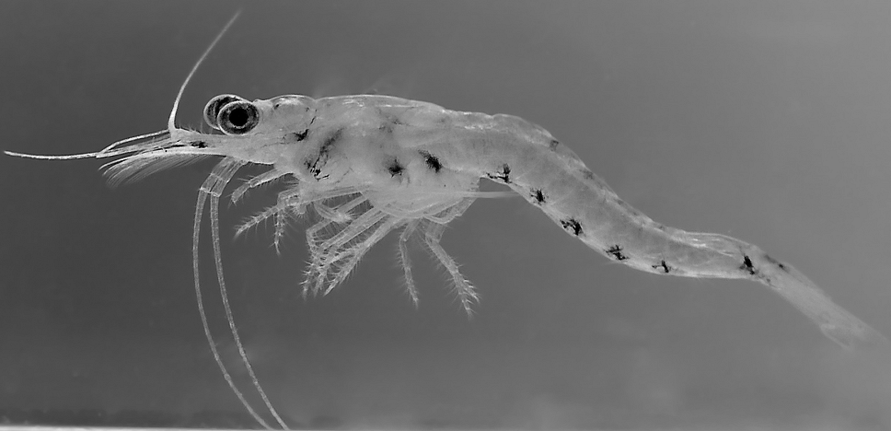
An agent-based, Monte-Carlo style model
Simulates an individual Mysis throughout the entire year at an hourly timestep.
Many individuals are simulated to get an idea of population-wide trends.
Input comes from environmental variables (light intensity, water temperature and food availability/variability).
http://www.mysis.com/gallery/mysis_diluviana/
Notes:
Reword second bullet.
Inputs are environmental variables and biological constants.

Slide 5
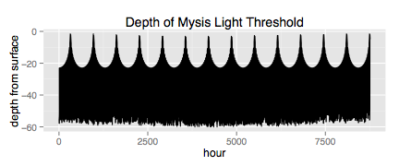
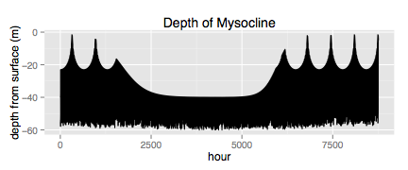
Input comes in terms of Mysis migration extent under
the assumption of temperature and light “ceilings”
Light intensity levels
+
Temperature profile
=
Mysocline
Notes:
Flip thermocline figure

Slide 6
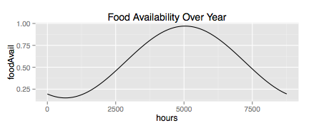
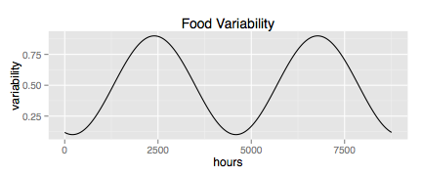
And food availability/variability in pelagic environment
Normalized measure of food quality and quantity in the pelagic environment to the benthic environment.
Directly maps to probability of migrating, scales feeding reward.
Paired with food variability to approximate seasonal variability.

Slide 7
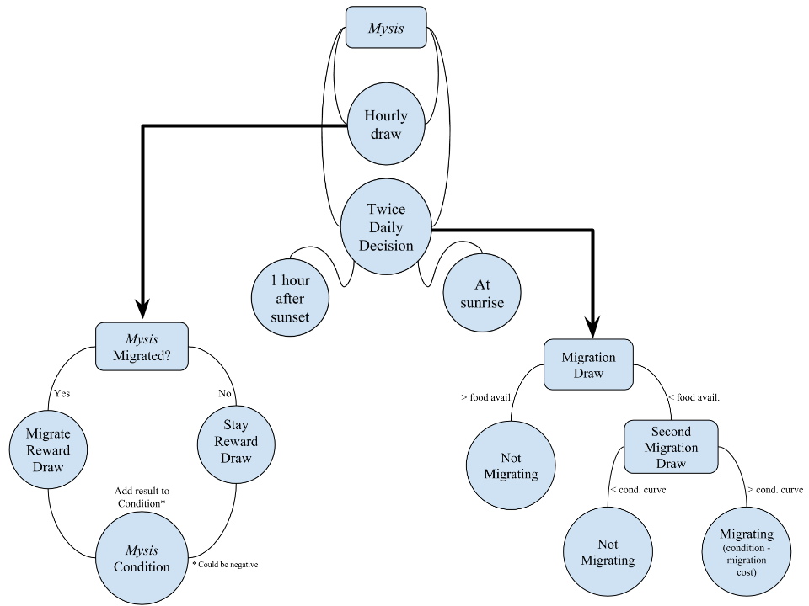
Model Structure
Notes:
Make fonts bigger!

Slide 8
The Mysocline
Highlights seasonal fluctuations in migration extent
Early spring and late fall are light bounded.
Late spring, summer and early fall are thermocline bound

Slide 9
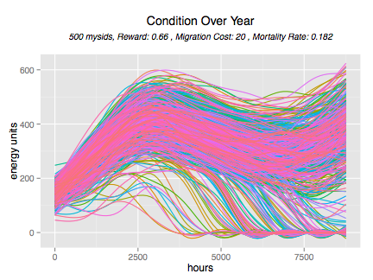
Each line represents a single Mysis; seasonal trends in condition values; cost of migration weighed with the variability of reward

Slide 10
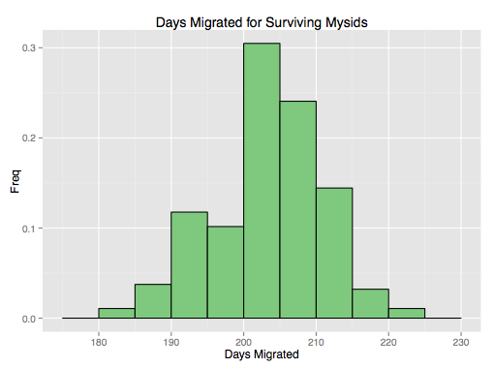
Distribution of Number of Days Migrated

Slide 11
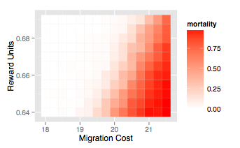
Model shows greater sensitivity to migration cost changes than feeding reward

Slide 12
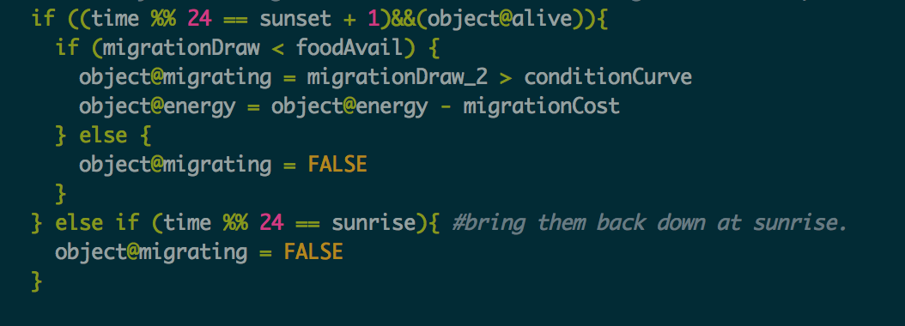
Language
The entire model was coded in R.
This makes it easier to share the code with peers for future investigation and expansion.
Shiny Servers and RMarkdown furthered the accessibility.

Slide 13
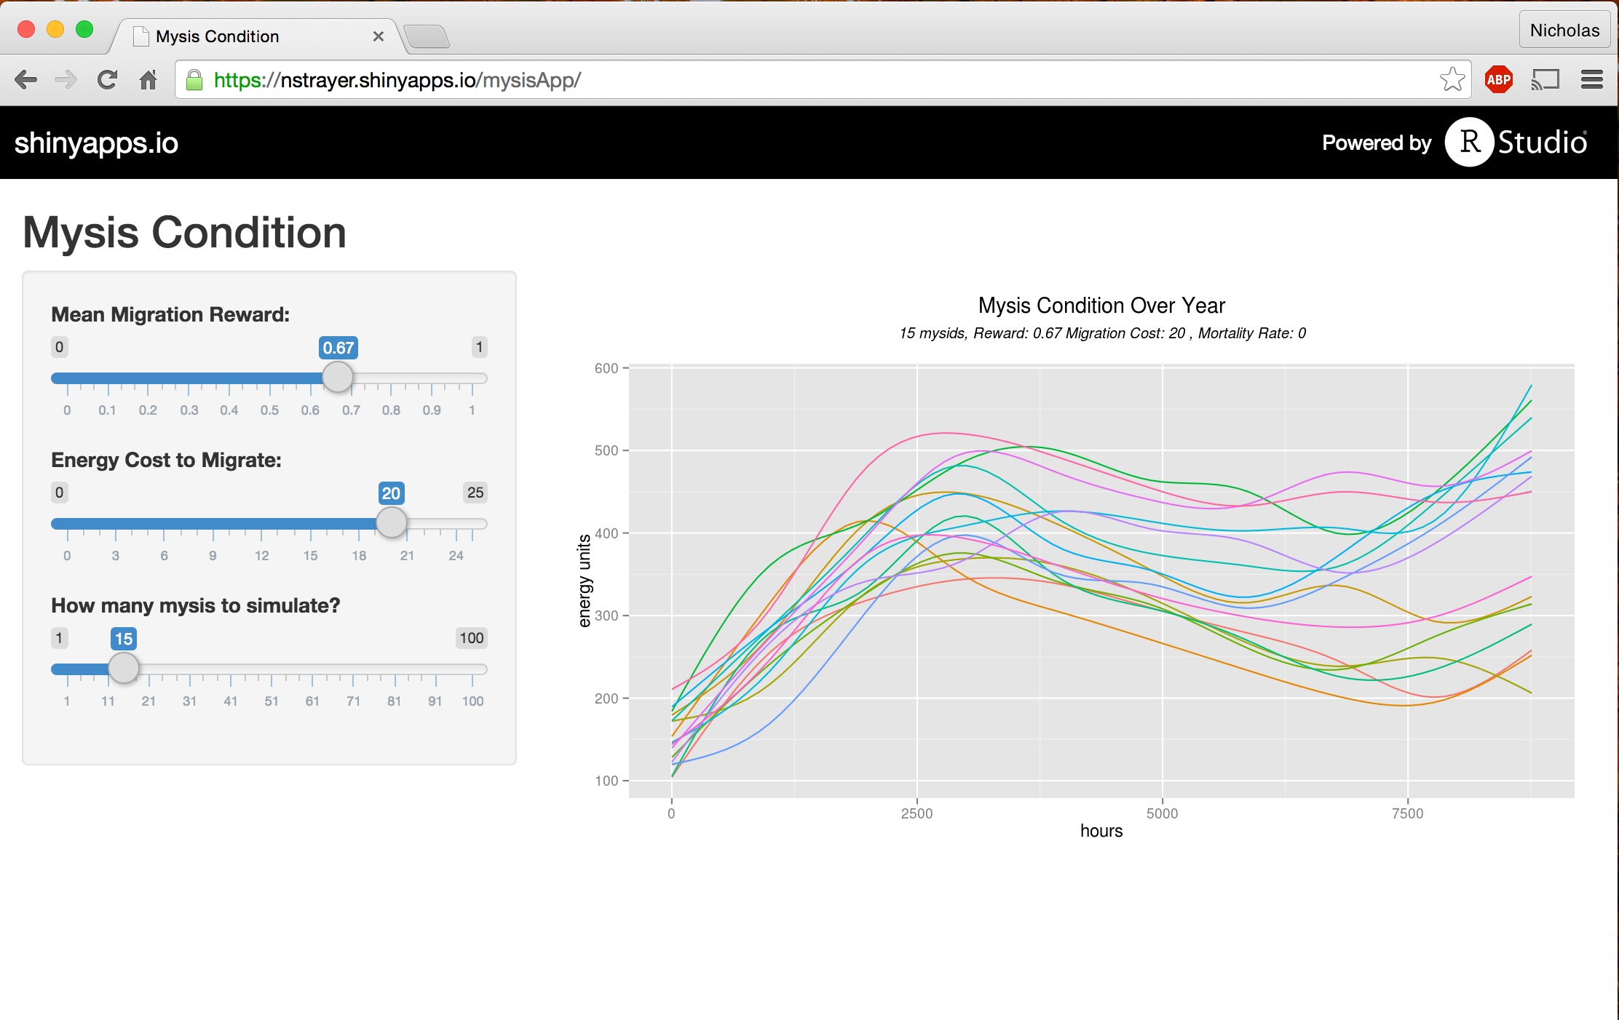
https://nstrayer.shinyapps.io/mysisApp/

Slide 14
Where To Go Now?
Probe the possibility of multiple stable migration patterns.
Dig in to specific aspects of the model. E.g. predation risk, benthic food availability
Utilize real data in model inputs such as thermocline depth and food availability. (Oh, and to validate.)

Slide 15
Acknowledgments
Office of Undergraduate Research.
Peter Euclide for Mysis insights.
Professors James Bagrow & Daniel Bentil for advising.
James Marsh Professor-at-Large Program

