Slide 1
THE JOURNEY
Building an Autonomous Web Agent
From a blank folder to a live GitHub repo — 14 steps, 9 services, and more than a few real bugs along the way.
MakeMyTrip: Autonomous Web Operations Agent · Google Gemini (free tier) only — no paid API

Slide 2
CHAPTER 1
The Idea
Deciding what to build, and how it would think
Traditional automation breaks the moment a website's UI changes
Goal: an agent that reasons about a page like a human, instead of following hardcoded selectors
Chose a fully free stack from day one — no Claude, no OpenAI, no paid API
User Task
▸
LLM Brain
▸
Action
▸
Browser
Perceive → Reason → Act → Repeat
Tech stack: browser-use + Playwright + Gemini (free) + Streamlit
▸ Next: turning that idea into a working folder on disk

Slide 3
CHAPTER 2
Setting the Stage
Environment setup — and the first two speed bumps
✓
Created the project folder & virtual environment
mmt-agent/ + venv
!
‘uvx’ not recognized
Not required — used plain pip + playwright instead
!
‘No module named playwright’
venv wasn't activated — activated it, then pip install playwright
▸ Next: getting a free API key and talking to the agent for the first time

Slide 4
CHAPTER 3
First Contact
A free API key, and the agent's very first run
Got a free Gemini API key from Google AI Studio — no credit card needed
Wrote the first test: “Go to makemytrip.com and tell me what tabs are visible”
A real Chromium browser opened on its own, navigated to MakeMyTrip, read the page, and answered correctly
✓
Milestone unlocked
The core loop — perceive, reason, act — worked end to end for the first time. Everything after this was about scaling it up.
▸ Next: the hard part — teaching it to actually search a real flight

Slide 5
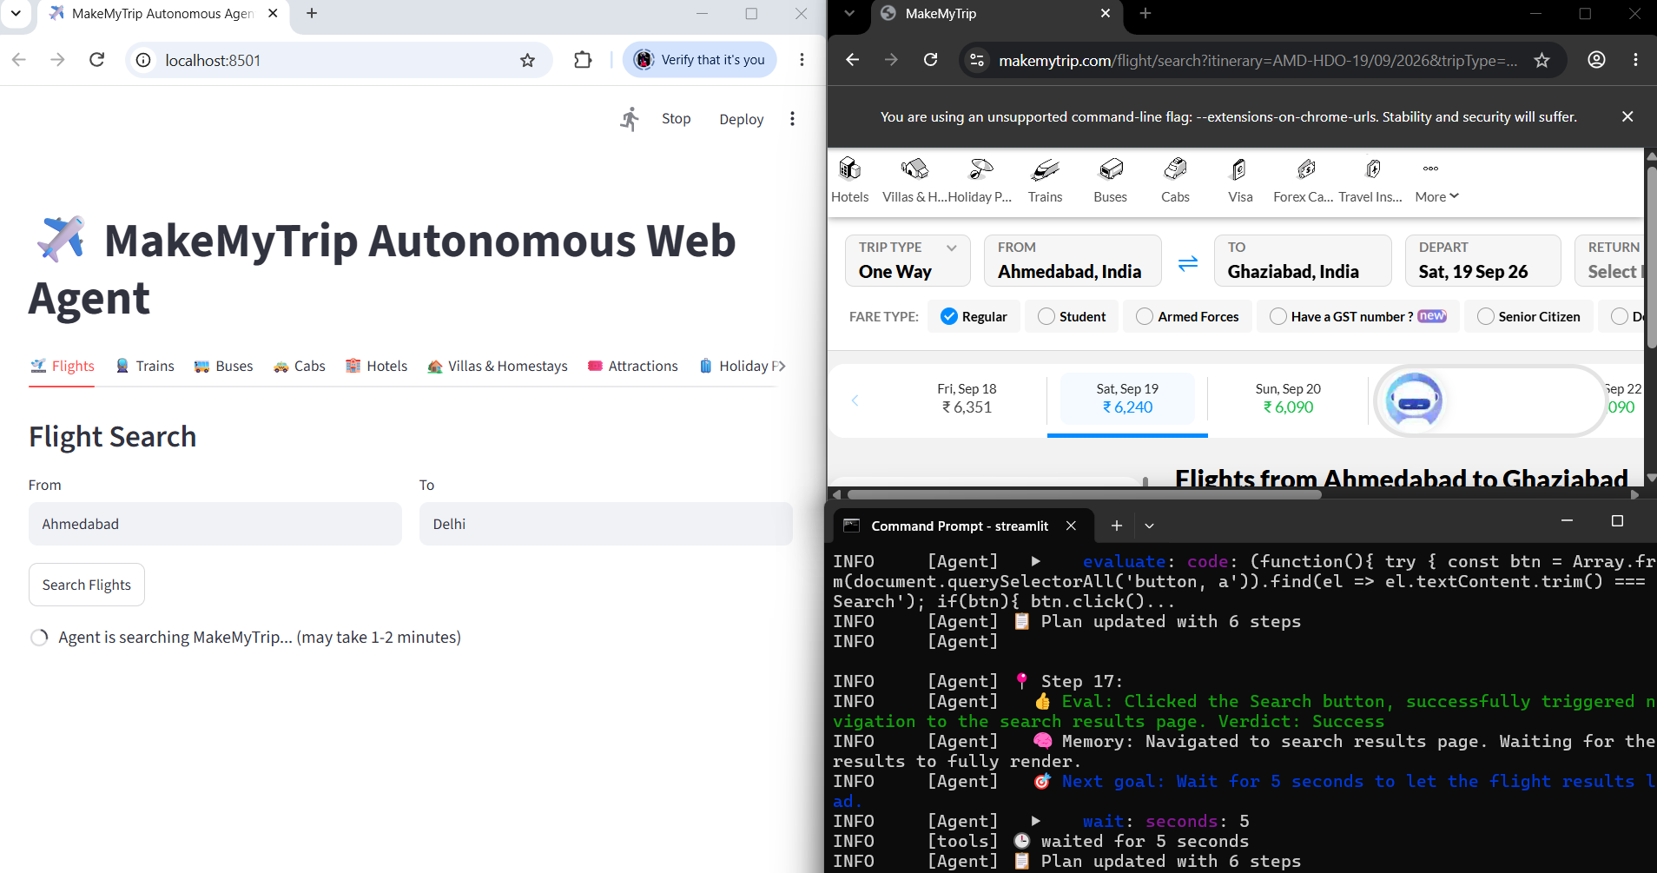
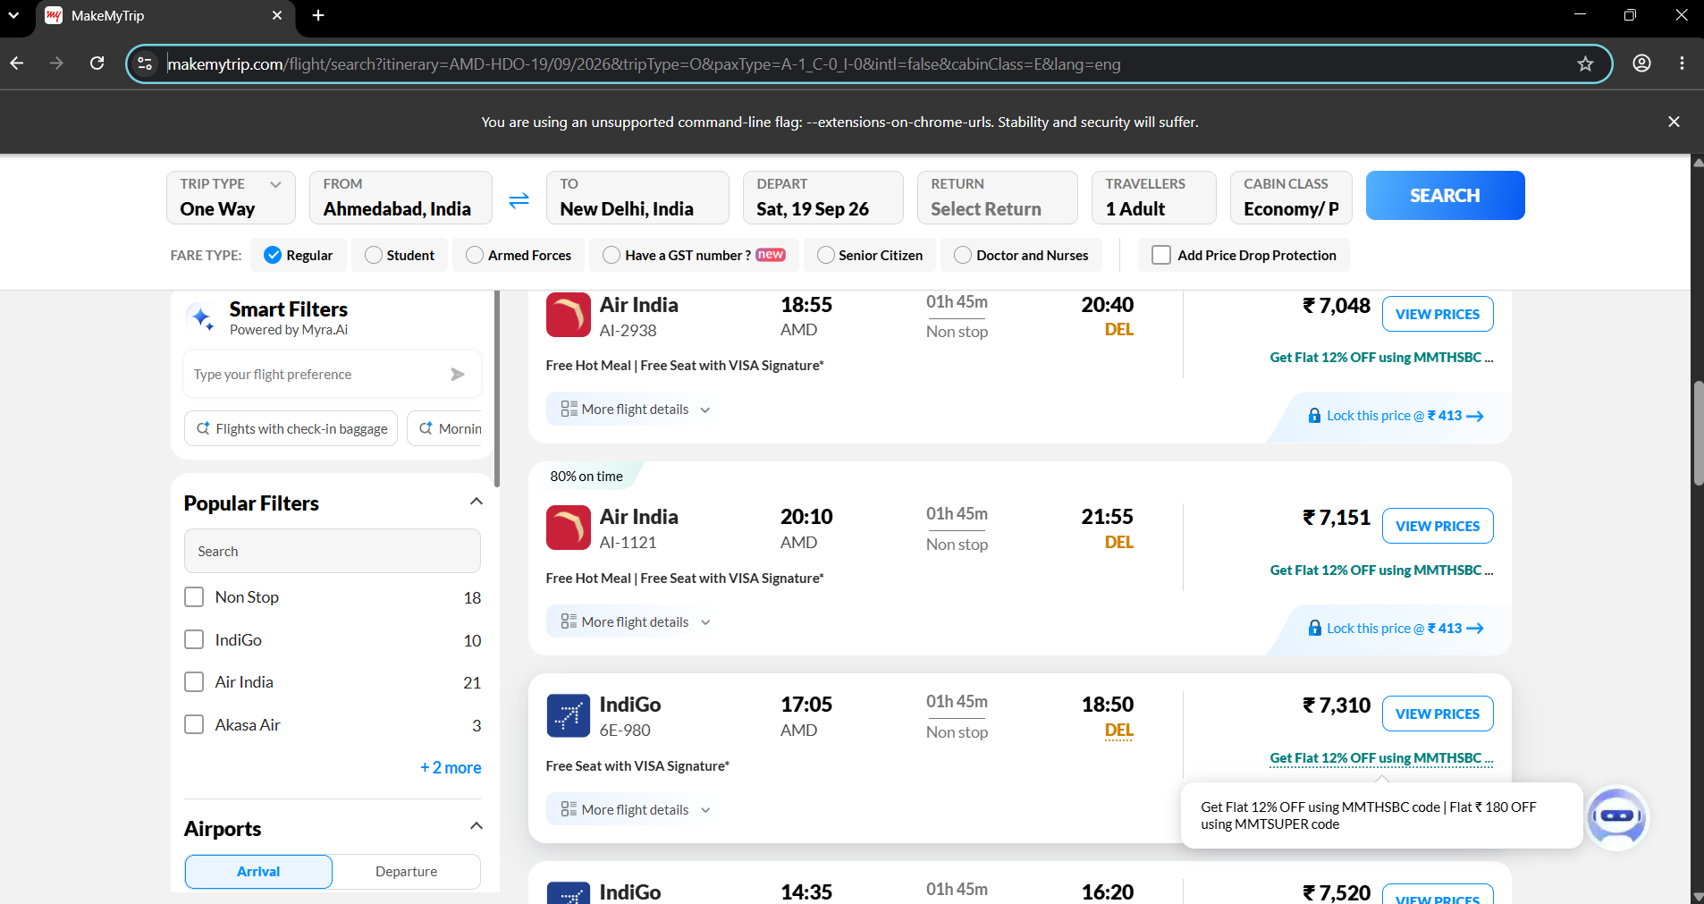
CHAPTER 4
Into the Fire
Five real errors stood between “hello” and a working flight search
1
Login popup blocked every click → taught the agent to close popups first
2
Library version mismatch crash → upgraded browser-use & google-genai
3
Wrong message format in a test script → fixed the test, not the agent
Agent live-driving makemytrip.com
4
Gemini server overload (503) → switched to gemini-flash-lite-latest
✓
SUCCESS — full flight search, real prices extracted
Real flight results read straight off the page
▸ Next: turning messy text answers into clean, structured data

Slide 6
CHAPTER 5
Taming the Output
From free-text answers to validated, structured JSON
Defined Pydantic schemas (Flight, FlightResults) describing exactly what fields mattered
Agent was told to fill that schema instead of writing a paragraph
Output became clean, predictable JSON — ready for a database, a dashboard, or an API
Every result auto-saved as a timestamped .json file
{
"airline": "Air India",
"flight_number": "AI-424",
"departure_time": "13:00",
"price": "₹ 6,351"
}
▸ Next: adding Hotels, and giving the whole thing a real interface

Slide 7
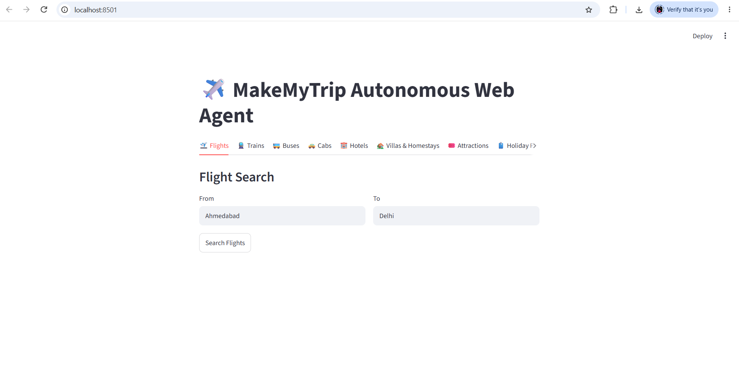
CHAPTER 6
Hotels, and a Real Interface
Reusable code, and a UI anyone can click through
Hotels module built on the exact same pattern as Flights
Logic consolidated into one reusable agent_core.py
A Streamlit app wrapped it all in tabs — no code required to run a search
First click-through worked end to end, no terminal needed
The Streamlit app — Flights tab, ready to search
▸ Next: growing from 2 services to a much bigger map

Slide 8
CHAPTER 7
Expanding the Map
Attractions and Holiday Packages joined the lineup
✓
✓
NEW
NEW
Flights
Hotels
Attractions
Holiday Packages
Same pattern as before: a Pydantic schema + a focused task prompt = a new, working service in minutes.
▸ Next: the user takes the wheel and triples the project overnight

Slide 9
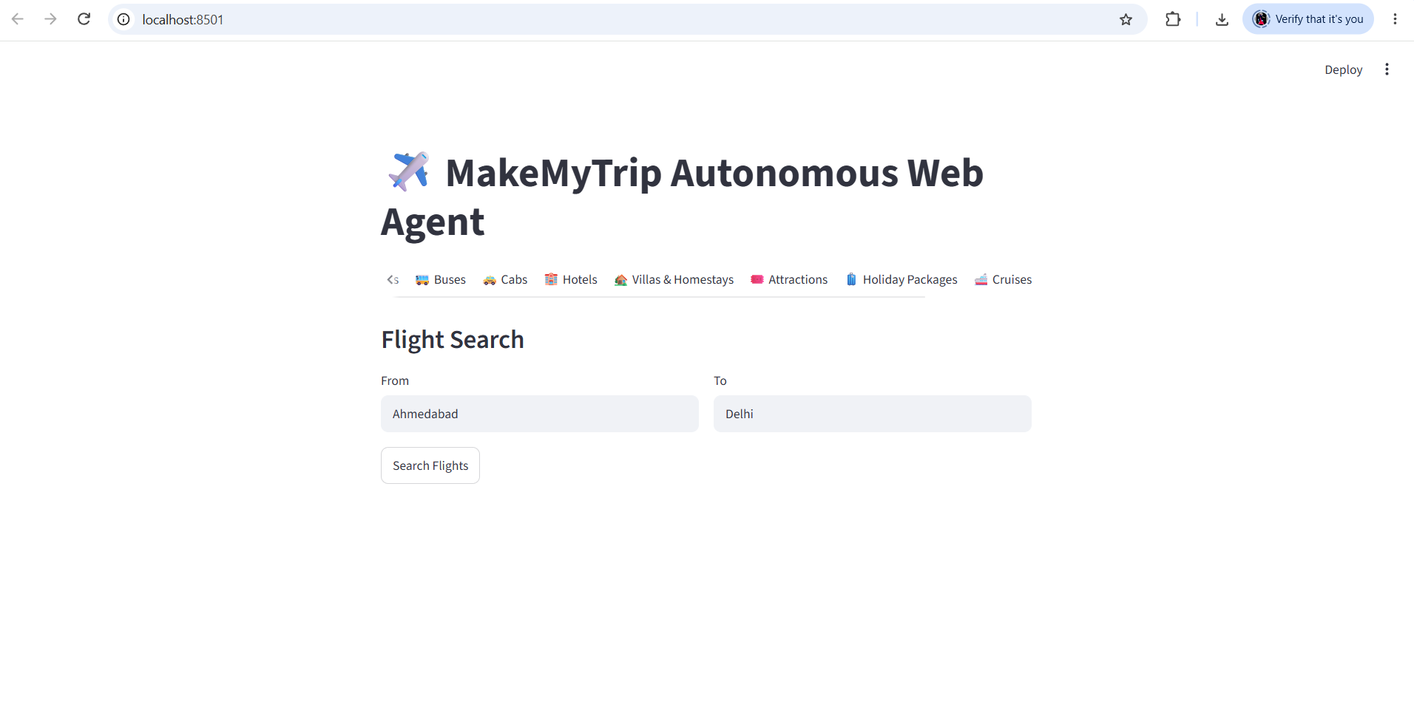
CHAPTER 8
Going Solo
Five more services added independently — then a bug hunt
Buses, Trains, Cabs, Villas and Cruises added on their own initiative
Project grew from 4 to 9 fully working services
Bug hunt
A copied line meant 5 services crashed on save (wrong variable name). The app.py file was also missing 2 imports. Both fixed, all 9 re-tested.
All 9 service tabs, confirmed working
▸ Next: writing it all down, so the project explains itself

Slide 10
CHAPTER 9
Writing It Down
A README that explains the project to a stranger
Overview & Architecture
Tech Stack & Setup
What the agent is, and how the loop works
Exact install steps, free API key instructions
Challenges & Solutions
Safety & Ethics
Every real bug faced, and how it was fixed
Why it never proceeds past the results page
▸ Next: reversing the checklist — requirements, slides, and proof

Slide 11
CHAPTER 10
The Polish Pass
Reproducibility, a pitch deck, and a results showcase
📦
requirements.txt
pip freeze captured every exact package version for one-command setup
📊
Presentation deck
A 10-slide technical walkthrough of architecture, stack and results
📄
Results showcase PDF
All 9 services' real output compiled into one clean reference document
▸ Next: proving it actually works — screenshots and a live demo

Slide 12
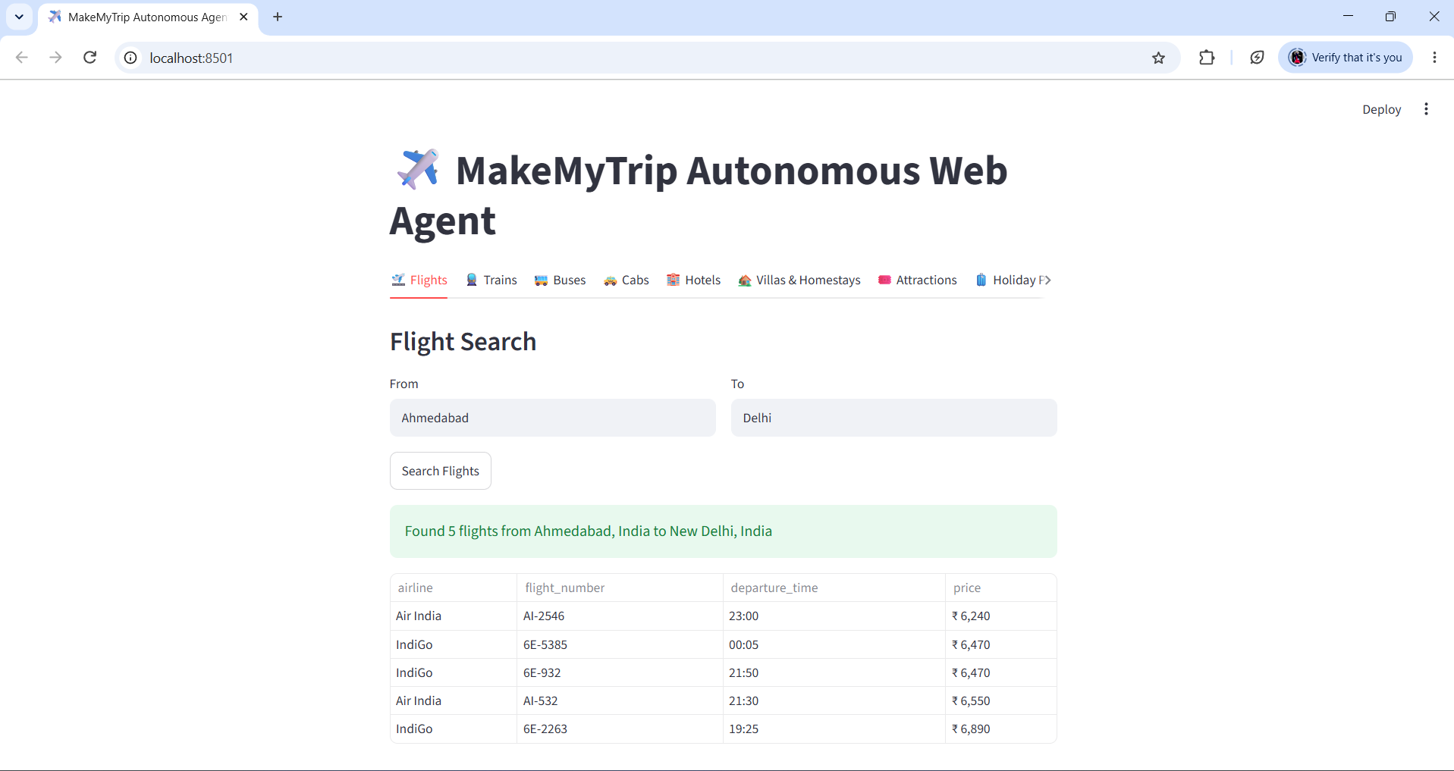
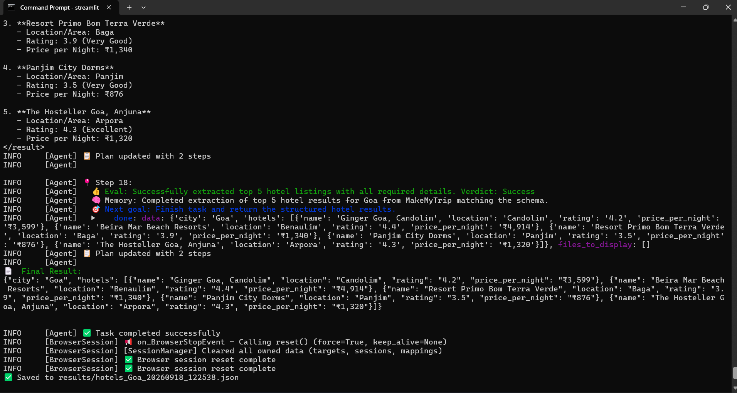
CHAPTER 11
Capturing Proof
Real screenshots and a demo video, woven into the README
Final result, rendered live in the app
Terminal confirming a completed Hotels search
▸ Next: the final step — making it public

Slide 13
CHAPTER 12
Going Public
From a local folder to a live GitHub repository
git init
git add .
git commit -m "Initial commit..."
git remote add origin <repo-url>
git branch -M main
git push -u origin main
✓
Guarded along the way
.gitignore kept .env, venv/ and logs/ out of the repo
API key never left the local machine
Repo verified live on GitHub after push
▸ Next: looking back at everything that got built

Slide 14
The Finished Journey
14 steps, zero paid APIs, one working autonomous agent
✓
9 autonomous service modules
✓
100% free tech stack (Gemini free tier)
✓
Structured, validated JSON output
✓
Interactive Streamlit web app
✓
Full README documentation
✓
Reproducible requirements.txt
✓
10-slide presentation deck
✓
Results showcase PDF
✓
Real screenshots & demo video
✓
Public, live GitHub repository

Slide 15
Thank You
MakeMyTrip: Autonomous Web Operations Agent — The Full Story
Built step by step, bug by bug, with browser-use · Playwright · Google Gemini (free) · Streamlit

