Slide 1
From Console Agent to a Full Travel Dashboard
THE UPGRADE STORY
9 services, a click-through Streamlit app, and a fast cheapest-fare-per-date mode.
MakeMyTrip: Autonomous Web Operations Agent · browser-use + Playwright + Gemini (free tier) + Streamlit

Slide 2
The Idea
CHAPTER 1
An agent that reasons about a page like a human, not like a script
Traditional automation breaks the moment a website's UI changes
This agent perceives the page, reasons about it, and acts — then repeats
Fully free stack: Gemini free tier, no paid API
User Task
›
LLM Brain
›
Action
›
Browser
Perceive → Reason → Act → Repeat
Tech stack: browser-use + Playwright + Gemini (free) + Streamlit
▸ Next: watching the agent drive a real MakeMyTrip search

Slide 3
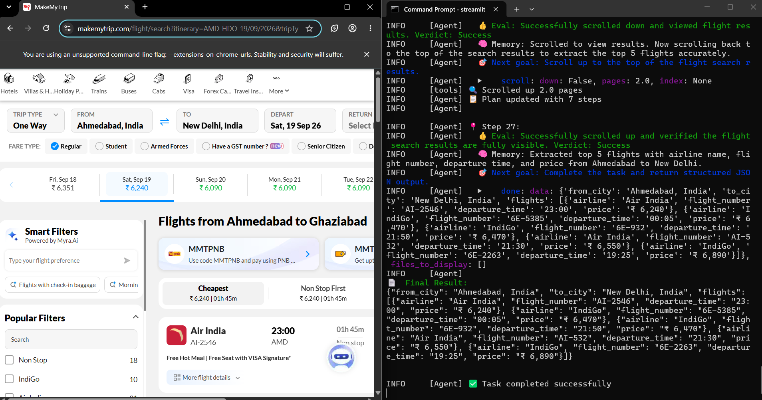
The Agent at Work
CHAPTER 2
A real Chrome window on the left, the agent's reasoning on the right
1
Opens makemytrip.com and searches Ahmedabad → New Delhi, 19 Sep 26
2
Scrolls the results and reads airline, flight number, time and price
3
Evaluates every step (“Verdict: Success”) and sets the next goal
4
Returns structured JSON — “Task completed successfully”
Browser and agent log, side by side
▸ Next: turning what the page shows into clean data

Slide 4
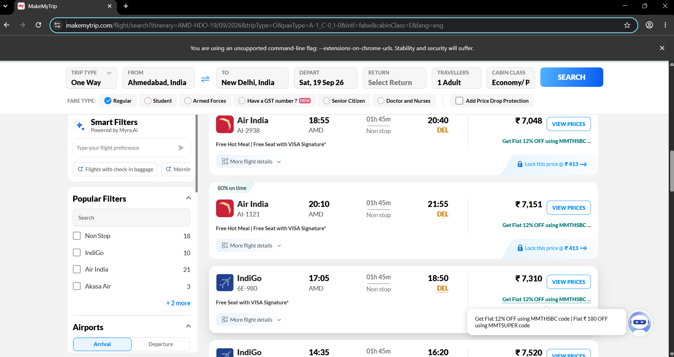
Taming the Output
CHAPTER 3
From a busy results page to validated, structured JSON
{
"airline": "Air India",
"flight_number": "AI-2938",
"departure_time": "18:55",
"price": "₹ 7,048"
}
MakeMyTrip results page the agent reads
A Pydantic schema tells the agent exactly which fields matter
Output is predictable JSON — ready for a UI, a database or an API
▸ Next: the same pattern, applied to hotels

Slide 5
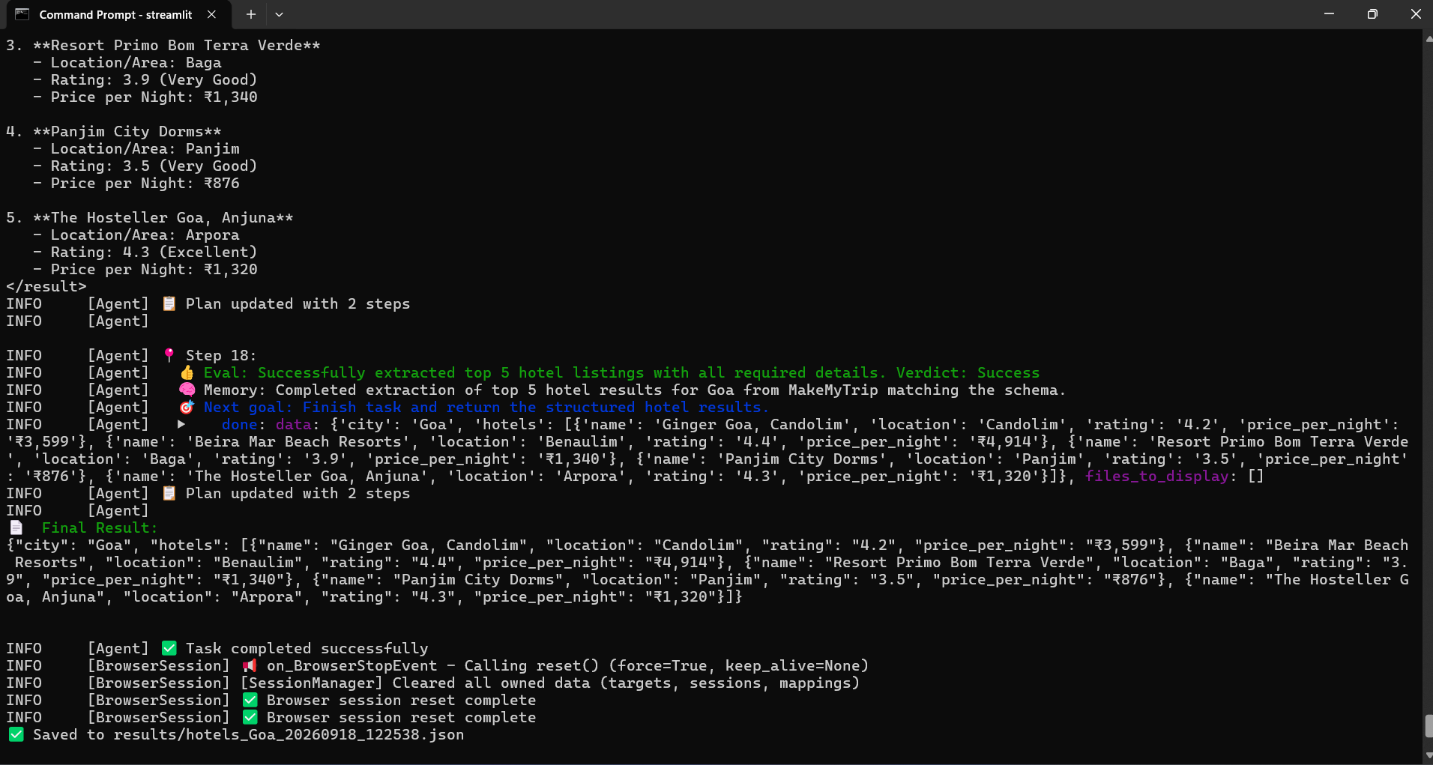
Hotels, Same Pattern
CHAPTER 4
A new service in minutes: one schema plus one focused task prompt
Goa, top 5: name, area, rating and price per night
Cheapest: Panjim City Dorms at ₹876 per night
Priciest: Beira Mar Beach Resorts at ₹4,914
Saved automatically as a timestamped file in results/
Terminal: top 5 Goa hotels extracted and saved
▸ Next: giving it a real interface anyone can click

Slide 6
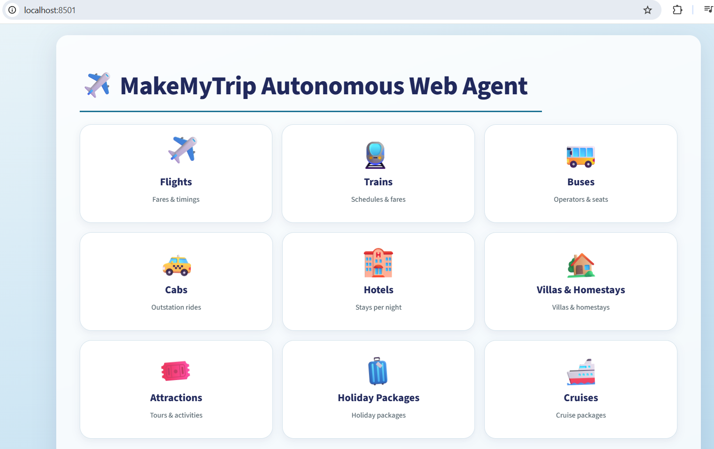
A Real Interface
CHAPTER 5
A Streamlit app on localhost:8501 — no terminal needed to search
One tile per service on the home screen
Click a tile to open its guided search form
Everything runs through the same agent core
Clean cards, one calm blue theme
MakeMyTrip Autonomous Web Agent — home
▸ Next: meet all nine services

Slide 7
Nine Services, One Agent
CHAPTER 6
Each tile is a schema and a prompt on top of the same loop
Flights
Fares & timings
Trains
Schedules & fares
Buses
Operators & seats
Cabs
Outstation rides
Hotels
Stays per night
Villas & Homestays
Villas & homestays
Attractions
Tours & activities
Holiday Packages
Holiday packages
Cruises
Cruise packages
▸ Next: zooming into the Flights form

Slide 8
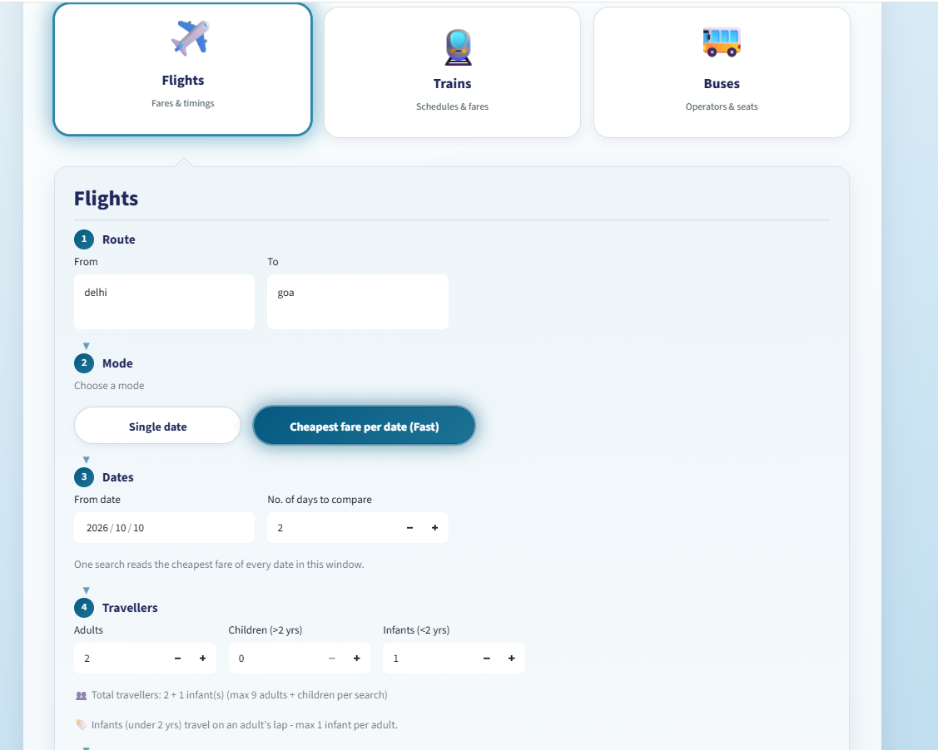
A Guided Search Form
CHAPTER 7
Four numbered steps take the user from route to travellers
Route
From and To, typed as plain city names (delhi → goa)
1
Mode
Single date, or Cheapest fare per date (Fast)
2
Dates
A start date and how many days to compare
3
Travellers
Adults, children (>2 yrs), infants (<2 yrs); 1 infant per adult
4
Flights tab with Route, Mode, Dates, Travellers
▸ Next: the fast mode: every date in one search

Slide 9
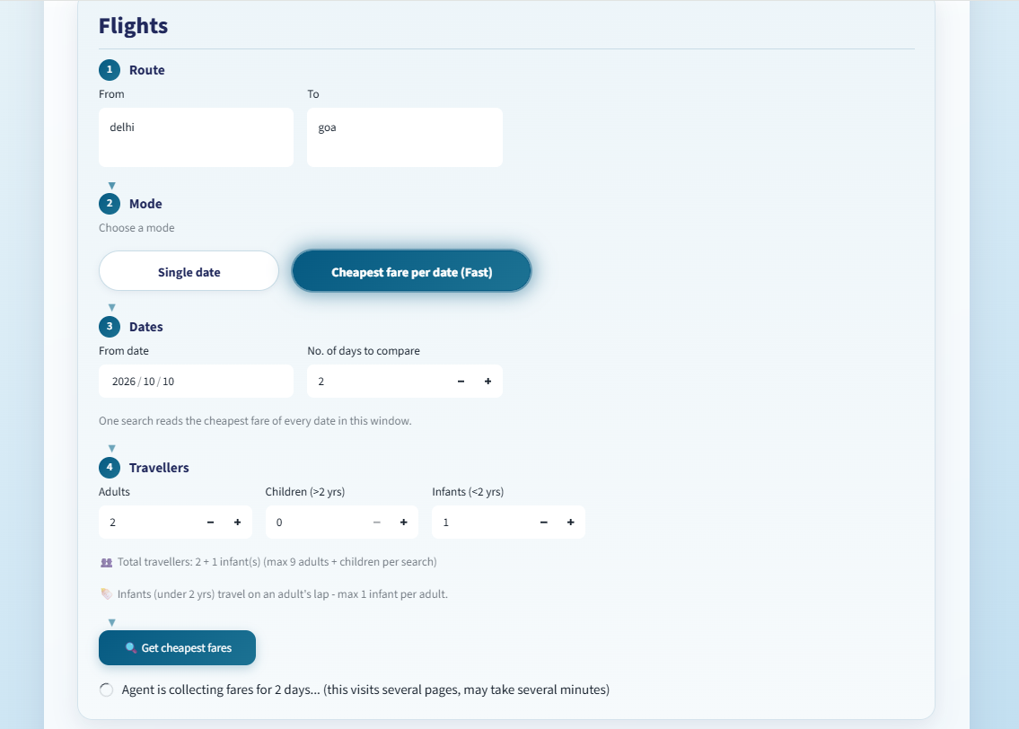
Cheapest Fare per Date
CHAPTER 8
One search reads the lowest fare of every date in the window
Fast mode: no more searching date by date by hand
Test run: delhi → goa, 10–11 Oct 2026, 2 adults + 1 infant
Live status: “Agent is collecting fares for 2 days…”
✓ Why it matters
A visit to several pages, run by the agent, replaces many manual searches. It may take a few minutes, and the app says so.
Get cheapest fares — agent at work
▸ Next: reading the results dashboard

Slide 10
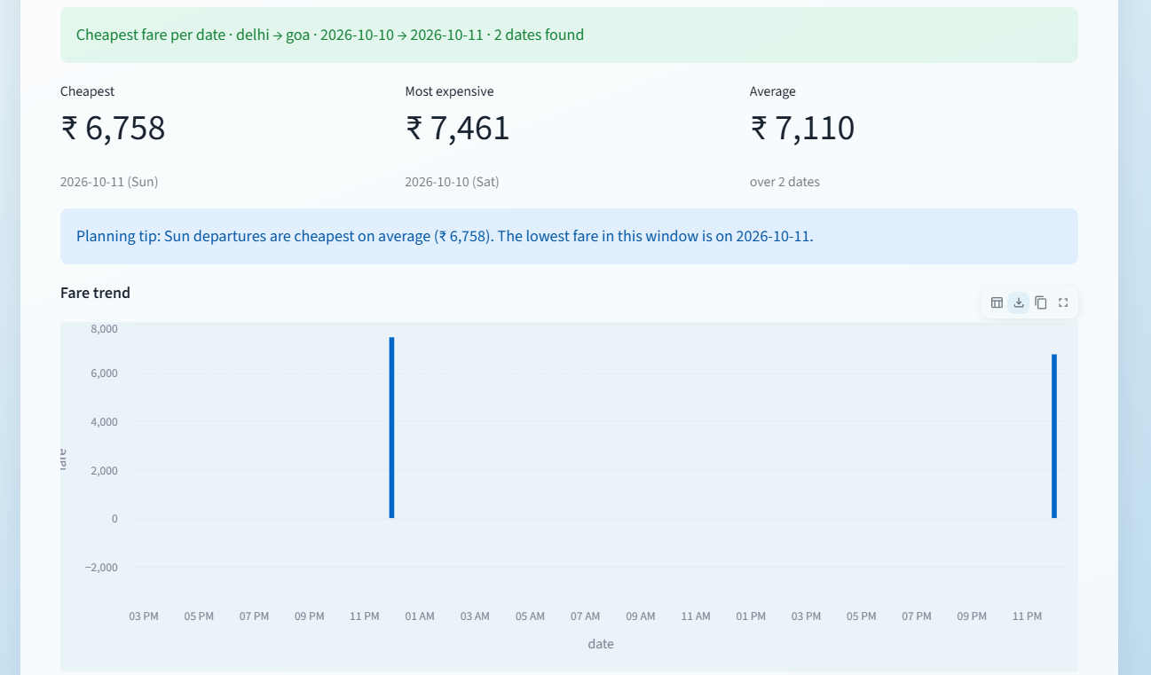
The Results Dashboard
CHAPTER 9
Key numbers first, then a planning tip generated from the data
Cheapest
₹ 6,758
2026-10-11 (Sun)
Most expensive
₹ 7,461
2026-10-10 (Sat)
Average
₹ 7,110
over 2 dates
Summary banner, key numbers and fare trend
▸ Next: tables, charts and CSV export

Slide 11
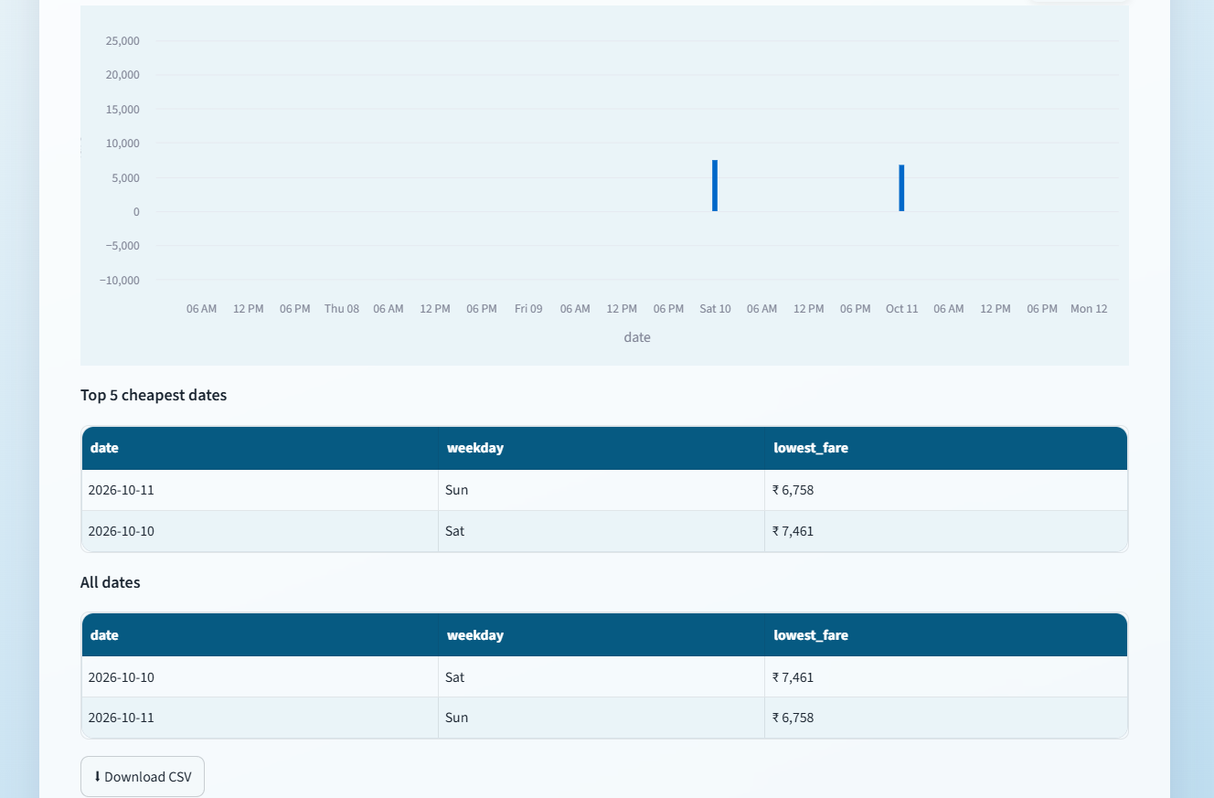
Charts, Tables, Export
CHAPTER 10
Everything needed to decide, and to take the data away
Fare trend chart for a quick visual read
Top 5 cheapest dates ranked with weekday and lowest fare
All dates table in date order
Download CSV for Excel or further analysis
Fare chart, ranked tables and CSV download
▸ Next: two small things spotted in the screenshots

Slide 12
Polish Items Spotted
CHAPTER 11
Small, fixable, and found by looking closely at the real output
!
Chart axis shows hours, not dates
?
City to airport mapping
With only two dates, the chart treats the date as a continuous time axis: hairline bars at odd hours, and a y-axis that dips below zero.
The search “New Delhi” produced the code AMD-HDO and the page heading read “Ghaziabad”, while listed flights land at DEL.
Fix: plot the date as text (categorical) and start the axis at 0.
Fix: map each city to its IATA code (DEL) before searching.
▸ Next: taking it public

Slide 13
Going Live for Free
CHAPTER 12
From a GitHub repo to a public link, with no paid hosting
GitHub repo
›
Docker image
›
Free Space
›
Public URL
Code pushed, .env kept out
Python, Chromium and Playwright
Hugging Face Space, API key as a Secret
Share the app link
✓ Guarded along the way
Browser runs headless on the server. The Gemini API key lives only in Space Secrets, never in the repo.
▸ Next: the finished journey

Slide 14
The Finished Journey
Zero paid APIs, one working autonomous agent, one real dashboard
9 autonomous service modules
100% free tech stack (Gemini free tier)
✓
✓
Structured, validated JSON output
Streamlit app with a tile for every service
✓
✓
Guided forms with adults, children, infants
Cheapest-fare-per-date fast mode
✓
✓
Metrics, fare chart and ranked tables
CSV download and public GitHub repo
✓
✓

Slide 15
Thank You
MakeMyTrip: Autonomous Web Operations Agent — The Upgrade Story
Built with browser-use · Playwright · Google Gemini (free) · Streamlit

