Slide 1
SCHEDULE OPTIMIZER 3000
By: Nelson A. Penn and Nathan B. STromberg

Slide 2

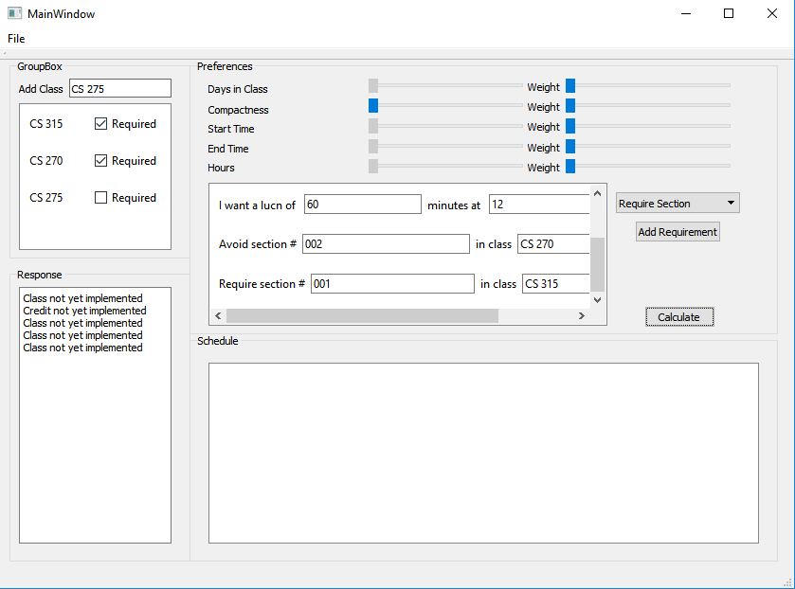
Main UI Elements

