Slide 1

Kock* framework
ByBorya
*Kotlin Mock
Powered by:
Brek Roman
Tarasov Artem

Slide 2
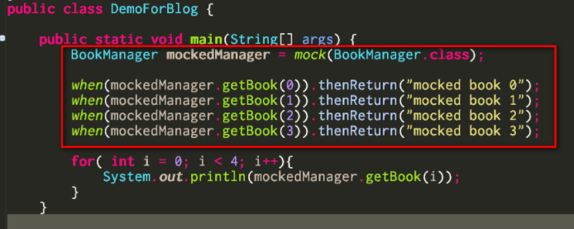
What is a Mock framework?
Mock framework allows you to mock (or stub) methods of a class.

Slide 3
What are mock frameworks are able to do?

Slide 4
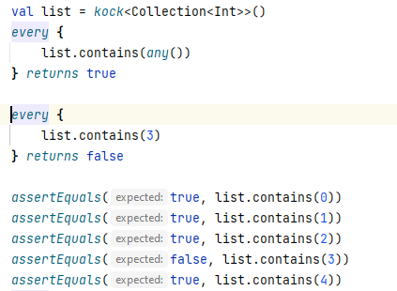
We are mock frameworks are able to do?
Stubbing
(making a method return
what you want)

Slide 5
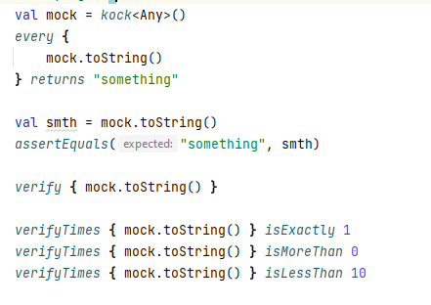
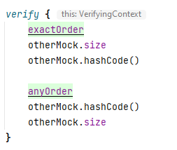
We are mock frameworks are able to do?
2. Verifying

Slide 6
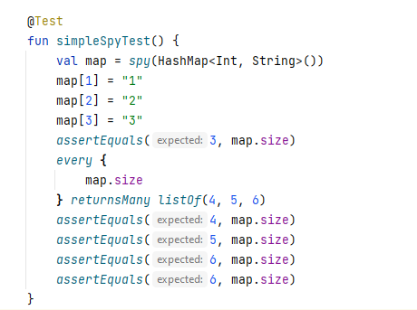
We are mock frameworks are able to do?
3. Spying
(collecting invocation information)
* and so on

Slide 7
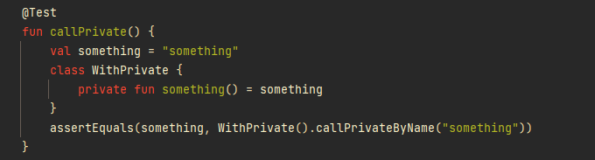
Extra features
Calling private methods

Slide 8
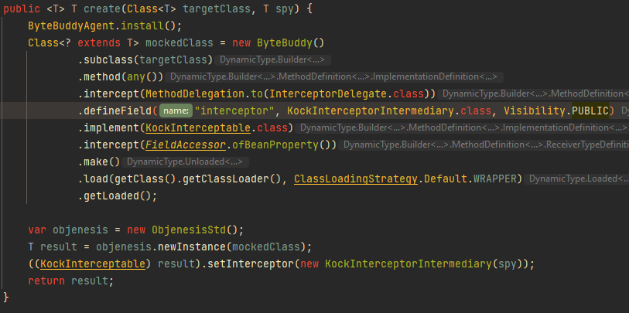
Implementation

Slide 9
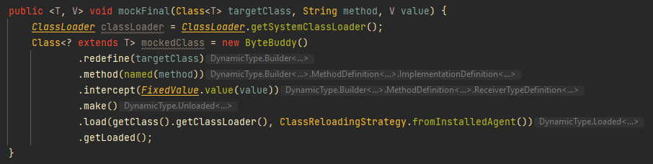
Implementation

Slide 10
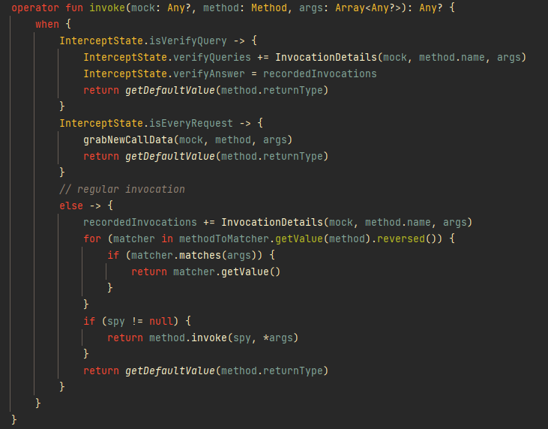

Slide 11
Current Existing Frameworks (java, kotlin)
Mockito
Mockk (the main thing on which we based our implementation)
PowerMock

Slide 12
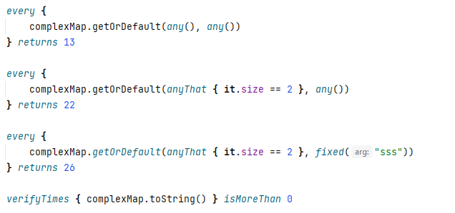
How to implement such framework?
Create subclass in runtime and return its instance with intercepting all calls
or manipulate with bytecode of existing class
Collect info about every call
Create DSL that is convenient
to use

Slide 13
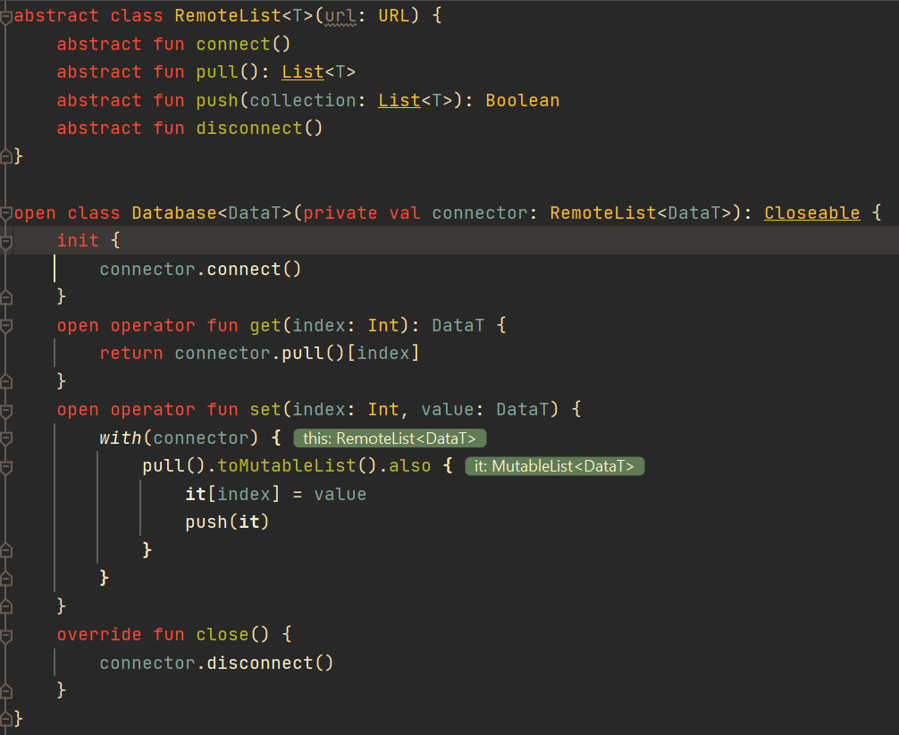
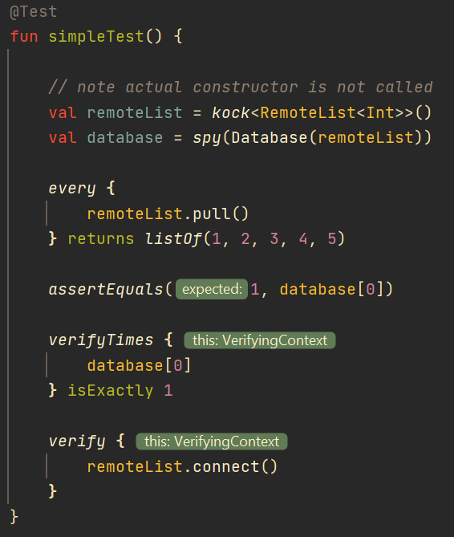

Slide 14




What did we use?

Slide 15
What else we have researched into
Private method plugin for IntelliJ IDEA
Ref lombok
Hide highlighting errors and infer types for methods that don’t exist compile time
Final classes stubbing

Slide 16
Research result
Private method access via “object._private()” notation is possible via compile time using ByteBuddy Plugin package (involves javaagent and compile-time operations)
It is possible to integrate that into the IDE using a plugin. Hiding highlighting errors is relatively easy, and inferring the type is hard

Slide 17
Research result
Final methods stubbing is possible, but hard to get right and is really hard to debug.

Slide 18
How did we split the work?
Roman
Verify statements
Private methods
ByteBuddy intercepting
Dsl research
Intellij Plugin SDK research
Artem
Every statement
Argument Matchers
ByteBuddy intercepting
Initial instrument choice and research
Static methods

Slide 19
Challenges we encountered
Debugging (gets harder when you are “hacking” JVM)
ByteBuddy poor documentation and source code
Little community to help, the more advanced a problem gets, the lesser answers on StackOverflow
Kotlin-Java interoperability issues and compatibility

