Slide 1


Kotlin vs Java API Styles
research

Slide 2
Research goals
Understand how Java and Kotlin are different as languages
Using that information define how a typical Kotlin framework/library would be written unlike a Java framework/library
Foresee possible complication if “Kotlin for Kotlin and Java” framework is desired, if such exist

Slide 3
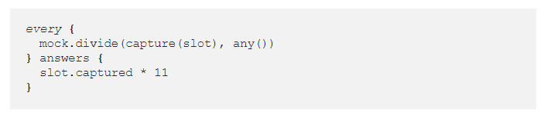

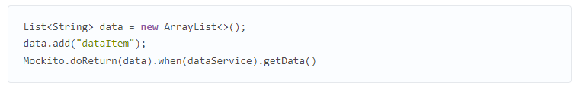
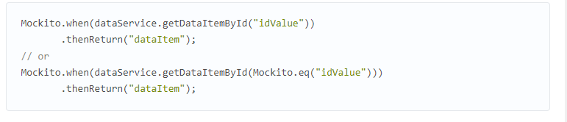
existing APIs

Slide 4
Kotlin and Java are interoperable
https://kotlinlang.org/docs/java-interop.html
https://www.baeldung.com/kotlin/java-interoperability
In general, you can use both Java and Kotlin in one single project and it should work ok

Slide 5
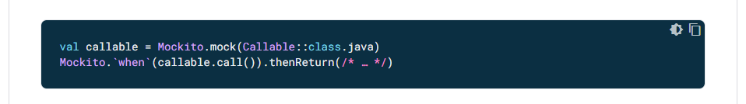
Mockito usage in Kotlin
https://developer.android.com/kotlin/interop
almost identical

Slide 6
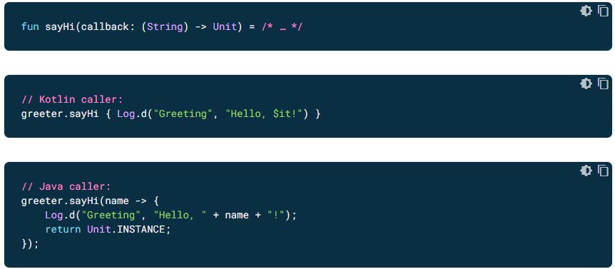
Idiomatic Kotlin code may produce spaghetti Java code
*

Slide 7
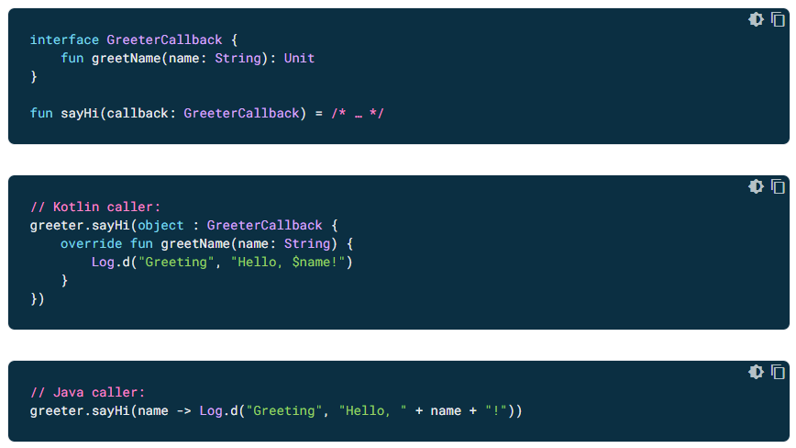

Slide 8
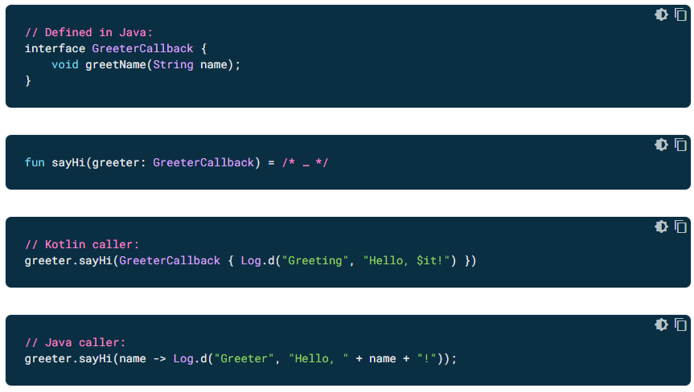

Slide 9
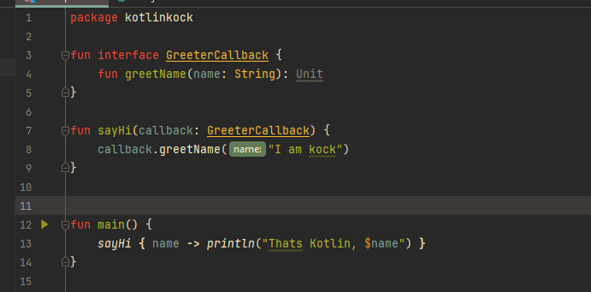
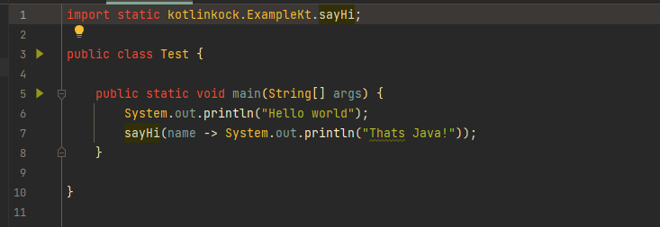

Slide 10
Conclusions
A (not-too-fancy) framework written by Kotlin enjoyers will indeed work in Java, perhaps producing spaghetti for Java fans
https://developer.android.com/kotlin/interop#kotlin_for_java_consumption
Making a framework comfortably usable in both Kotlin and Java seems possible but involves struggles of finding such solutions and may make source code clunkier and less idiomatic (it may be not that bad)

Slide 11
“Kotlin way”
Kotlin is very rich for different syntactic sugars as it has many tricks from many different modern languages. A subset of those makes Kotlin usable for making user-friendly DSLs

Slide 12
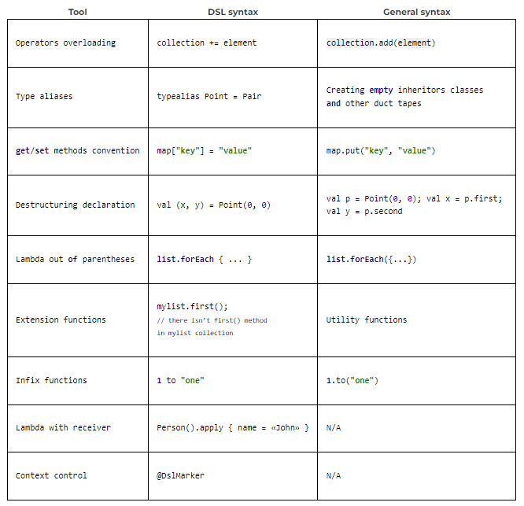

Slide 13
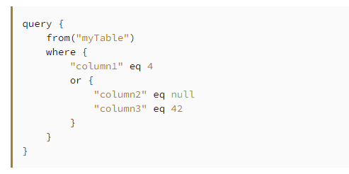

Slide 14
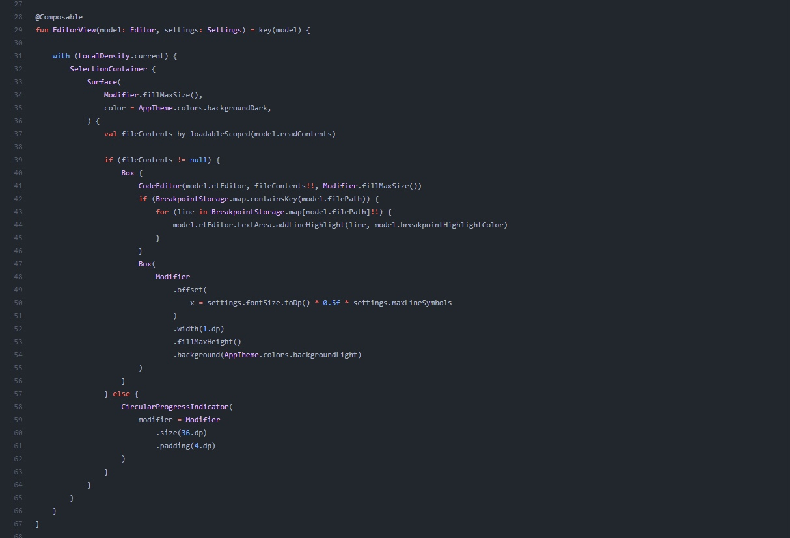

Slide 15
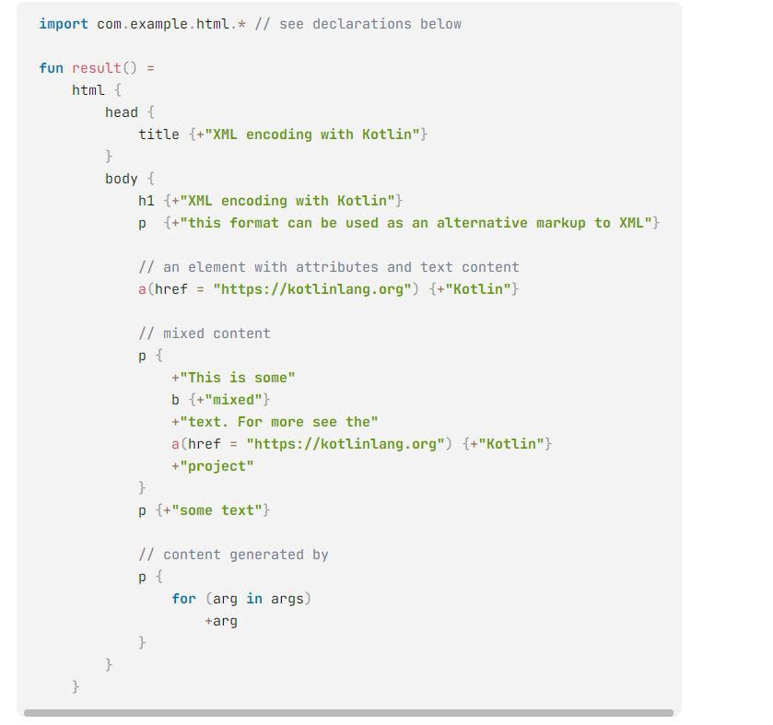
https://kotlinlang.org/docs/type-safe-builders.html#full-definition-of-the-com-example-html-package

Slide 16
Receivers
https://stackoverflow.com/questions/45875491/what-is-a-receiver-in-kotlin

Slide 17

MockK
https://github.com/mockk/mockk

Slide 18
panik
inline reified can’t be used in Java
all that juicy DSL stuff aint goin to java

Slide 19
